Slide 1
File Integrity Guardian

Slide 2
Agenda
01 Introduction & Abstract
12 Data Flow Diagram
02 Problem Statement
13 Python Backend
03 What is FIM?
14 React Frontend
04 Why FIM Matters
15 API Endpoints
05 Research — Industry Tools
16-22 Tool Demo + Screenshots
06 Technology Stack
23-25 Security Recommendations
07 Hashing Algorithms
26 Proof of Concept
08 SHA-256 vs MD5
27 Tools & Technologies
09 Impact Analysis
28 Challenges & Learnings
10 Business Impact
29 Future Enhancements
11 System Architecture
30 References
31 Thank You / Q&A

Slide 3
Abstract
GOAL
Build a full-stack File Integrity Monitoring tool that verifies system file integrity using cryptographic hashing (SHA-256 & MD5).
METHOD
Python backend uses hashlib to compute real hashes on OS files, stores a trusted baseline, and compares on each scan to detect unauthorized changes.
OUTPUT
Interactive React dashboard with real-time scanning, file browser, auto-scheduler, 5-level status indicator, alert system, and security report generation.

Slide 4
Problem Statement
THE THREAT
Attackers modify critical system files to install backdoors, escalate privileges, disable firewalls, and establish persistence — often undetected for months.
KEY CHALLENGES
▸ No trusted baseline to compare current file states against
▸ Manual file checking is impractical at scale
▸ Unauthorized modifications to OS binaries go undetected
▸ Compliance standards (PCI DSS, HIPAA, SOX) require FIM
OUR SOLUTION
File Integrity Guardian — automated hashing, monitoring, alerting, and reporting for critical system files.

Slide 5
What is File Integrity Monitoring ?
FIM is a cybersecurity practice that detects changes to critical system files by comparing their current state against a trusted baseline using cryptographic hash functions.
Read File
Computer Hash
Store Baseline
Re-Scan
Compare & Alert
What it monitors
Standards requiring FIM
Detection types
OS binaries, config files, logs, registries, permissions
PCI DSS (11.5), HIPAA, SOX, ISO 17799, CIS Benchmarks
Content changes, permission changes, file deletion, new files

Slide 6
Why FIM Matters
🔓
🛡️
⚡
Backdoor Detection
Compliance
Early Warning
Modified binaries reveal attacker persistence
PCI DSS, HIPAA, SOX all mandate FIM controls
Detect breaches in minutes, not months
Key Stat: 9.8% of organizations fail PCI audits due to lacking FIM (Verizon). Average breach detection without FIM: 197 days (IBM).

Slide 7
Research : Industry FIM Tools Landscape
Tool
URL
Category
Popularity
OSSEC
ossec.net
Open-source HIDS+FIM
10k+ GitHub stars
Tripwire
tripwire.com
Commercial FIM
Fortune 500 standard
Wazuh
wazuh.com
Open-source SIEM+FIM
30k+ GitHub stars
SolarWinds SEM
solarwinds.com
Commercial SIEM+FIM
Gartner Leader
AIDE
aide.github.io
Open-source FIM
Linux standard
Qualys FIM
qualys.com
Cloud FIM
19k+ enterprises
CrowdStrike
crowdstrike.com
Cloud SaaS FIM
EPP market leader
Samhain
la-samhna.de
Open-source HIDS
Linux/Unix standard

Slide 8
Technology Stack Comparison
OSSEC
C, SQLite, MD5/SHA-1/SHA-256, inotify, manager-agent
Tripwire
C/C++, proprietary DB, SHA-256/SHA-512/HAVAL, policy-driven
Wazuh
OSSEC fork, Elasticsearch/Kibana, RESTful API, real-time + scheduled
AIDE
C, flat-file DB, MD5/SHA-1/SHA-256/SHA-512, cron-based
OUR STACK
Python 3.10+ (hashlib, Flask) + React.js (Vite) + JSON persistence + REST API + Cross-platform Windows & Linux

Slide 9
Hashing Algorithms
Algorithm
Output Size
Security Level
FIM Usage
MD5
128-bit (32 hex)
❌ Broken — collisions feasible
Legacy only
SHA-1
160-bit (40 hex)
⚠️ Weakened — SHAttered 2017
Being phased out
SHA-256
256-bit (64 hex)
✅ Secure — no known attacks
Industry standard
SHA-512
512-bit (128 hex)
✅ Strongest common option
High-security
Input File (any size)
→
SHA-256 hashlib.sha256()
→
64-char hex fingerprint

Slide 10
MD5 (Broken)
SHA-256 (Secure)
✗ 128-bit output (32 hex characters)
✓ 256-bit output (64 hex characters)
✗ Created by Ron Rivest in 1991
✓ Designed by NSA in 2001 (SHA-2)
SHA-256 vs MD5 Deep Dive
✗ Collision attacks proven feasible
✓ No known practical collisions
✗ Fast but insecure for FIM
✓ Used in Bitcoin, SSL/TLS, code signing
✗ Used only for backward compatibility
✓ Industry standard for modern FIM
✗ NOT suitable for security use
✓ Our primary algorithm ✓

Slide 11
Impact Analysis: Attack Targets
/etc/passwd & shadow
Create backdoor accounts, weaken passwords
CRITICAL
cmd.exe / powershell.exe
Replace with trojanized versions capturing creds
CRITICAL
svchost.exe / kernel32.dll
DLL hijacking, rootkit installation
CRITICAL
hosts file
DNS poisoning, redirect traffic to malicious sites
HIGH
crontab / scheduled tasks
Establish persistence via scheduled malicious tasks
HIGH
firewall rules (iptables)
Disable network protection, open access
CRITICAL
SSH config / sshd_config
Weaken SSH security, allow unauthorized access
HIGH
/boot/vmlinuz (kernel)
Install kernel-level rootkits
CRITICAL

Slide 12
Business Impact of Undetected Tampering
🔓
💥
📋
Data Breach
Service Disruption
Compliance Failure
Stolen credentials, customer data exfiltration
Modified binaries causing system instability
Audit failures under PCI DSS, HIPAA, SOX
📉
💰
⏱️
Reputation Damage
Financial Loss
Operational Downtime
Loss of customer trust after breach disclosure
Incident response costs, regulatory fines, lawsuits
Systems offline during investigation & recovery

Slide 13
System Architecture Diagram
React Frontend (:5173)
Python Backend (:5000)
Dashboard + 5-Level Status
hashlib SHA-256 / MD5
File Table + Hash Viewer
os.stat() File Metadata
⇄
Alert Feed + Scan History
Real OS File Scanner
REST API
File Browser Modal Popup
Baseline Comparison Engine
Auto-Scan Scheduler
JSON Data Persistence

Slide 14
Data Flow Diagram
User Clicks Scan
React → POST /api/scan
Python Reads OS Files
Compute SHA-256 Hash
Compare vs Baseline
Match ✓ → INTACT
Mismatch ⚠ → ALERT

Slide 15
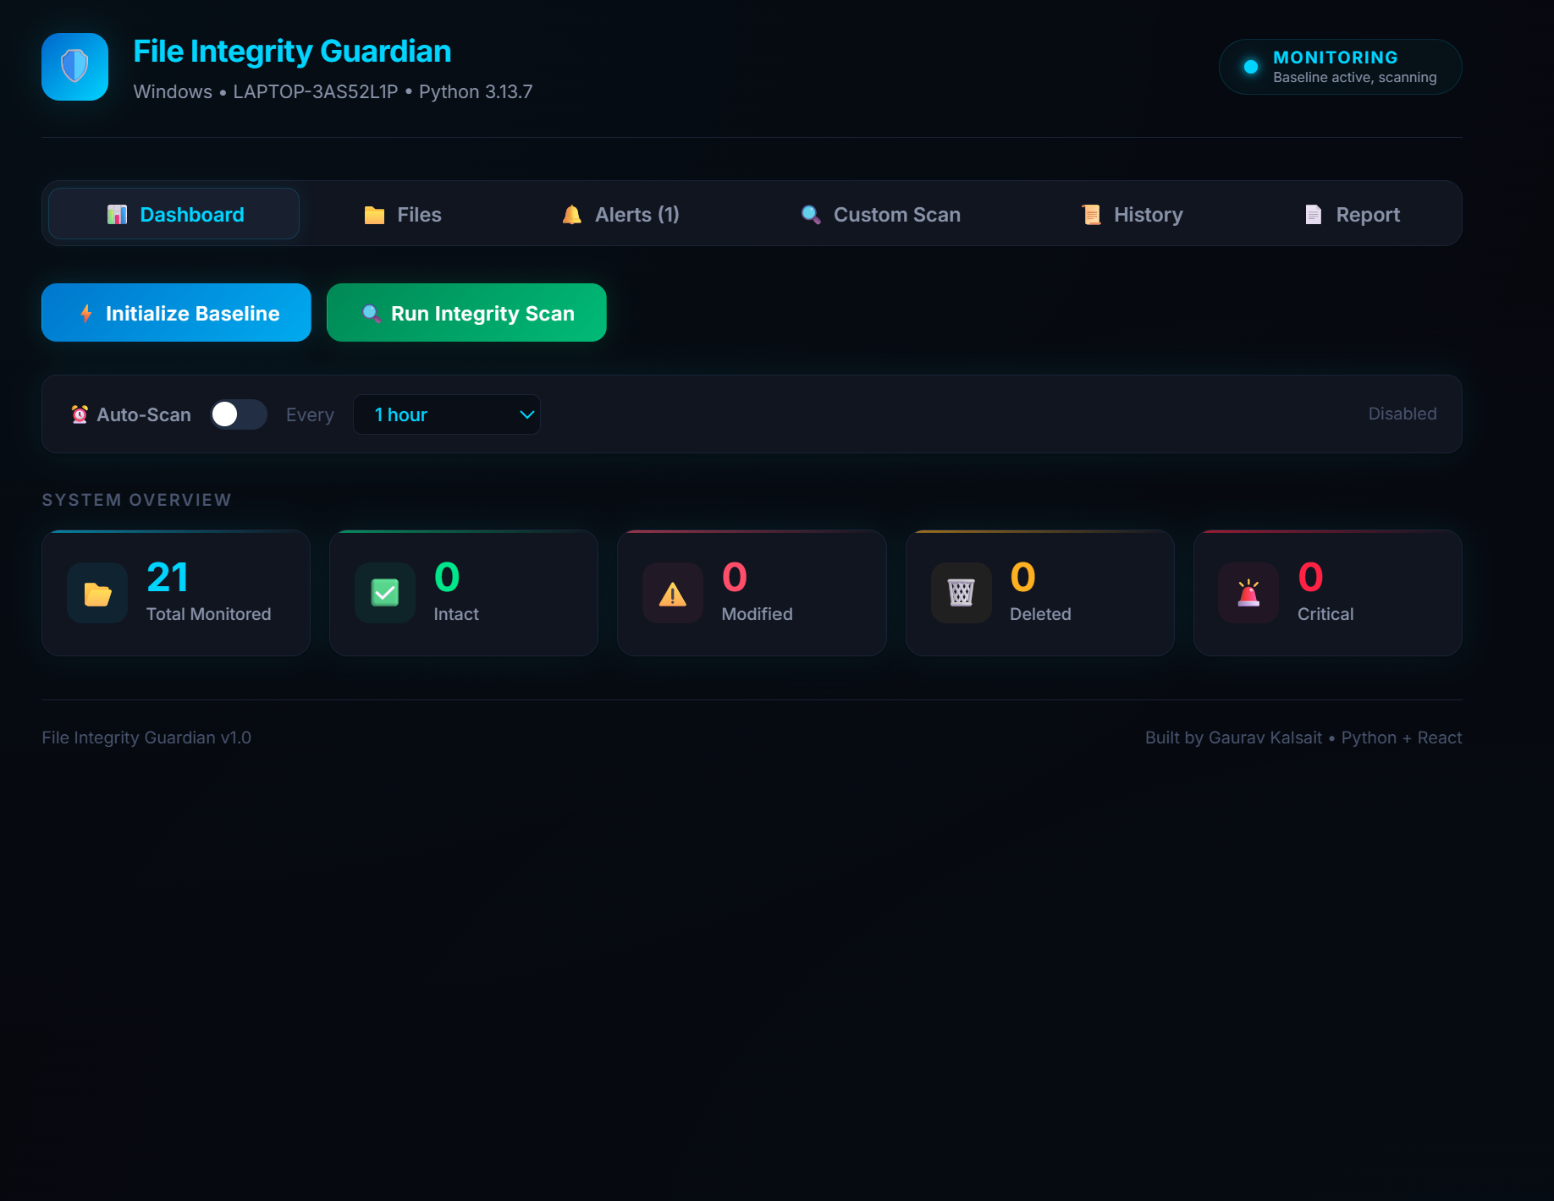
Demo: Dashboard — System Overview

Slide 16
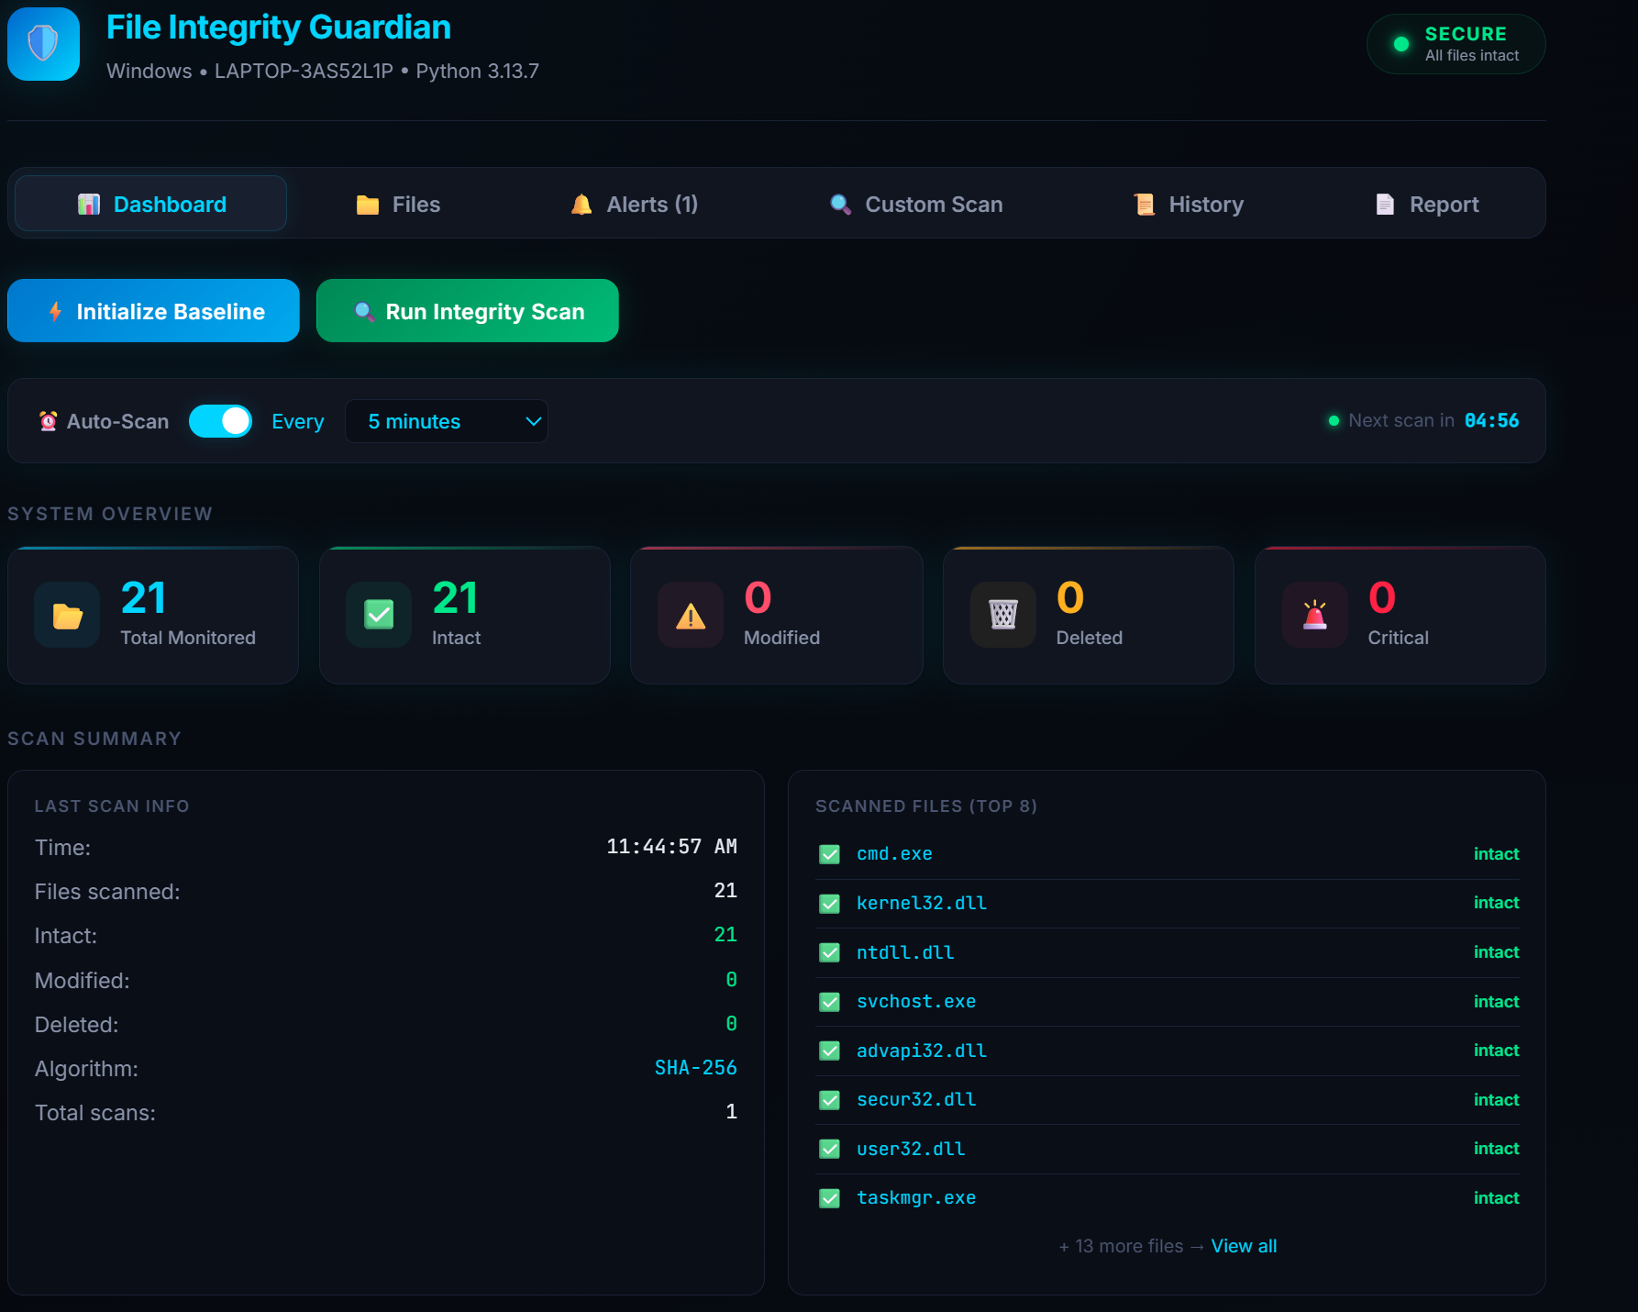
Demo: Dashboard — Auto-Scan Scheduler

Slide 17
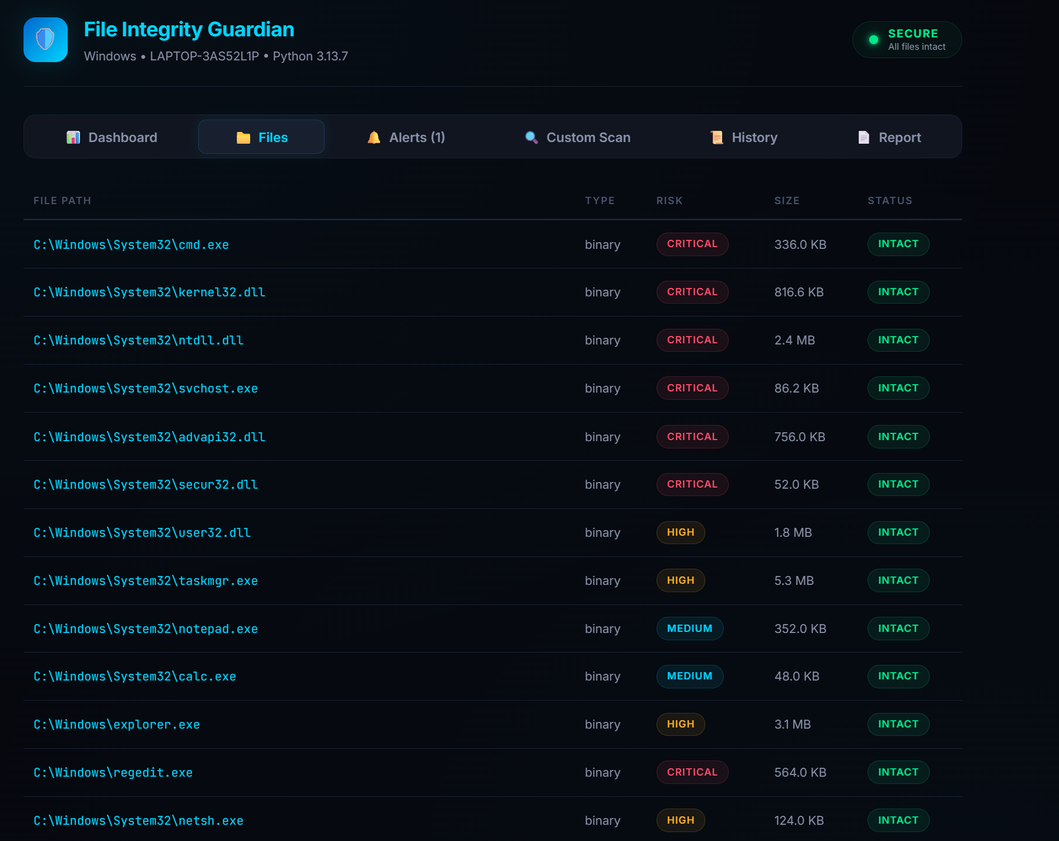
Demo: Files Tab — Monitored Files Table

Slide 18
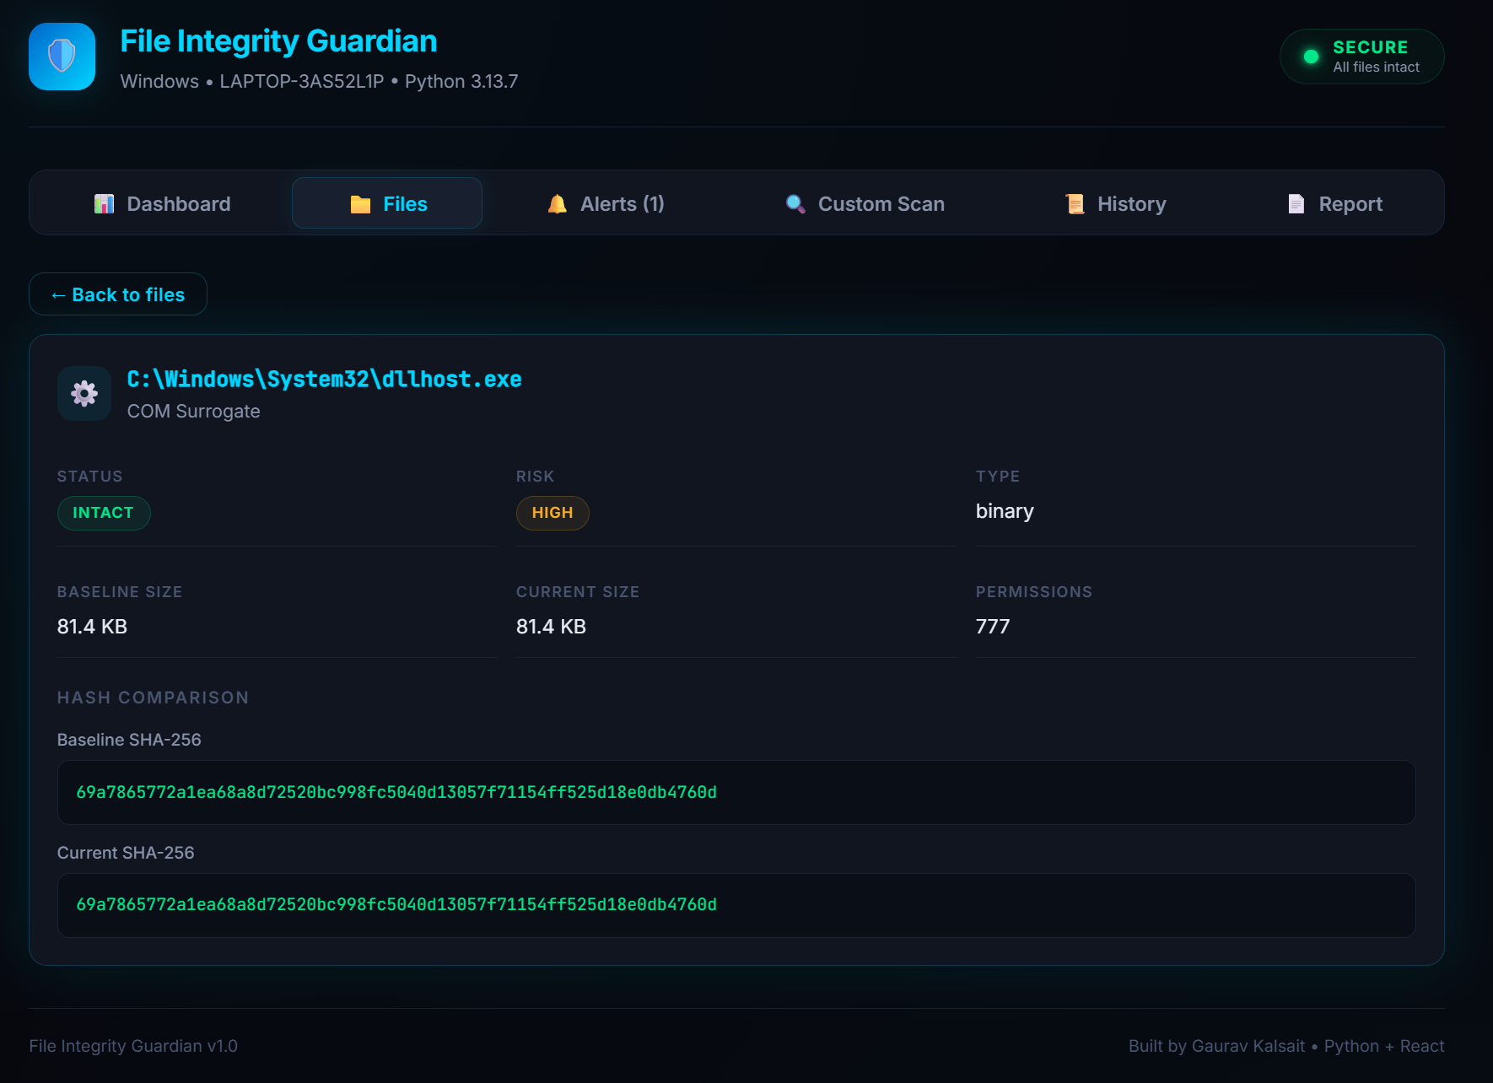
Demo: Files Tab — Hash Comparison Detail

Slide 19
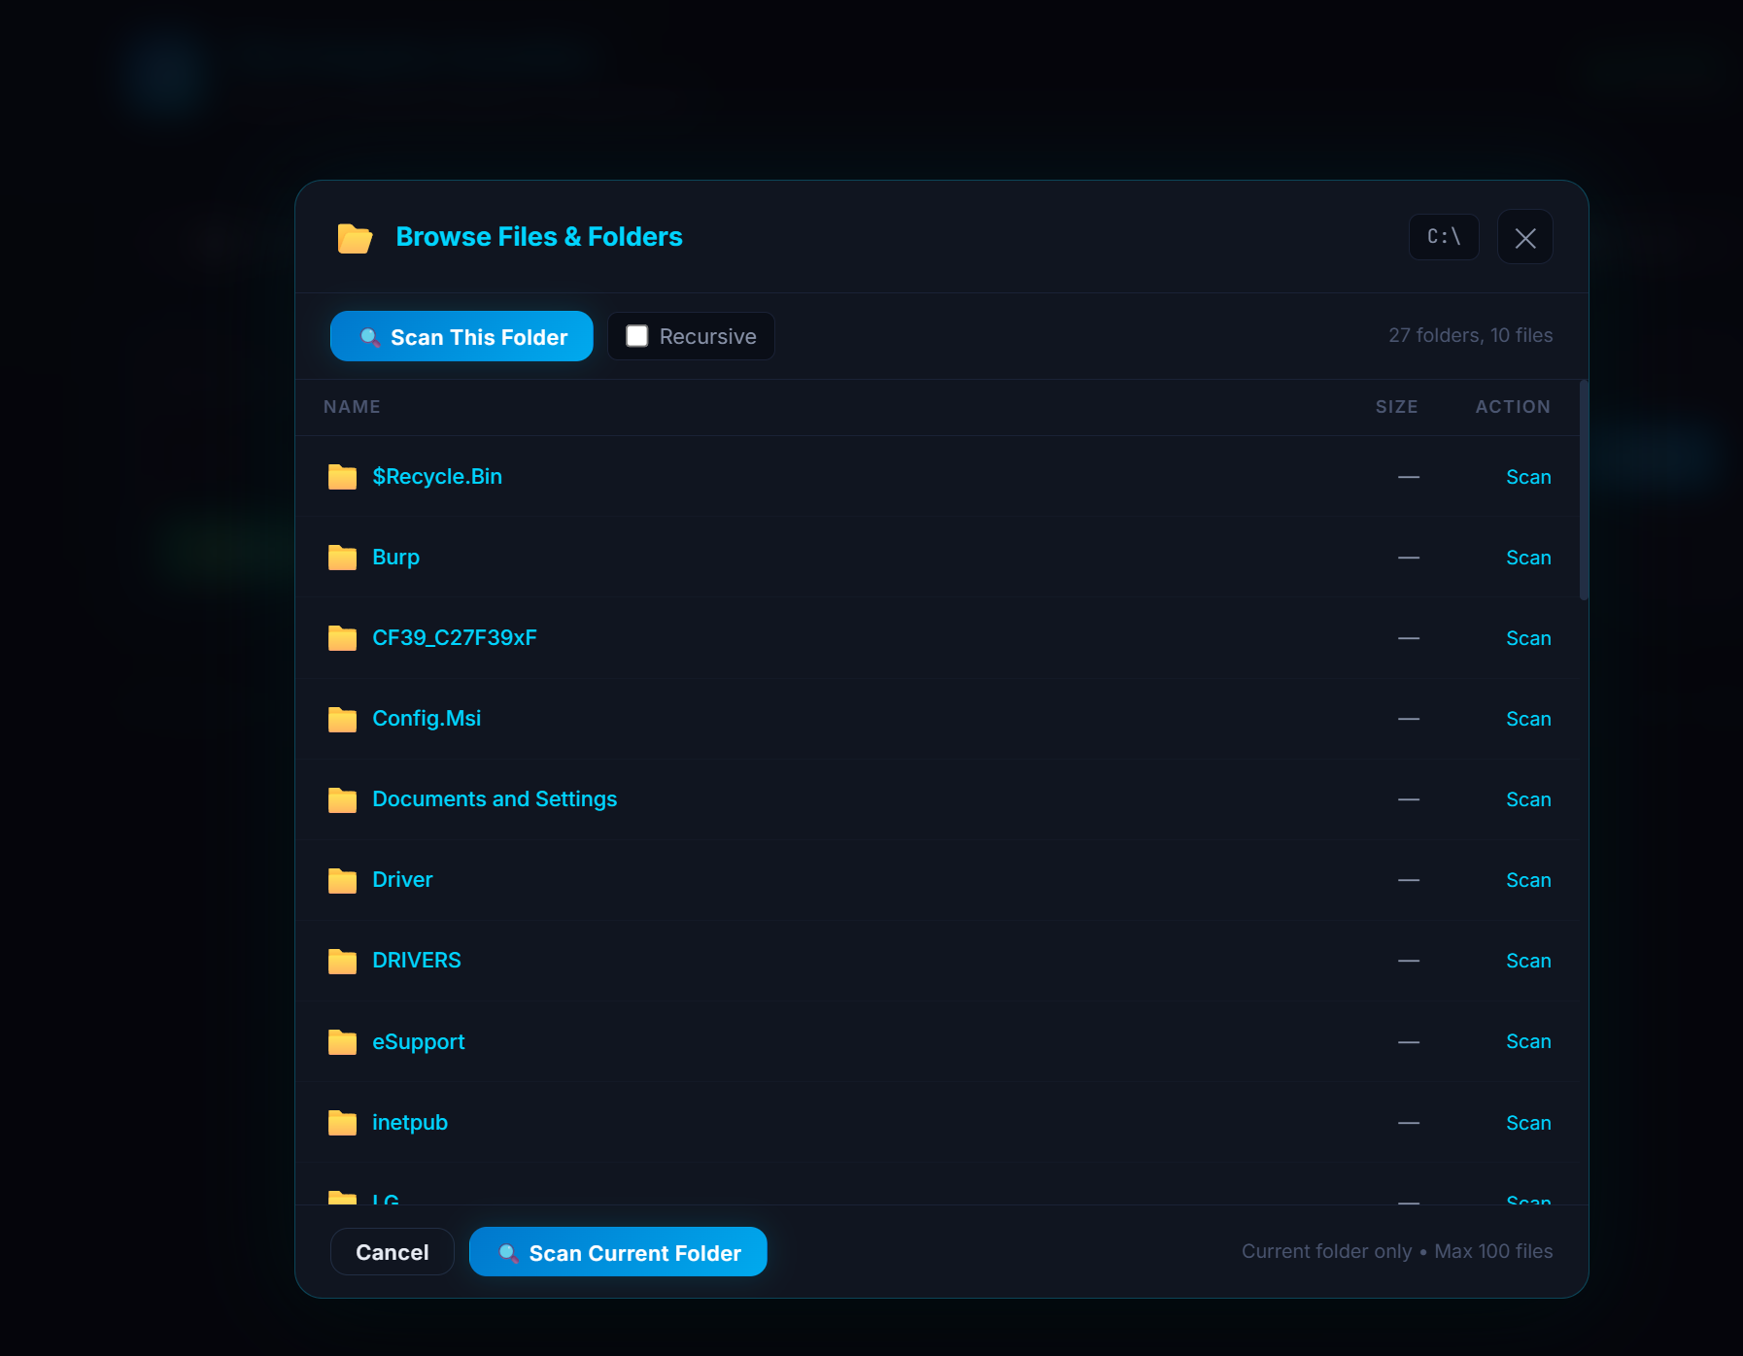
Demo: Custom Scan — File Browser Popup

Slide 20
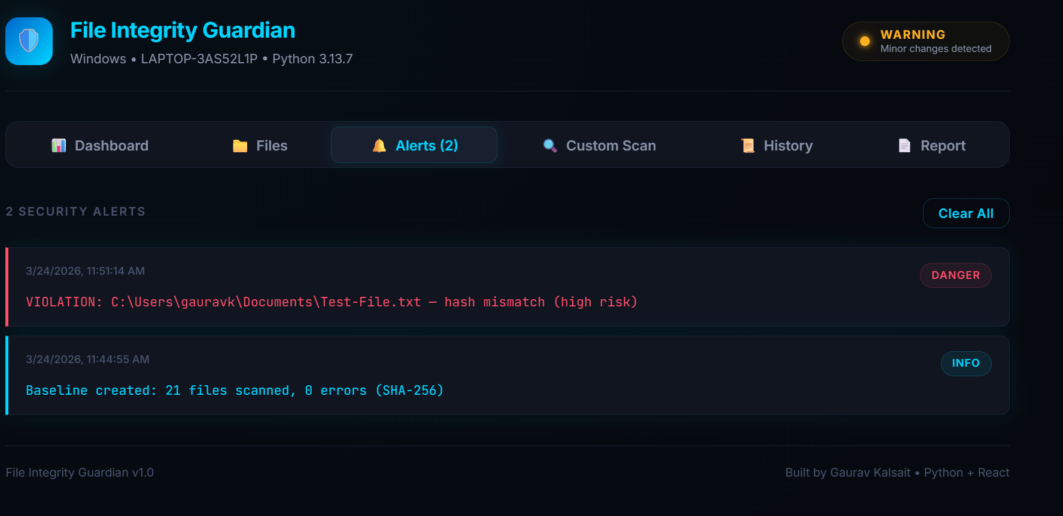
Demo: Alerts Tab — Security Alert Feed

Slide 21
Recommendations: Preventive
▸ 🔒 Use SELinux/AppArmor for mandatory access controls
▸ ⚡ Enable real-time monitoring with inotify / auditd
▸ 🏗️ Deploy read-only file systems for production
▸ 💾 Store baselines on air-gapped storage
▸ 🔐 Use SHA-256 exclusively — MD5/SHA-1 are broken

Slide 22
Recommendations: Detective
▸ ⏰ Schedule automated scans every 4-6 hours
▸ 📊 Integrate FIM alerts with SIEM (Splunk, Elastic)
▸ 🔍 Monitor permission changes (644 → 777 = compromise)
▸ 🔗 Cross-reference FIM alerts with auth logs

Slide 23
Recommendations: Response
▸ 1. Isolate affected systems immediately
▸ 2. Restore from trusted backups
▸ 3. Conduct forensic log analysis
▸ 4. Block C2 communication via firewall
▸ 5. Reset all exposed credentials
▸ 6. Document incident timeline
▸ 7. Update baseline after clean state

Slide 24
Proof of Concept
1
Initialize Baseline
Python hashes 20 system files → stores baseline.json
2
Run Integrity Scan
Recalculates hashes → compares with baseline
3
Detect Violations
Hash mismatch → DANGER alert with risk level
4
Inspect Details
Click file → side-by-side SHA-256 comparison
5
Auto-Scan
Enable scheduler → system auto-scans at intervals

Slide 25
Tools & Technologies
Python 3.10+
Backend server + file hashing
hashlib
SHA-256 / MD5 computation
Flask
REST API framework
Flask-CORS
Cross-origin access
React.js (Vite)
Frontend dashboard
JavaScript ES6+
Frontend logic
JSON
Data persistence
Inter + JetBrains Mono
Typography
Git + GitHub
Version control
VS Code
Code editor

Slide 26
Challenges & Learnings
CHALLENGES
KEY LEARNINGS
▸ Permission denied on protected system files (SAM)
✓ Cryptographic hashing is essential for data integrity
▸ CORS configuration between React (:5173) and Flask (:5000)
✓ Full-stack architecture provides power + usability
▸ Cross-platform file paths (Windows \ vs Linux /)
✓ FIM is a critical compliance requirement in enterprise
▸ Large file hashing efficiency (8KB chunked reads)
✓ SHA-256 is current standard over MD5/SHA-1
▸ Modal overlay z-index and positioning
✓ File metadata (perms, size) matters as much as content
▸ Auto-scan timer cleanup on component unmount
✓ Separation of concerns: CSS/JSX/Python = clean code

Slide 27
Future Enhancements
Email / Slack Alerts
Notify security teams on violations
Planned
Database Backend
SQLite / PostgreSQL for better scale
Planned
Multi-host Monitoring
Agent-based architecture for multiple servers
Future
SIEM Integration
CEF / Syslog export for Splunk, Elastic
Future
CSV / PDF Export
Download reports for compliance documentation
Planned
Windows Service
Run as background service on startup
Planned
Real-time Watchdog
inotify / ReadDirectoryChanges for instant alerts
Future
File Diff Viewer
Show exact content changes between versions
Planned

Slide 28
REST API Endpoints
Method
Endpoint
Description
GET
/api/status
System info + baseline status
GET
/api/files
List monitored files with metadata
POST
/api/baseline/create
Create trusted hash baseline
POST
/api/scan
Run integrity scan vs baseline
GET
/api/alerts
Get all security alerts
POST
/api/alerts/clear
Clear alert history
POST
/api/browse
Browse directory contents
POST
/api/custom-files
Hash individual file
POST
/api/scan-folder
Scan folder (recursive option)
GET
/api/report
Generate security report
GET
/api/history
Get all scan history

Slide 29
References
[1] OSSEC Syscheck Documentation — ossec.net
[2] AccuKnox — Top FIM Tools 2025 — accuknox.com
[3] Comparitech — Best FIM Tools — comparitech.com
[4] SolarWinds — FIM Software — solarwinds.com
[5] WafaTech — Mastering AIDE — wafatech.sa
[6] OSSEC GitHub — Hash Discussion — github.com/ossec
[7] MojoAuth — MD5 vs SHA-256 — mojoauth.com
[8] DNSstuff — FIM for Enterprises — dnsstuff.com
[9] TrustRadius — FIM Reviews — trustradius.com
[10] PCI DSS v4.0 Requirement 11.5 — pcisecuritystandards.org

Slide 30
🛡️
Thank You!
File Integrity Guardian v1.0
Full-Stack FIM Tool • Python + React • SHA-256 / MD5
Built by Gaurav Kalsait
Questions & Discussion
github.com/gaurav-kalsait/file-integrity-guardian

