Slide 1
XV6: A COW Fork and Scheduling Experiment
Team Name: system_haters
Team Members: Gaurav Kumar, Kakadiya Omikumar Anilbhai
github link:

Slide 2



Slide 3
Domain of Project
Part 1: Copy-On-Write (COW) in xv6
Domain: Operating systems, memory management.
Why this area?
COW is a practical optimization to reduce memory overhead during process creation, making it essential for systems handling high workloads.
Implementing and evaluating COW in xv6 offers insights into how modern OS optimize resource utilization efficiently.
Part 2: Scheduling Experiments in xv6
Domain: Operating systems, CPU scheduling.
Why this area?
CPU scheduling determines process execution order, impacting system performance.
The focus is on comparing different scheduling algorithms based on their runtime in xv6, providing a clear understanding of their efficiency under various workloads.

Slide 4
Problem Description
Problem Description The project focuses on optimizing and analyzing critical aspects of an operating system:
Copy-On-Write (COW): Efficient memory usage during process creation.
Scheduling Algorithms: Understanding and comparing the efficiency of different CPU scheduling strategies.
Problem Statement
In modern operating systems, memory and CPU are key resources that demand efficient utilization.
This project implements COW in xv6 to demonstrate memory savings during process forking and compares scheduling algorithms in xv6 based on their runtime performance to evaluate their efficiency.

Slide 5
Scope, Goals, and Deliverables
Scope
COW Implementation: Analyze how COW reduces memory usage by deferring page duplication during process creation.
Scheduling Comparisons: Focus on evaluating different scheduling algorithms based on their runtime under various workloads.
Goals
Implement COW in xv6 and measure memory savings effectively.
Compare scheduling algorithms (FCFS, Round Robin, Priority Scheduling, MLFQ) in xv6 by benchmarking their runtime efficiency.
Deliverables
A working COW implementation with measurable memory savings.
Comparative results and analysis of scheduling algorithms based on their runtime.

Slide 6
Component of Project Part I: COW fork
The implementation of Copy-On-Write (COW) in xv6 involved the following key modifications:
Modification to copyuvm Function
The copyuvm function, responsible for duplicating the address space during fork(), was modified to make all shared pages read-only, by marking the pages as non-writable, any write attempt by either the parent or child triggers a page fault, allowing the kernel to defer page duplication until it is actually needed.
Trap Handler for Page Faults
A new trap handler was implemented to specifically handle COW_Fault. This handler identifies when a write attempt on a shared read-only page occurs and ensures the process requesting the write is allocated a separate, writable copy of the page.
Reference Count Management
A dedicated mechanism was created to track the reference count of each physical page in memory.
The reference count is incremented when a page is shared between processes and decremented when a process releases a page.
The COW trap handler checks the reference count:
If the reference count is greater than one, a new page is allocated, and the data from the shared page is copied into it.
If the reference count is one, the page is unshared and made writable directly.

Slide 7
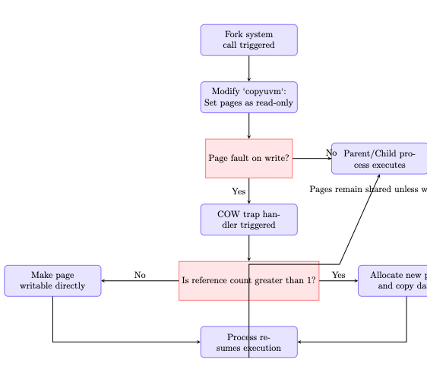
Design Part I: COW fork
Components: copyuvm, Page tables, COW handler, Reference counter
Flow: Fork → Pages set as read-only in copyuvm→ Write causes page fault → COW handler → Reference count check → Allocate new page or make writable → Resume execution

Slide 8
Implementation Details Part I: COW fork
Abstract Idea: Save memory during fork() by sharing pages until a write occurs.
Implementation:
Modified copyuvm() to set pages as read-only.
Created a COW trap handler to handle page faults and allocate new pages.
Added reference counting to manage shared pages.
Challenges:
Figuring out the flow of how memory is allocated during fork().
Testing:
Ran benchmarks to measure memory savings during fork().

Slide 9
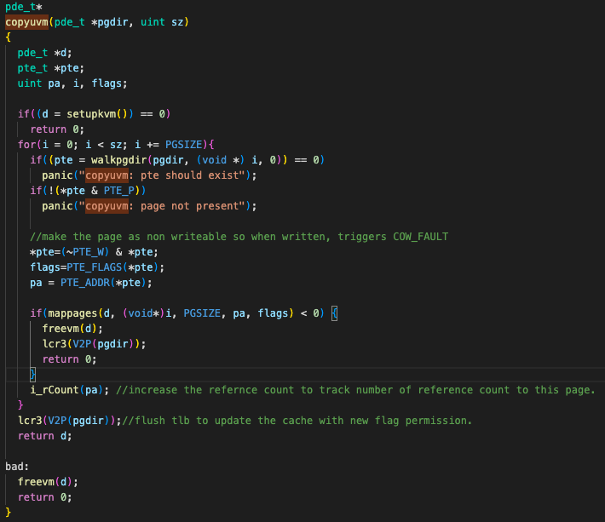
Modified copyuvm() to set pages as read-only.

Slide 10
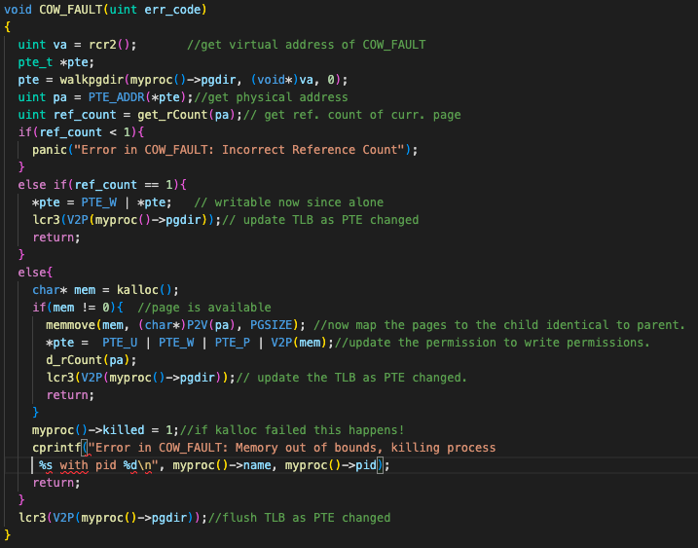
COW Fault handling

Slide 11
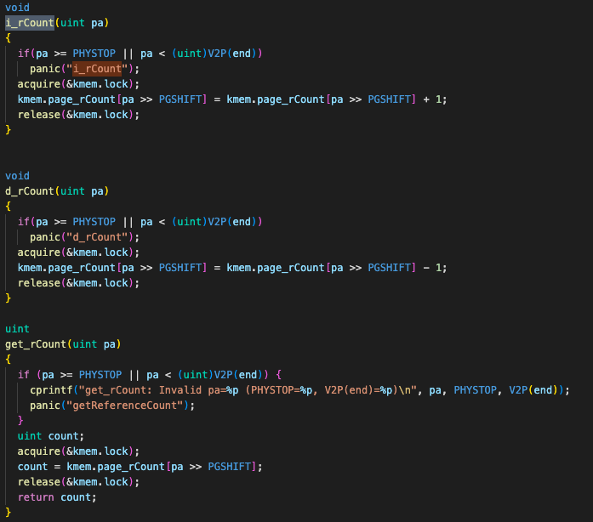
Reference count functions

Slide 12
Evaluation I: COW fork
1. Evaluation Objectives
Does the implementation reduce memory usage by sharing pages until modified?
How many pages are saved by COW compared to traditional fork()?
Does the memory reclaim correctly after the child processes are terminated?
Test Description:
The parent process initializes a large shared array (shared_array) to ensure substantial page usage.
A child process is forked and modify the array to trigger Copy-On-Write (COW).
Test Functions:
getfreepages(): Used to measure free pages in the system before and after writes.
fork(): Creates child processes to test COW behavior.

Slide 13
2. Workloads
Shared Data Size: Large array size (102400 integers) to induce approximately 100 page faults.
Child Actions: Modify the shared array to force COW and measure the memory allocation.
Parent Actions: Track memory usage before and after child process complete.
3. Results Summary
Pages Saved by COW:
The number of pages saved before any modification (shared pages).
Pages allocated post-modification by each child due to COW.
Parent's Memory: The memory usage reverts to the initial state after reaping the child processes.

Slide 14
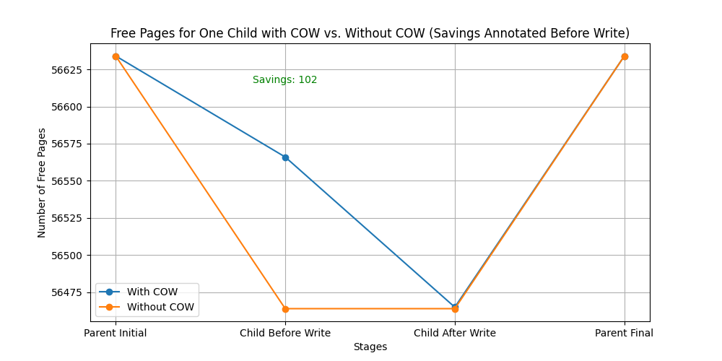
Pages saved by COW fork

Slide 15
Component of Project Part II: Scheduling Experiment
The major changes in the project were made to the proc structure and the scheduler function to support enhanced scheduling features and performance tracking.
Key Changes to proc Structure
Process Timings: Track process creation, runtime, end time, and I/O time for precise performance metrics.
Priority Management: Store and manage process priorities for Priority-Based Scheduling (PBS).
Queue Management: Enable multi-level scheduling by tracking the queue and time spent in each queue.
Execution Metrics: Count the number of process runs, ticks used, and last execution timestamp to assist in fair scheduling decisions.
Key Changes to scheduler Function
Enhanced Scheduling Logic: Incorporate the new priority and queue-based scheduling mechanisms.
Dynamic Queue Adjustments: Allow processes to move between queues based on execution metrics.
Fine-Grained Metrics Tracking: Update process timing and execution details during context switches for more accurate comparisons.

Slide 16
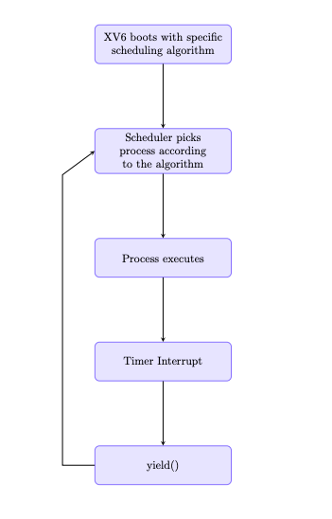
Design Part II: Scheduling Experiment
Components: proc structure (with added fields), Scheduler function, Queues.
Flow: XV6 boots with specific scheduling algorithm → Scheduler picks process according to the algorithm → → Process executes → Timer Interrupt → yield() → Scheduler picks next RUNNABLE process according to algorithm

Slide 17
Implementation Details Part II: Scheduling experiment
Abstract Idea: Compare scheduling algorithms based on runtime.
Implementation:
Added fields to struct proc for tracking runtime, priority, queues, etc.
Modified scheduler() function to implement different algorithms (FCFS, RR, PBS, MLFQ).
Challenges:
Tuning parameters for fairness in MLFQ.
Testing:
Collected runtime data for each algorithm using a set of predefined workloads.
Generated comparative plots.

Slide 18
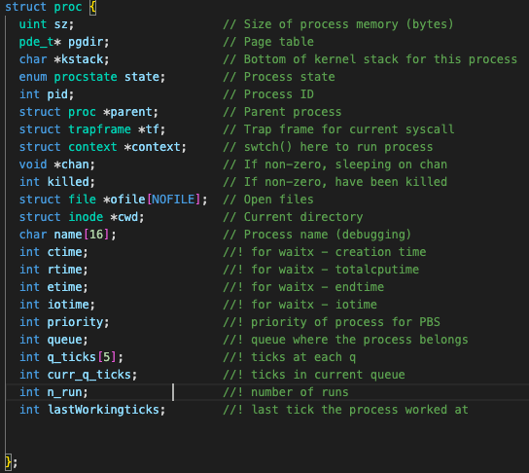
Added fields to struct proc for tracking runtime, priority, queues, etc.

Slide 19
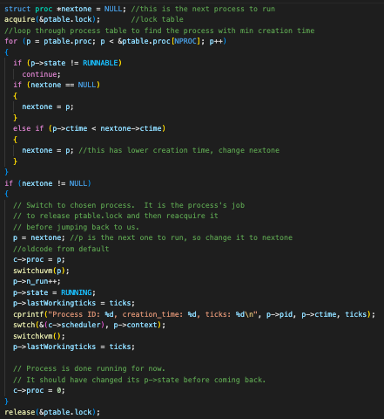
FCFS Implementation

Slide 20
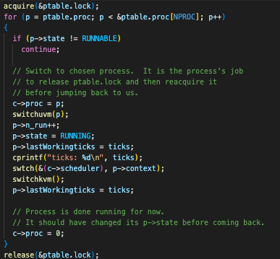
RR Implementation

Slide 21
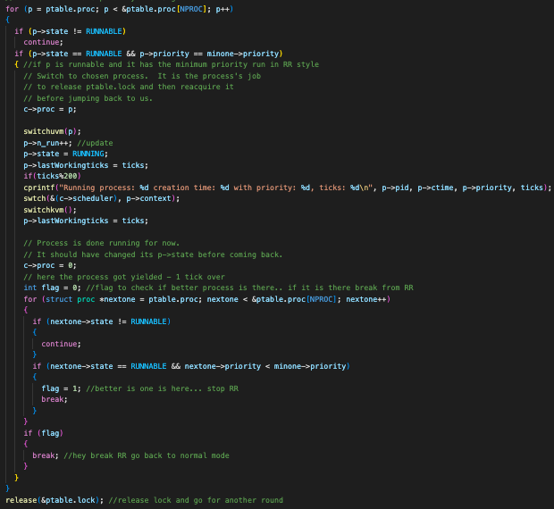
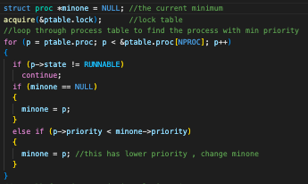
PBS Implementation

Slide 22
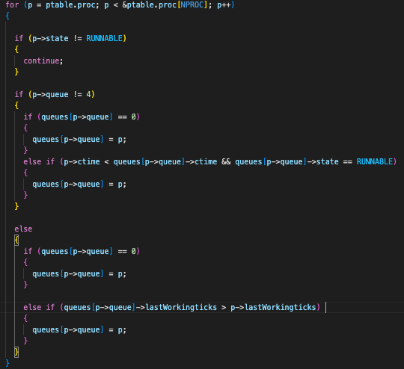
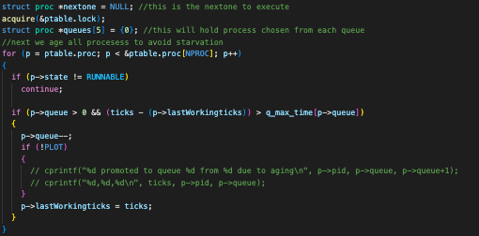
Runnable process for each queue
MLFQ Implementation
Code for handling starvation

Slide 23
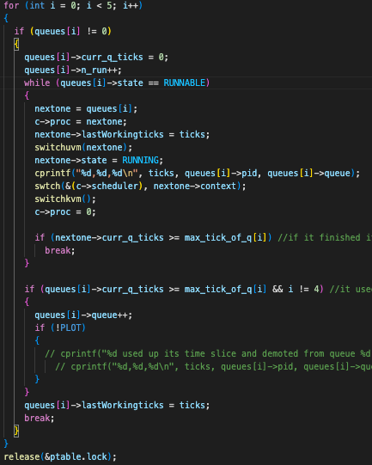

prioritising the queue
Time slices used for benchmarking

Slide 24
Evaluation II: Scheduling
1. Evaluation Objectives (Questions)
How does the choice of wait times in different MLFQ queues impact its performance?
How do CPU-bound and I/O-bound processes behave under the MLFQ scheduling policy?
How do FCFS, RR, PBS, and MLFQ compare in terms of runtime efficiency?
2. Setup
Test Description:
Configured MLFQ with varying wait times across queues to observe its effect on process performance.
Created workloads with CPU-bound and I/O-bound processes to study queue switching dynamics.
Compared the runtime performance of four scheduling algorithms: FCFS, Round Robin (RR), Priority-Based Scheduling (PBS), and Multilevel Feedback Queue (MLFQ).

Slide 25
Evaluation II: Scheduling
3. Workloads
CPU-bound Processes: Long-running compute-intensive processes.
I/O-bound Processes: Processes with frequent I/O wait states.
4. Parameters/Configurations (Independent Variables)
Wait Times in MLFQ Queues: Configured to prioritize different types of processes at various levels.
Scheduling Algorithms: FCFS, RR, PBS, and MLFQ.
Workload Type: CPU-bound, I/O-bound
5. Metrics (Dependent Variables)
Runtime: Total time taken by each algorithm to complete all processes in a workload.
Queue Switching Dynamics: Frequency and pattern of processes moving between queues in MLFQ.
Process Completion Efficiency: Time taken for individual CPU-bound and I/O-bound processes to complete.

Slide 26
Evaluation II: Scheduling
6. Results Summary
MLFQ Performance: Wait times in queues significantly influence process prioritization and efficiency.
CPU-Bound vs. I/O-Bound: MLFQ adapts dynamically, with CPU-bound processes gradually moving to lower-priority queues, while I/O-bound processes stay at higher priorities.
Algorithm Comparison:
FCFS: Simple but inefficient for mixed workloads.
RR: Fair but leads to higher context switching overhead.
PBS: Good prioritization but less adaptive to dynamic workloads.
MLFQ: Best balance of fairness and efficiency for varied workloads.

Slide 27
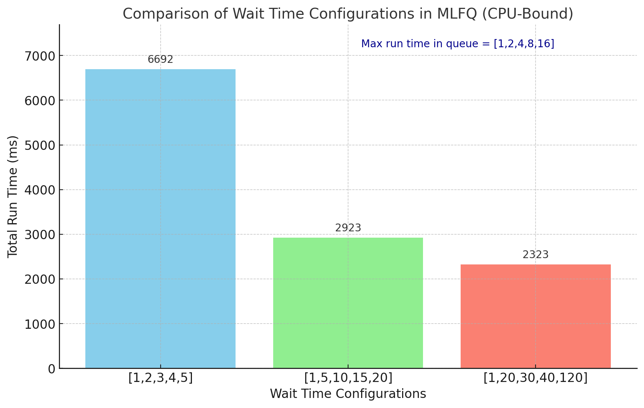
MLFQ Configuration w.r.t queue wait and run time

Slide 28
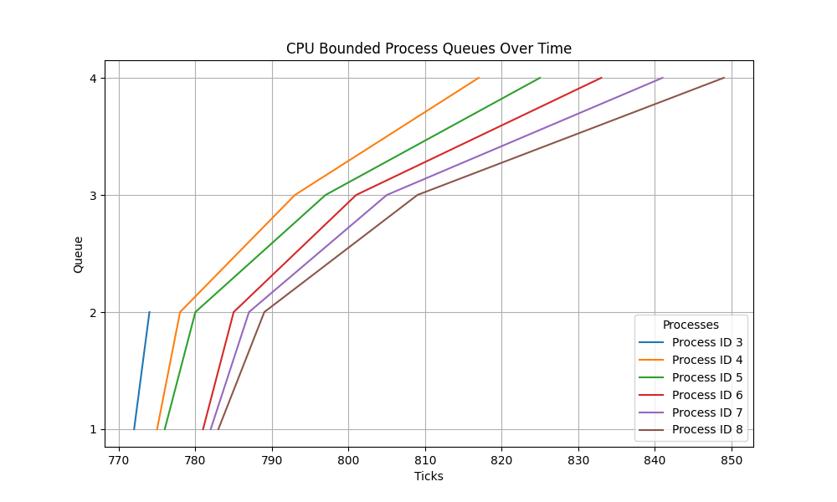
CPU bound Process runs in MLFQ (for 5 processes)

Slide 29
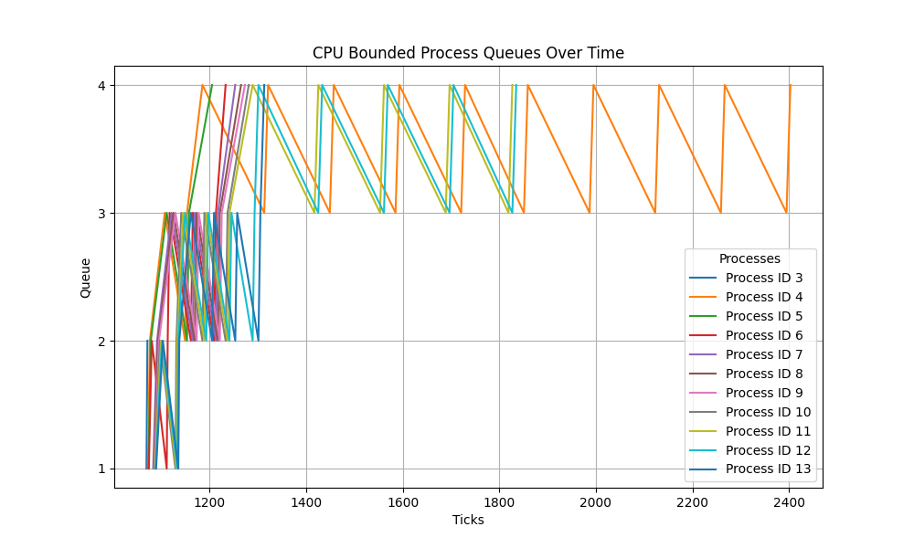
CPU bound processes run in MLFQ (for 10 processes)

Slide 30
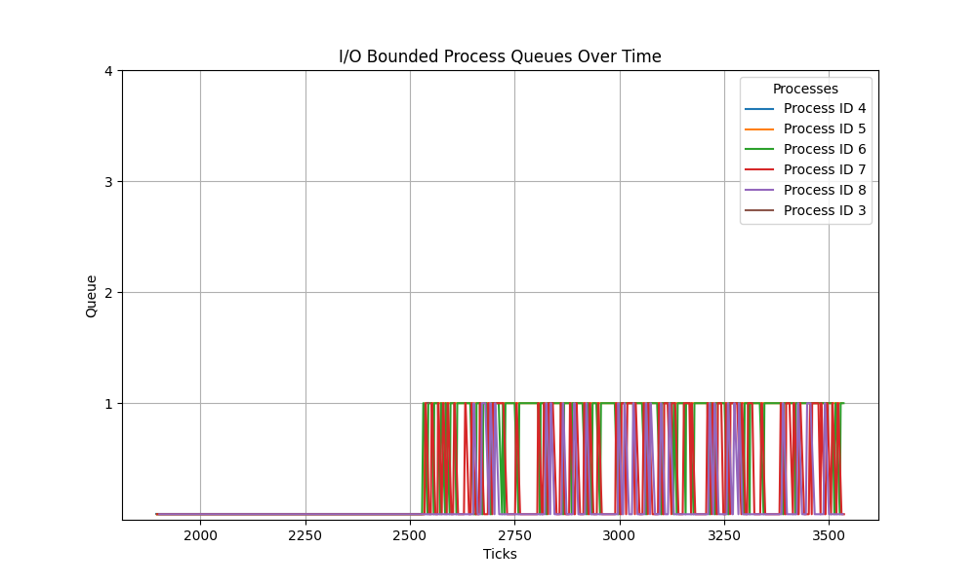
I/O bound process run in MLFQ (5 processes)

Slide 31
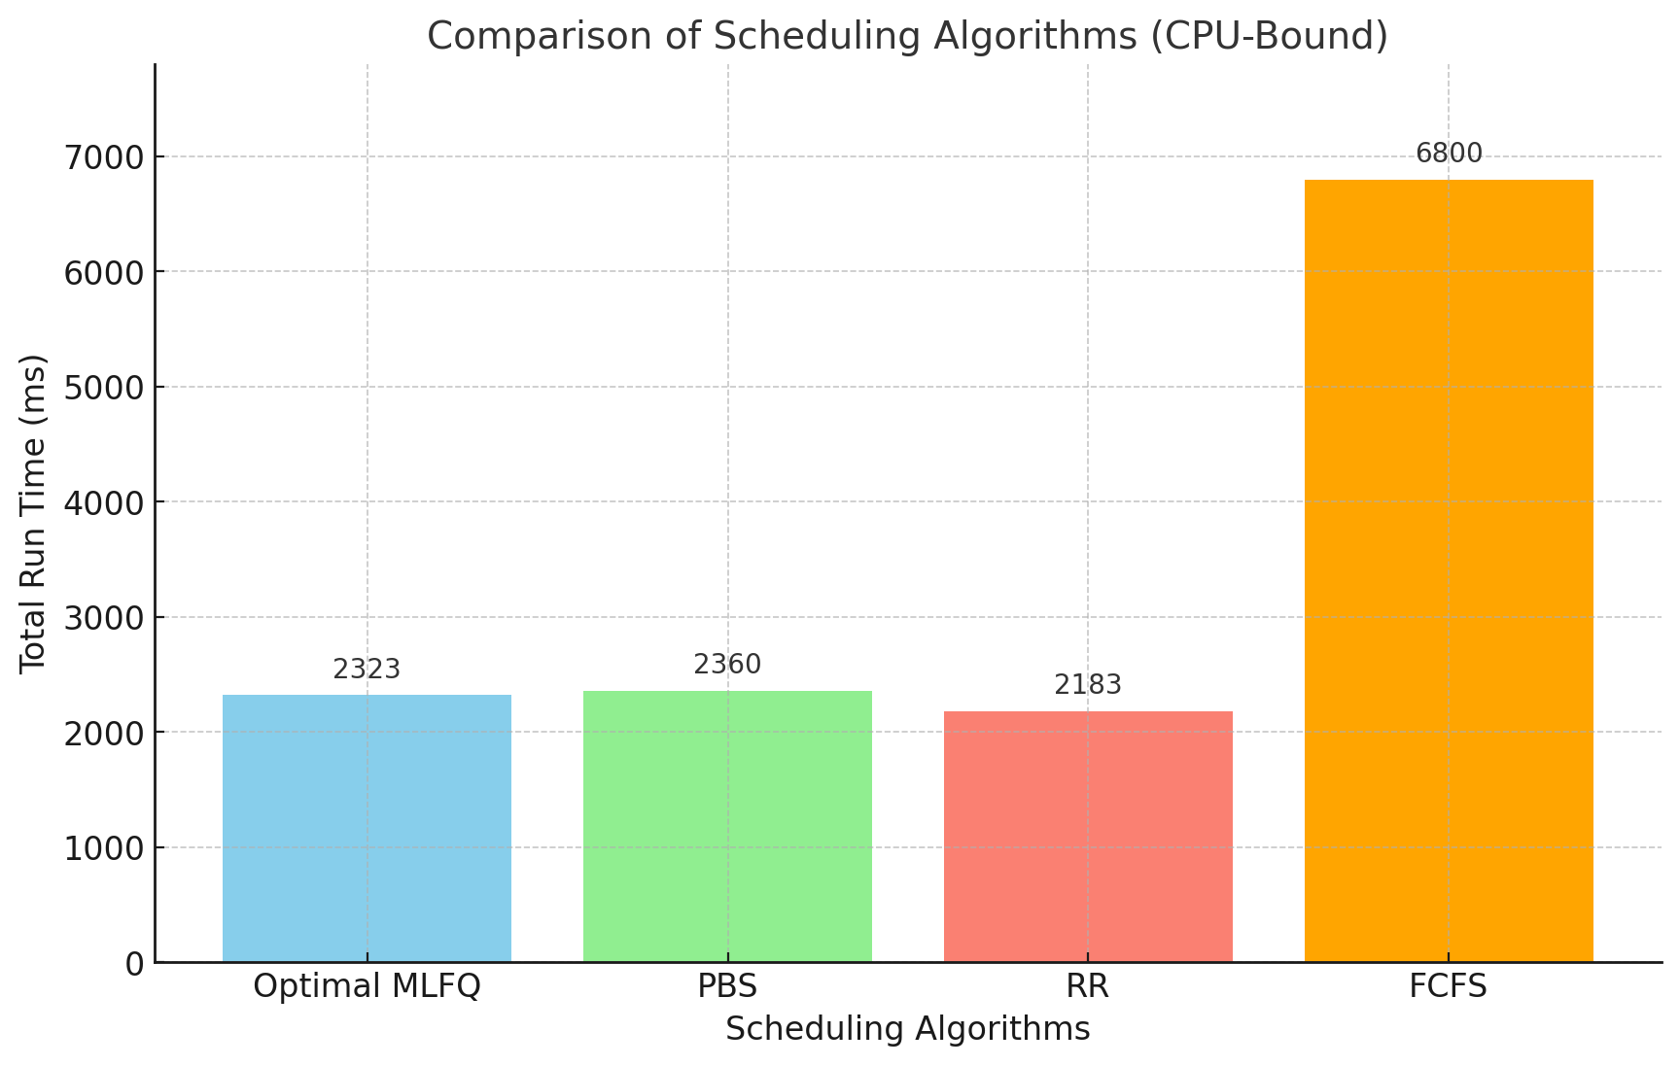
Comparison of different scheduling algorithms (w.r.t 10 processes with same workload.)

Slide 32
Unfinished Scope
Copy-On-Write (COW)
Advanced Performance Metrics:
Current implementation focuses on memory savings, but detailed performance analysis (e.g., page fault handling overhead, execution time impact) has not been conducted.
Stress Testing:
The COW implementation is tested on simple workloads; testing under heavy workloads or multi-level fork scenarios remains incomplete.
Scheduling
Lottery Scheduling Comparison:
Implementing and comparing Lottery Scheduling, a probabilistic scheduling algorithm, with FCFS, RR, PBS, and MLFQ can introduce the concept of fairness and unpredictability in scheduling.
This comparison could highlight how systems handle stochastic workloads or systems requiring randomness.

Slide 33
Challenges
Handling Complex Page Faults in COW:
Ensuring that the page fault handler correctly identifies when a page needs to be copied, and managing the memory mapping during the page fault process, was challenging.
Ensuring the child processes did not modify shared pages unnecessarily, while also maintaining efficient memory usage, required careful design.
Implementing Efficient Process Scheduling Algorithms:
Comparing the performance of different scheduling algorithms such as FCFS, RR, PBS, and MLFQ required careful implementation to measure and assess runtime fairly.
Handling the complexity of scheduling decisions, such as context switching and accounting for CPU-bound vs. I/O-bound processes, added layers of complexity.

Slide 34
Reflection
Understanding Memory Optimization with COW:
Implementing Copy-On-Write (COW) provided a deep understanding of how memory can be efficiently shared and optimized between parent and child processes.
The real-time effect of memory-saving techniques and how COW helps reduce memory usage during process creation and modification was a key learning experience. Tracking the number of free pages before and after forking allowed for clear insights into the efficiency of the technique.
Exploring Multiple Scheduling Algorithms:
The exploration of various scheduling algorithms, such as FCFS, Round Robin (RR), PBS, and MLFQ, was intriguing, especially when analyzing their different performances under varying workloads. Understanding how each algorithm prioritizes tasks and impacts system responsiveness was a valuable aspect of the project.
The challenge of comparing CPU-bound and I/O-bound processes, and understanding how they are handled differently by scheduling algorithms, was also quite engaging. It was particularly interesting to see the MLFQ algorithm adapt to these changing workloads.

Slide 35
Conclusion
This project provided valuable hands-on experience with memory optimization through Copy-On-Write (COW) and in-depth analysis of scheduling algorithms like FCFS, RR, PBS, and MLFQ. By comparing their performance in various scenarios, I gained a deeper understanding of how different algorithms impact system efficiency and responsiveness. The exploration of memory management and process scheduling highlighted the trade-offs between performance, fairness, and resource utilization, providing a comprehensive view of system-level optimizations and their practical implications.

Slide 36
References
XV6 source code – used for implementing and testing Copy-On-Write and scheduling algorithms.
"Operating Systems: Three Easy Pieces" (OSTEP) by Arpaci-Dusseau and Arpaci-Dusseau – provided theoretical insights into scheduling and memory management concepts.

