Slide 1
Phase I Analysis of Manufacturing Process Dataset
Advanced Quality Control
Final Project (4th Dec, ‘18)
Gaurav Rai
Gaurav Burman
Atul Srivastava

Slide 2

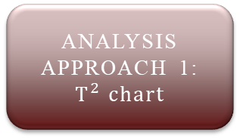
ANALYSIS
APPROACH 1:
$T^{2} chart$
Preliminary Analysis
Estimate the distribution type of dataset.
Plot $T^{2}$chart
Plot 𝑇^2 chart
Find the sample covariance matrix of the data set. It is a 209X209 square matrix.
Calculate ${\text{μ}}_{0}$ and ${\text{Σ}}_{0}$
Calculate "μ" _0 and "Σ" _0
After all the iterations are performed, calculate the in-control population parameters of the dataset.
Perform trend analysis on dataset.
Check for missing data in the dataset and remove if any.
Use to calculate the $T^{2}$ statistic for each observation since the population parameters ${\text{μ}}_{0}$ and ${\text{Σ}}_{0}$ are unknown.
Use to calculate the 𝑇^2 statistic for each observation since the population parameters "μ" _0 and "Σ" _0 are unknown.
Calculate UCL and plot $T^{2}$ chart.
Calculate UCL and plot 𝑇^2 chart.
Remove out-of-control data points/observations from the original dataset.
Perform multiple iterations of the $T^{2}$control chart plotting until there are no out-of-control data points
Perform multiple iterations of the 𝑇^2 control chart plotting until there are no out-of-control data points
ANALYSIS
APPROACH 2:
PCA
Preliminary Analysis
Principal Components Analysis
Use covariance matrix and eigen vectors of the dataset to calculate a set of linearly independent principal components.
Plot multi-univariate charts
Check for missing data in the dataset and remove if any.
Plot univariate charts of each PC.
Scale the dataset by standardizing each variable, since no information about the dimensions of the data is given.
Select the ‘vital few’ principal components using Preto chart, Scree plot and Minimum Description Length chart.
Choose an appropriate value of α for the individual charts such that the composite α is the same as that of Approach 1.
Calculate ARL values and estimate the in-control population parameters of the dataset.

Slide 3
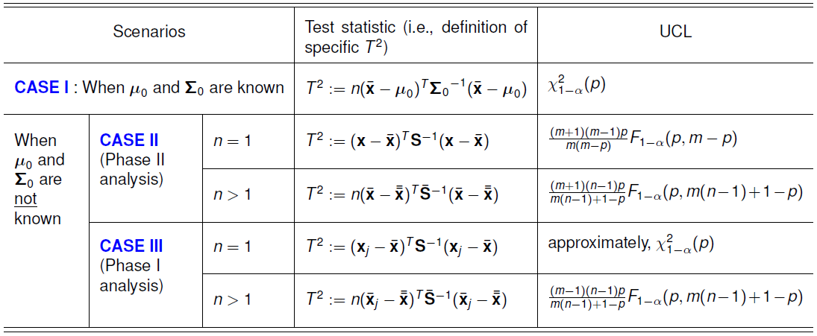


ANALYSIS APPROACH I : $T^{2} chart$
For this dataset, the population parameters ${\text{μ}}_{0}$ and ${\text{Σ}}_{0}$ are unknown and n=1, which corresponds to the case marked in the below table.
We choose our α as 0.05
So, UCL ≈ χ²_{1-α} (p)
= χ²_{1-0.05} (209)
= 243.7272

Slide 4
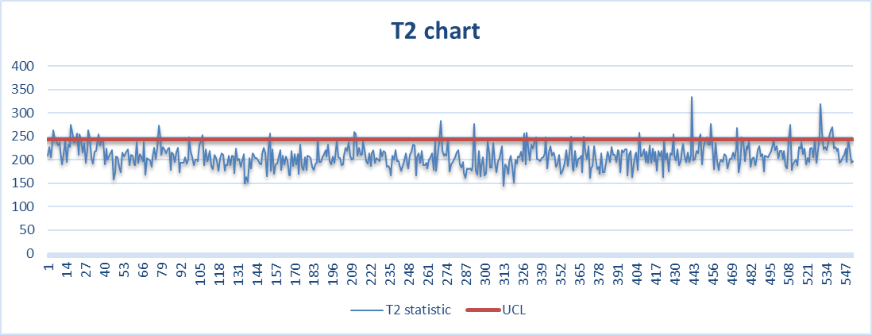
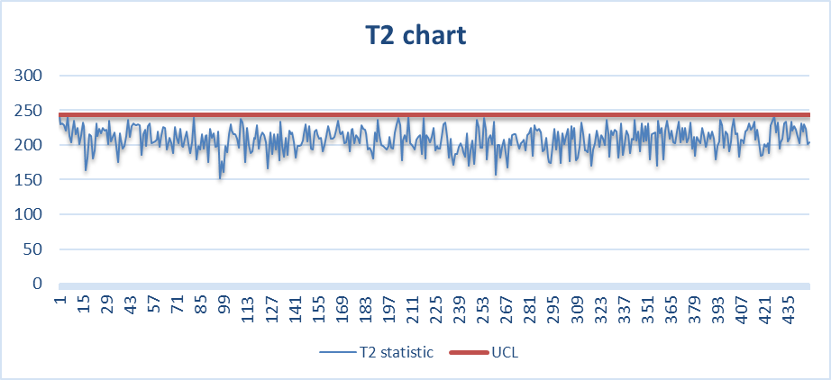


APPROACH I : $T^{2} chart$
We will start by creating our first $T^{2}$ chart and then removing the out-of-control observations by performing multiple iterations.
RESULT: We have performed Phase I analysis of the manufacturing process dataset. A total of 106 out-of-control observations were removed after performing iterative analysis using $T^{2}$ chart. 13 iterations were done!
ITERATION 1 [44 OOC points]
552 data points
0 OOC after 13 iterations
446 data points
ITERATION 13 [All data points in control]

Slide 5

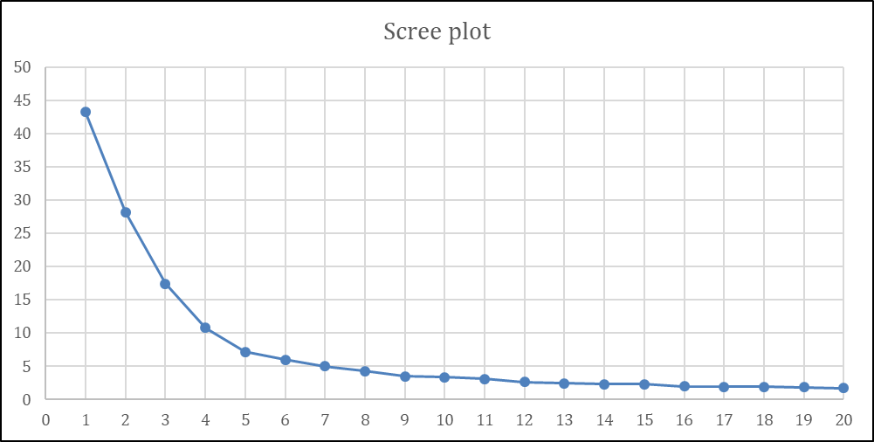
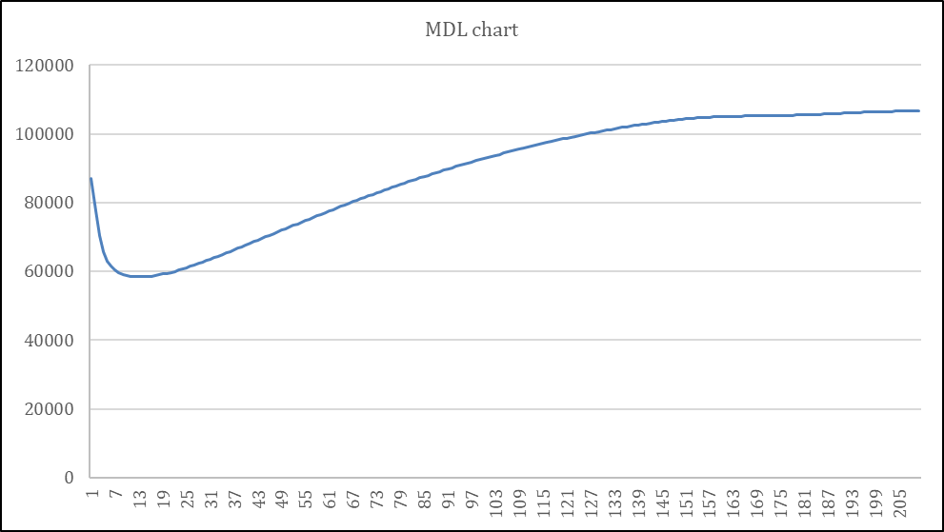
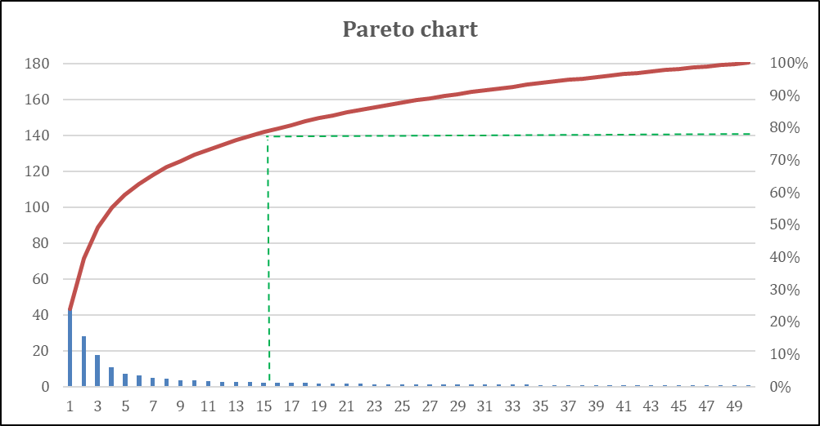

APPROACH II : $PCA$
We start off my standardizing the dataset and using for the calculation of PCs.
Performing PCA, we obtained 209 PCs for 552 observations. To choose the optimum number of PCs we made use of MDL plot in conjunction with scree plot and pareto plot. illustrate MDL Plot, Scree plot and Pareto plot for different PCs. Using these three plots we decided to take the top 10 PCs for our analysis.

Slide 6
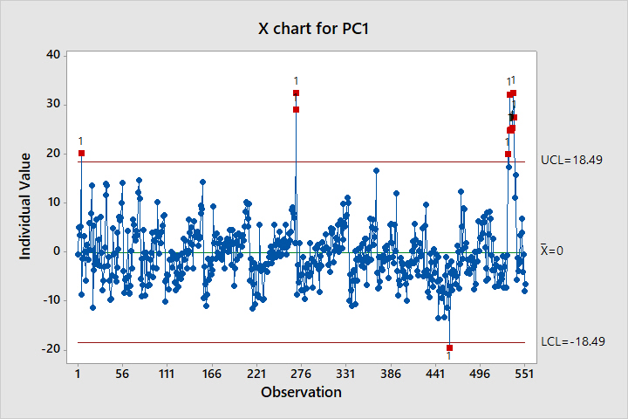
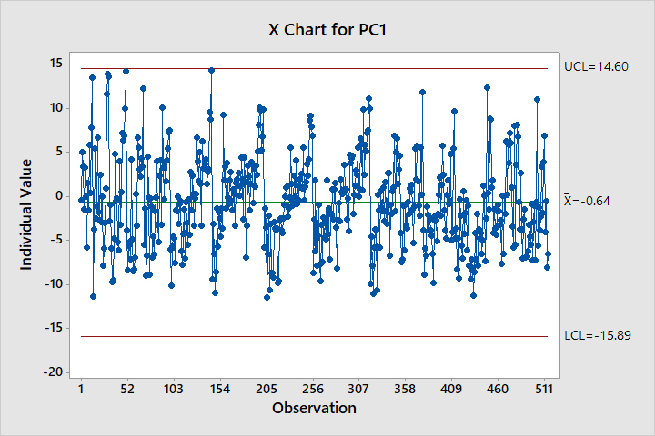

APPROACH II : $Univariate analysis on PCs$
We start off by performing a univariate analysis of the obtained 10 PCs.
Since we want the overall significance level to be α = 0.05, the α` for individual control charts on PCs was selected as approx. α` = α/10 = 0.005.
This brought the UCL for the univariate chart from the standard 3-sigma to a lower value of 2.81-sigma.
We have used the ‘either-or’ rule as our composition decision rule for OOC. All the OOC points are discarded after 4 iterations. The X chart for PC1 has been shown below:
It should be noted that we have performed this analysis for all 10 PCs. We have shown the chart here for only PC1.
ITERATION 1 [12 OOC points]
ITERATION 4 [0 OOC points]

Slide 7
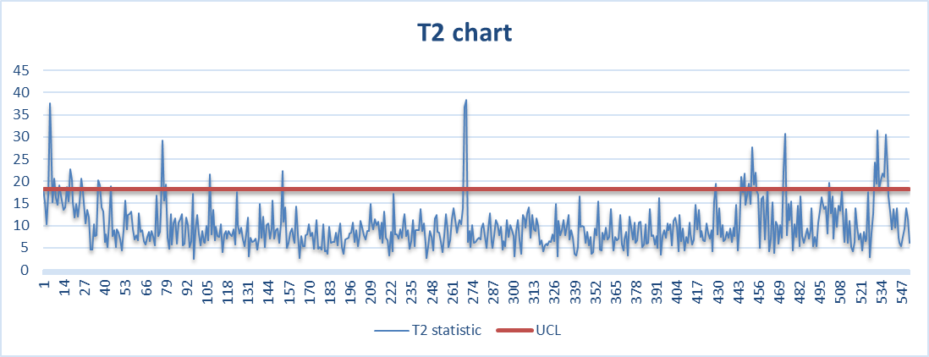
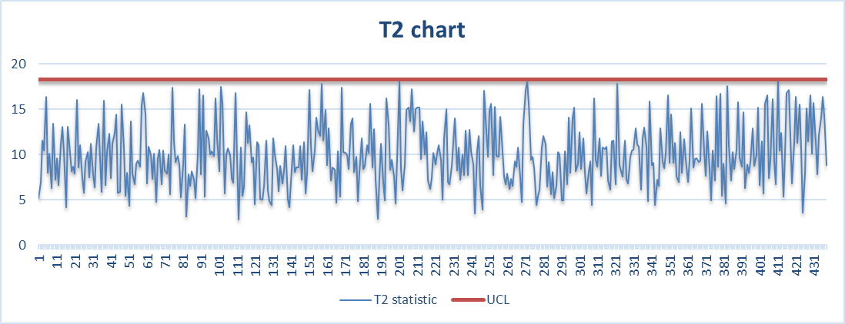

APPROACH II : $T^{2} analysis on PCs$
We have performed multiple iterations using the T² chart analysis on the top 10 PCs until all the OOC points are discarded.
UCL is χ²₁₋ α(10), where α is 0.05. UCL = 18.307
552 data points
ITERATION 1 [38 OOC points]
0 OOC after 8 iterations
438 data points
ITERATION 8 [All data points in control]

Slide 8


APPROACH II : $RESULTS$
Univariate analysis on PCs –
Since composite ‘α’ value is 0.05, that would mean that individual ‘α’ value is 0.005, which is very
less and corresponds to an ARL value 20. So the system would generate a false alarm after every 20
observations on average.
Following is a tabulated form that shows the no. of OOCs after each iterations.
T² chart analysis on PCs –
T² chart on PCs discards 114 observations from dataset. The final in- control parameters ${\text{μ}}_{0}$ and ${\text{Σ}}_{0}$ are:

Slide 9
CONCLUSION
We applied 3 different approaches for detecting out of control data points from the historical dataset.
Hotelling T-sq chart on original dataset – detected 106 out of control observations in 13 iterations.
Univariate Shewhart chart on first 10 PCs – detected 37 out of control observations in 4 iterations. Not found to be effective as we considered 10 PCs instead of 2-3 so curse of dimensionality hampered the results as we tried to achieve composite significance level of 0.05 (95% confidence interval) same as in T-sq chart.
Hotelling T-sq chart on 10 PCs – detected 114 out of control observations in 8 iterations. More effective as it detected more number of observations in lesser number of iterations.

Slide 10

Thanks & Gig’em!

