Slide 1
Milestone-II

Slide 2
SQL statements with Oracle XML returning XML data

Slide 3
#1 Find the requesters and the payment numbers of who have made any payments below $500.
Query with general requirements
(no attribute)
Access object data from more than one object table using references.
select xmlroot(xmlelement("paymentUnder500",
xmlagg(xmlelement("requester",
xmlelement("name", p.oid.tid.srid.rid.requesterName),
xmlelement("paymentNumber", p.paymentNumber)))), version '1.0')
from payment p where p.itemValue<500;

Slide 4
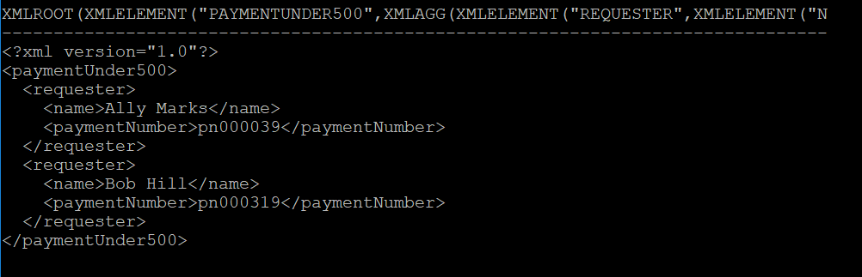
#1.XML data returned
XML documents contain more than two levels of element hierarchy.
The document must contain XML declaration and the root element

Slide 5
#2 List all software requests with their attributes and the staff members handling them
Query contains XML tags with attributes
Access object data from more than one object table using references.
select xmlroot(xmlelement("serviceRequest",
xmlagg(xmlelement("ticket",
xmlattributes(s.ticketID as "ID"),
xmlforest(s.softwareName as "softwareName",
s.softwareType as "softwareType",
s.srid.srStatus as "status",
s.srid.problemDescription as "description",
s.checkPriority() as "priority"),
xmlelement("handler",
xmlelement("name", s.sid.fullName()))))), version '1.0')
from swreq s;

Slide 6
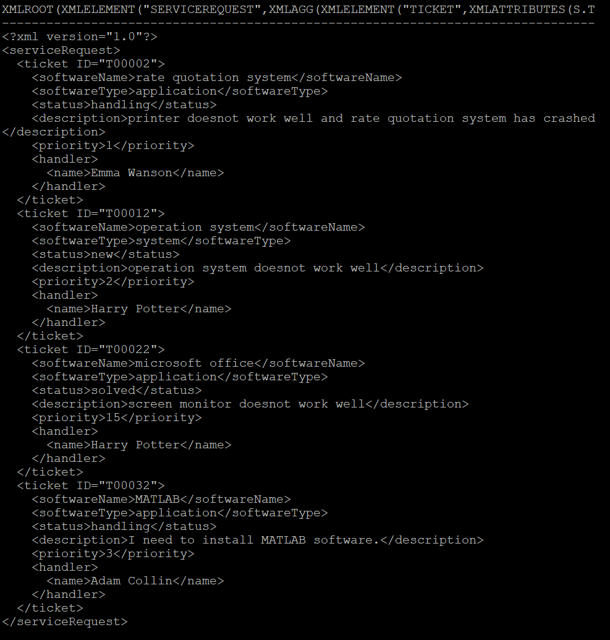
#2.XML data returned
XML documents contain more than two levels of element hierarchy.
The document must contain XML declaration and the root element

Slide 7
#3 list IT staff group by different team who are handling hardware requests.
Queries contain GROUP BY clause
Access object data from more than one object table using references.
select xmlroot(xmlelement("list",xmlagg(
xmlelement("team",xmlattributes(h.sid.teamname as "teamName"),
xmlagg(xmlelement ("staff",
xmlforest(h.sid.staffID as "id",h.sid.fullname() as "name")))))),version '1.0')
from hwrequest h group by h.sid.teamname;

Slide 8
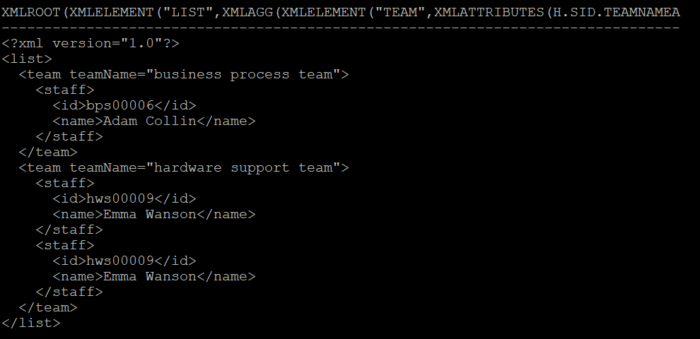
#3.XML data returned
XML documents contain more than two levels of element hierarchy.
The document must contain XML declaration and the root element

Slide 9
#4 for all the payments, list all the ticket ID ,its category and the approver(departmentHead).
Query request create XML documents using Oracle XSU
Accessing data from more than one object table using object-relational approach;
Provide user-defined tag names
OracleXML getXML -user "grp3/here4grp3" \
-conn "jdbc:oracle:thin:@sit.yorku.ca:1521:studb10g"\
-rowsetTag "paymentlist" -rowTag "ticket" -rowIdAttr "item"\
" select p.oid.tid.ticketid as id, \
p.oid.tid.category as category, \
p.dcode.departmenthead as approver \
from payment p"

Slide 10
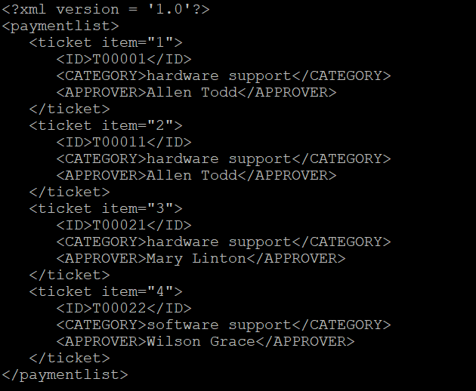
#4.XML data returned
XML documents contain more than two levels of element hierarchy.
The document must contain XML declaration and the root element

Slide 11
XML files in Oracle XML DB repository using DBMS_XDB & XQUERY

Slide 12
Creating a Folder
SQL> declare
ret boolean;
begin
ret
:=dbms_xdb.createfolder('/public/m3xml3');
commit;
end;
/

Slide 13
Creating Resources
Created seven xml files:
ticket.xml inventory.xml payment.xml serviceRequest.xml company.xml staff.xml requester.xml

Slide 14
ticket.xml
SQL> declare
ret boolean;
begin
ret :=
dbms_xdb.createresource('/public/m3xml3/ticket.xml',
'<ticket>
<request type="Hardware">
<ticketID> T0001 </ticketID>
<status> Open </status>
<category> Hardware Upgrade </category>
<tQuantity> 1 </tQuantity>
<severity> 2 </severity>
<createDate> 01/11/2018 </createDate>
<staffNotes> Currently waiting for approval from the department head. </staffNotes>
<deviceName> 256GB SSD </deviceName>
<deviceType> Memory Drive </deviceType>
<staffID> IT1 </staffID>
<serviceRequestID> S0001 </serviceRequestID>
</request>

Slide 15
ticket.xml Continued
<request type="Software">
<ticketID> T0002 </ticketID>
<status> Solved </status>
<category> Software support </category>
<tQuantity> 1 </tQuantity>
<severity> 3 </severity>
<createDate> 01/11/2018 </createDate>
<staffNotes> Downloaded the software onto the requested users computer. </staffNotes>
<deviceName> MATLAB </deviceName>
<deviceType> application </deviceType>
<staffID> IT2 </staffID>
<serviceRequestID> S0002 </serviceRequestID>
</request>

Slide 16
ticket.xml Continued
<request type="Software">
<ticketID> T0003 </ticketID>
<status> Open </status>
<category> Operating system upgrade </category>
<tQuantity> 1 </tQuantity>
<severity> 1 </severity>
<createDate> 01/11/2018 </createDate>
<staffNotes> Waiting for user to drop off their laptop. </staffNotes>
<deviceName> Windows 10 Pro </deviceName>
<deviceType> OS </deviceType>
<staffID> IT3 </staffID>
<serviceRequestID> S0003 </serviceRequestID>
</request>

Slide 17
ticket.xml Continued
<request type="Hardware">
<ticketID> T0004 </ticketID>
<status> Solved </status>
<category> keyboard replacement </category>
<tQuantity> 1 </tQuantity>
<severity> 1 </severity>
<createDate> 01/11/2018 </createDate>
<staffNotes> Replaced the users keyboard </staffNotes>
<deviceName> Lenovo Keyboard 100MX </deviceName>
<deviceType> USB keyboard </deviceType>
<staffID> IT4 </staffID>
<serviceRequestID> S0004 </serviceRequestID>
</request>
</ticket>
');
commit;
end;
/

Slide 18
List all software requests with severity greater than 2.
SQL> xquery
let $c := doc("/public/m3xml3/ticket.xml")
for $d in $c/ticket/request
where $d/@type="Software" and $d/severity>2
return $d/ticketID
/
Result Sequence
--------------------------------------------------------------------------------
<ticketID> T0002 </ticketID>

Slide 19
Find the payment number and the total value of each order of payment when quantity is equal to 1.
SQL> xquery
let $c := doc("/public/m3xml3/payment.xml")
for $d in $c/invoice/payment[quantity = 1]
return <payment number = "{$d/number}">
<Total_Value>{$d/value/text()}</Total_Value></payment>
/
Result Sequence
--------------------------------------------------------------------------------
<payment number=" P0001 "><Total_Value> 250.00 </Total_Value></payment>
<payment number=" P0002 "><Total_Value> 150.00 </Total_Value></payment>
<payment number=" P0003 "><Total_Value> 175.00 </Total_Value></payment>
<payment number=" P0004 "><Total_Value> 25.00 </Total_Value></payment>

Slide 20
List the name of the employee who solved the ticket number T0004.
SQL> xquery
let $c :=doc ("/public/m3xml3/ticket.xml")
let $d :=doc ("/public/m3xml3/staff.xml")
for $x in $c/ticket/request
for $y in $d/itSupportStaff/staff
where $x/ticketID=" T0004 " and $x/staffID=$y/ID
return $y/name/text()
/
Result Sequence
--------------------------------------------------------------------------------
Mary Bird

Slide 21
List the ticket request types solved and the ticketID for all products which cost greater than 100 dollars.
SQL> xquery
let $c := doc("/public/m3xml3/ticket.xml")
for $d in $c/ticket/request
let $t := doc("/public/m3xml3/inventory.xml")
for $u in $t/inventory/order
where $d/ticketID = $u/@ticketID and $d/status = " Solved " and $u/productPrice > 100
return <Ticket ID="{$u/@ticketID}"> <TicketType>{$d/@type}</TicketType> </Ticket>
/
Result Sequence -------------------------------------------------------------------------------- <Ticket ID=" T0002 "><TicketType>Software</TicketType></Ticket>

Slide 22
THANK YOU!

