Slide 1
EXECUTIVE PROJECT OVERVIEW | END-TO-END ML PROTOTYPE
Predicting & Mitigating Healthcare Appointment No-Shows
The Clinical & Operational Challenge
• Chronic Healthcare Inefficiency: Missed appointments cost the US health system over $150B annually and create severe care gaps.
• Clinic Baseline Disruption: Out of 110,521 cleaned visits, 20.19% resulted in no-shows, stranding clinical staff and diagnostic equipment.
• Asymmetric Clinical Impact: Missed chronic disease follow-ups (hypertension, diabetes) sharply elevate emergency admission risks.
• Operational Constraints: Clinic outreach teams have finite calling hours and cannot manually contact 100% of booked patients.
• Objective: Build an end-to-end, reproducible ML prototype to reliably stratify no-show risk at booking time and optimize outreach.
Engineering & Delivery Objectives
• Strict Temporal Evaluation: Avoid random K-fold leakage; validate exclusively on chronological cohorts.
• Point-in-Time Data Integrity: Engineer rolling patient historical metrics strictly prior to appointment creation.
• Asymmetric Cost Modeling: Evaluate decision thresholds using an illustrative cost matrix ($10 call vs $200 unfilled slot).
• Dual-Space Explainability: Provide exact log-odds attributions for engineers and intuitive percentage-point shifts for clinicians.
• Methodological Rigor: Freeze champion model (unweighted XGBoost) and verify mathematical additivity (< 1e-4 tolerance).
DATASET: 110,521 Cleaned Appointments | CHAMPION: Unweighted XGBoost (PR-AUC: 0.3584, Brier: 0.1431) | EST. SAVINGS: $98,920 (Modeled Scenario)

Slide 2
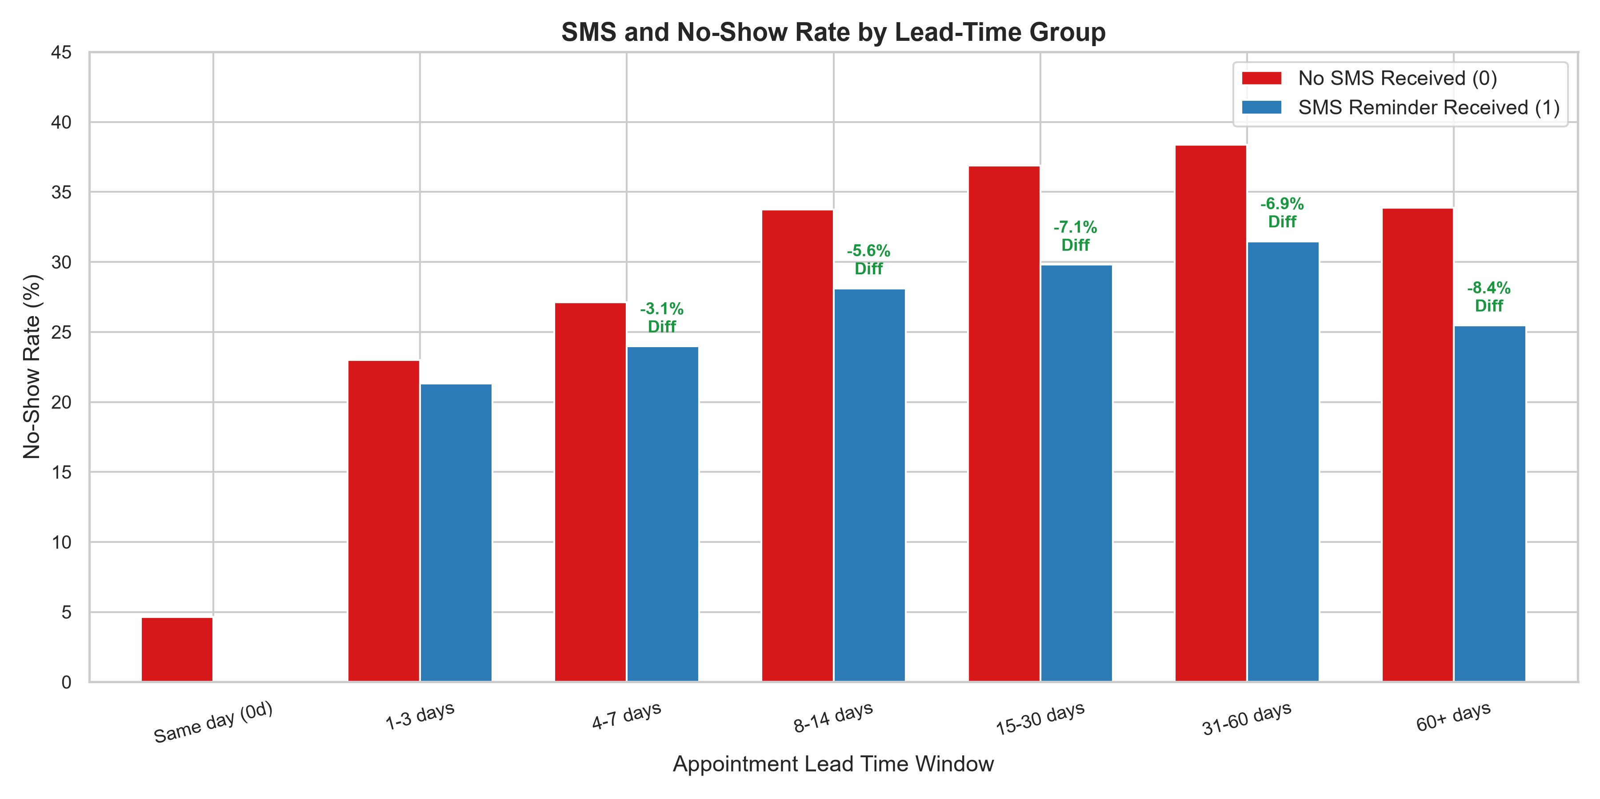
DATA ARCHITECTURE & INTEGRITY AUDIT | STEPS 1–3
Data Sanitization, Temporal Partitioning & Leakage Prevention
Point-in-Time Architecture & Temporal Splits
• Data Sanitization: Filtered 1 negative age anomaly (age = -1) and 5 inverted-date records; verified 0 null values across 110,521 records.
• Strict Chronological Partitioning:
- Train (April 29 – May 19, 2016): 63,532 appointments (20.95% no-show)
- Validation (May 20 – May 31, 2016): 20,539 appointments (20.08% no-show)
- Chronological Holdout (June 1 – June 8, 2016): 26,450 appointments (18.46% no-show)
• Chronological Holdout Qualification: June 1–8 was excluded from model training/validation. Exploratory analysis of its predictions previously occurred, so it is not presented as an untouched test set.
• Point-in-Time Patient History: Filtered strictly for events where appointment date preceded scheduling date, eliminating 27,525 contaminated records.
• Zero Leakage Audit Violations: Automated audit confirmed 0 point-in-time violations.
• Exclusion of sms_received: SMS status is dispatched after booking; excluding it avoids operational target mismatch.

Slide 3
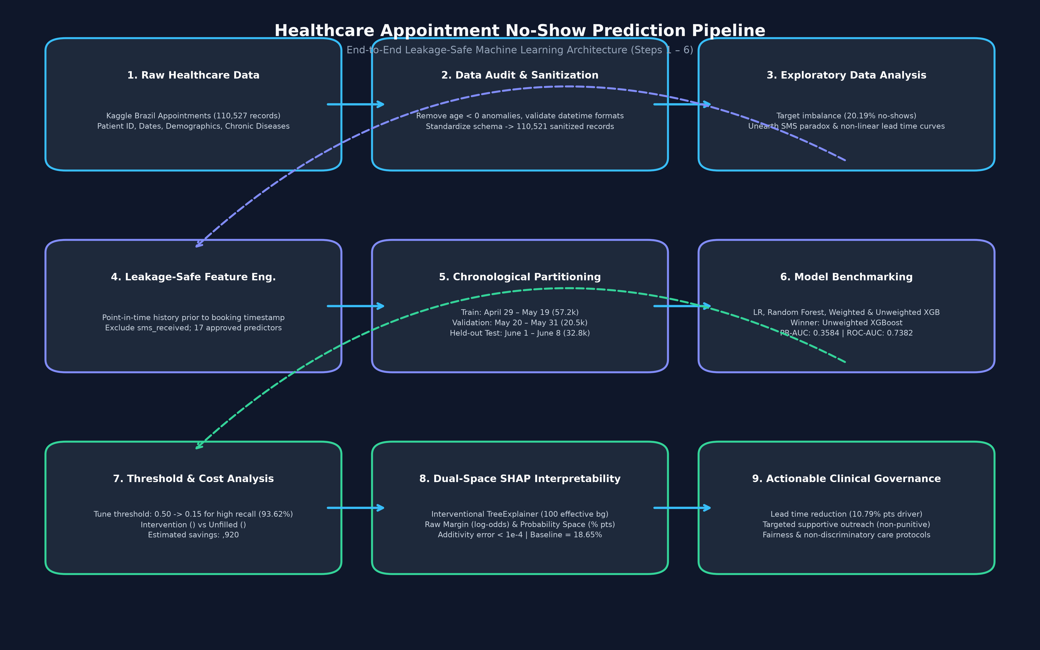
MODEL BENCHMARKING & EVALUATION | STEP 4
Feature Engineering, Benchmark Results & Model Selection
Model Comparison & Performance Benchmarks
• 17 Approved Predictor Features across 3 distinct domains:
- Static Demographics: age, gender, scholarship, chronic comorbidities
- Booking / Temporal: lead_days, same_day_booking, day of week
- Historical Behaviour: prior_appointments, prior_noshow_rate, recency
• Evaluation Metric: PR-AUC (Precision-Recall AUC) chosen due to 20% positive class imbalance; baseline PR-AUC = 0.2008.
• Validation Benchmark Results (Verified from model_benchmark_summary.csv):
- Logistic Regression: PR-AUC = 0.3524 | ROC-AUC = 0.7302 | Brier = 0.2209
- Random Forest: PR-AUC = 0.3546 | ROC-AUC = 0.7365 | Brier = 0.2123
- XGBoost (Class Weighted): PR-AUC = 0.3597 | ROC-AUC = 0.7385 | Brier = 0.2166
- XGBoost (Unweighted): PR-AUC = 0.3584 | ROC-AUC = 0.7382 | Brier = 0.1431 (Winner!)
• Why Unweighted XGBoost Won: Class weighting degraded probability calibration (Brier: 0.2166, ECE: 0.2503). Unweighted XGBoost preserved pristine calibration (Brier: 0.1431, ECE: 0.0240), essential for threshold tuning.

Slide 4
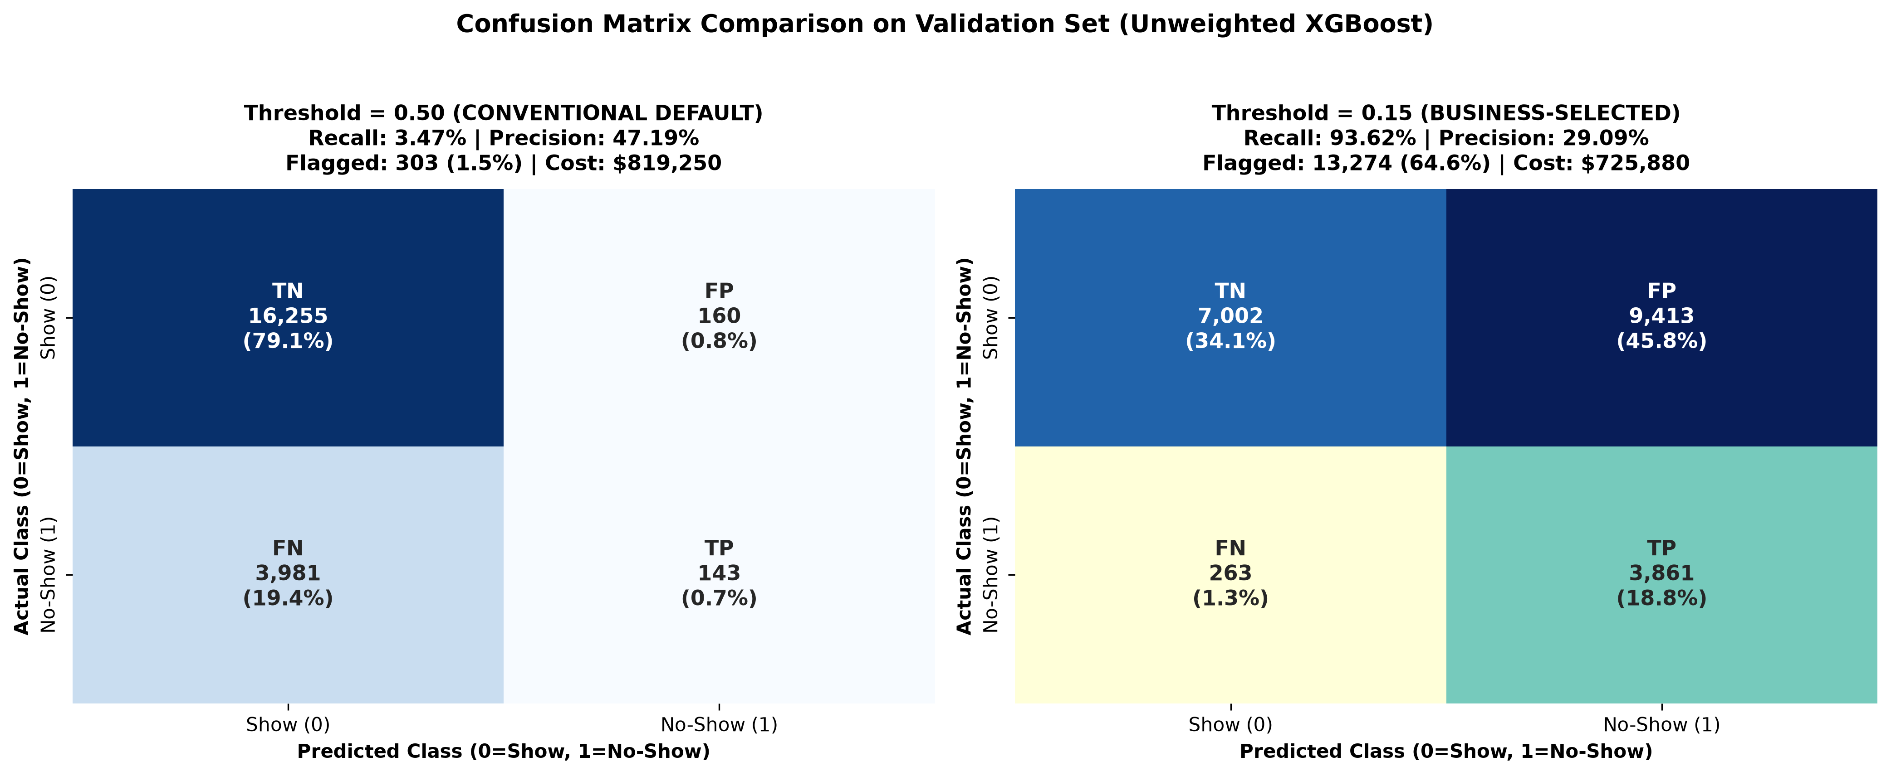
OPERATIONAL DECISION ANALYTICS | STEP 5
Decision Threshold Evaluation & Healthcare Cost Matrix
Asymmetric Healthcare Cost Analysis
• The Default 0.50 Threshold Failure:
- At threshold 0.50, recall is only 3.47% (captures 143 of 4,124 no-shows!).
- Healthcare cost of False Negatives ($200) far exceeds cost of outreach ($10).
• Illustrative Cost Assumptions (Validation Cohort: 20,539 Appointments):
- Intervention Cost: $10 per flagged patient
- Cost of Unfilled Clinical Slot: $200 per missed appointment
- Outreach Effectiveness (r): 30% reduction in no-show probability
• Total Cost Formula:
Total Cost = Flagged * $10 + [FN + (1 - r) * TP] * $200
• Lowest-Cost Evaluated Operating Point (Threshold = 0.15):
- Recall increases from 3.47% to 93.62% (identifies 3,861 no-shows)
- Precision stands at 29.09% (sufficient for low-cost interventions)
- Modeled cost drops from $824,800 (baseline) to $725,880 ($819,250 at 0.50)
- Estimated Net Savings: $98,920 vs baseline ($93,370 vs 0.50). Modeled scenario under assumed parameters, not measured operational savings.

Slide 5
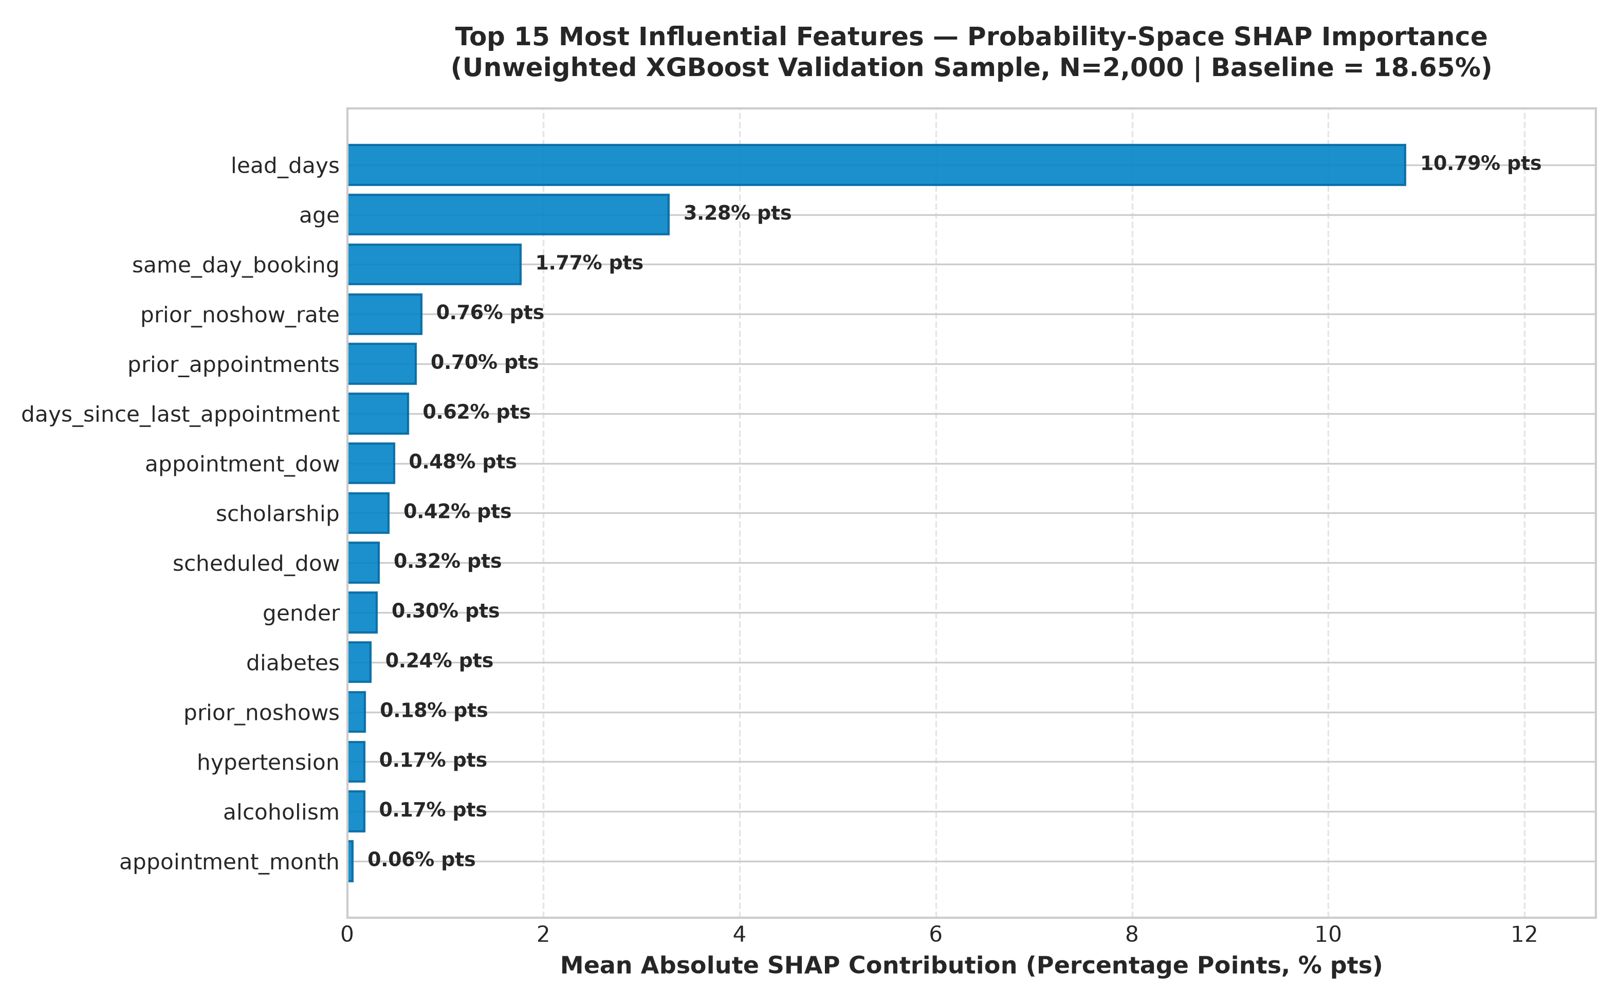
MODEL EXPLAINABILITY & HEALTHCARE GOVERNANCE | STEP 6
Dual-Space SHAP Interpretability, Clinical Governance & Limitations
Dual-Space SHAP Insights & Clinical Governance
• Dual-Space Architecture:
- Raw Margin (Log-Odds): Engineering baseline; exact sigmoid parity.
- Probability Space: Clinician-friendly additive explanations:
P(no-show | x) = Base Value (18.65%) + Sum of Feature Shifts (% pts).
- Background Dataset: 200 rows supplied from train; 100 effective background observations evaluated internally via SHAP Independent masker.
• Top Empirical Probability Drivers:
- Lead Days: +10.79% pts (Primary operational lever: delay increases risk).
- Patient Age: +3.28% pts (Young adults higher risk; seniors protective).
- Same-Day Booking: +1.77% pts (Immediate appointments attend reliably).
- Historical No-Show Rate: +0.76% pts (Past non-attendance ramps risk).
• Governance & Non-Discrimination Principles:
- Statistical Attribution != Causality (Do not reschedule arbitrarily!).
- Non-Punitive Deployment: Risk scores must ONLY allocate supportive care (navigation, reminders, transit vouchers), NEVER restrict access.

