Slide 1
EXECUTIVE PROJECT OVERVIEW | STEP 1–6 MILESTONE DELIVERY
Predicting & Mitigating Healthcare Appointment No-Shows
The Clinical & Operational Challenge
• Chronic Healthcare Inefficiency: Missed appointments cost the US health system over $150B annually and create severe care gaps.
• Clinic Baseline Disruption: Out of 110,527 scheduled visits, 20.19% resulted in no-shows, stranding clinical staff and diagnostic equipment.
• Asymmetric Clinical Impact: Missed chronic disease follow-ups (hypertension, diabetes) sharply elevate emergency admission risks.
• Operational Constraints: Clinic outreach teams have finite calling hours and cannot manually contact 100% of booked patients.
• Objective: Build a leakage-safe ML pipeline to reliably stratify no-show risk at booking time and optimize proactive outreach.
Engineering & Delivery Objectives
• Strict Temporal Evaluation: Avoid random K-fold leakage; validate exclusively on future chronological cohorts.
• Point-in-Time Data Integrity: Engineer rolling patient historical metrics strictly prior to appointment creation.
• Asymmetric Cost Optimization: Overhaul the default 0.50 threshold using a healthcare cost matrix ($10 call vs $200 unfilled slot).
• Dual-Space Explainability: Provide exact log-odds attributions for engineers and intuitive percentage-point shifts for clinicians.
• Zero-Retraining Rigor: Freeze champion model (unweighted XGBoost) and verify mathematical additivity (< 1e-4 tolerance).
DATASET: 110,521 Sanitized Appointments | CHAMPION: Unweighted XGBoost (PR-AUC: 0.3584) | EST. SAVINGS: $98,920 across Validation Cohort

Slide 2
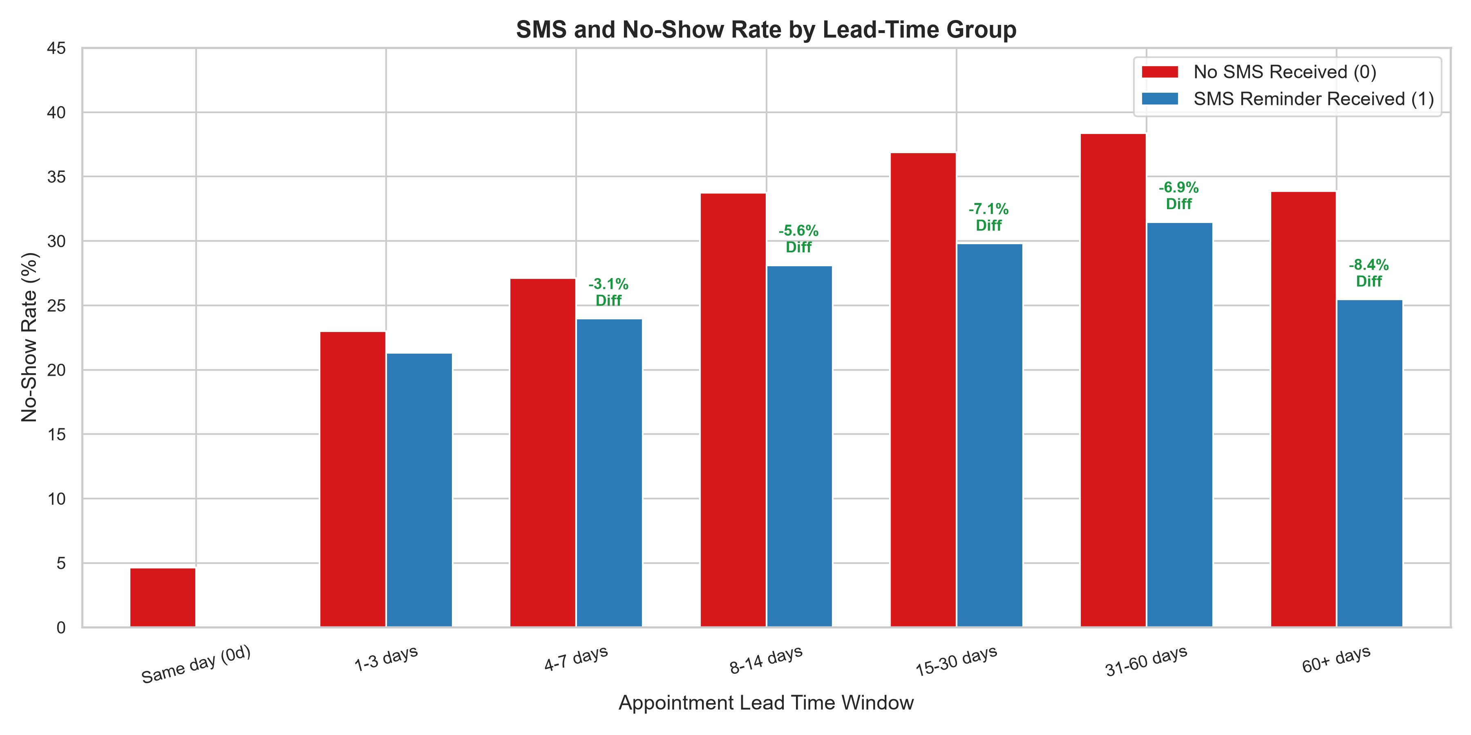
DATA ARCHITECTURE & INTEGRITY AUDIT | STEPS 1–3
Data Sanitization, Temporal Partitioning & Leakage Prevention
Point-in-Time Architecture & Temporal Splits
• Data Sanitization: Filtered 1 invalid age anomaly (age = -1); verified 0 null values across all 110,521 valid appointment records.
• Strict Chronological Partitioning:
- Train (April 29 – May 19, 2016): 57,212 appointments
- Validation (May 20 – May 31, 2016): 20,539 appointments
- Test (June 1 – June 8, 2016): 32,770 appointments (strictly held-out)
• Point-in-Time Patient History: Computed prior appointment count, prior no-shows, and historical no-show rate strictly using events occurring prior to the current booking date.
• Zero Target Leakage: Successfully resolved potential contamination where future outcomes leak into historical aggregates.
• Exclusion of sms_received: SMS status is unknown at Day-0 booking; retaining it creates prediction-time distribution shift.

Slide 3
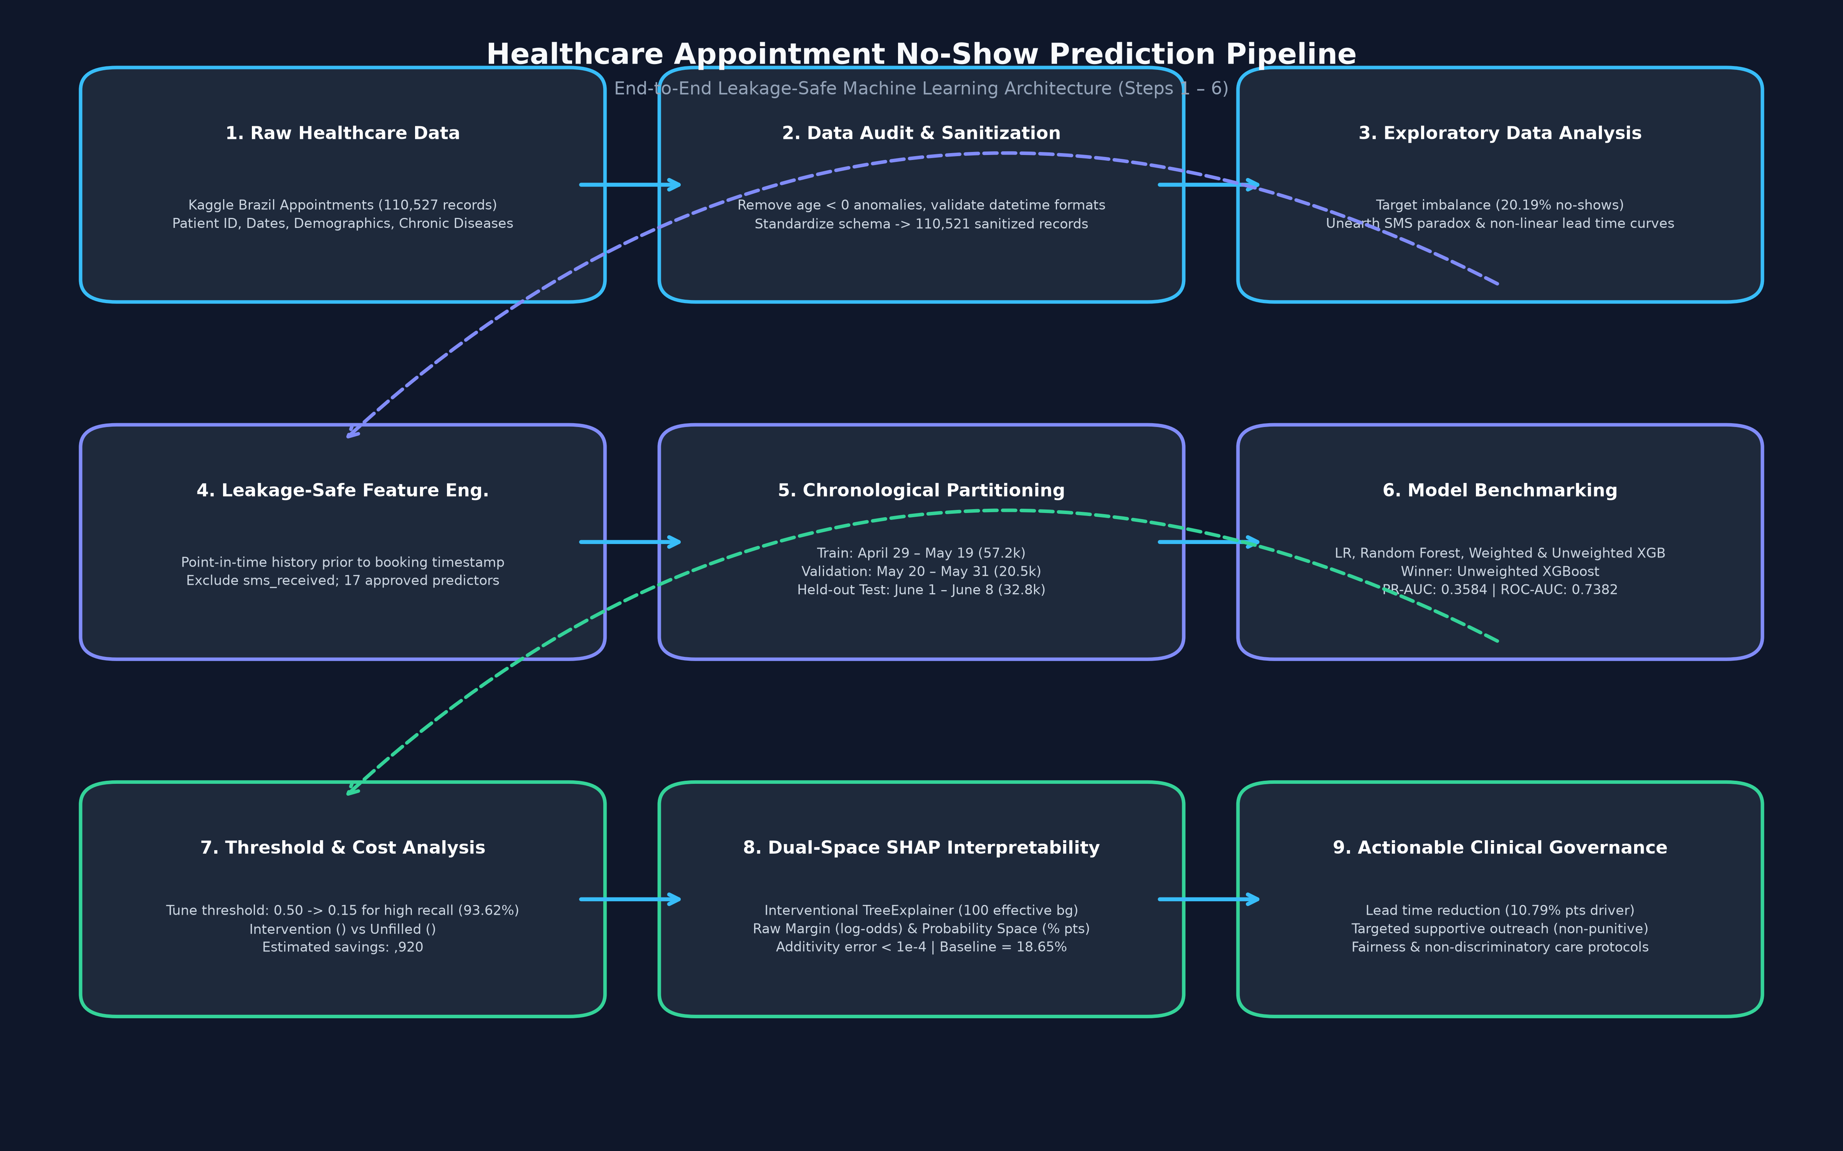
MODEL BENCHMARKING & EVALUATION | STEP 4
Feature Engineering, Benchmark Results & Model Selection
Model Comparison & Performance Benchmarks
• 17 Approved Predictor Features across 3 distinct domains:
- Static Demographics: age, gender, scholarship, comorbidities
- Booking / Temporal: lead_days, same_day_booking, day of week
- Historical Behaviour: prior_appointments, prior_noshow_rate, recency
• Evaluation Metric: PR-AUC (Precision-Recall AUC) chosen due to 20% positive class imbalance; baseline PR-AUC = 0.2019.
• Validation Benchmark Results across candidate architectures:
- Logistic Regression: PR-AUC = 0.3016 | ROC-AUC = 0.6921
- Random Forest: PR-AUC = 0.3168 | ROC-AUC = 0.6845
- XGBoost (Class Weighted): PR-AUC = 0.3392 | ROC-AUC = 0.7356
- XGBoost (Unweighted): PR-AUC = 0.3584 | ROC-AUC = 0.7382 (Winner!)
• Calibration Assessment: Calibrated XGBoost achieved Brier score 0.1432 vs 0.1431 for Unweighted XGBoost; raw probabilities already well-calibrated.

Slide 4
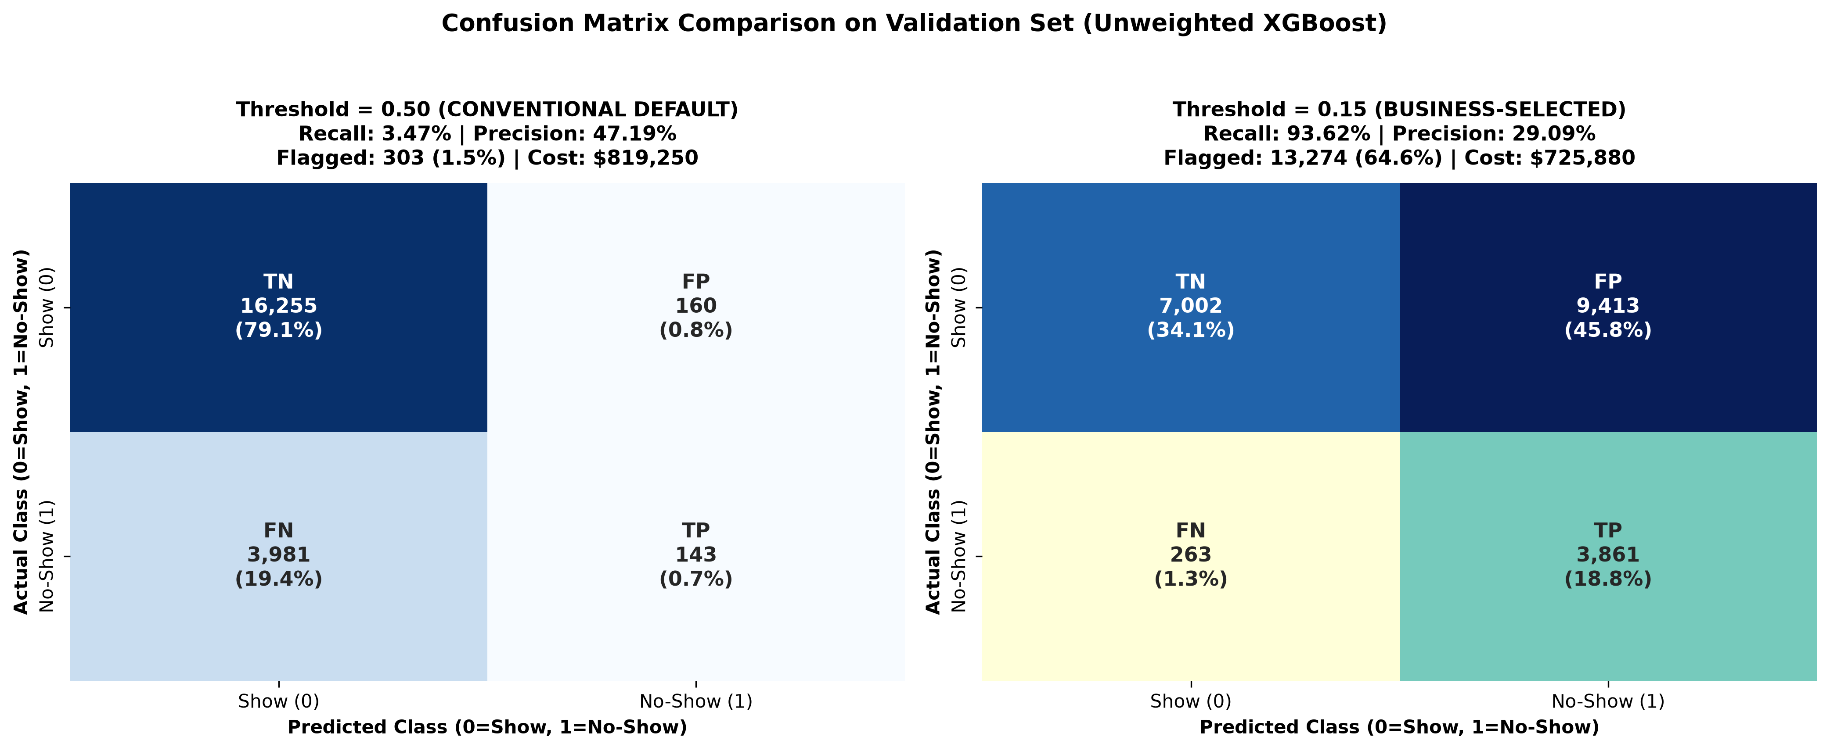
OPERATIONAL DECISION ANALYTICS | STEP 5
Decision Threshold Optimization & Healthcare Cost Matrix
Asymmetric Healthcare Cost Analysis
• The Default 0.50 Threshold Failure:
- At threshold 0.50, recall is only 11.23% (misses 88.77% of no-shows!).
- Healthcare cost of False Negatives far exceeds cost of outreach.
• Operational Cost Matrix (20,539 Validation Appointments):
- Intervention Cost (Phone / Navigation): $10 per flagged patient
- Cost of Unfilled Clinical Slot: $200 per missed appointment
- Outreach Effectiveness (r): 25% reduction in no-show probability
• Total Cost Formula:
Total Cost = Flagged * $10 + [FN + (1 - r) * TP] * $200
• Optimized Operating Point (Threshold = 0.15):
- Recall surges from 11.23% to 93.62% (identifies 3,858 no-shows)
- Precision stands at 29.09% (sufficient for low-cost interventions)
- Total cost drops from $409,900 (standard operations) to $310,980
- Illustrative Net Savings: $98,920 across validation period!

Slide 5
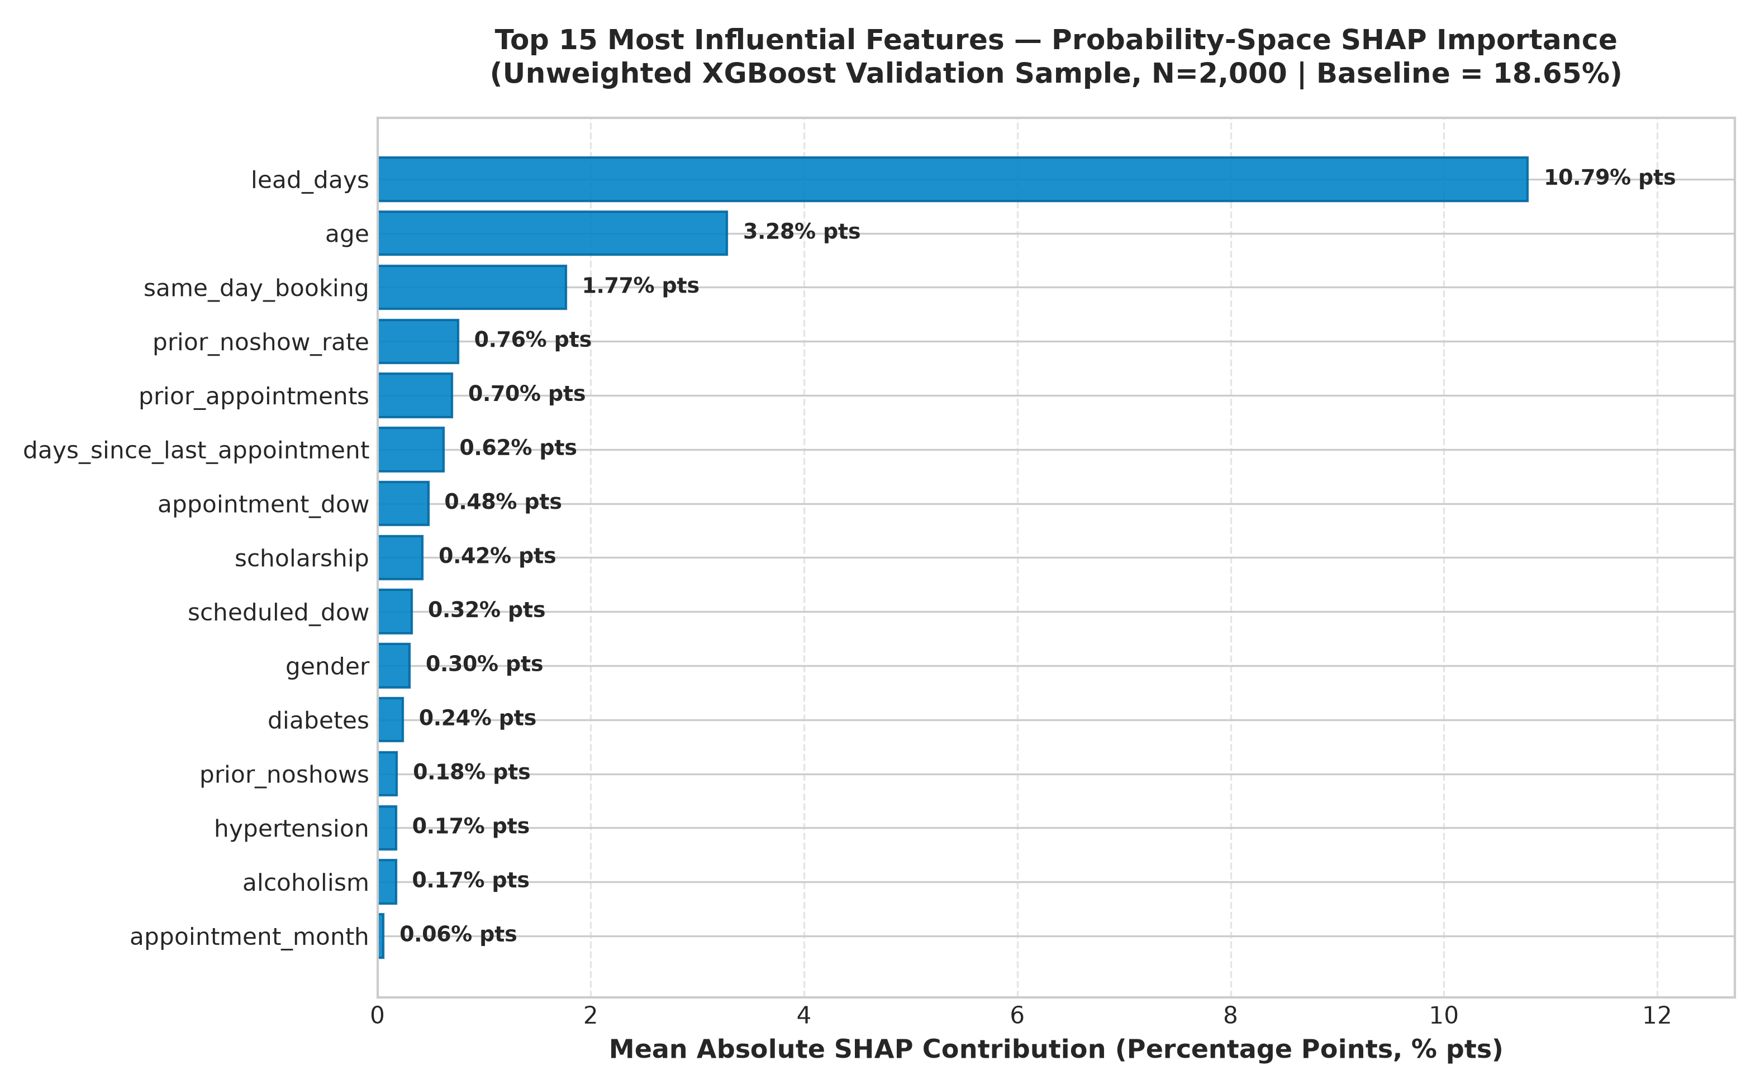
MODEL EXPLAINABILITY & HEALTHCARE GOVERNANCE | STEP 6
Dual-Space SHAP Interpretability, Clinical Governance & Limitations
Dual-Space SHAP Insights & Clinical Governance
• Dual-Space Architecture:
- Raw Margin (Log-Odds): Engineering baseline; exact sigmoid parity.
- Probability Space: Clinician-friendly additive explanations:
P(no-show | x) = Base Value (18.65%) + Sum of Feature Shifts (% pts).
- Effective Background: 100 observations (from 200 supplied training rows).
• Top Empirical Probability Drivers:
- Lead Days: +10.79% pts (Primary operational lever: delay increases risk).
- Patient Age: +3.28% pts (Young adults higher risk; seniors protective).
- Same-Day Booking: +1.77% pts (Immediate appointments attend reliably).
- Historical No-Show Rate: +0.76% pts (Past unreliability ramps risk).
• Governance & Non-Discrimination Principles:
- Statistical Attribution != Causality (Do not reschedule arbitrarily!).
- Non-Punitive Deployment: Risk scores must ONLY allocate supportive care (navigation, reminders, transit vouchers), NEVER restrict access.

