Slide 1
Cyber
security
Gaurav Yadav
IIITS

Slide 2

What Is Cyber Security?
Cyber security is the practice of defending computers, servers, mobile devices, electronic systems, networks, and data from malicious attacks.

Slide 3

Why Cybersecurity ?

Slide 4
How?
Hacking( Grey, Black and White Hat)
Cyber Security

Slide 5
Hackers
Black Hat Hackers
Grey Hat Hackers
White Hat Hackers

Slide 6
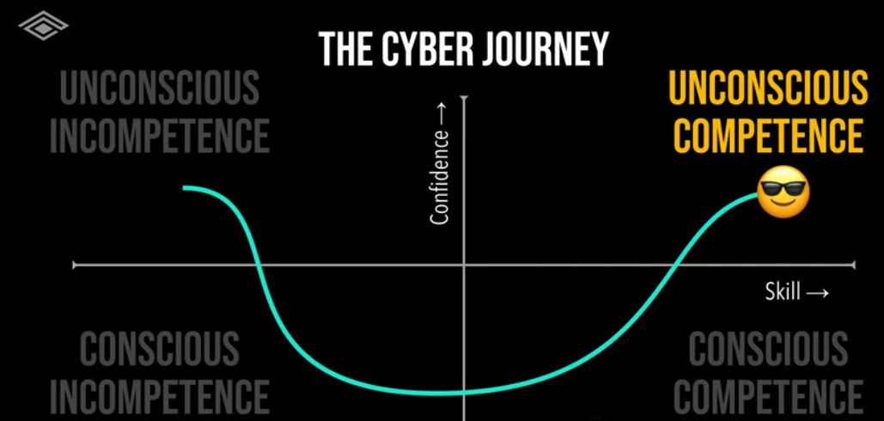

Slide 7
Thank You!
Any Queries?

