Slide 1
AI-Powered Intelligent
Incident Response System
IIRS — Automated Observability & Root Cause Analysis
Group 10
Team Project Presentation

Slide 2
Team Members
GY
VK
RK
AK
Gaurav Yadav
Vamsi Krishna Akavarapu
Rashmi KR
Avinash Kandimalla
DH
K
P
Dinesh Halaharvi
Krishna
Pavan
Indian Institute of Remote Sensing (IIRS) — Project Team

Slide 3
Agenda
01
Problem Statement
05
Technology Stack
Challenges in modern incident response
Tools, frameworks, and integrations
02
Objectives
06
Results
Live demo outputs — Case 1 & 2
03
System Architecture
07
Conclusion
Multi-agent design & data flow
Key takeaways and future scope
04
Workflow
End-to-end process walkthrough

Slide 4
Problem Statement
The Challenge
What IIRS Provides
1
Modern distributed applications generate overwhelming volumes of logs & telemetry data
Evidence-grounded
Every claim traceable to telemetry/knowledge
2
Manual analysis is time-consuming and error-prone — especially for L1 on-call engineers
Auditable
Reasoning traces + tool calls logged
3
Correlating alerts with logs, metrics, and traces requires fragmented tool-hopping
Safe by design
Read-only diagnostics by default
4
Delayed triage leads to longer downtime and higher risk of incorrect actions
Human-in-the-loop
Approvals required for impactful actions

Slide 5
Objectives
1
Collect telemetry data from applications.
2
Store logs, metrics, and traces in centralized systems.
3
Analyse logs using AI models.
4
Identify root causes of failures.
5
Provide suggested solutions for detected issues.
6
Visualize monitoring data through dashboards.
8

Slide 6
System Architecture
Retriever Agent
Evidence Collection
Analyst Agent
Root Cause Analysis
Gathers logs, metrics & traces from Loki, Prometheus & Tempo
Uses LLMs to analyze patterns & generate root cause explanations
Critic Agent
Validation & Safety
Planner Agent
Triage & Planning
Validates conclusions, checks evidence quality & flags gaps
Generates structured triage plan & executes read-only actions

Slide 7
Workflow
1
Application generates logs & telemetry data
2
OpenTelemetry collects logs, metrics & traces
3
Data stored in Loki (logs), Prometheus (metrics) & Tempo (traces)
4
Python backend fetches relevant telemetry on alert trigger
5
Telemetry converted into structured prompts
6
Prompts sent to the AI / LLM model for analysis
7
AI generates ranked root cause analysis with confidence scores
8
Results returned as structured Incident Brief to on-call engineer

Slide 8
Technology Stack
Programming Language
Python
Framework
FastAPI
Containerization
Docker
Logging
Loki
Metrics
Prometheus
Tracing
Tempo
Telemetry Collection
OpenTelemetry
AI Model
GPT-5 mini

Slide 9
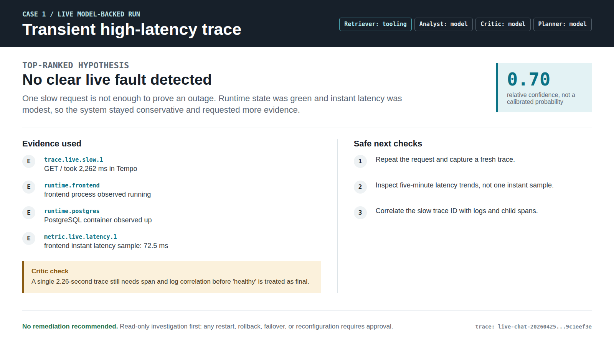
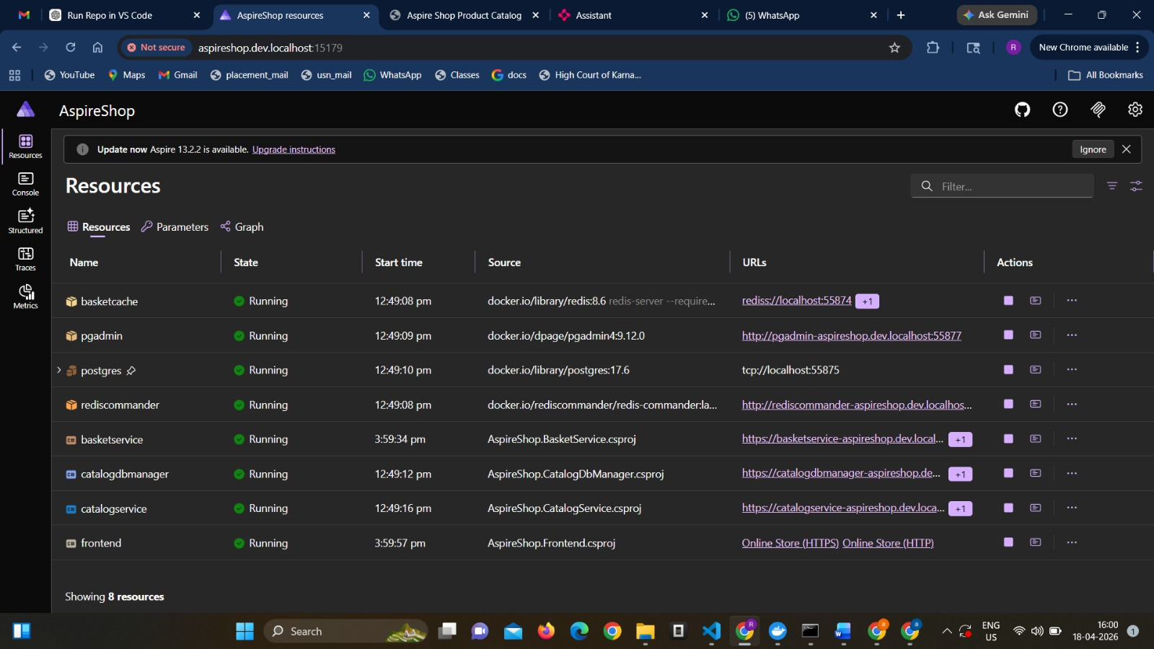
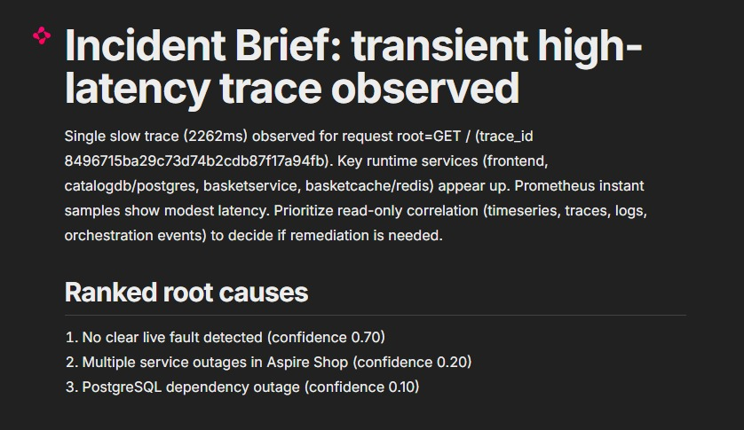
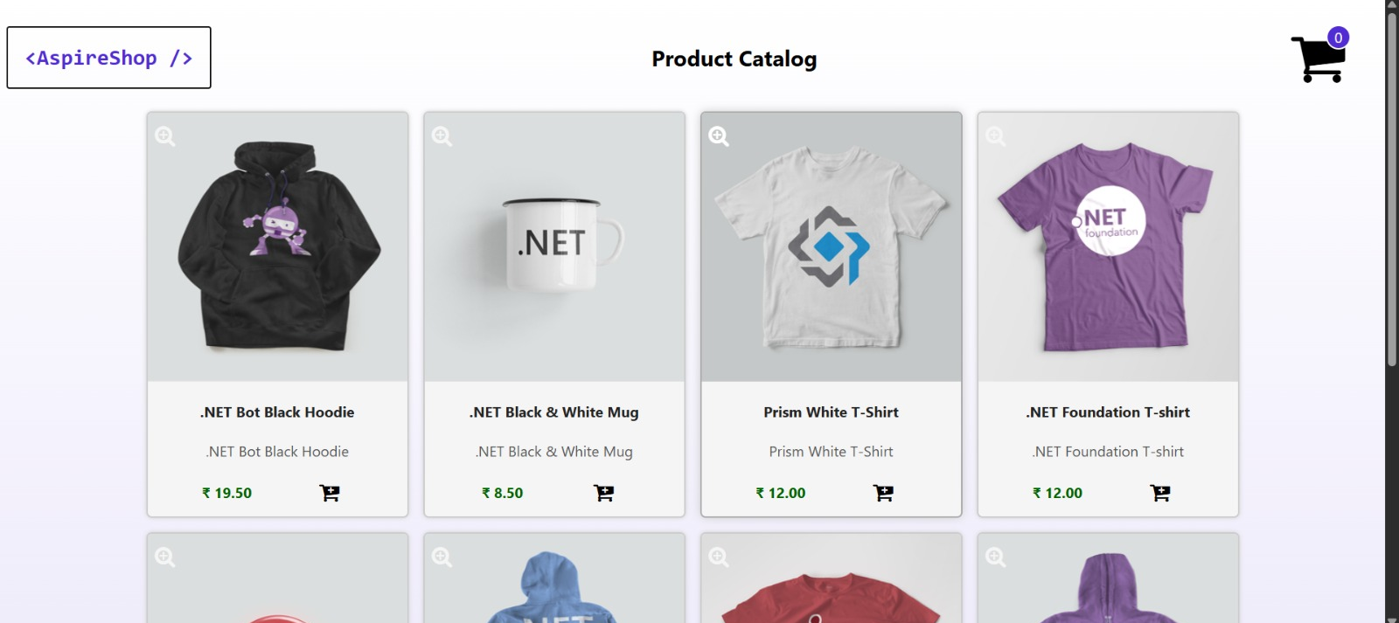
System Output — Case 1: Normal Operation
When everything is working fine
IIRS Incident Brief — Transient high-latency trace
AspireShop Product Catalog — Running normally
Result: No clear live fault detected (confidence 0.70) — System confirmed healthy, no remediation needed

Slide 10
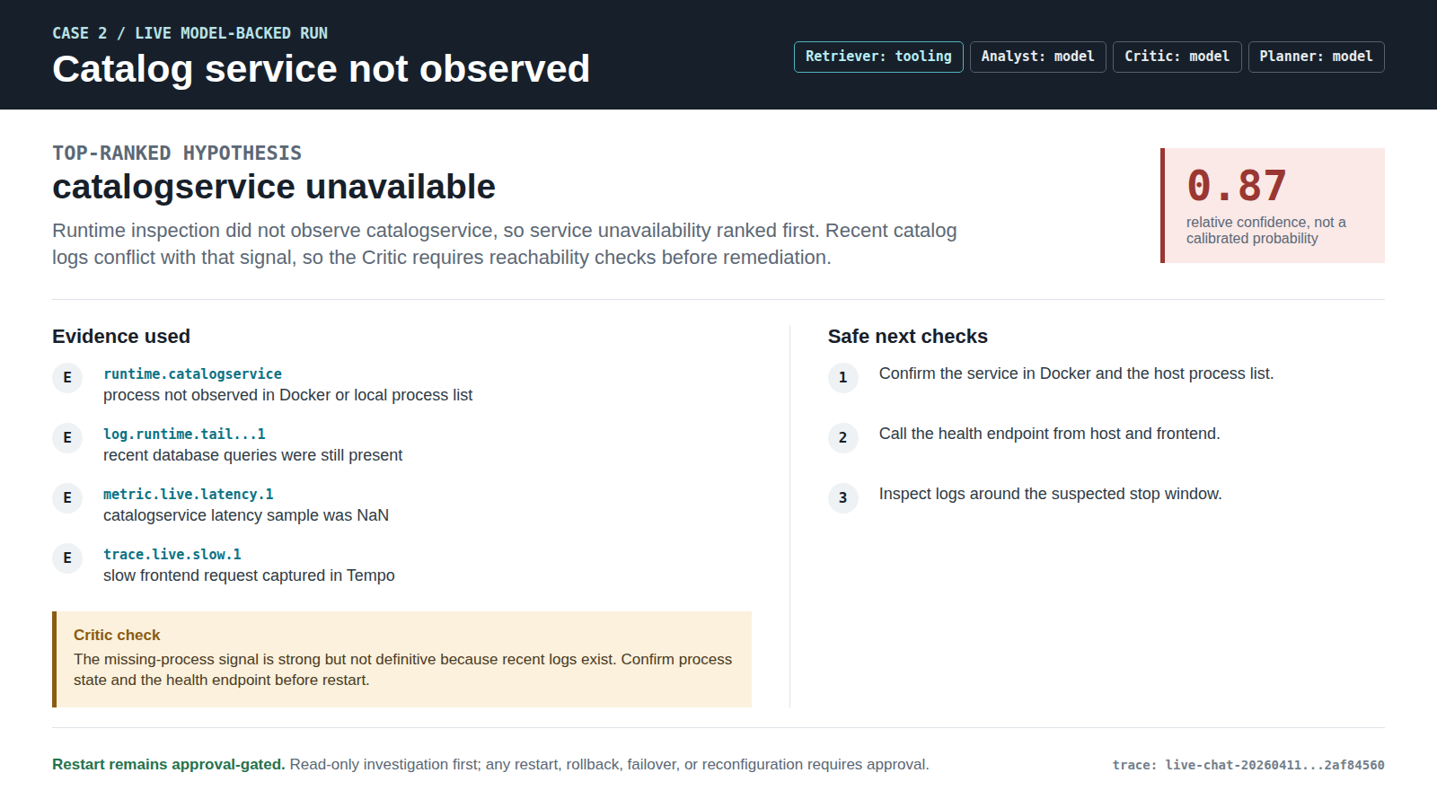
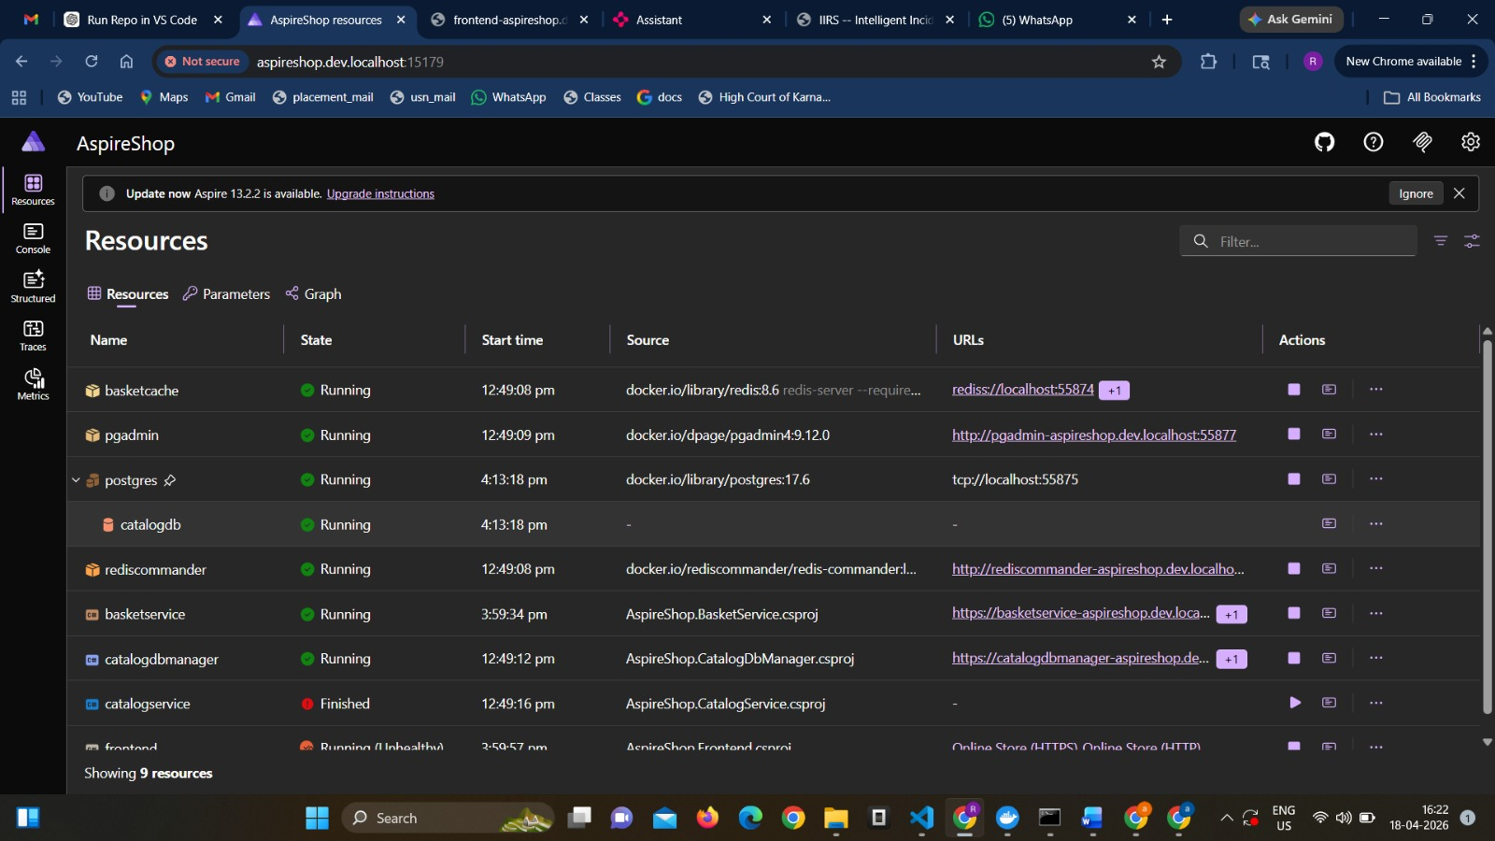
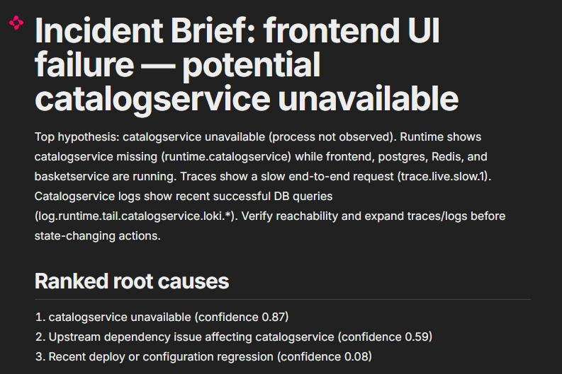
System Output — Case 2: Service Failure Detected
When catalog service is stopped
Before: All 8 services running (AspireShop)
After: catalogservice — Finished (stopped)
IIRS correctly identified: catalogservice unavailable (confidence 0.87)

Slide 11
Conclusion
Key Takeaways
Future Scope
Automates root cause detection via multi-agent AI architecture
Automated remediation with approval workflows
Reduces mean time to triage for on-call engineers
Integration with CI/CD for deployment-correlated RCA
Evidence-grounded reasoning ensures auditability and trust
Real-time alert scoring and incident priority ranking
Safe by design — read-only diagnostics, human approval for actions
Support for custom runbook ingestion & knowledge base
Demonstrates AI integration with modern observability stacks

