Slide 1
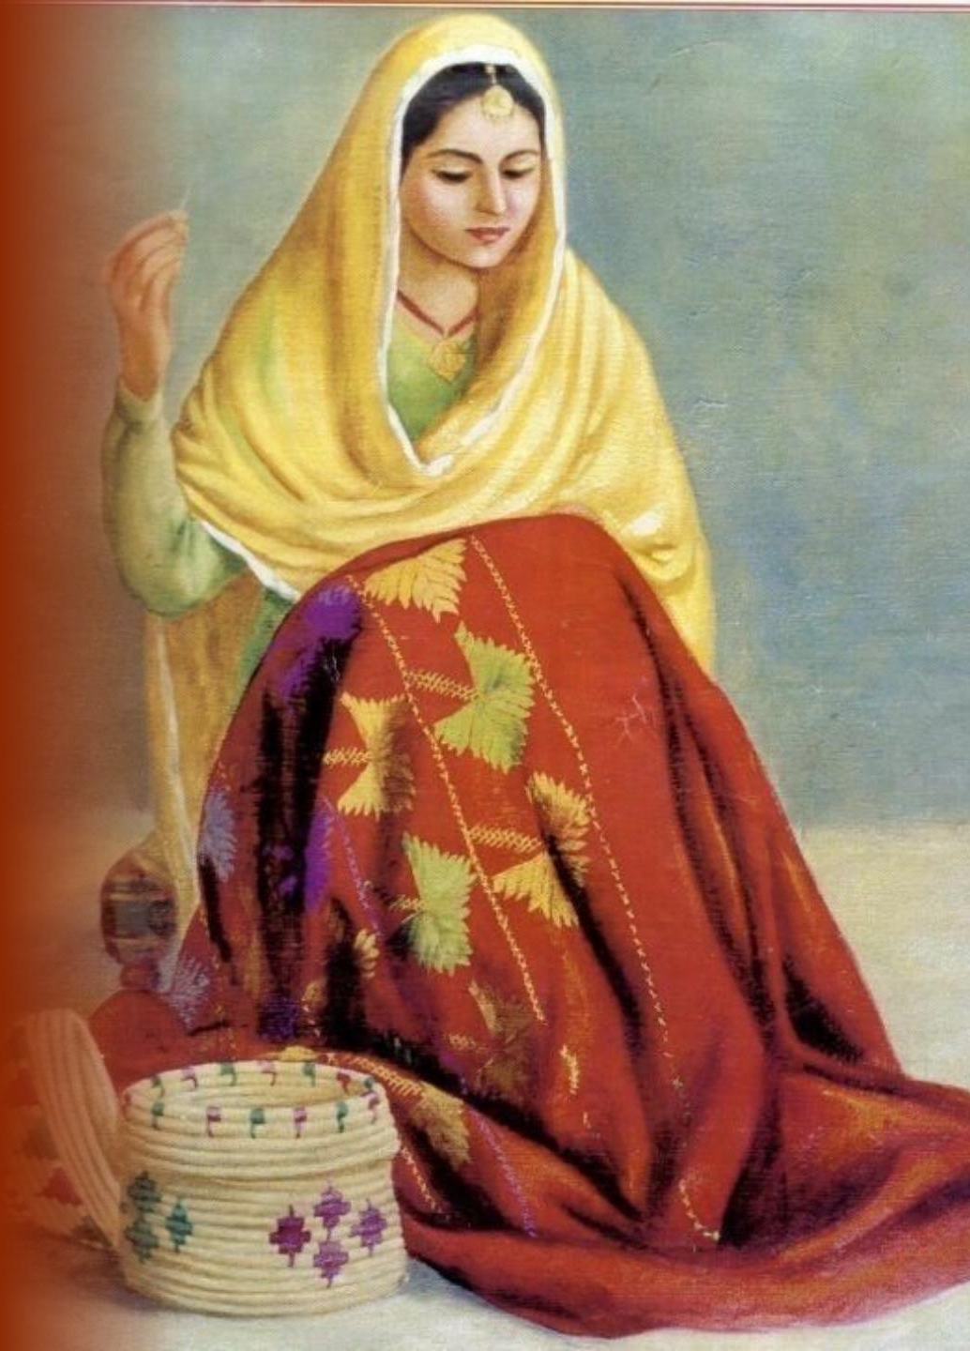
VENTURE VAULT • PUNJABI HANDLOOM REINVENTED
SUTRA KHES
Elevating Punjab's double-cloth geometric weaving into luxury home decor and a global heritage lifestyle brand, handwoven by master pit-loom artisans.
HERITAGE CRAFT VENTURE
Rooted in 90s Punjabi folklore, household warmth, and the timeless geometry of double-woven cloth.
Notes:
Open with the brand: Sutra Khes reinvents Punjab's double-cloth Khes weaving as modern luxury home decor and a global heritage lifestyle brand.
Set the tone: the imagery and palette draw on 90s Punjabi folklore, household warmth and the geometry of double-woven cloth.
Frame the ask: this is a Venture Vault pitch for a heritage craft venture that keeps master pit-loom artisans at its centre.

Slide 2
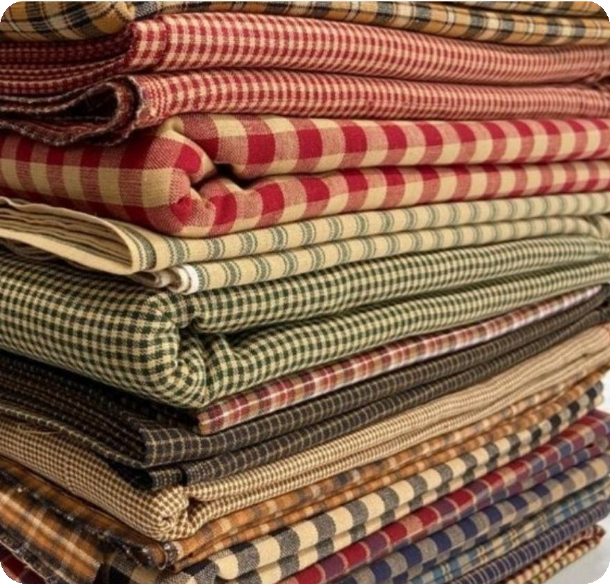
01. HERITAGE & ORIGIN
The Original Idea: What Was Traditional Khes?
Bridal Heirloom & Daaj
Traditionally woven by women on household pit-looms as an essential bridal dowry gift (daaj), each piece carrying ancestral blessings, family pride and good wishes into a new home.
Charkhana & Geometric Grids
Heavy-weight double-layer cotton checks (charkhana) and damask patterns woven as one cloth, giving complete double-sided reversible warmth and a bold geometric identity.
Sustainable Material Roots
Handspun 100% organic cotton yarn dyed with natural indigo, turmeric, and madder root, using a low-impact, zero-waste process rooted in village self-reliance.
Why it matters: Khes is far more than bedding. It is a women-led, sustainable textile tradition whose geometry, reversibility and natural materials already match what modern luxury buyers look for.
Notes:
Explain what traditional Khes is: a heavy double-layer cotton cloth woven by women on household pit-looms, traditionally gifted as part of a bride's daaj (dowry).
Point out the charkhana checks and damask patterns: the geometry is woven as one cloth, which makes the textile reversible and warm on both sides.
Stress the material roots: handspun organic cotton and natural dyes (indigo, turmeric, madder root) mean the original craft was already sustainable and low-waste.
Transition: the craft has everything luxury buyers want today, so why is it disappearing?

Slide 3
02. MARKET REALITY & CRISIS
The Problem Today: Why Khes Needs Reinvention
-85%
100%
ZERO
Dying Pit-Looms
Outdated Perception
Modern Formats
Cheap synthetic fleece and power-loom copies flooded markets, displacing rural master weavers and silencing their pit-looms.
Younger buyers see Khes as heavy rural bedding rather than a luxury collectible accent, so its design value goes unrecognised.
No lightweight apartment-friendly throws, structured apparel or contemporary upholstery exist to bring Khes into modern homes.
The opportunity: The very qualities that made Khes obsolete in rural markets (heavy, handmade, reversible) become premium attributes once the cloth is redesigned into lighter, contemporary formats for urban and international buyers.
Notes:
Walk through the three problems left to right. The -85% pit-loom decline, 100% outdated perception and ZERO modern formats are the figures already on the slide.
Dying pit-looms: cheap synthetic fleece and power-loom imitations displaced rural master weavers and made the real craft uneconomical.
Outdated perception: younger buyers see Khes as heavy rural bedding, not a luxury collectible, so its design value goes unrecognised.
No modern formats: there are no lightweight, apartment-friendly throws, structured apparel or contemporary upholstery. Close on the opportunity box: the same qualities become premium once redesigned.

Slide 4
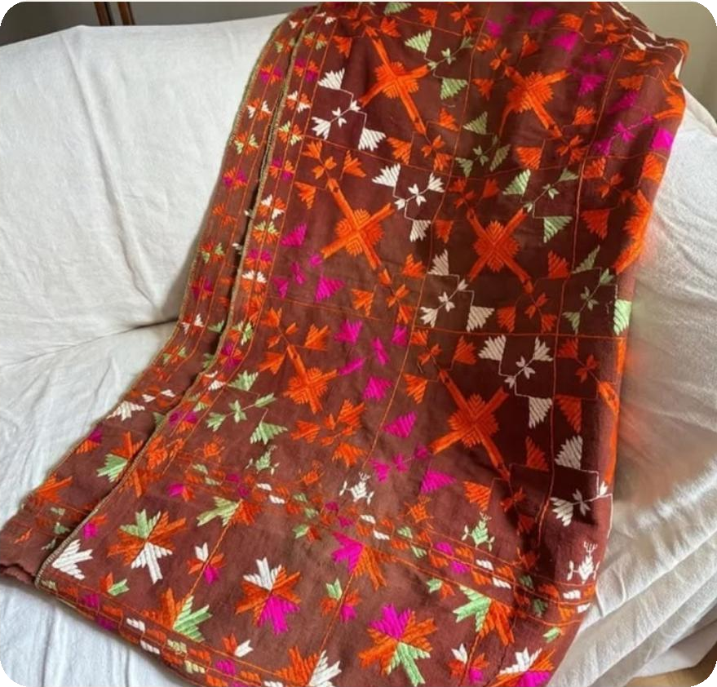
03. THE SOLUTION & INNOVATION
Sutra Khes: Redesigned Product & Future Potential
1
Luxury Home Decor Line
Modern couch throws, reversible bed runners, and geometric cushion covers tailored for minimalist global interiors, bringing double-cloth warmth to lightweight, apartment-friendly living.
2
Wearable Heritage Apparel
Unisex tailored jackets, capes, winter wraps, and structured tote bags that carry the double-cloth geometry from the home into everyday and runway-ready fashion.
3
Future Global Scalability
Expanding into eco-certified luxury hotel upholstery, Maison & Objet exhibitions, and international fashion runways to build a global heritage lifestyle brand.
From heirloom to brand: Begin with home decor to build recognition, extend into apparel and accessories for wider reach, then scale into hospitality upholstery and global design platforms.
Notes:
Present the solution as three steps of growth, matching the numbered circles.
1. Luxury home decor: couch throws, reversible bed runners and cushion covers for minimalist interiors. This is the entry product line.
2. Wearable heritage apparel: unisex jackets, capes, winter wraps and structured totes, extending the double-cloth geometry into fashion.
3. Future global scalability: eco-certified hotel upholstery, Maison & Objet exhibitions and international runways. Frame this as the long-term upside, not the launch plan.

Slide 5
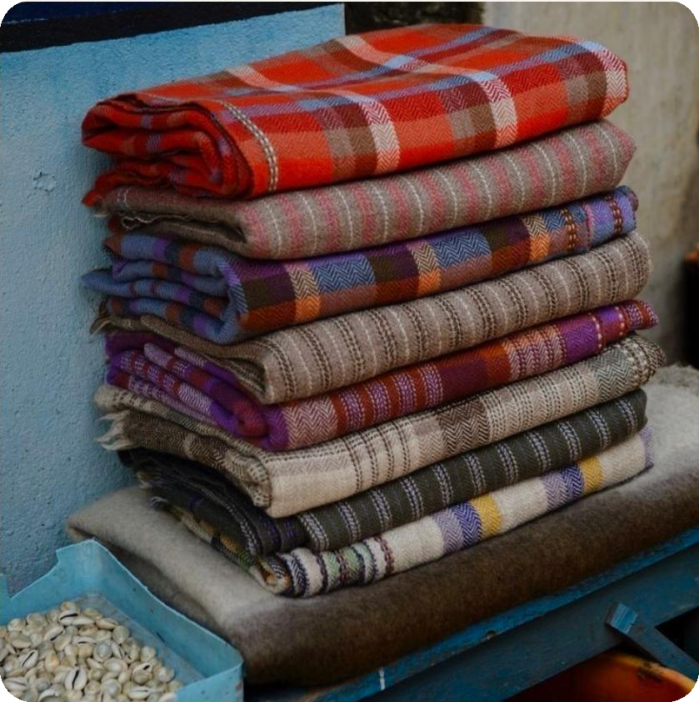
04. MARKET SEGMENTATION
Target Market Breakdown
PRIMARY HIGH-MARGIN SEGMENT
NRI & Punjabi Diaspora
High-income diaspora families in Canada, UK, US, and Australia seeking authentic, nostalgic heritage textiles that connect their homes to Punjab.
HIGH LTV REPEAT BUYERS
Ethical Luxury Shoppers
Urban design enthusiasts, architects, and conscious buyers valuing handloom authenticity, zero synthetics, and a traceable story behind every piece.
BULK VOLUME CONTRACTS
Boutique Resorts & B2B
Heritage hotels, eco-resorts, and interior design firms requiring custom woven throws, drapes, and cushion sets supplied in bulk on repeat contracts.
Go-to-market logic: Diaspora buyers deliver the highest margin through D2C, ethical shoppers drive repeat purchases, and B2B contracts add bulk volume and brand visibility.
Notes:
Introduce three segments in order of their role: margin, loyalty and volume.
NRI and Punjabi diaspora in Canada, UK, US and Australia: the primary high-margin segment, buying nostalgia and authentic heritage.
Ethical luxury shoppers: designers, architects and conscious buyers who value handloom authenticity and no synthetics; high lifetime value and repeat purchase.
Boutique resorts and B2B: heritage hotels, eco-resorts and design firms ordering custom throws, drapes and cushion sets in bulk.
Link forward: these segments map directly to the D2C, wholesale and hospitality channels on the financial slide.

Slide 6




05. COMPETITIVE ADVANTAGE
USP & Competitive Edge
100% Reversible Weave
100% Organic & Natural Dyes
Dual-faced double-cloth weave offering two distinct colorways in one single product, doubling utility and letting buyers restyle a room by simply flipping the piece.
Zero synthetic chemicals; colored exclusively with herbal indigo, madder root red, and turmeric yellow, safe for skin, soil, and the village water supply.
3x Fair Weaver Wages
Artisan Traceability QR
Direct cluster sourcing eliminates middle-tier brokers, paying master pit-loom artisans 3× the market average (≈ ₹810/day vs ₹270/day) for dignified, steady work.
Every product includes a scannable tag linking to the specific weaver profile, village cluster, and loom location, so buyers see exactly who made it.
Why it is hard to copy: Authentic craft, chemical-free colour, fair pay and full traceability give buyers a story that power-loom imitations cannot match.
Notes:
Four competitive edges, each with a proof point.
100% reversible weave: two colorways in one product, so one purchase does the work of two.
100% organic and natural dyes: herbal indigo, madder root red and turmeric yellow, with zero synthetic chemicals.
3x fair weaver wages: direct cluster sourcing removes brokers; artisans earn about Rs 810 per day versus Rs 270 market average.
Artisan traceability QR: every product links to the weaver profile, village cluster and loom location. Together these make the brand hard to imitate.

Slide 7
06. BUSINESS & FINANCIAL MODEL
Revenue Streams & Marginal Profitability
68%
42%
2.8×
D2C E-Commerce
Retail Wholesale
B2B Hospitality
60% Revenue Share
25% Revenue Share
15% Share • High LTV/CAC
High-margin online channel reaching the global diaspora and design lovers via our own Shopify storefront.
Boutique handicraft stores, luxury multi-brand galleries, and airport pop-ups that build visibility and trust.
Bulk custom supply contracts for luxury eco-resorts, boutique hotels, and design studios, with repeat orders.
Marginal Profit by Channel
Artisan Wages
Channel | Revenue Share | Margin | Contribution
D2C E-Commerce | 60% | 68% | 40.8%
Retail Wholesale | 25% | 42% | 10.5%
Blended margin | 85% | 60.4% | 51.3%
₹270
per day
market average
₹810
per day
Sutra Khes master artisan (3×)
+₹540 per day above market average
Fair, steady income to keep pit-looms alive.
Contribution = revenue share × margin. Benchmarks: branded D2C handicraft margin 60–70%; wholesale markup 1.5–2× (≈33–50% margin).
Sources: Crafts Council of India & Institute for Human Development, Economics of Indian Craft (2026); EPCH, Building Your Brand; Shriram Finance.
Notes:
Walk the three revenue streams: D2C e-commerce (60% of revenue, 68% margin), retail wholesale (25% share, 42% margin) and B2B hospitality (15% share, high LTV/CAC).
Use the table to show contribution = revenue share x margin: D2C contributes 40.8% and wholesale 10.5%, giving a blended 60.4% margin across the 85% of revenue shown.
Highlight the wages card: Rs 810 per day versus the Rs 270 market average, a Rs 540 per day premium, shows that profitability and fair pay go together.
Cite the benchmarks and sources in the footer if questioned: branded D2C handicraft margins of 60-70% and wholesale markups of 1.5-2x.

Slide 8
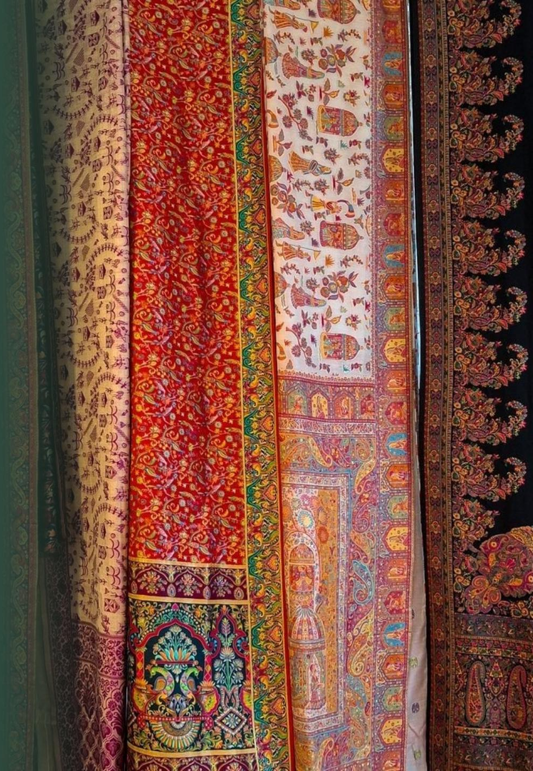
VENTURE VAULT 2026
Let’s Weave the Future of Punjab’s Heritage Together.
Preserving pit-loom craftsmanship while delivering sustainable luxury to global households and fair livelihoods to weavers.
Thank You & Questions!
Sutra Khes • Geometric Luxury Handlooms • Heritage, Reinvented
Notes:
Close by restating the mission: preserve pit-loom craftsmanship while delivering sustainable luxury to global households and fair livelihoods to weavers.
Recap the three proof points: a heritage product with real market fit, a defensible edge (reversible, natural, fair, traceable) and a margin-positive channel mix.
Invite questions and discussion.

