Slide 1

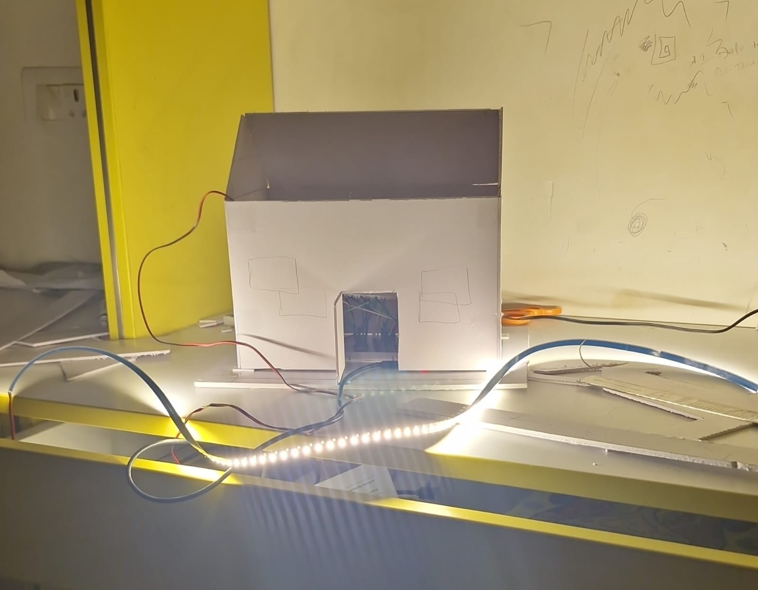
HackFusion 2k26
Intelligent Light Intensity
Measurement System
with Auto-Calibration Using Machine Learning
[ Prototype
Photo
(small) ]
Team [LuxSense] Members [Gaurav Yadav] | [Radheshyam E.P] Dept / College [SRM INSTITUTE OF SCIENCE AND TECHNOLOGY, TIRUCHIRAPPALLI, TAMIL NADU / DEPARTMENT OF ELECTRONICS AND COMMUNICATION ENGINNEERING WITH SPECIALIZATION IN DATA SCIENCE]
Mentor of the Project [Dr. A.N. Gnana Jeevan]
Designation/ Department [Assistant Professor, School of Computing, SRM INSTITUTE OF SCIENCE AND TECHNOLOGY, TIRUCHIRAPPALLI]
ESP32 • LDR • TSL2561 • BH1750 • DHT22 • Machine Learning • Smart Home Automation
Notes:
Good morning everyone. Our project is an intelligent light intensity measurement system with auto-calibration using machine learning. The goal of this project is to improve the reliability of low-cost light sensing and use it in a practical smart home lighting prototype.

Slide 2

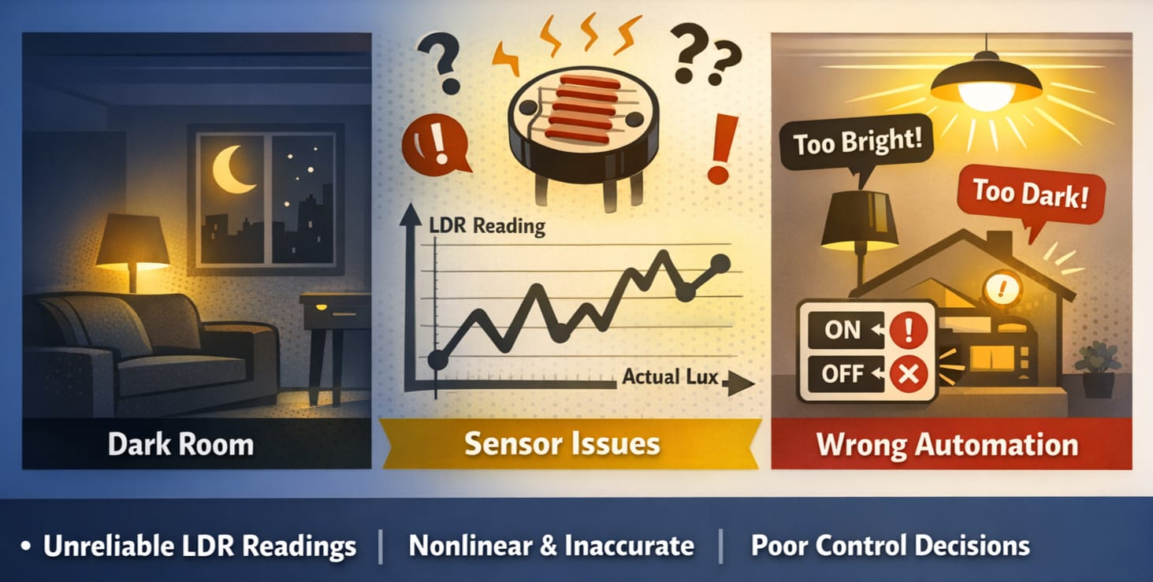
Problem Statement
Accurate light measurement is critical for indoor automation and energy-efficient lighting
[ Image:
Dark Room /
Light Automation /
Sensor Problem
Illustration ]
Low-cost sensors like LDR are affordable — but not reliable enough for real use
Raw LDR values are nonlinear and do not directly represent lux
Direct automation using raw sensor values leads to poor and unpredictable control decisions
Notes:
The problem is that low-cost light sensors like LDRs are easy to use, but their readings are nonlinear and unreliable for accurate lux measurement. Because of this, direct light control using raw values is not dependable.

Slide 3

Existing Drawbacks
Traditional LDR-based systems use raw analog values directly
Current System Flow
Raw LDR Value
Raw readings vary with environment and sensor aging / drift
No Calibration
No proper calibration means poor and inconsistent accuracy
Direct Decision Logic
Wrong measurements trigger incorrect lighting ON/OFF decisions
❌ Incorrect Output
Basic systems are low-cost, but not intelligent or reliable
Notes:
In existing systems, raw LDR values are used directly for automation. That is the weakness. Since the values are not calibrated, the system may make incorrect decisions and reduce reliability.

Slide 4
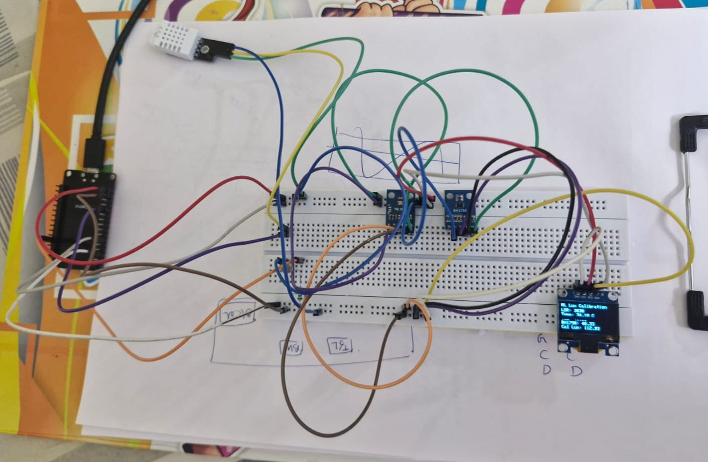
Proposed Solution / Innovation
Primary Sensor
LDR — Low-cost, widely available light sensor
[ Component Photo:
LDR, TSL2561,
BH1750, DHT22,
ESP32 together ]
Reference Sensor
TSL2561 — Accurate lux reference during ML training
Validation Sensor
BH1750 — Secondary validation and cross-check
Env. Monitor
DHT22 — Temperature input for model accuracy
ML Calibration
Regression model predicts calibrated lux from raw data
Auto Light Control
Calibrated lux drives automatic LED ON / OFF logic
Notes:
Our solution is to calibrate the low-cost LDR using machine learning. We use TSL2561 as the reference sensor during training, BH1750 for validation, and DHT22 for temperature monitoring. Instead of using raw LDR values, we predict calibrated lux and use that for control.

Slide 5

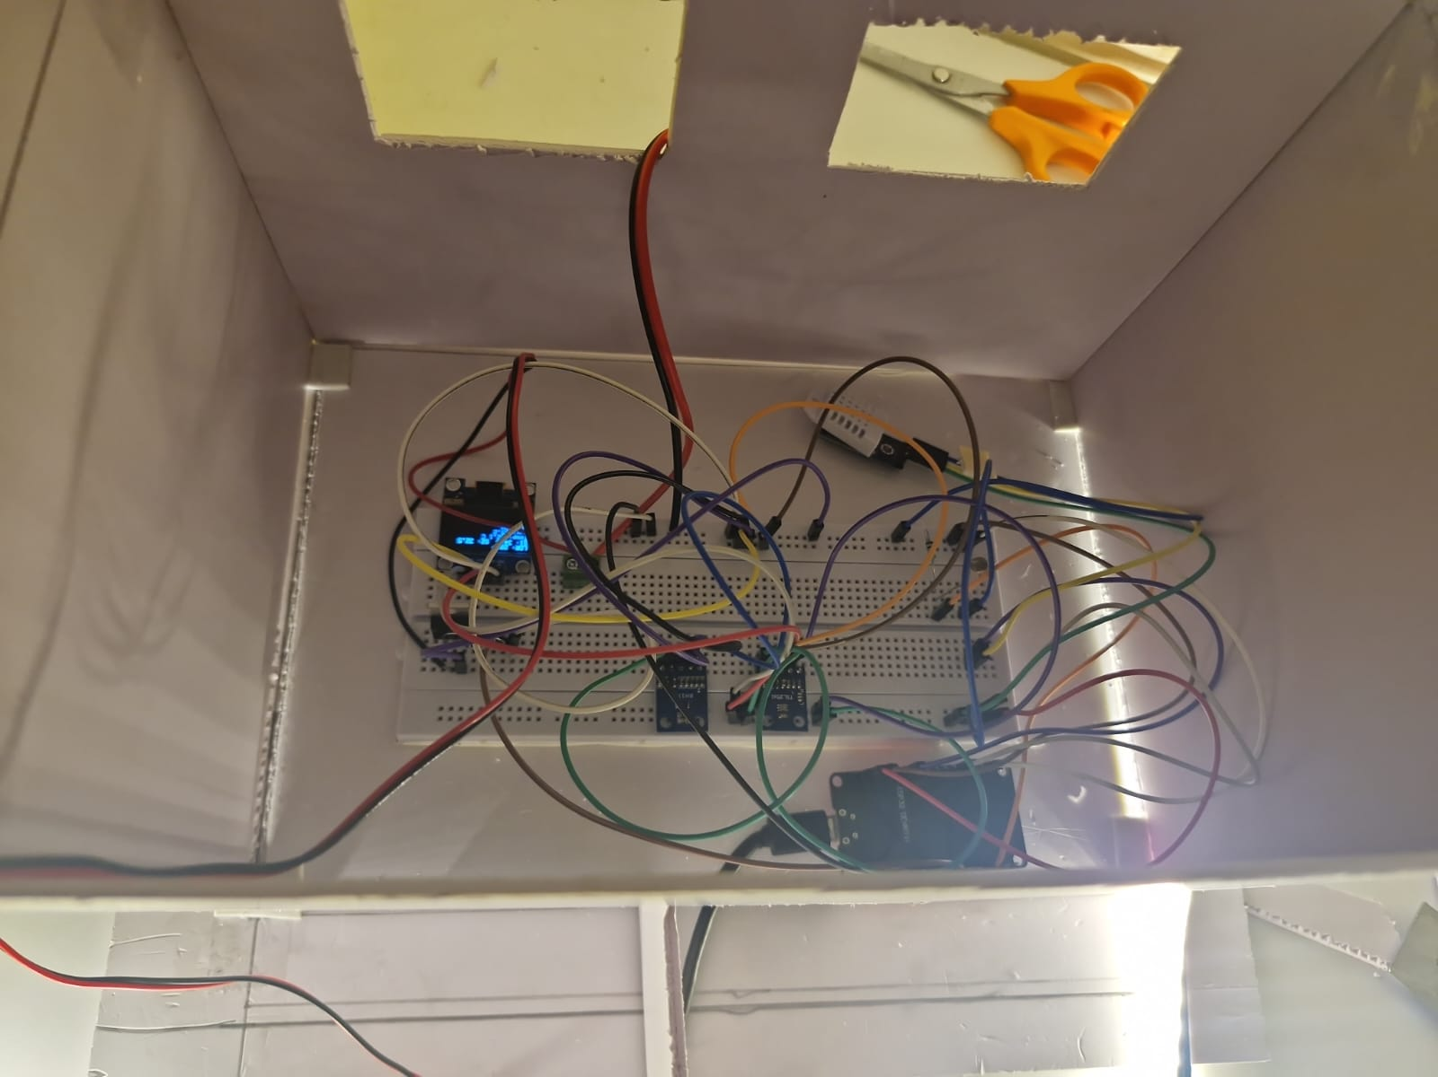
Hardware and Software Used
⚙ Hardware
💻 Software
[ Hardware Setup
Photo or
Component Layout ]
ESP32 — Main microcontroller
Arduino IDE
LDR — Primary light sensor
Python 3
TSL2561 — Reference lux sensor
BH1750 — Validation sensor
Regression ML Model
DHT22 — Temperature sensor
Dataset Preprocessing
OLED Display — Real-time output
Data Analysis Tools
LED Strip — Controlled lighting
MOSFET Driver — PWM switching
House Model — Demo prototype
Notes:
This slide shows the hardware and software stack. ESP32 is the main controller. The sensors provide measurement and validation, OLED shows real-time values, and the MOSFET controls the LED strip. Python was used for dataset handling and model development.

Slide 6

System Architecture
Sensors
LDR · TSL2561
BH1750 · DHT22
ESP32
Controller
Calibration
ML Model
Calibrated
Lux Value
Threshold
Decision
MOSFET
Driver
LED
Control
OLED Display
(Real-time values)
Sensor data is collected in real time from all four sensors
Calibration ML model estimates corrected lux from raw input values
Calibrated lux is compared to a threshold to trigger automatic LED ON / OFF
Notes:
The system starts with sensor data collection. ESP32 reads all sensor values, then uses the calibration logic to estimate calibrated lux. This value is displayed and compared with a threshold. Based on the result, the MOSFET turns the LED ON or OFF.

Slide 7

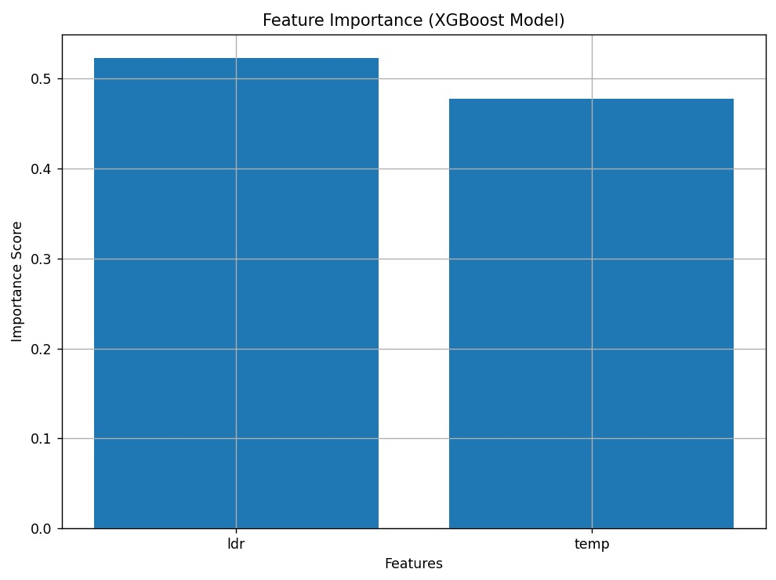
Dataset Generation and ML Calibration
Parameters
Time · LDR · Temperature · TSL2561 (lux) · BH1750 (lux)
Feature Importance — XGBoost Model
Collection
Recorded under varied indoor lighting conditions
ML Target
TSL2561 lux used as reference target for training
Validation
BH1750 used for cross-comparison and validation
Model
Regression model trained to predict calibrated lux from raw inputs
Notes:
We generated a dataset by recording LDR, temperature, TSL2561, and BH1750 values under different indoor lighting conditions. TSL2561 was used as the reference target for the machine learning model, and the model learned to predict calibrated lux from raw sensor inputs.

Slide 8

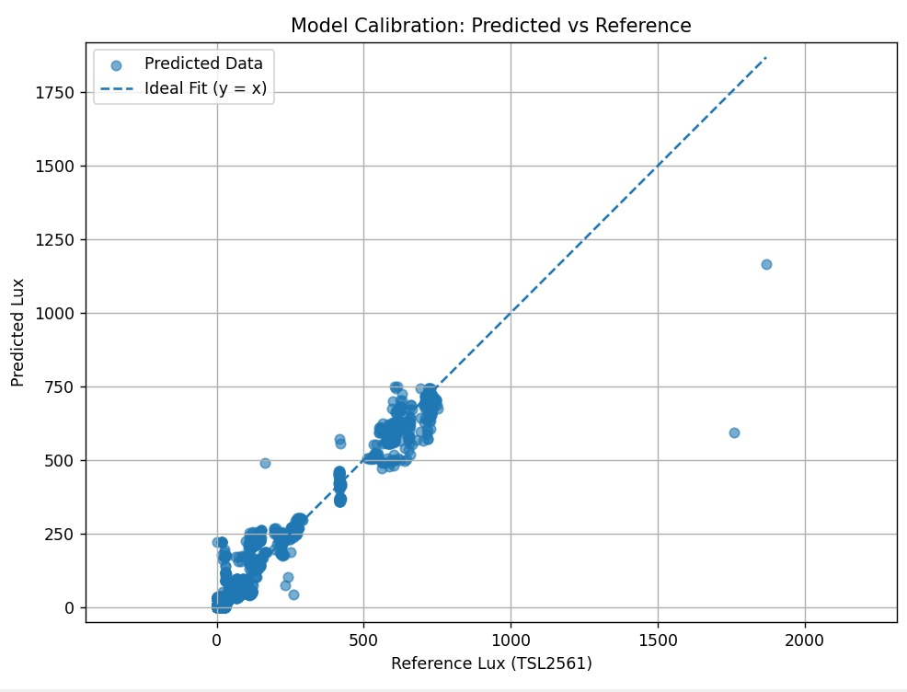
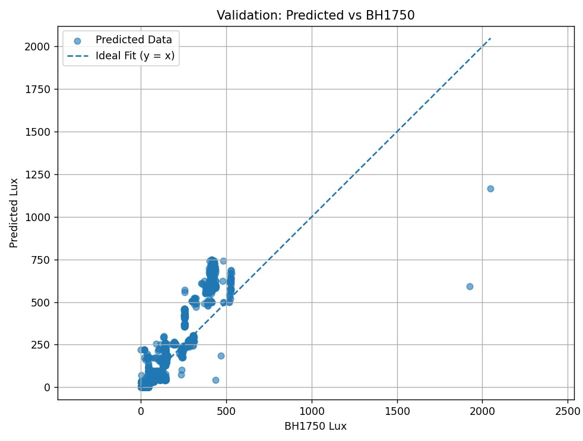
Results and Performance
Real-time sensor values displayed on OLED successfully
Predicted vs Reference (TSL2561)
Validation vs BH1750
Calibrated lux predicted accurately from raw sensor input
LED turns ON in low light, OFF when brightness is sufficient
Improved reliability compared to direct raw LDR control
Prototype tested and validated in indoor smart home setup
4
XGB
RT
Sensors
ML Model
Prediction
Notes:
These results show that the system was able to predict calibrated lux from raw inputs and use it for lighting control. The comparison graph is important because it shows that calibrated output is more meaningful than direct raw sensor readings.

Slide 9
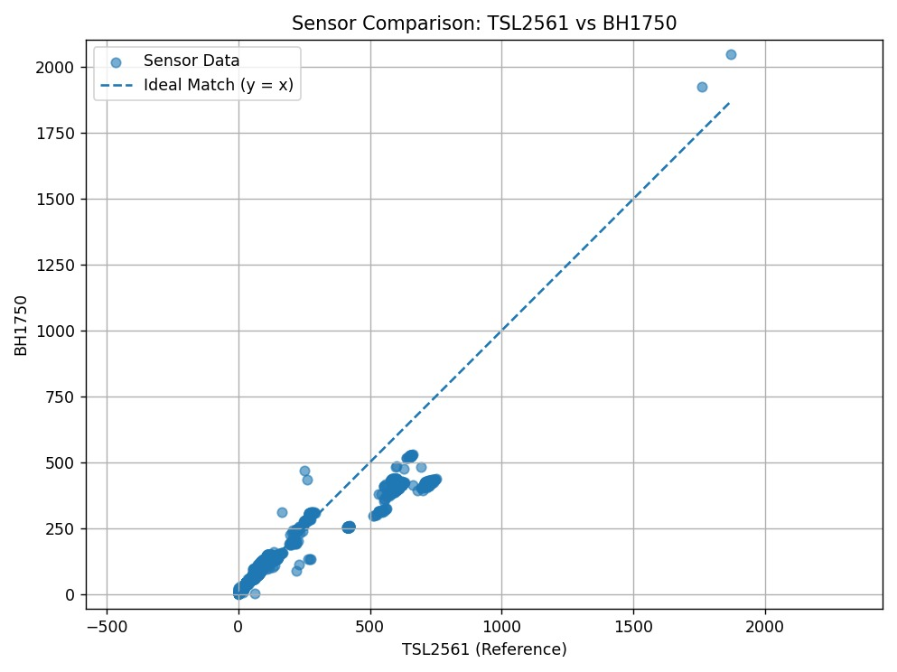
Comparison / Validation
Raw LDR is noisy and nonlinear
Sensor Comparison: TSL2561 vs BH1750
Calibrated output closely follows TSL2561 reference
BH1750 confirms accuracy of calibrated lux
ML model significantly reduces measurement error
Raw LDR (uncalibrated)
TSL2561 Reference Lux
Calibrated Lux (ML Output)
BH1750 Validation
Notes:
This comparison graph is the most important visual proof of the project. It shows that the calibrated lux output closely matches the accurate TSL2561 reference, while raw LDR is unreliable and noisy. This validates the ML calibration approach.

Slide 10

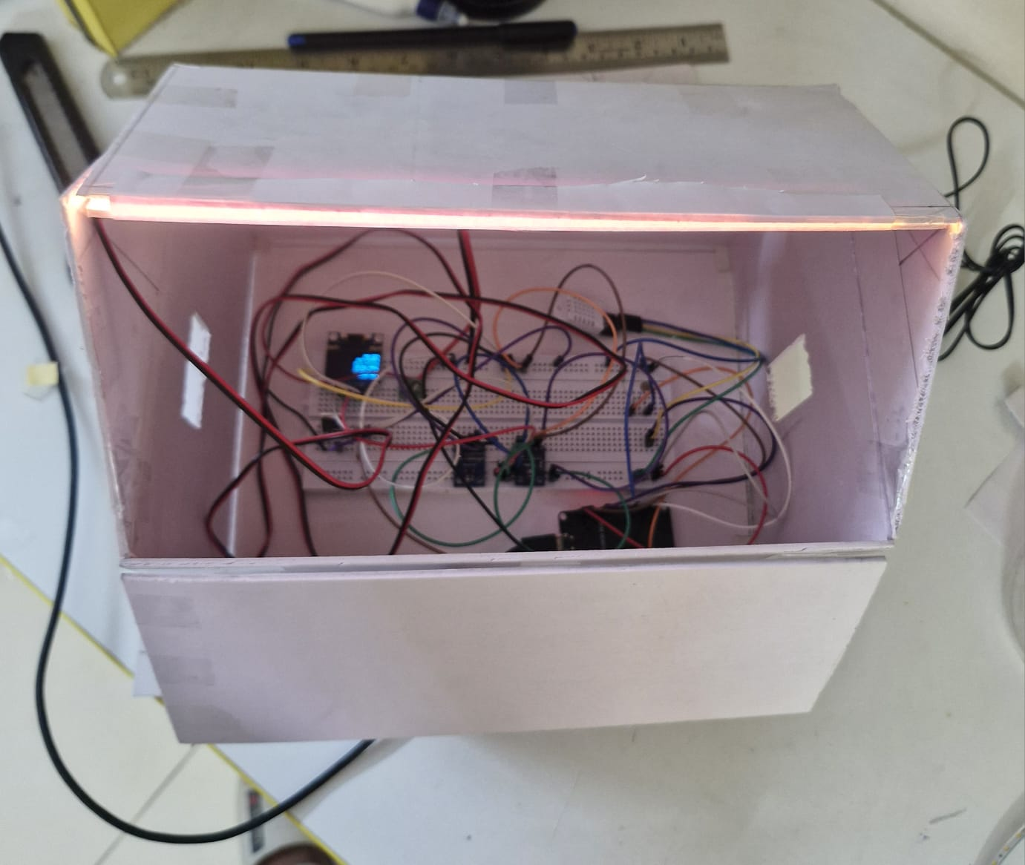
Smart Home Demo • Applications • Future Scope
Smart Home Demo
Future Scope
[ House Model Photo
or
LED ON / OFF Demo
or
Full Prototype Inside
House Model ]
House model built for indoor demo
IoT dashboard integration
Monitors indoor light in real time
Multi-room automation
LED ON when calibrated lux is low
Dimming / PWM control
LED OFF when brightness is sufficient
Street lighting extension
Applications
Edge ML deployment
Smart home lighting systems
Automatic room light control
Energy-efficient indoor setups
Building automation
Notes:
To make the project application-oriented, we built a house model and demonstrated automatic lighting control in an indoor environment. This shows how calibrated light sensing can be used in smart home lighting. In future, the same concept can be extended to IoT systems, multi-room setups, and larger lighting applications.

Slide 11

Conclusion
Intelligent Light Intensity
Measurement System
with Auto-Calibration Using Machine Learning
Developed an ESP32-based intelligent light measurement system
Improved low-cost LDR reliability using ML calibration
Used TSL2561 as reference sensor, BH1750 for validation
Predicted calibrated lux in real time on the device
Demonstrated automatic lighting control in a house model
Proved low-cost intelligent indoor automation is practical
Notes:
In conclusion, our project improves the usefulness of a low-cost LDR sensor through machine learning-based calibration. It predicts calibrated lux in real time and uses it for automatic light control. The smart house prototype demonstrates that this approach is practical for indoor automation.

