Slide 1
HEALTH OF THE TRANSFORMER

Slide 2
PROBLEM IDENTIFICATION
For a better economy or development of the nation ,one of the major factor is Electricity.
There has been a lot of innovations and development in the field of electricity generation and distribution.
Even most parts of nation don’t have any issues with the generation and the distribution of the Electricity.
But there is a gap in the maintenance of the distribution stations .
So,we want to take a small and important section of distribution i.e Transformer. There are a lot of issues with the Transformers.
such as Tripping, malfunction due to over heating , decrease in the level of the oil and excess voltage load.

Slide 3
EXISTING SOLUTIONS
Usage of mechanical breaker system. Which trips when the incoming voltage is high.
No location of the damaged transformer.(unless Information from the surrounding people).
No monitoring of the parametrs.

Slide 4
OUR IDEA
The basic idea of the project is to monitor the health of the transformer.
The health in the context of transformer gives us the parameters such as Temperature , load on the transformer, oil level .
These parameters define the age of the transformer. Mostly, the transformer malfunctions due to variations in above parameters.
So, our idea is to monitor these parameters continuously using the sensors , gather the data and display them using a web page and a mobile application with a complete functionality consisting of alerts for a malfunction of a transformer and the location of transformer using a gps interface.

Slide 5
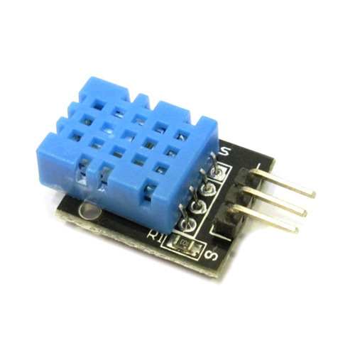
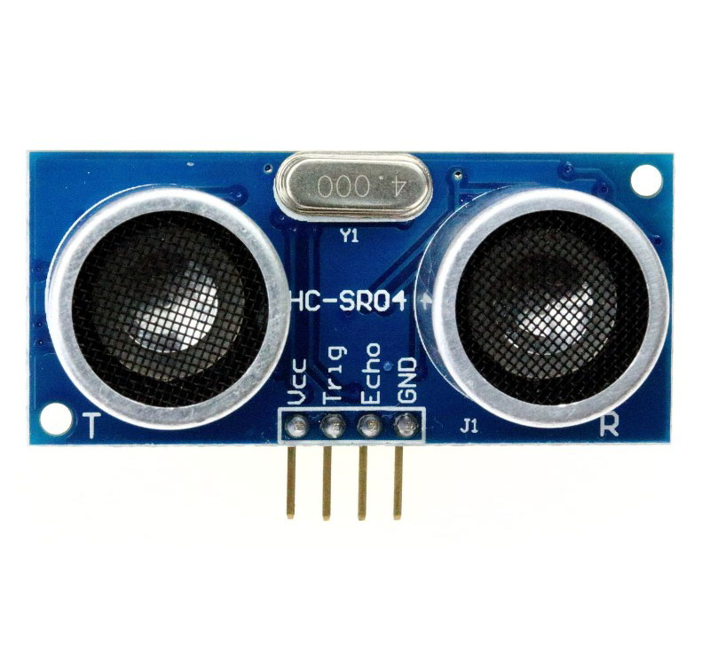
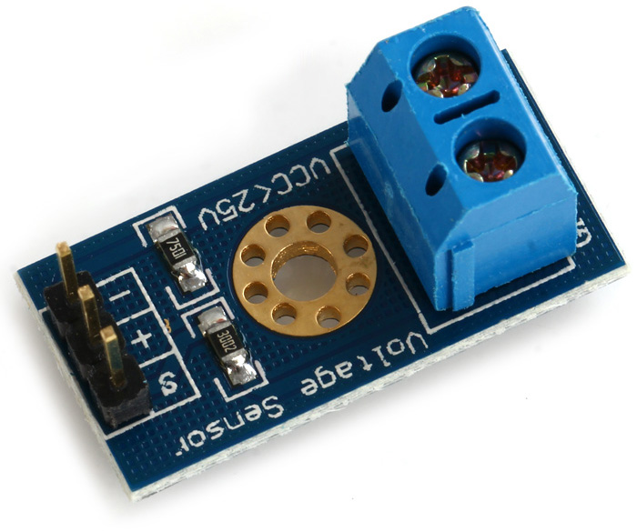
SENSORS
A device which detects or measures a physical property and records it.

Slide 6
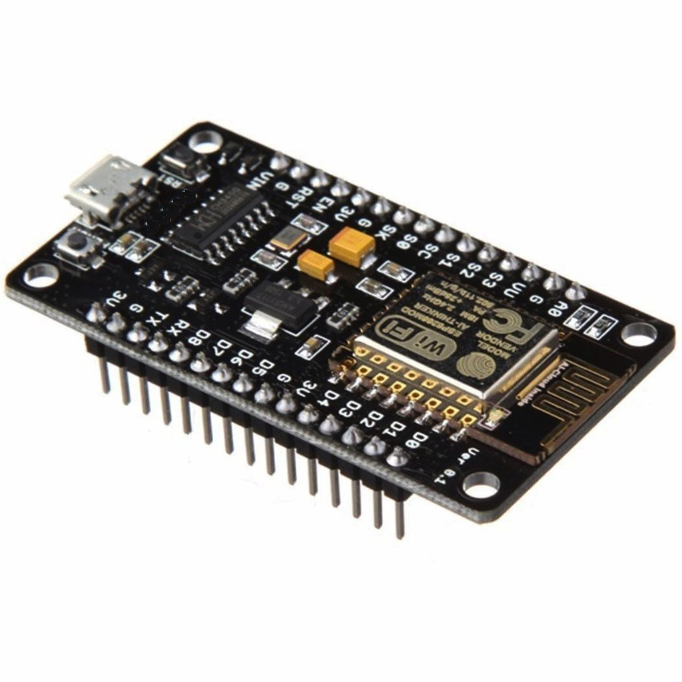
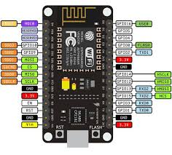
Controller
A device which controls and processes the given input data and produces a desired output.
For our idea we are using node mcu(esp8266 module).

Slide 7
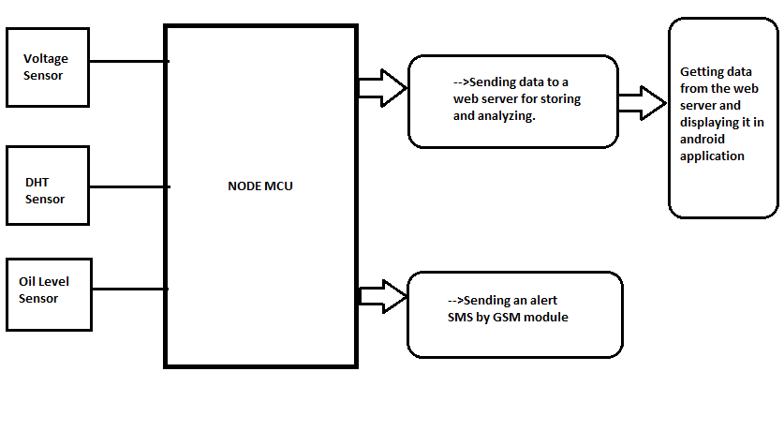
Overview

Slide 8
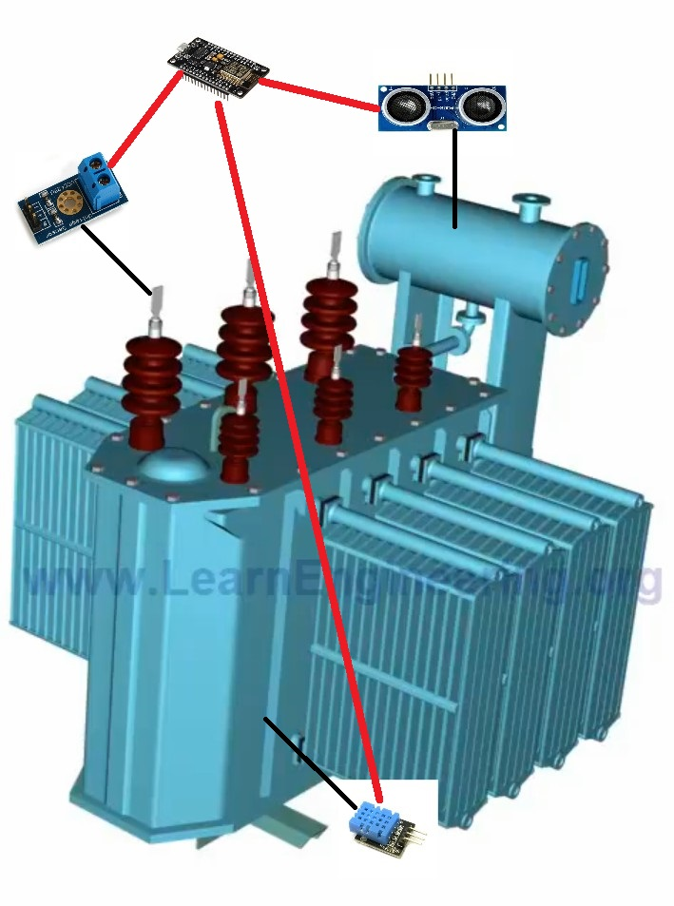
Interfacing the sensors, controller to the transformer

Slide 9
EXECUTION OF THE PROJECT IN DEPARTMENT
Dashboard at the substation.(To monitor the parameters)
Any major variations in the parameters give an alert message to the supervisor and Field worker along with the location.
This allows the authorities to predict the health based on the parameter changes .
Avoid the unnecessary catastrophe.
Reduces the loss of investment/damage charges.

Slide 10
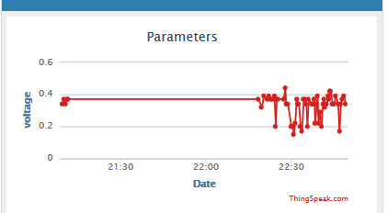
Live Data Analysis. Voltage(Incoming)

Slide 11
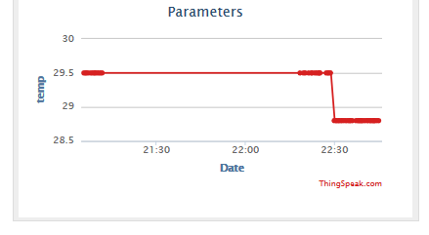
Temperature

Slide 12
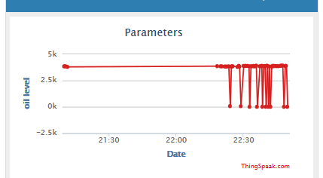
Oil Level Indication

Slide 13
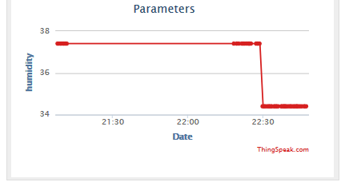
Humidity

Slide 14
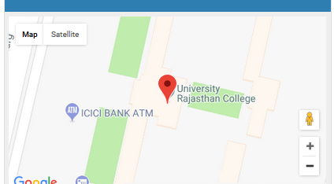
GEOLOCATION

Slide 15
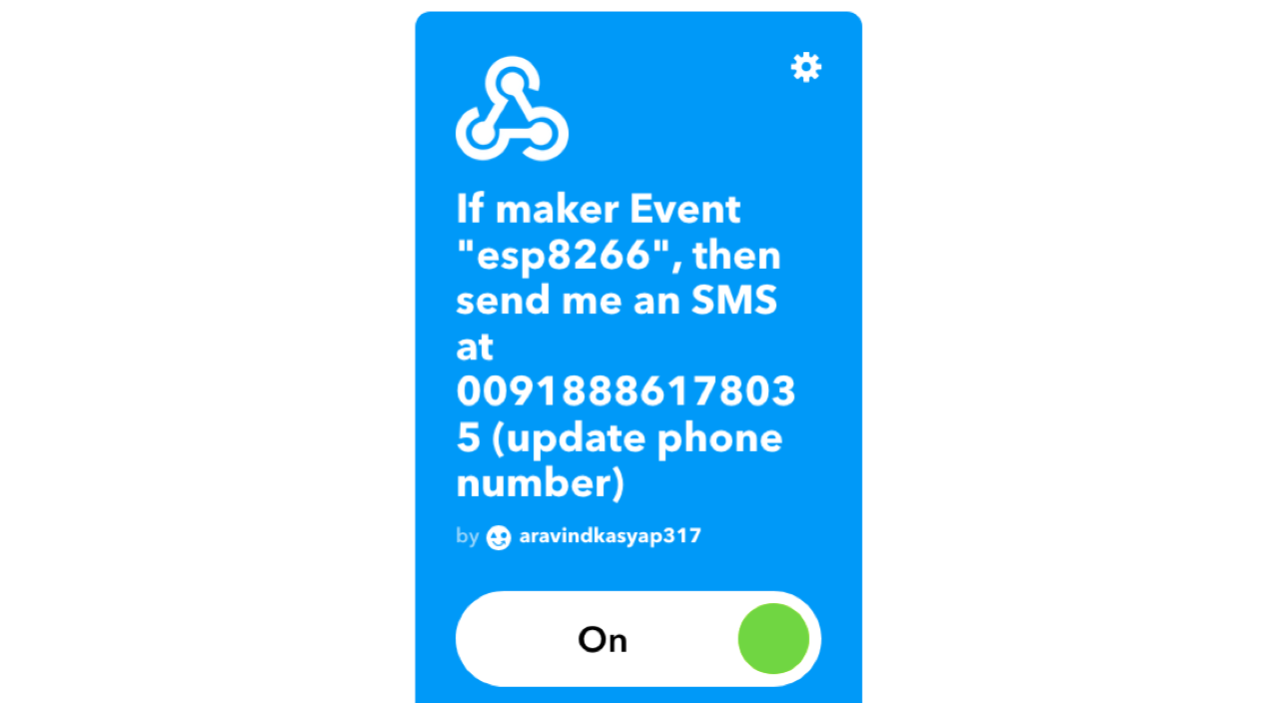
Alerts Applet

Slide 16
FURTHER DEVELOPMENTS
Can apply data analytics analyze the data available in the server.
Application of machine learning algorithms on the data will be useful for the prediction of the parameters.

Slide 17
APPLICATION
Avoid the damage of transformer .
Prior information about the malfunction.
Live data tracking.
Easy identification of the problem.
Predict the performance of the transformer.

Slide 18
TEAM MEMBERS
D.Sai Aravind Kasyap
Gaurav Kumar
Ashwin duth
Santosh Krishna
Team name: ULTRA INSTINCT

