Slide 1




09-08-2024
ViMEET
1

Slide 2
Vishwaniketan’s
Institute of Management Entrepreneurship & Engineering Technology
Computer Science & Engineering (AI & ML) Department
Major Project Presentation
ON
“Blockchain Freight Network”
BY
Mr. Gaurav Yadav
Mr. Aayush Vishwakarma
Mr. Ayush Mishra
Mr. Smit Gawand
Under Guidance of
Prof. Ashwini Garole
09-08-2024
ViMEET
2

Slide 3
OUTLINE
1. Introduction and Motivation
2. Research Objectives and Scope
3. Problem Statement
4. Literature Review
5. Gap Analysis
6. Proposed System
7. Conclusion
09-08-2024
ViMEET
3

Slide 4
Introduction
Exploration of the key benefits and applications of Logistics and Shipping Industry in Blockchain Technology, from enhancing traceability and accountability to facilitating smart contracts and automating documentation processes. Join us on this journey as we uncover the transformative power of blockchain technology in revolutionizing the future of logistics and shipping.
09-08-2024
ViMEET
4

Slide 5
Research Objective
Assessment of current challenges
Exploration of blockchain technology
Identification of use cases
Evaluation of benefits and limitations
Case studies and best practices
Assessment of ROI and business impact
Use of Business Intelligence
09-08-2024
ViMEET
5

Slide 6
Problem Statement
To avoid Lack of transparency and traceability in tracking goods across supply chains
To overcome Security vulnerabilities from centralized databases and intermediaries.
For the reduction of Complexity in documentation and compliance management.
09-08-2024
ViMEET
6

Slide 7
Literature Review
Sr. No | Authors Name | Objective | Method | Research Gap
1 | Ashraf Shirani | To examine the feasibility of a blockchain-based approach to enhancing transparency, efficiency, and economy of the global maritime logistics and finds the approach much promising. | A proof-of-concept Web client application, built using Linux Foundation's Hyperledger Sawtooth framework | Multiple entities in the supply chain, with their disjointed and often incompatible administrative procedures, outdated paperwork practices, and competing interests, add a great deal to the cost and time for exporters and importers.
2 | Lifeng Ni , Elnaz Irannezhad | To emulate the shipping logistics process and illustrate the automated and self-executing nature of smart contracts and transactions among various logistics participants by implementing RAFT consensus mechanism. | Homomorphic Encryption technique is used to enhance the security against brute force attacks and Improvement in encryption process was greater compared to the decryption process. | Techniques for reducing the size of ciphertext and public key need to be investigated and analysis of bootstrapping procedure needs to be performed.
09-08-2024
ViMEET
11
7

Slide 8
Literature Review
Sr. No | Authors Name | Objective | Method | Research Gap
3 | Bc. Michal P˚ulp´an | Development and deployment of SaaS solution for logistics automation in e-commerce | Implementation strategies for web clients, developed with ReactJS. | This platform confronts issues, presenting a new approach to the landscape of automation logistic expedition and post-purchase experience.
4 | Kelly Gerakoudi‑Ventouri | This study explored how Blockchain technology can address issues, such as vast documentation and information asymmetry in the shipping industry | The research data were analyzed based on a qualitative paradigm with grounded theory to explore the significance of blockchain technology to decision-making | The present case differs from previous ones can alter the intuitive mode of decision-making, making it more analytical and evidence-based
09-08-2024
ViMEET
11
8

Slide 9
Gap Analysis
Interoperability Issues
Scalability Challenges
Regulatory and Legal Barriers
Cost and Complexity
Data Privacy and Security
09-08-2024
ViMEET
9

Slide 10
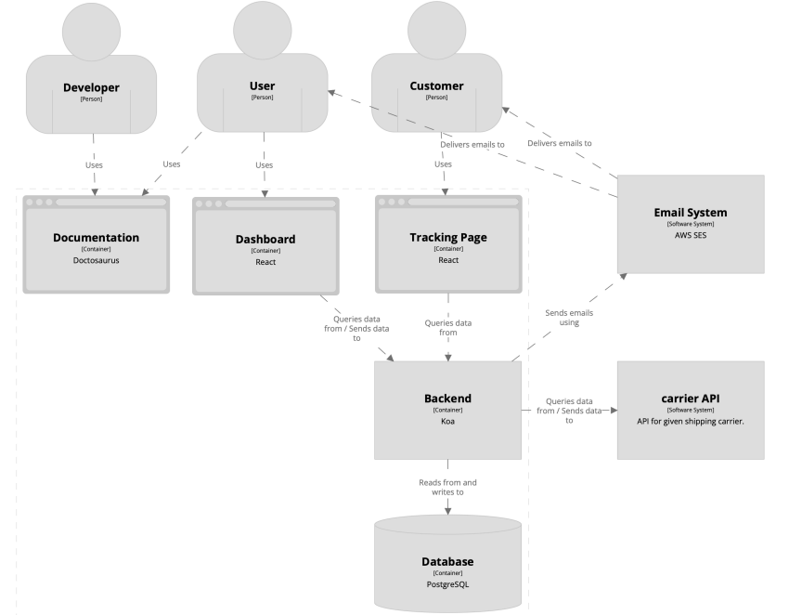
Proposed System Design
09-08-2024
ViMEET
10

Slide 11
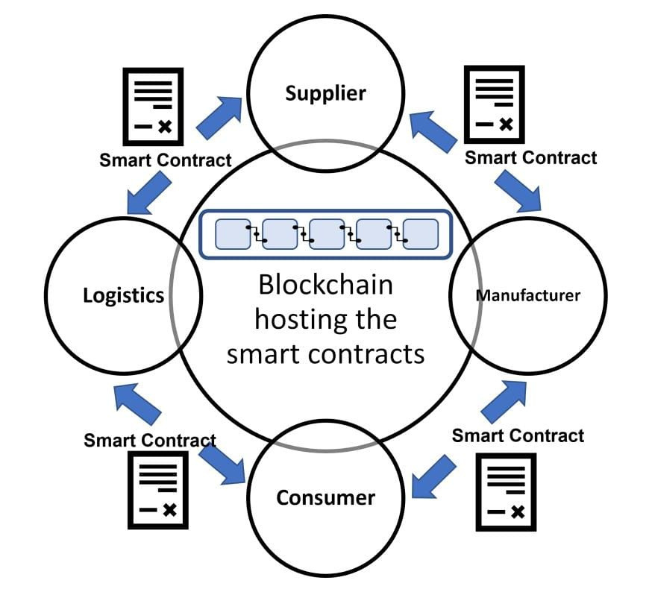
Flowchart
09-08-2024
ViMEET
11

Slide 12
Conclusion
Blockchain technology has significant potential in logistics and shipping. It can streamline processes, enhance transparency, and reduce administrative delays. Key applications include document workflow management, tracking and tracing, and digitalizing international shipping. By eliminating paper-based inefficiencies, blockchain can revolutionize the industry and create job opportunities .
09-08-2024
ViMEET
12

Slide 13
Thank You !!
09-08-2024
ViMEET
13

