Slide 1
Electrical Wire Fault Detection

Slide 2
Abstract
Electrical systems are prone to faults that can cause damage, malfunctions, or even electrical fires. Detecting these faults is essential to maintain the safety and reliability of electrical systems. One way to detect faults in electrical wires is to use Faraday's second law of electromagnetic induction.
Faraday's law states that a changing magnetic field induces an electric field and, consequently, an electric current in a conductor. By using this law, it is possible to detect electrical faults in wires by inducing a magnetic field in the wire and measuring the resulting voltage.
The technique involves placing a magnetic field near the wire under test. The magnetic field can be generated by a permanent magnet or an electromagnet. When the magnetic field is applied, it induces an electric current in the wire under test. If the wire is fault-free, the induced current will be proportional to the applied magnetic field. However, if there is a fault in the wire, the current induced will be distorted and not proportional to the applied magnetic field.
By measuring the amplitude and phase of the induced voltage, it is possible to locate the fault and determine its severity. The amplitude of the induced voltage is proportional to the distance between the fault and the measurement point, while the phase of the induced voltage indicates the type of fault.
There are several advantages to using this technique for electrical fault wire detection. It is non-destructive and non-invasive, meaning that the wire does not need to be disconnected or cut to perform the test. It is also quick and can be performed while the electrical system is in operation. Furthermore, this technique can detect faults that are difficult to locate using other methods, such as insulation breakdowns.

Slide 3
Problem Statement
Electrical faults, such as short circuits and open circuits, are a common cause of power outages and electrical fires. Detecting these faults early is crucial for preventing accidents and minimizing downtime. However, traditional methods of fault detection can be time-consuming and expensive. Therefore, there is a need for a more efficient and cost-effective method of electrical fault detection.

Slide 4
Literature Review
In this literature review, we will explore some of the research that has been conducted in this field, including the various types of concealed electrical wire detectors and their applications.
Types of Concealed Electrical Wire Detectors : There are several types of concealed electrical wire detectors that have been developed for different applications. Some of the most common types include:
Magnetic Field Detectors: These detectors work by detecting the magnetic field produced by an electrical current passing through a wire. They are typically handheld devices that can be used to scan walls, floors, and ceilings for hidden wires.
Radio Frequency (RF) Detectors: RF detectors use radio waves to detect the presence of electrical wires. They can be used to locate wires behind walls, as well as underground cables.
Infrared (IR) Detectors: IR detectors use thermal imaging technology to detect the heat signature of electrical wires. They can be used to locate wires that are hidden behind walls, ceilings, or floors.
Here are some patents and there number which are filed by the scientists
1)Electrical wiring safety device for use with electrical wire US7482535B2 Robert Jay Sexton.
2)System for inductive power provision in wet environments US8536737B2 Yossi Azancot.
3)Device for analysis of synthetic rope or cable, and method of use EP3126778B1 Sylvain Ouellette.

Slide 5
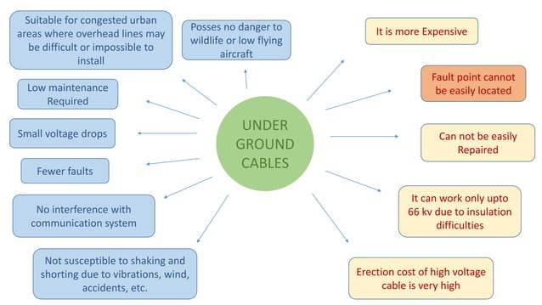

Slide 6
Proposed Methodology
In conductor when current flows, Magnetic field induces in perpendicular direction. It’s direction can determined by using right hand thumb rule.
we are using Faraday’s second law of Electromagnetic Induction which states that moving conductor in magnetic field produces back emf.
If we can use this back emf to verify the flow of current in wire we can detect fault in wire.

Slide 7
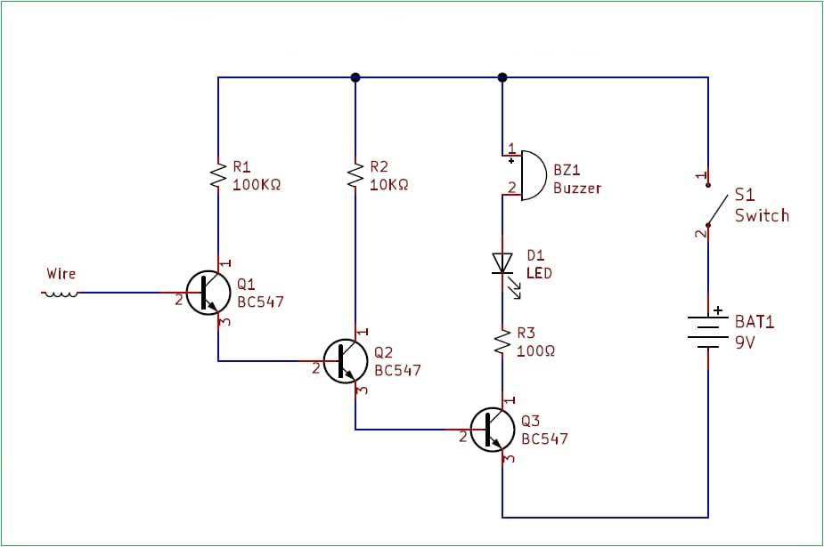
Start
System Initialization
Is back emf is detected
No
Yes
Amplifier to strengthen back emf
LED blink
End

Slide 8
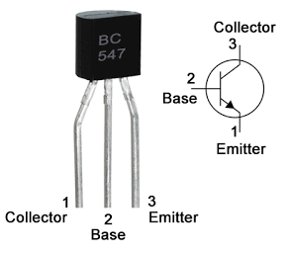
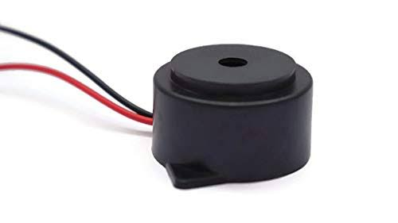
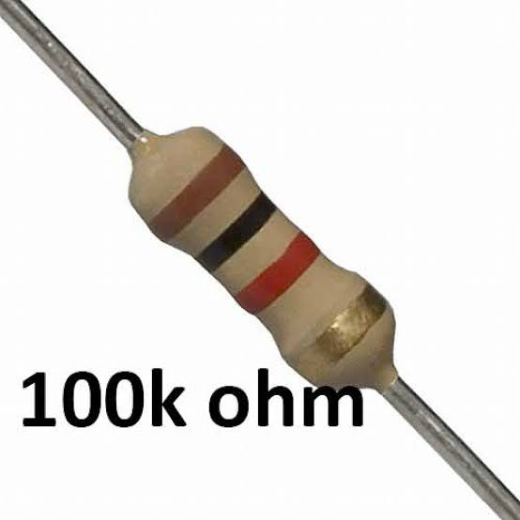
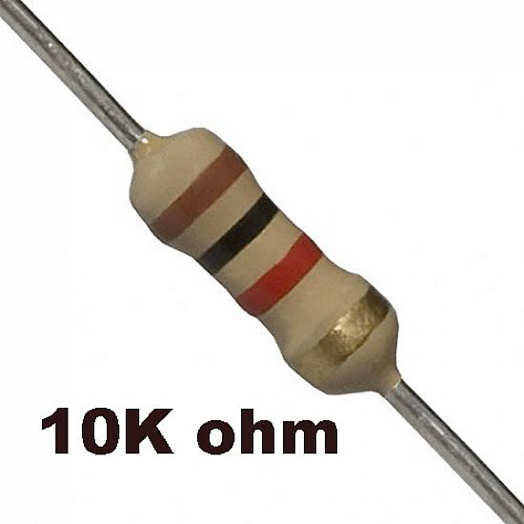
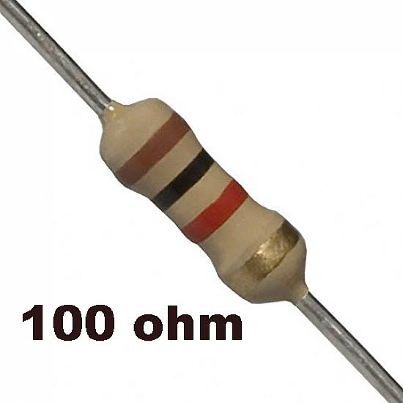
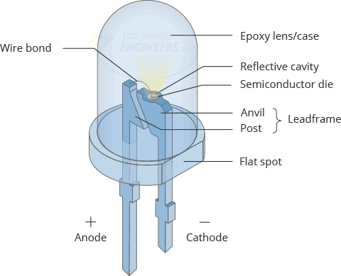
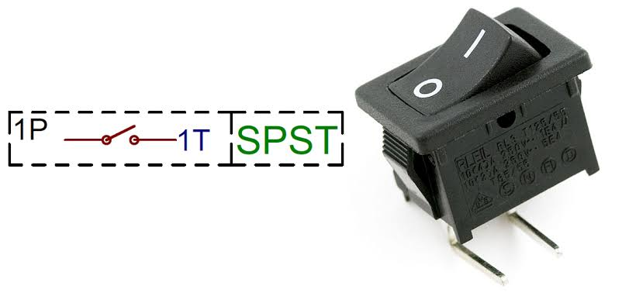
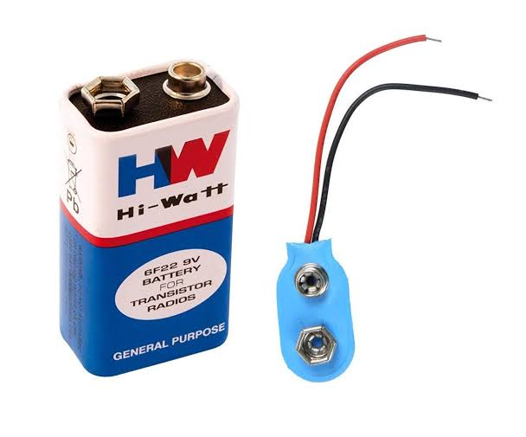
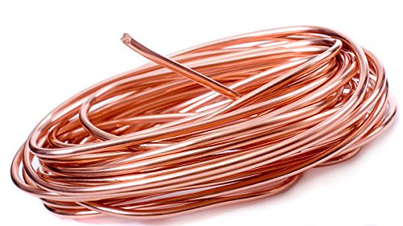
Components :-
1. Mosfet: BC547 X 3 2. Buzzer 3. Resistor: 100Kohm, 10Kohm, 100ohm
4. LED 5. SPST(Single Pole Single Throw) 6. Battery: 9V 7. Wire used as antenna

Slide 9
Application
Some specific applications of wire fault detection:
Automotive Industry: In the automotive industry, wire fault detection is used to identify faults in the wiring harnesses of vehicles. This helps prevent electrical failures and ensures the safety of passengers.
Aerospace Industry: In the aerospace industry, wire fault detection is used to identify faults in the wiring systems of aircraft. This helps ensure the safety and reliability of the aircraft.
Telecommunications Industry: In the telecommunications industry, wire fault detection is used to identify faults in the cables and wiring used for communication networks. This helps prevent downtime and improves the overall performance of the network.
Power Distribution Industry: In the power distribution industry, wire fault detection is used to identify faults in power transmission lines. This helps prevent power outages.

Slide 10
Future Scope
Wire cut detection is a critical project, and there is always scope for improvement and expansion. Here are some potential future directions for wire cut detection projects:
Improved Detection Accuracy: The primary goal of any wire cut detection project is to detect any cuts or tampering on wires accurately. To achieve this, researchers can explore different techniques and algorithms that can detect even minor changes in the wire's electrical conductivity, such as machine learning and artificial intelligence-based algorithms.
Wireless Wire Cut Detection: One potential future direction for wire cut detection projects is to move away from wired connections altogether. In this scenario, researchers could develop wireless wire cut detection systems that can monitor the status of the wires from a distance.
Integration with Smart Home Systems: With the growing popularity of smart home technology, integrating wire cut detection with smart home systems could be another potential future direction. This integration could provide homeowners with real-time notifications of any wire cuts, and even automate certain responses to prevent damage or theft.
Expanding Application to Other Industries: Wire cut detection systems are not limited to just the home security industry. In the future, the technology could be applied to other industries that rely on wires and electrical conductivity, such as the automotive industry, aerospace, and even healthcare.
Developing Cost-Effective Solutions: Another potential future direction for wire cut detection projects is to develop more cost-effective solutions. This would make the technology more accessible to a wider range of consumers and industries. Overall, wire cut detection technology is continually evolving and improving. As technology advances, we can expect to see more innovative applications of wire cut detection systems in the future.

Slide 11
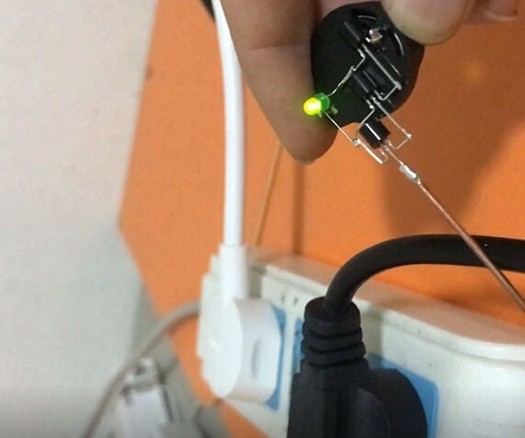
Result
The project successfully developed a wire fault detection
device using magnetic fields. It accurately detects and locates faults in electrical wires, such as breaks, short circuits, and insulation defects. The device includes a magnetic field generator, sensors, signal processing, and a user interface for efficient fault detection and localization.

Slide 12
Conclusion
In conclusion, the wire cut detection project is a valuable initiative that can provide numerous benefits to various industries.
The project aimed to detect wire cuts in a timely manner, prevent damage to equipment, ensure safety, and minimize downtime.
The project's outcomes demonstrate the effectiveness of wire cut detection and highlight the importance of integrating it into a broader maintenance and repair strategy.
The project's findings have significant implications for safety, reliability, and cost-effectiveness and can be applied in practice to enhance the performance of electrical systems.

Slide 13
Thank you

