Slide 1

MOLECULE - Web Based Open Community Platform
Presented by :-
Aditi Garg
Akash Sharma
Anant Sharma
Gaurav Jain
Mehak Bhatia
Nishant Bansal
Under the Supervision of :-
Ms. Megha Chhabra
DEPARTMENT OF COMPUTER SCIENCE & ENGINEERING
SCHOOL OF ENGINEERING AND TECHNOLOGY

Slide 2
Index
Idea
Problem Statement
Objectives
Technology using
Level 1 DFD
Novelty
Work Distribution
Website Screenshot
Machine Learning Models
MSP
Outcomes
Team details

Slide 3
Idea
Many dedicated platforms for QnA (StackOverflow, Geeks for Geeks etc.), but why not for other profession(s)?
Only QnA platform is not good enough. What else we can add for enhancing networking experience.

Slide 4
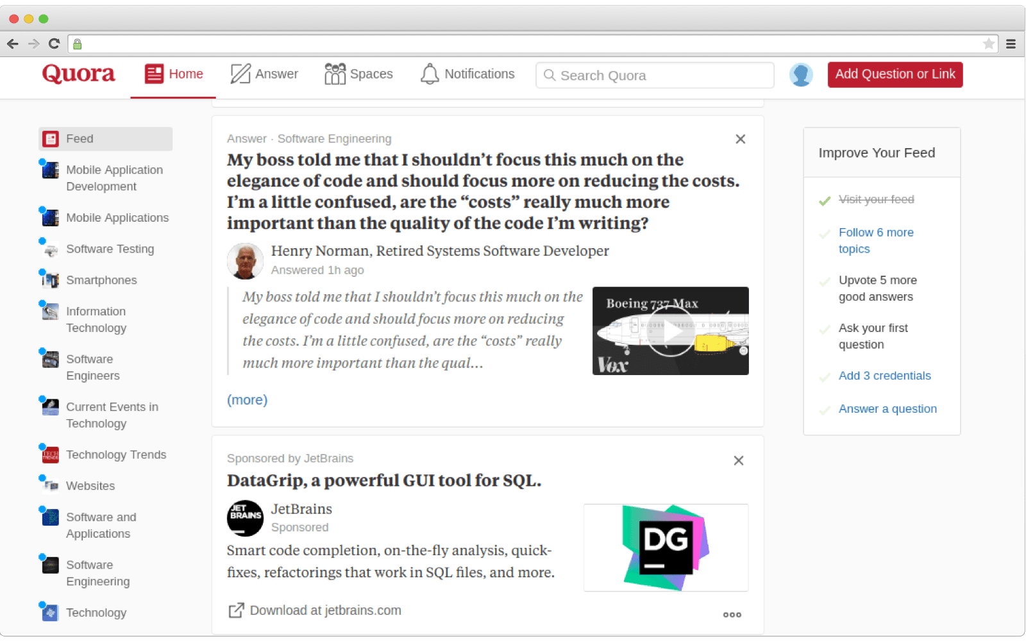
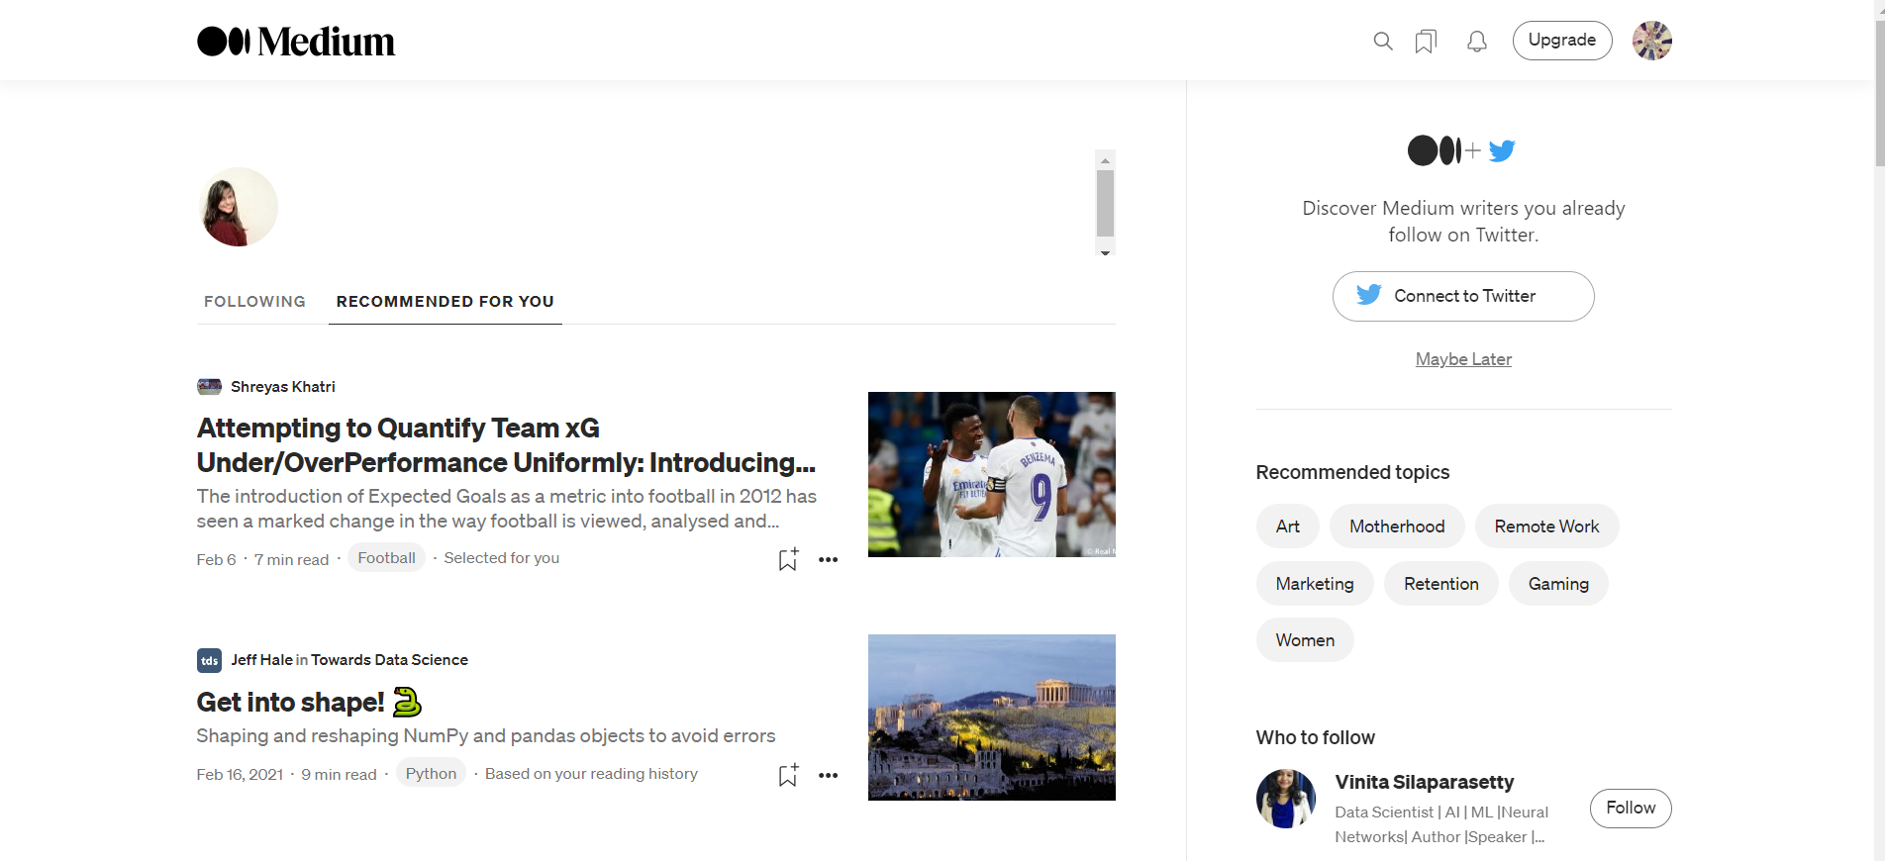
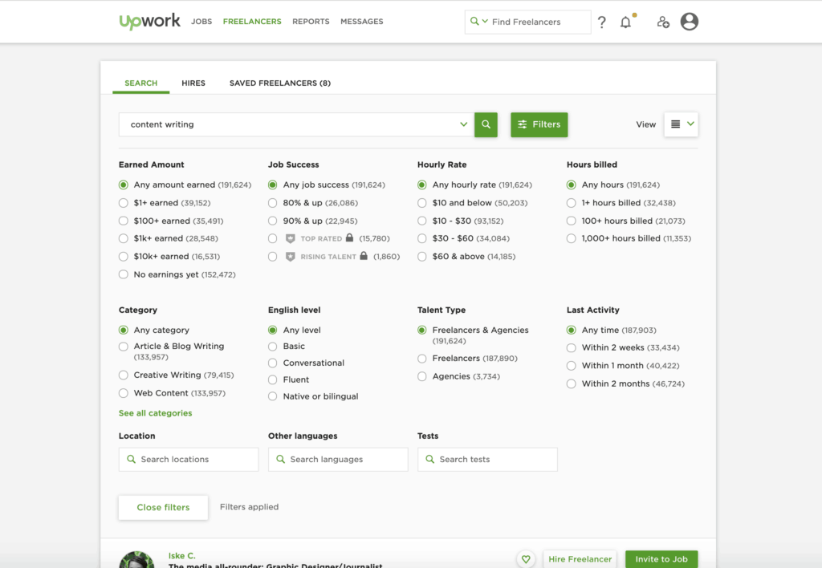
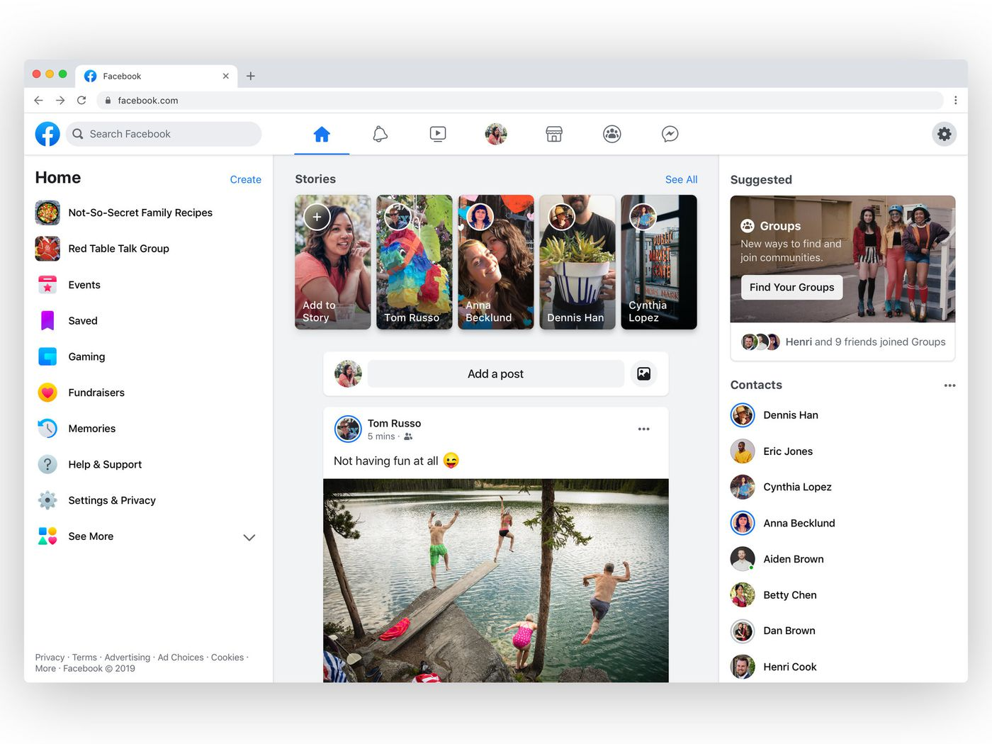
Quora
Medium
Upwork
Facebook
4

Slide 5
Problem Statement
Build a Web App, which allows an user to have custom community - open networking experience, with multiple functionalities over a single platform.

Slide 6
Objectives
A Web App, which will allow an user to:
Choose community of choice
Have QnA
Share posts
Get hired or hire
Read/write articles

Slide 7
Technologies using
MERN Stack: MongoDB, Express JS, React JS & NodeJS
Machine Learning: NLP
Languages: Python, HTML, CSS, JavaScript, JSX, ES6.

Slide 8
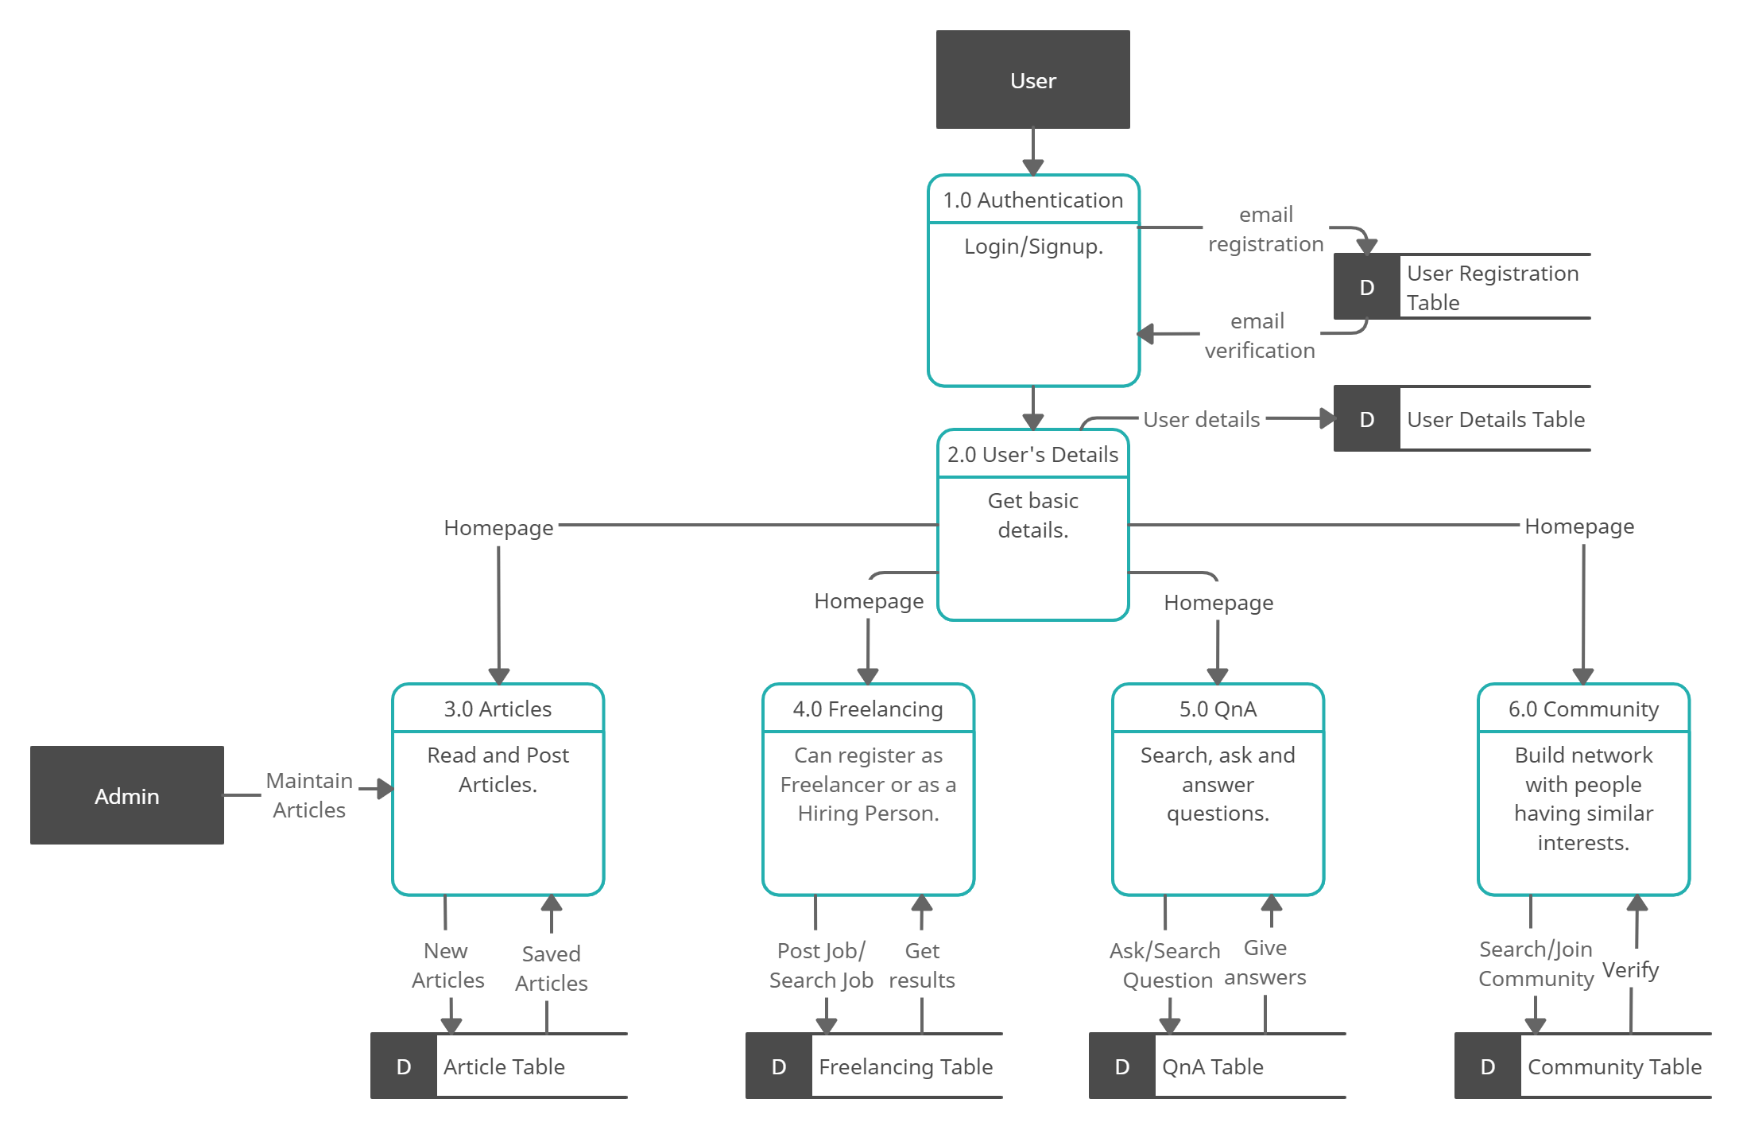
Data Flow Diagram
Figure 01: Data Flow Diagram – Level 01

Slide 9
Novelty
What we provide, that no one else is providing?
1. Feature to choose community of choice.
2. Multiple networking modules at one platform (QnA, Posts, Articles, Hiring)
3. Using ML for better customer experience.

Slide 10
Team Contribution
Name | Work
Akash Sharma | Authentication & Registration
Gaurav | Post Sharing Module & QnA Module
Nishant | Machine Learning Modules
Mehak | QnA Module
Aditi | Freelancer Module
Anant | Article Module
Table 01: Contribution

Slide 11
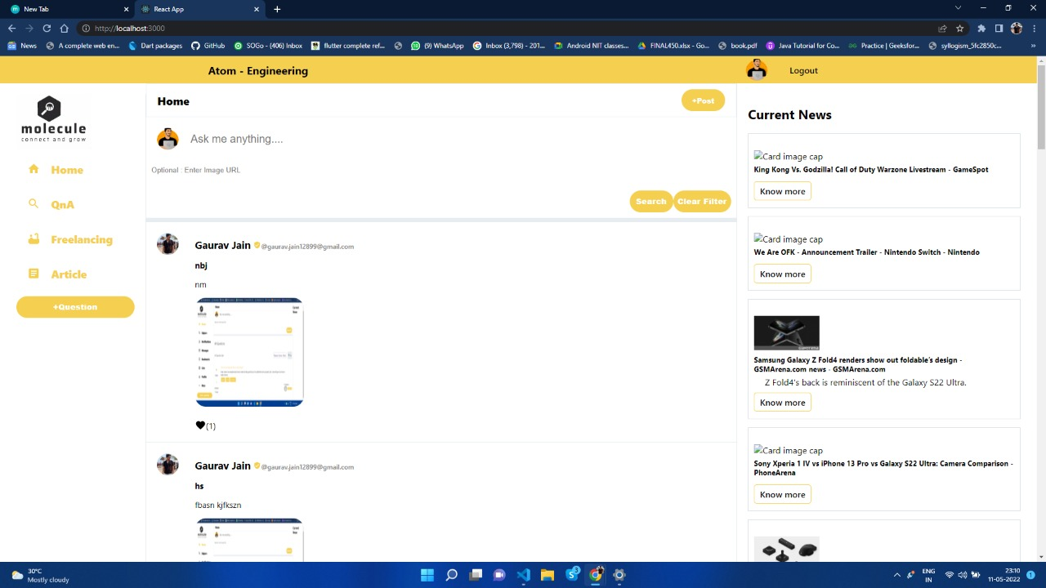
Homepage of Website
Figure 03: Homepage

Slide 12
Machine Learning Models
1. Text Searching using BERT
2. Nudity Detection using CNN
3. Phishing URL Detection

Slide 13
Business Strategy (MSP)
1. Ads on the website
2. Charges to join multiple communities
3. Cut from Freelancing projects

Slide 14
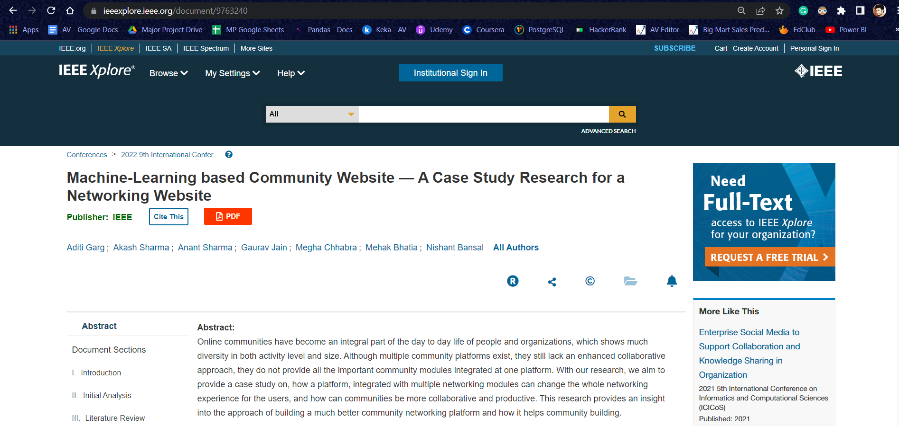
Outcome
A. Garg et al., "Machine-Learning based Community Website — A Case Study Research for a
Networking Website," 2022 9th International Conference on Computing for Sustainable Global
Development (INDIACom), 2022, pp. 604-608, doi: 10.23919/INDIACom54597.2022.9763240.
(IEEE Scopus)

Slide 15
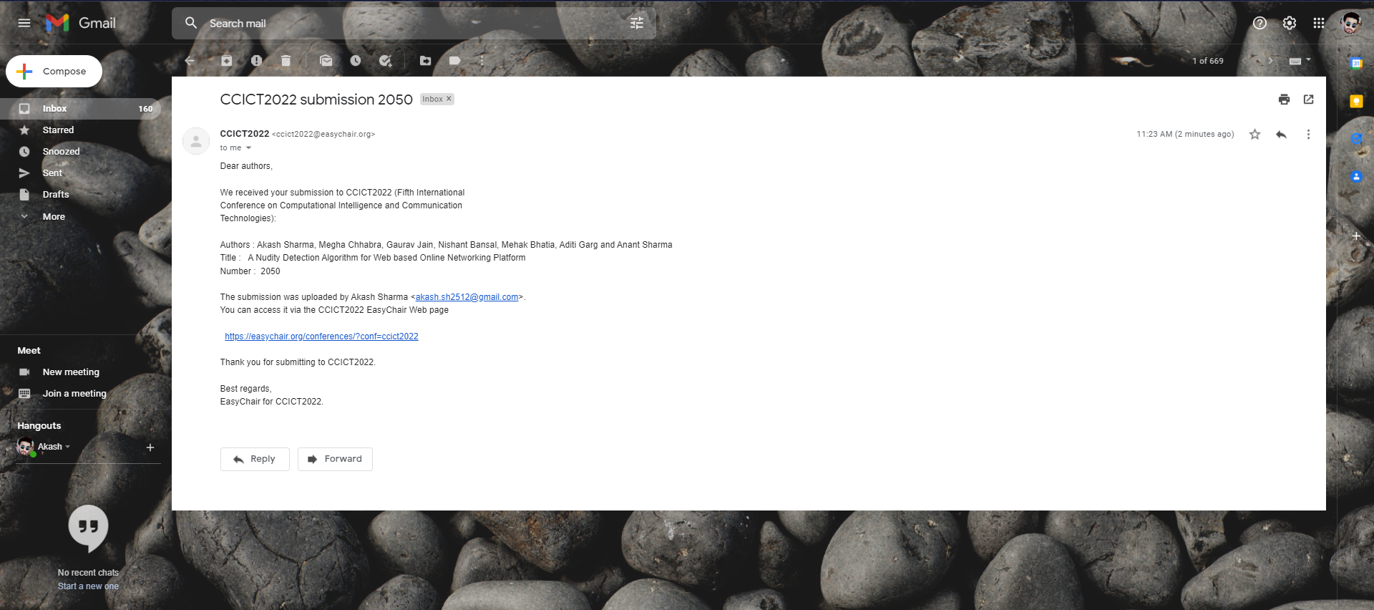
Outcome
“A Nudity Detection Algorithm for Web based Online Networking Platform,” CCICT2022 (Fifth
International Conference on Computational Intelligence and Communication Technologies),
2022
(IEEE Scopus)

Slide 16
Team Details
Gaurav Jain
Roll Number : 180101114-2018002620.gaurav@ug.sharda.ac.in
Guide/Mentor
Ms. Megha Chhabra
megha.chhabra@sharda.ac.in
Assistant Professor CSE
Aditi Garg
Roll Number : 180101021
2018015438.aditi@ug.sharda.ac.in
Akash Sharma
Roll Number : 180101033
2018002620.akash@ug.sharda.ac.in
Mehak Bhatia
Roll Number : 180101188
2018002620.mehak@ug.sharda.ac.in
Anant Sharma
Roll Number : 180101052
2018002620.anant@ug.sharda.ac.in
Nishant Bansal
Roll Number : 180101215
2018002620.nishant@ug.sharda.ac.in

