Slide 1
Discovering Relationships between Companies’ Stocks & their Internet Presence
Authors: Anna Burlyaeva, Gaurav Maheshwari

Slide 2
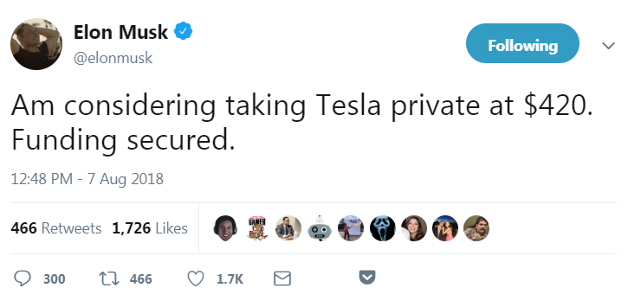
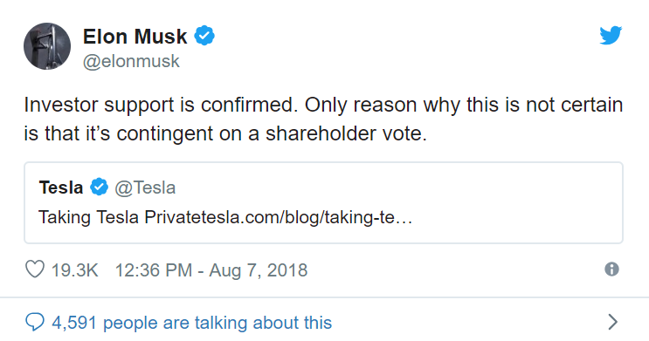
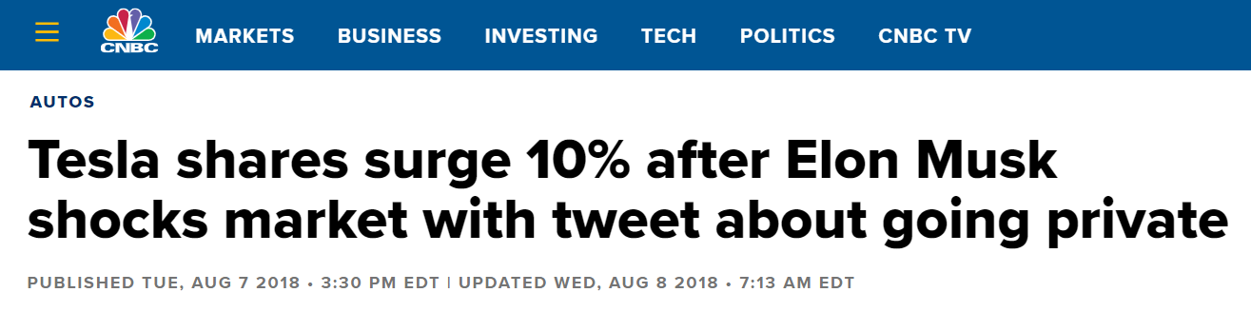
Motivation

Slide 3

Aim
To discover relationships between Company Stock Prices and their Internet Presence

Slide 4

Aim
To discover relationships between Company Stock Prices and their Internet Presence

Slide 5


Questions
Indicators of internet presence?
Data sources?
Relationships?
Statistical model?

Slide 6



Internet Presence Indicators
Search Queries Statistics
Twitter Posts Statistics
Online News Statistics

Slide 7

Data Sources
Data sources
Stock Data Statistics: IEX Cloud and IEX API 1.0
Search Queries Statistics: Pseudo API for Google Trends
Twitter Posts Statistics: Twitter API
Online News Statistics: News API

Slide 8
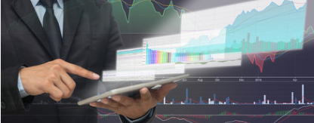


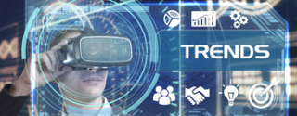
Data Sources
Data sources
Stock Data Statistics: IEX Cloud and IEX API 1.0
Search Queries Statistics: Pseudo API for Google Trends
Twitter Posts Statistics: Twitter API
Online News Statistics: News API

Slide 9
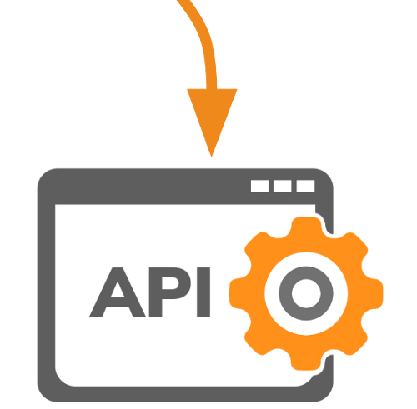



Tools

Slide 10

Data Retrieving
Twitter :
Various Twitter API’s and python libraries “tweepy”
Careful consideration on which tweet accounts to monitor
News:
newsapi.org
Stocks:
IEX API
Google Trends:
Pseudo API

Slide 11

Data Cleaning Process
Tweets and news are not on regular intervals for a particular stock
After performing sentimental analysis on tweets we had to merge results of sentiments by grouping them based on the dates
Merging the data from Twitter, multiple news API’s and Google Trends based on date
Comparing the data merged data with stock prices
We had to consider the fact that Tweets & News might have bias in the data

Slide 12
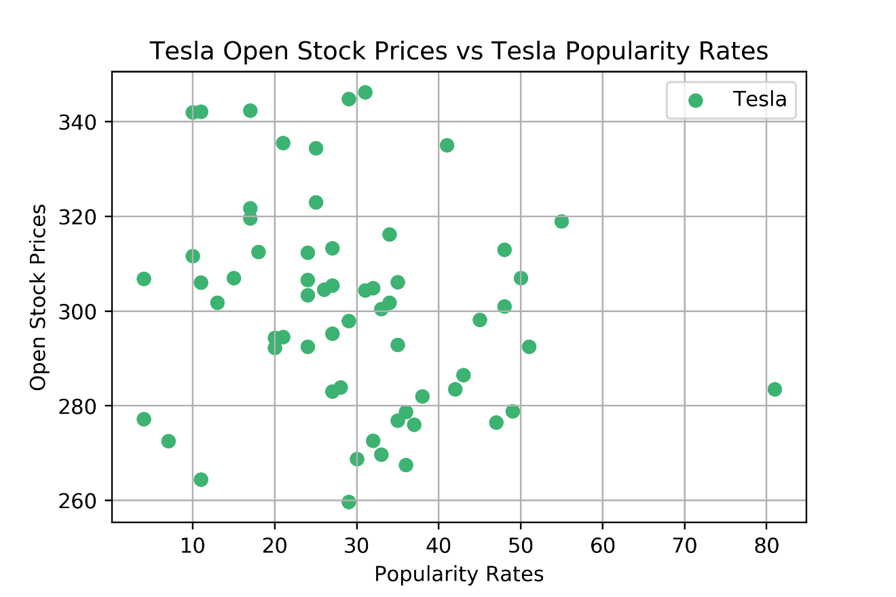
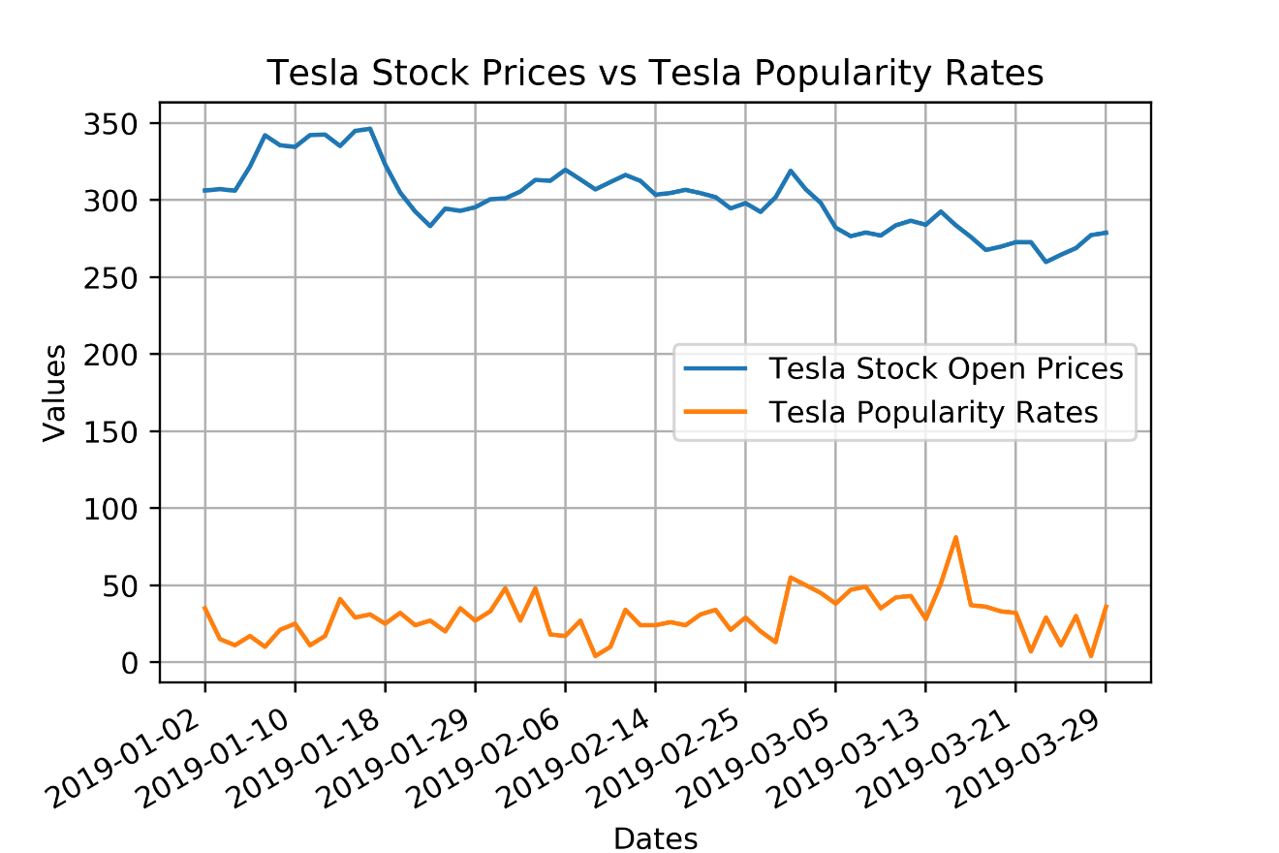
Visualization

Slide 13
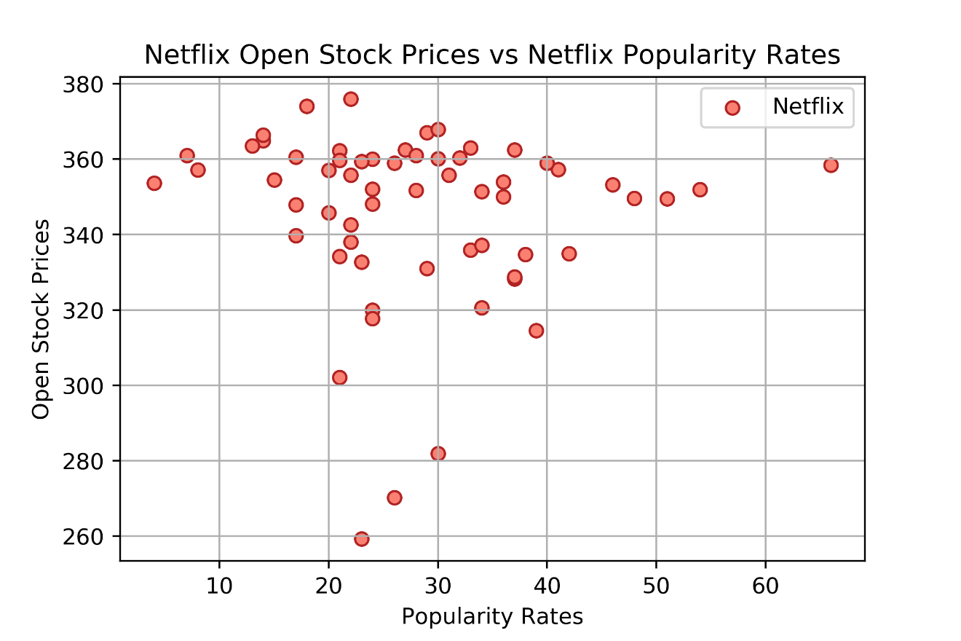
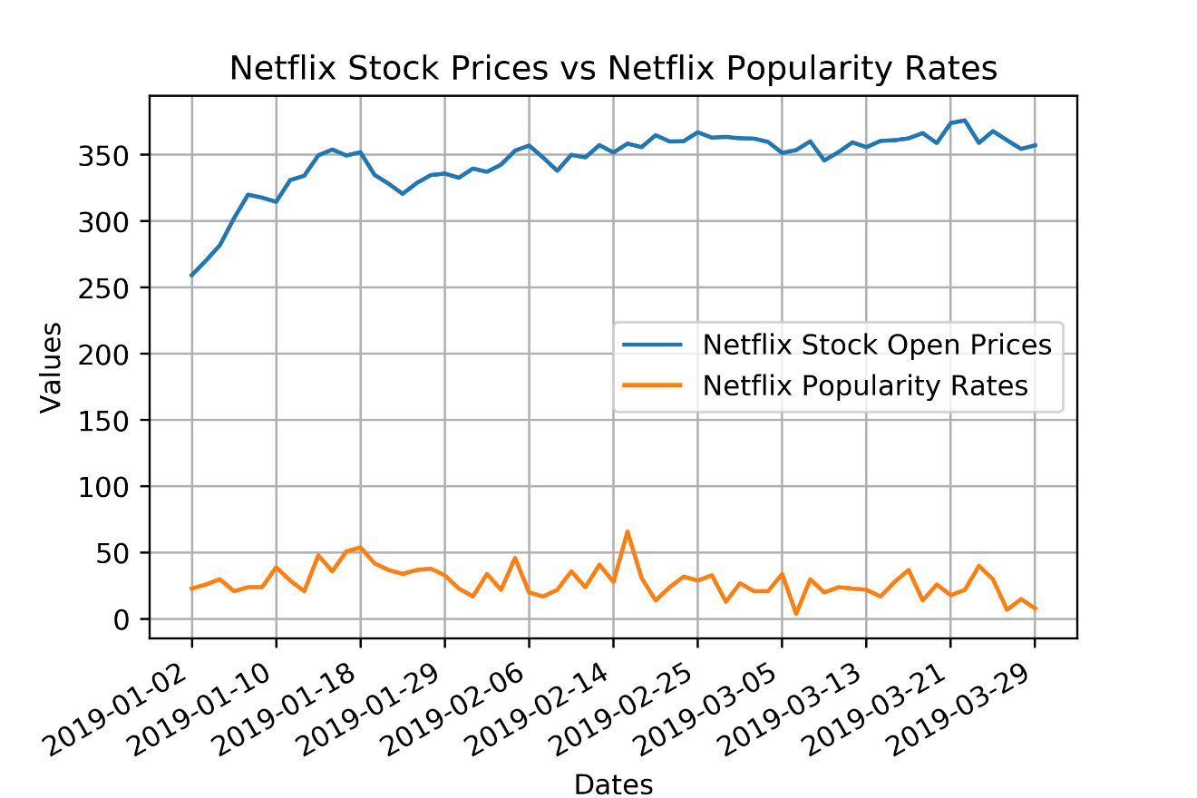
Visualization

Slide 14
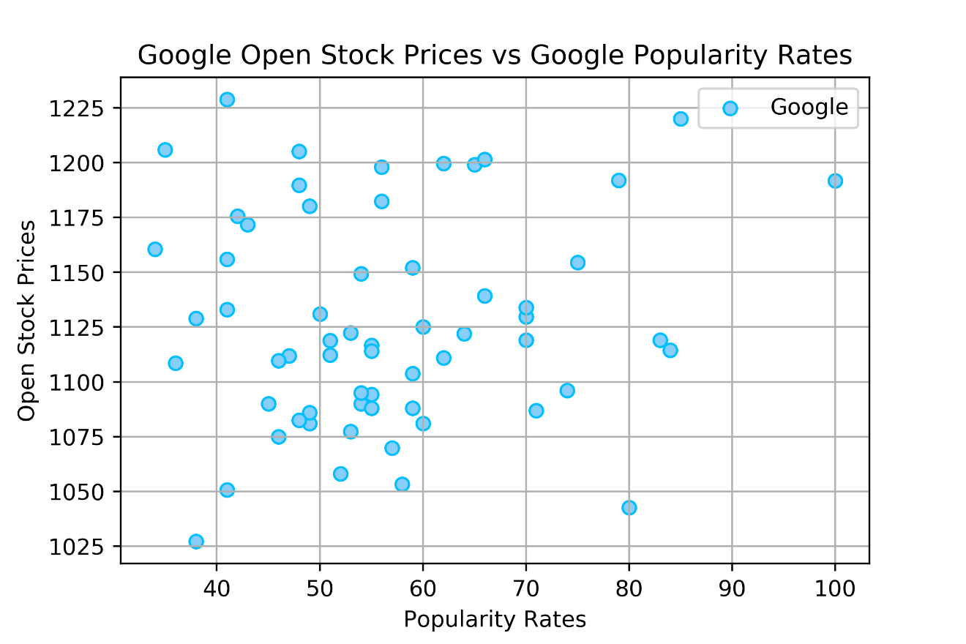
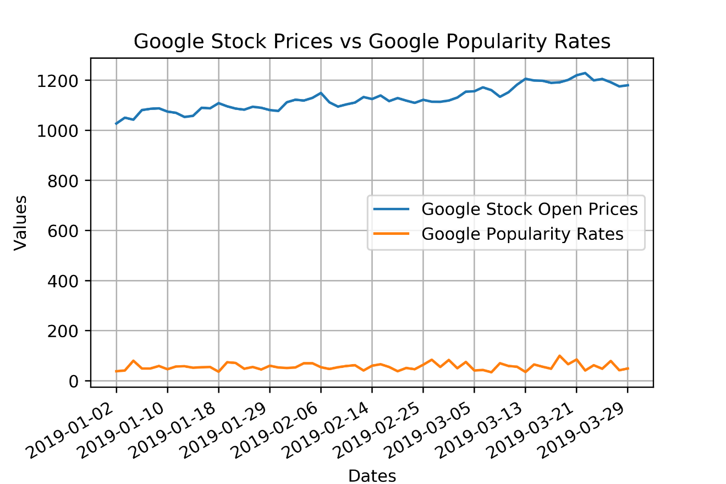
Visualization

Slide 15
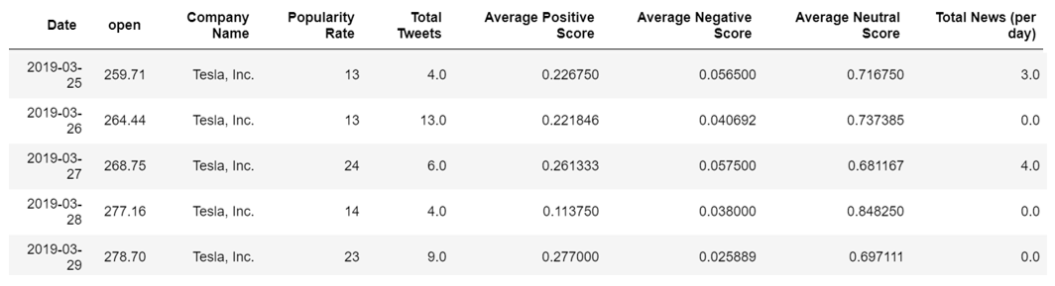
Data for Analysis
Final DataFrame:

Slide 16
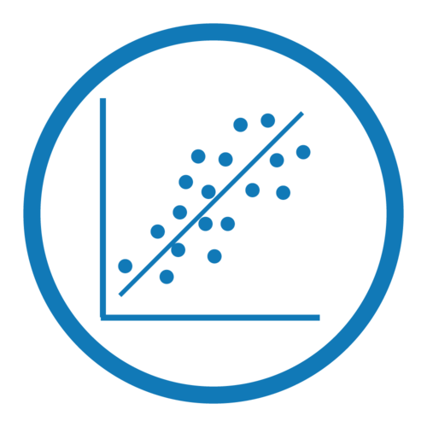
Data for Statistical Model
Dependent variable:
Open Stock Price
Independent variables:
Google Search Popularity Rate
Total Tweets
Twitter Sentiments (3 predictors)
Total News (per day)

Slide 17
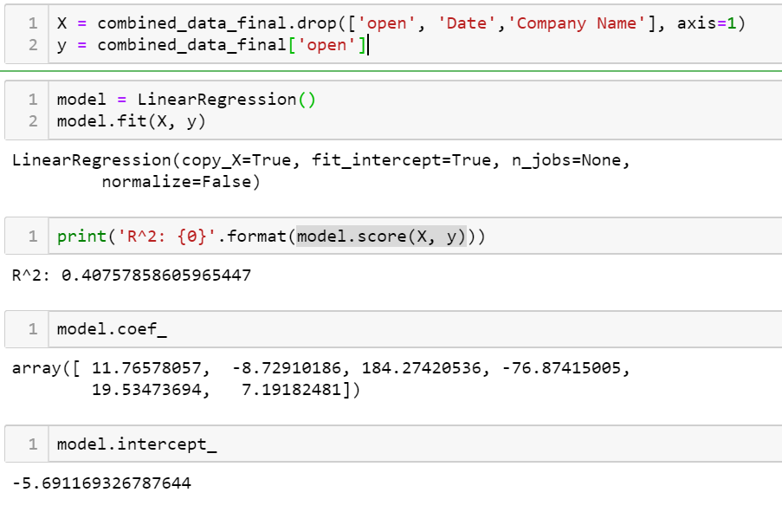
Model

Slide 18

Conclusion
Stock prediction requires lots of variables e.g. company performance, people’s emotion about he company, global economic situation, weather patterns, etc.
In this project we are only tracking tweets, news, google trends, company stock and we have limited access to free data, and our dataset is not representative
Sentiment analysis requires lots of data cleaning
Except data analytics capabilities we also have to use machine learning capabilities to perform sentimental analysis and other techniques
Our model doesn’t demonstrate a significant relationships among the data, but it doesn’t mean that there are no relationships there, we need to do more additional analysis

Slide 19

Q&A
Thank you for your attention!

