Slide 1

CSD894
Accelerating SSL by offloading RSA decryption
to GPGPUs in a heterogeneous environment
By
Gaurav Gupta
2013MCS2556
Advisor
Prof. Subodh Sharma

Slide 2
Outline
Problem
Solution
Optimizations
Observations & Results
Conclusion

Slide 3
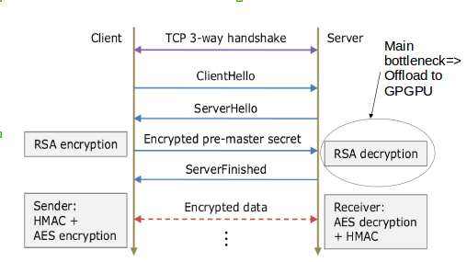
Problem
Costly decryption overheads at the server in a typical SSL handshake
Results in low server throughput and high client-side latency of secured web services over HTTPS
Off-board SSL accelerators available but very expensive

Slide 4

Solution
Offload RSA decryption to commodity GPGPUs
Exploit data parallelism in decryption algorithm -
Montgomery Algorithm for fast modular multiplication
Square And Multiply for exponentiation
Parallel Operations – Multiplication, Addition, Subtraction, Shift as CUDA kernels
Request level parallelism-
Batch multiple decryptions together – increases device occupancy and hence efficiency
Horizontal and Vertical Scalability-
Utilize available CPUs on the same node – host threads – OpenMP/pthread & CUDA Streams
Use multiple compute nodes containing CPUs & GPUs - MPI

Slide 5
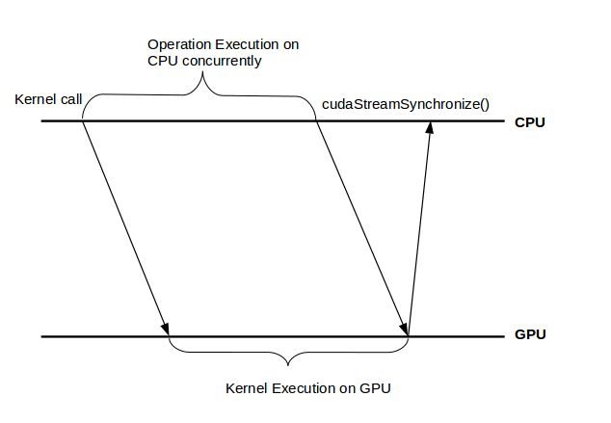
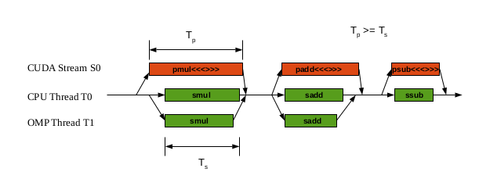

Slide 6
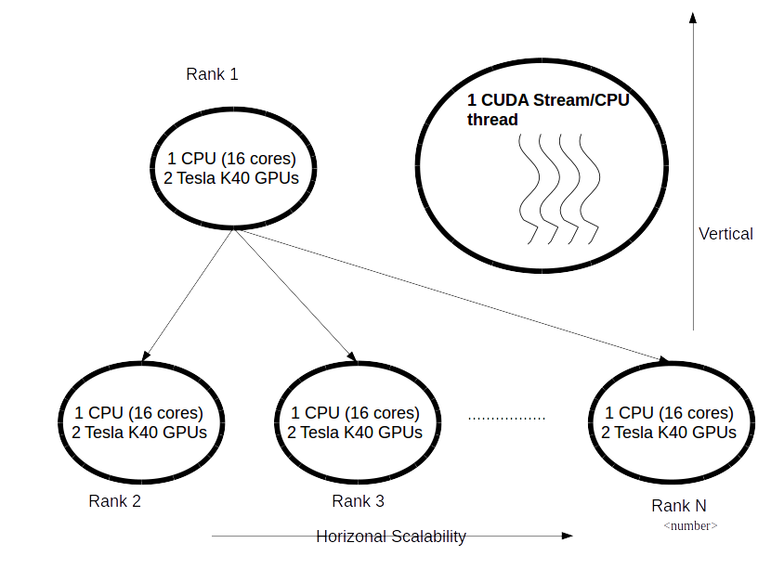

Slide 7
Optimizations
Optimization | Remarks
Memory Pooling – Shared, reusable host and device memory, reduces multiple CUDA runtime API calls(cudaMalloc, cudaFree) overheads | No blocking of independent CUDA streams
Using on-chip shared memory – minimize number of off-chip global load/stores | Coalesced read/write data to global memory once in kernel – 43% improvement in latency
Data Alignment, access patterns – minimize number of global memory transactions, Global Memory Coalescing & shared memory bank conflict prevention | Power consumption reduces – around 13% reduction at peak throughput
Kernel launch dimensions – important for high device occupancy and SM efficiency – SM should have enough number of schedulable warps – hide memory access, instruction dependency stalls | Empirical approach to calculate best dimensions for each kernel – 17% increase in throughput

Slide 8
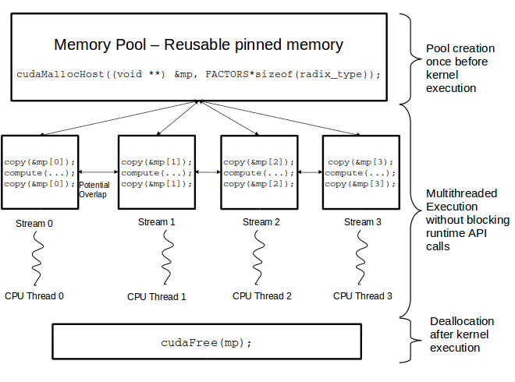
Memory Pooling

Slide 9
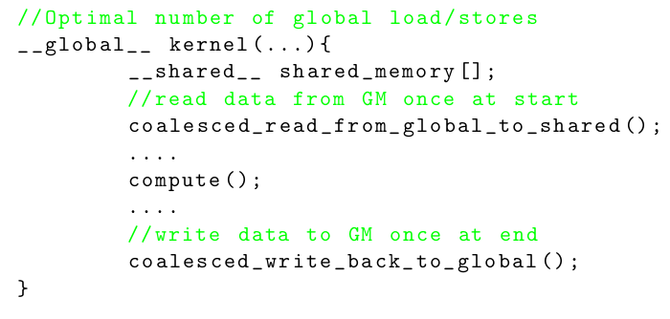
Shared memory and Access Patterns

Slide 10
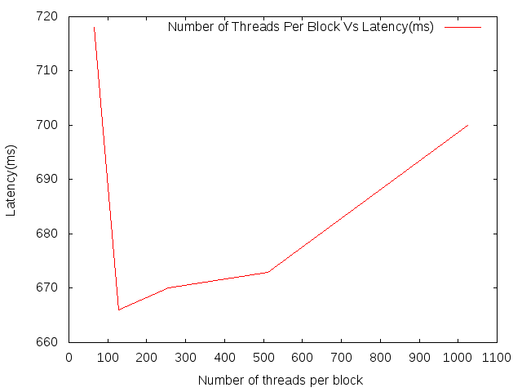
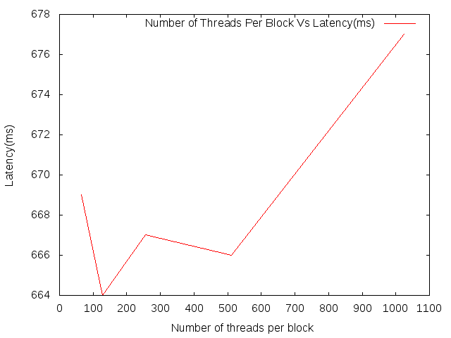
pmul<<<>>>
Optimal kernel dimensions
padd<<<>>>

Slide 11
Other Optimizations
Aysnchronous data transfer and execution – multiple streams
CUDA Stream pooling – reusable cached streams
Code optimizations like code motion,loop unrolling when #iterations known, common sub-expression elimination, function inlining
Numactl – bind process to processors in same NUMA node – reduce memory access latencies (eg. numactl –physcpubind=0,1,3,11 ./app)

Slide 12
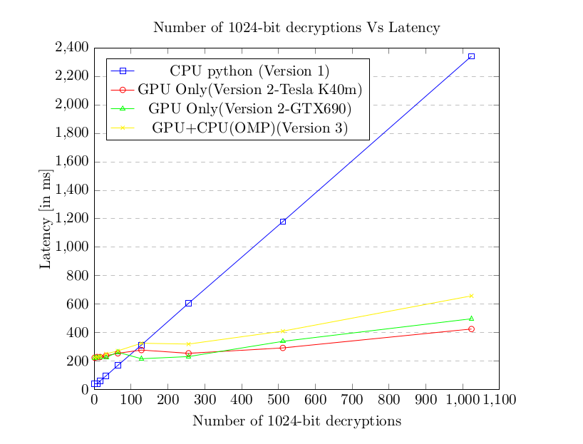
Observations

Slide 13
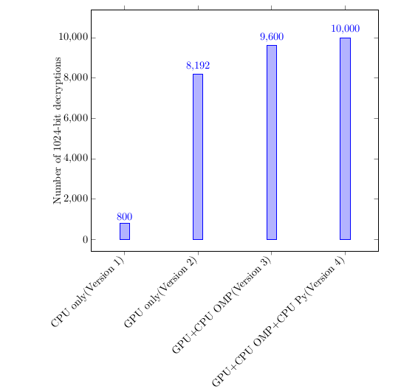
Observations

Slide 14
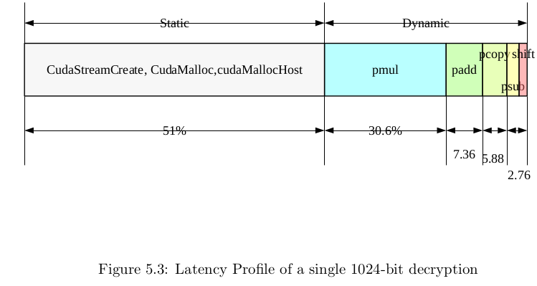
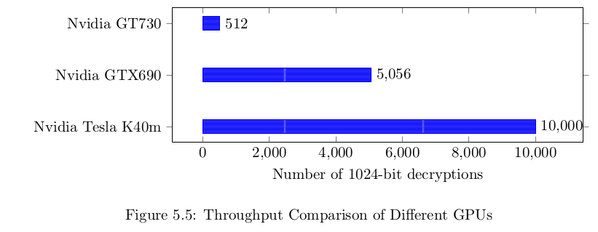
Observations

Slide 15
Results
Maximum throughput achieved – 10k 1024-bit decryptions per second – single node(2 X K40m, 1 X Xeon CPU 24 core, 2 NUMA nodes)
Shared memory throughput – l:874.77GB/s and s:720.61GB/s
Global memory throughput – l:7.17GB/s and s:7.17GB/s
Global memory load/store efficiency – 100% due to coalescing
IPC – number of instructions executed per SM per clock cycle- 1.66
Eligible warps per active cycle - 3.94
Multiprocessor Activity – ratio of time atleast one warp is active on any SM to the total time – 88%
Power consumption reduced from 88.7W to 77.2W (13%)

Slide 16
Conclusion
A scalable heterogeneous system to accelerate SSL has been proposed
A module (written in C with CUDA framework) has been developed which can be integrated with web servers to handle decryption during SSL handshake
Existing solutions reported 1800, 3863 and 5856 decryptions per second – this system achieved a maximum throughput of 10,000 RSA decryptions per second
More optimized and faster solution – SSLShader by KAIST,S.Korea– 27,000 throughput on GTX580 and two xeon processors
Various optimization approaches were proposed and power consumption was reduced by 13%

Slide 17
Future Work
Decryption ption on AMD Accelerated Processing Unit(APUs) with CPU and GPU on the same chip – reduced communication & data transfer overheads(PCI bus,etc.) and low power
Better approach for horizontal scaling - the throughput may not scale well using MPI framework due to node communication overheads and network bandwidth – 2 compute nodes gave similar throughput as 1 compute node

Slide 18
References
[1]Keon Jang et. al, Sslshader: Cheap SSL Acceleration With Commodity Processors, Proc. of the 8th USENIX Conference on Networked systems and Implementation,NSDI11.
[2] J.-J. Quisquater and C. Couvreu, Fast Decipherment Algorithm for RSA Public-key Cryptosystem, Electronics Letters, 18(21):905907, 1982.
[3] P. Montgomery, Modular Multiplication Without Trial Division, Mathematics of Computation, 44(170):519521, 1985.
[4] Maged Michael et al. Scale-up x Scale-out: A Case Study using Nutch/Lucene. Parallel and Distributed Processing Symposium, 2007. IPDPS 2007. IEEE International.
[5] V. Bunimov, M. Schimmler, and B. Tolg, A Complexity-Effective Version of Montgomerys Algorithm, Workshop on Complexity Effective Designs, ISCA02, May 2002.
[6] Szerwinski, R., Gneysu, T., Exploiting the Power of GPUs for Asymmetric Cryptography, In: CHES 2008 [39], pp. 7999 (2008).
[7] Yang Y, Li C, Zhou H , CUDA-NP: Realizing Nested Thread-level Parallelism in GPGPU Applications, J Computer Science Technology 30(1):319.
[8] M. Shand and J. Vuillemin, Fast Implementation of RSA Cryptography, 1th IEEE Symposium on Computer Arithmetic, Windsor, Ontario, Canada, pp. 252-259, 1993.
[9] J. Gilger, J. Barnickel, and U. Meyer GPU-acceleration of Block Ciphers in the OpenSSL Cryptographic Library, Proc. of the 15th int. conf. on Information Security, ser. ISC12. Springer-Verlag, 2012, pp. 338353.
[10] R Landaverde et. all, An investigation of Unified Memory access performance in CUDA, Extreme Computing Conference (HPEC), 2014 IEEE, 2014.

Slide 19
[11] Seluk, B. and Erkay, S, Highly-Parallel Montgomery Multiplication for Multi-core General-Purpose Microprocessors, Computer and Information Sciences III, 27th In- ternational Symposium on Computer and Information Sciences, pp. 467-476, 2013.
[12] Neves, S. and Araujo, F., On the Performance of GPU Public-Key Cryptography, IEEE International Conference on Application-Specific Systems, Architectures and Processors (ASAP), pp. 133-140, 2011.
[13] S. Collange, D. Defour, and A. Tisserand, Power consumption of gpus from a software perspective, Computational Science, pages 914923, 2009.
[14] L. Chen, O. Villa, S. Krishnamoorthy, and G. Gao, Dynamic Load Balancing on Single- and Multi-GPU Systems, Proc. of the IEEE International Parallel and Distributed Processing Symposium, 2010.
[15] P. Xiang, Y. Yang, M. Mantor, N. Rubin and H. Zhou, Revisiting ILP Designs for Throughput-Oriented GPGPU Architecture, 15th IEEE/ACM International Symposium on Cluster, Cloud and Grid Computing, May, 2015.
[16] H. M. Fadhil and M. I. Younis, Parallelizing rsa algorithm on multicore cpu and gpu, International Journal of Computer Applications, 87(6):1522, February 2014.Published by Foundation of Computer Science, New York, USA. 11.
[17] Z. Yao, V. Chenghua, C. Yuwei, and L. Wei, Efficient Acceleration of RSA Algorithm on GPU, IEEE International Conference on Oxide Materials for Electronic Engineering (OMEE), Lviv, Ukraine, pp. 531-534, 03 - 07 September, 2012.
[18] M. I. Younis, H. M. Fadhil, Z. N. Jawad, Acceleration of the RSA Processes based on Parallel Decomposition and Chinese Reminder Theorem, International Journal of Application or Innovation in Engineering and Management, Volume 5, Issue 1 January, 2016.

Slide 20
Thanks

