Slide 1

InTime
Roaming free.

Slide 2

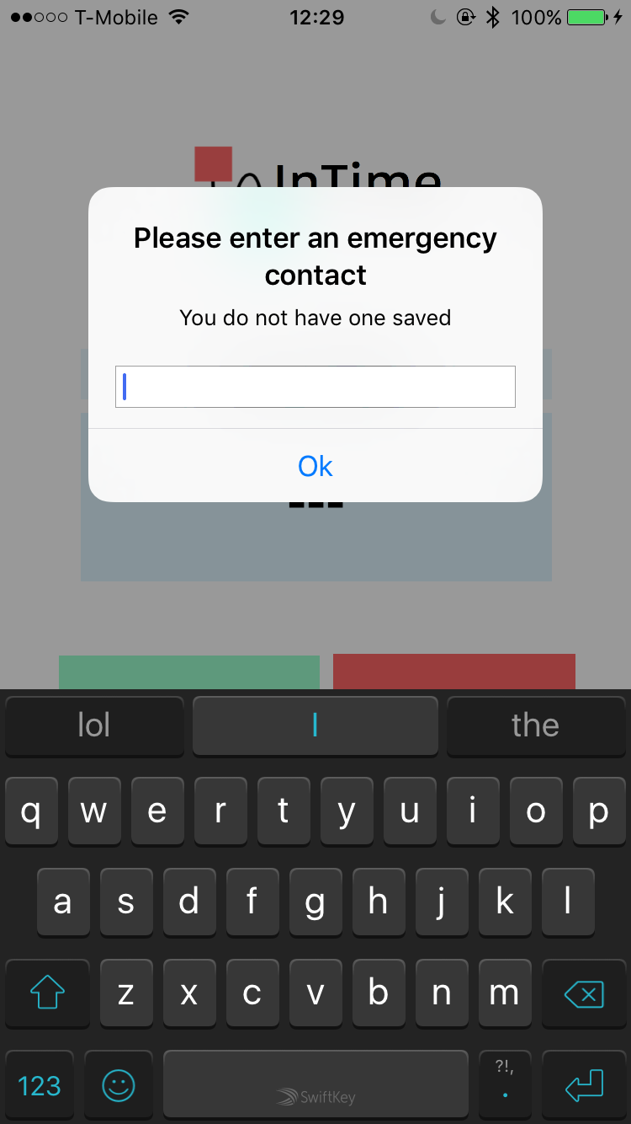
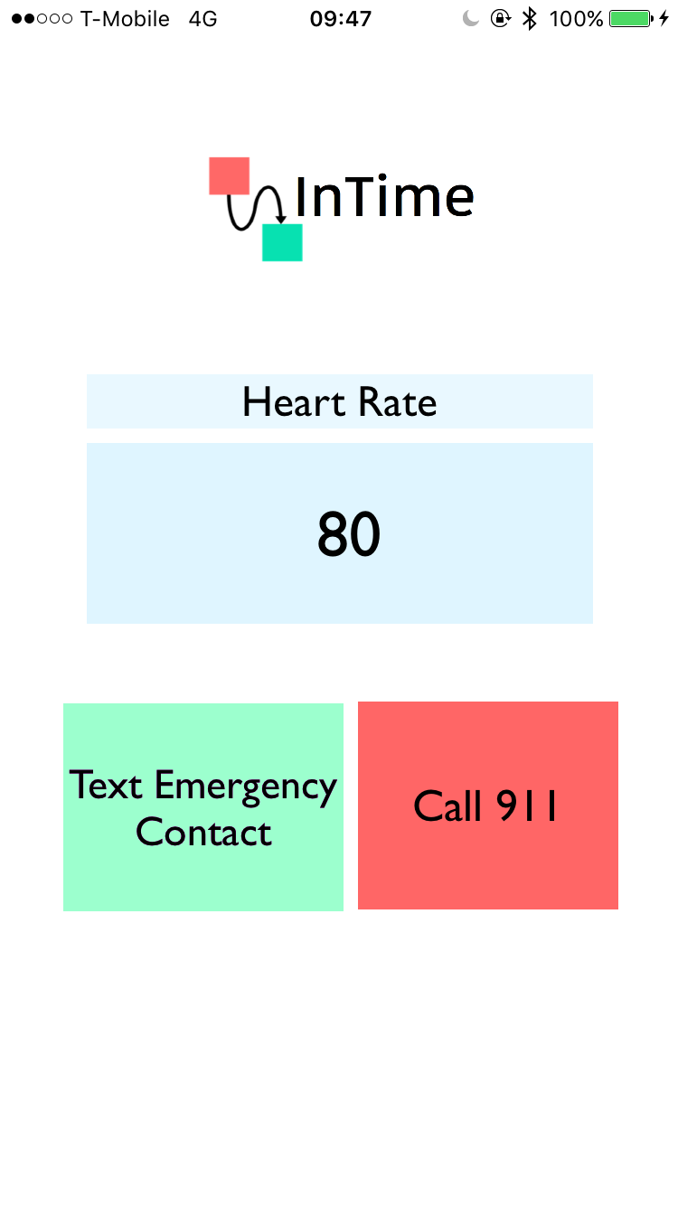

Slide 3
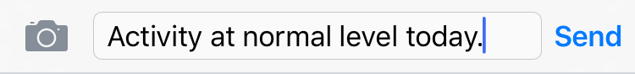
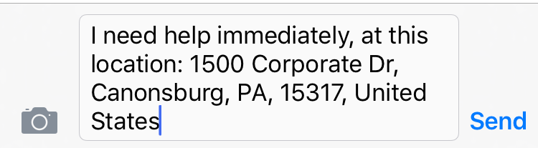
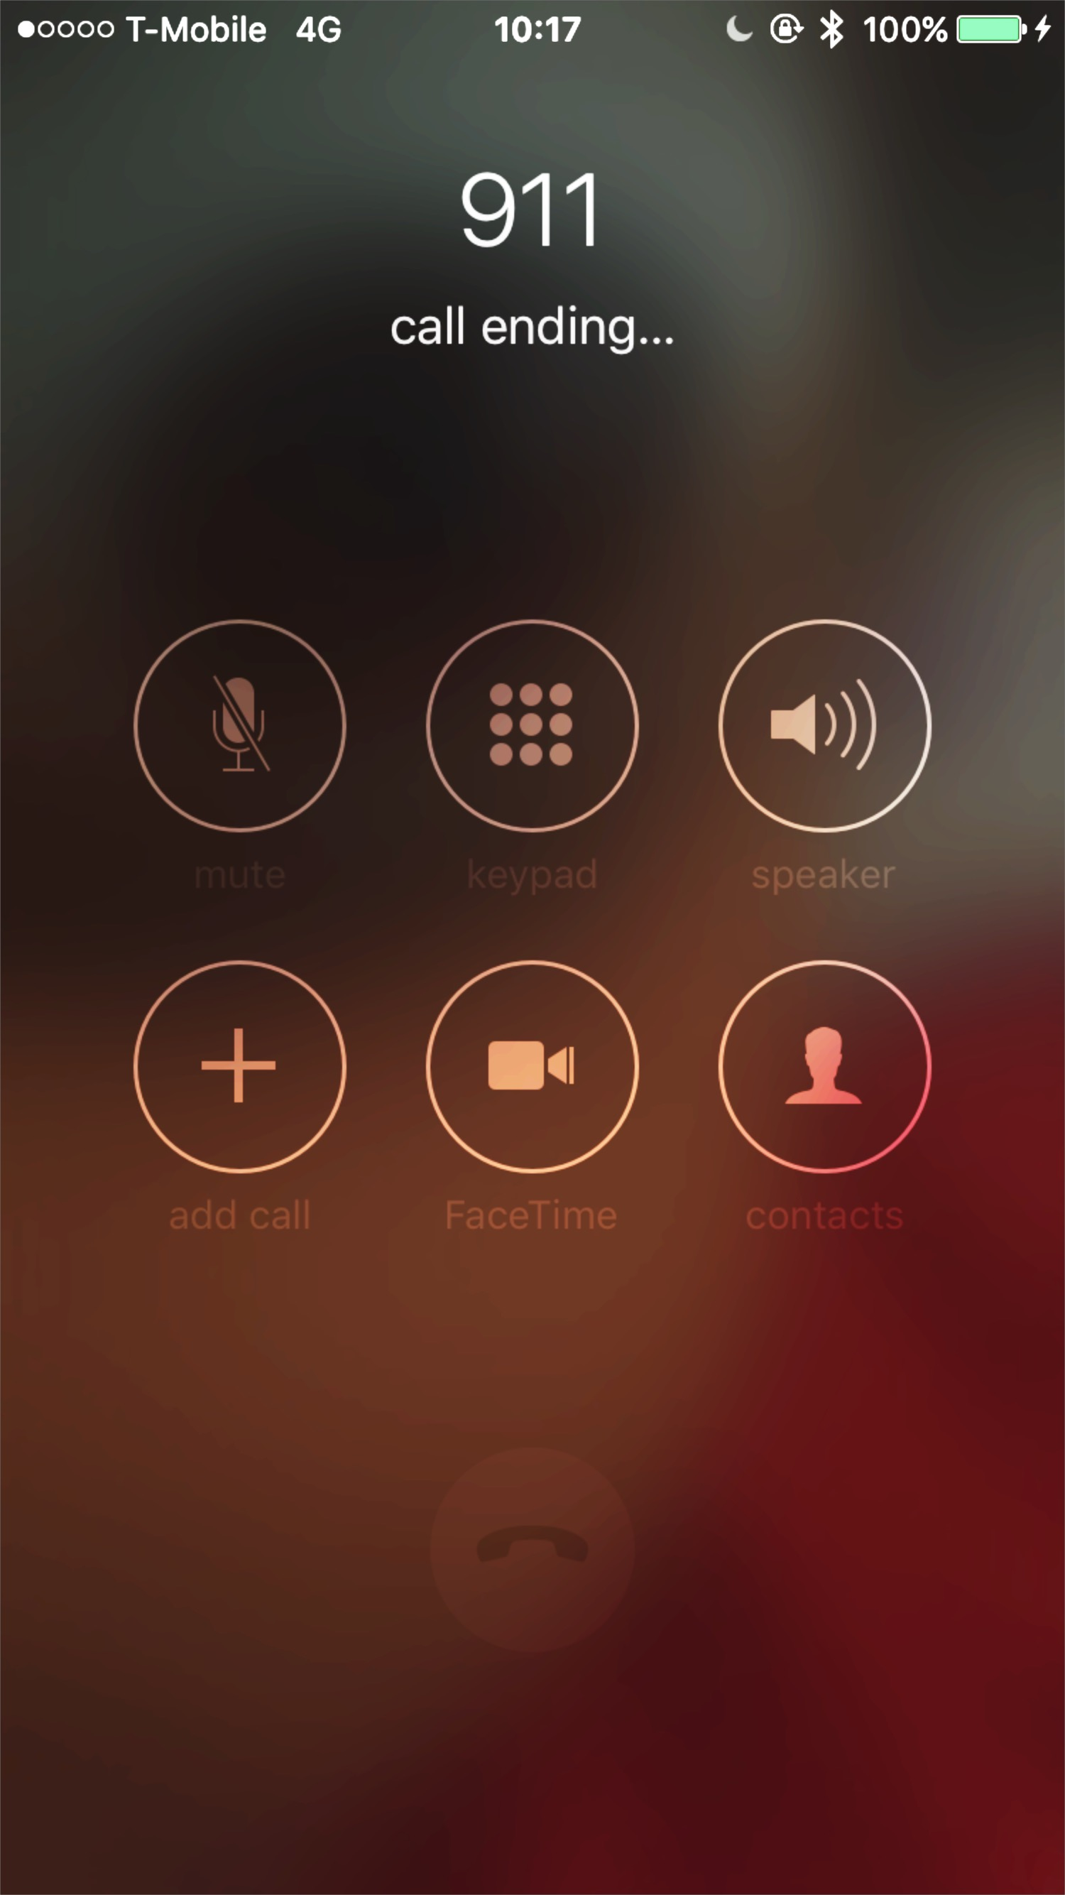
Gives real-time heart rate from the Microsoft Band 2.0
If rate is <40 bpm or >160 bpm, a text is sent to the emergency contact. Otherwise, a standard daily text is sent.

Slide 4
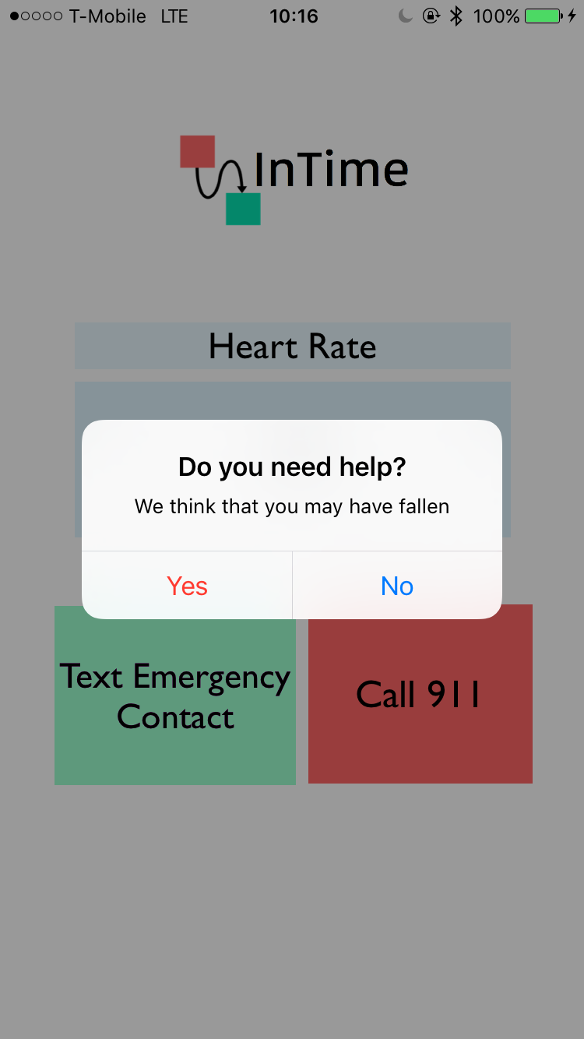
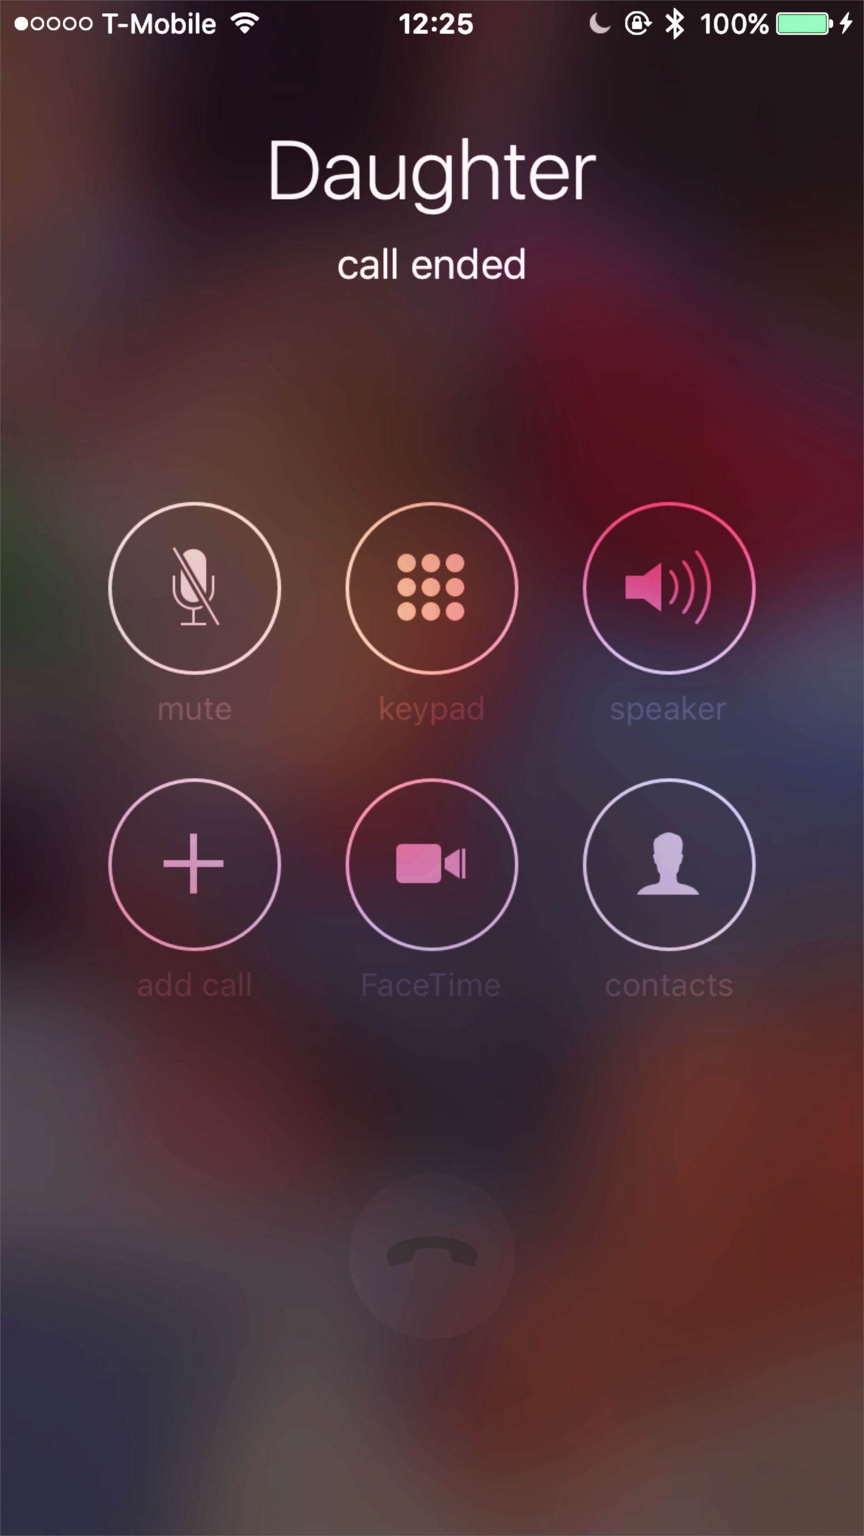
Uses an algorithm based on accelerometer data from the Microsoft Band 2.0
No further action is taken
If no response for 2 min:

Slide 5

Microsoft Band Kit iOS
MessageUI
CoreBluetooth
CoreLocation

Slide 6
Team BandAid
Namrita Murali
Gaurav Lahiry
Abhy Vytheeswaran
Sarika Bajaj

