Slide 1
Diabetes Prediction Using Ensembling of Different Machine Learning Classifiers
Gaurav Lodhi MT19063
Mansi Sharma MT19092
Era Sharma MT19121

Slide 2
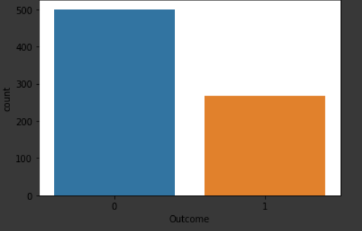
Aim :
Diabetes is a metabolic disease that causes high blood sugar . The risk factors and complication due to diabetes can be significantly reduced if the early prediction is possible. The accurate prediction of diabetes is different because of the outliers and missing data. In this paper, different machine learning,deep learning,ensemble methods are applied to predict whether the person is suffering from diabetes(label 1) or not(label 0). Here is the dataset class distribution.

Slide 3
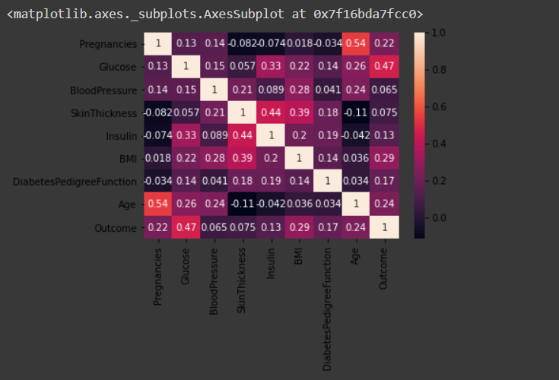
Data Preprocessing:
Missing values are filled
Outlier detection
Standardisation of data
Feature Selection
K-Fold Cross Validation
The heatmap shows correlation
Between all 8 features in order
To Get better understand
relation Between features
lighter the Color more similar is the 2 features

Slide 4
Methods applied
Machine Learning and deep learning model such as:
Decision tree
Random Forest
CNN
MLP
Naive Bayes
KNN

Slide 5
Methods applied
Ensembling model such as:
Bagging
Adaboost
Xgboost
ab+xb
knn+xg+dt
ad+knn+xg+dt
knn+xb+dt+rf+nb
knn+xb+dt+rf+nb+ad

Slide 6
Methodology:
Preprocessing of the data
Cross Validation
Hyper parameter tuning
Model fitting with best parameter
Results evaluation
New models fitted such as ensembler methods with different models to improve the performance

Slide 7
Results
Models | Precision | Recall | F1 score | Accuracy
KNN | 65.5 | 65 | 65.5 | 69
Decision tree | 69 | 70.5 | 69 | 71
Xg boosting | 73 | 73 | 73 | 75
Multi layer perceptron | 71 | 70.5 | 71 | 74
Random Forest | 72.5 | 73 | 73 | 75
Adaboosting | 72.5 | 72.5 | 72.5 | 75
Naive Bayes | 72 | 69.5 | 70.5 | 74
Bagging | 71 | 71.5l | 71 | 74

Slide 8
Models | Precision | Recall | F1 score | Accuracy
ab+xb | 86.1 | 78.3 | 82.01 | 89.3
knn+xg+dt | 84.4 | 77.8 | 80.9 | 88.5
ad+knn+xg+dt | 87.3 | 76.3 | 81.43 | 89.1
knn+xb+dt+rf+nb | 83.6 | 76.8 | 80.05 | 88.0
knn+xb+dt+rf+nb+ad | 81.3 | 77 | 81 | 89

Slide 9
New Analysis
Objective
Our Objective in this entire project was not only to improve the accuracy but also do the exploratory data analysis to see the impact of different factors on the outcome. We used different techniques to find these factors as well as to improve accuracy. One more objective we have was to find reproducibility of the proposed solution.

Slide 10
Exploratory Data analysis
We used sns heatmap to visualize the correlation between the features and to find the impact of one feature on the outcome. we found some interesting observations from this analysis
Glucose and age is heigh correlated to the outcome.
Age is heighly correlated to the pregnencies so one feature can represent both the features.
Blood pressure having very less correlation with the outcome. We can eliminate this feature for predicting the outcome.

Slide 11
Model improvement
Model accuracy in the selected paper was heigh and was the state of art model. But still we were able to improved the accuracy from 88% to 90% by using Keras Supported sequential model.
We also used accuracy weighted ensemble methods to improve stability of accuracy across the models. Previously used models were heighly oriented towards the roc auc score but this model is more stable for accuracy measure.

Slide 12
Conclusion
This was the state of the art heighly accurate model in the field of diabetes detection. We made this model more accurate by using our accuracy weighted approach. We also implemented a model by using Keras supported sequential model which is giving us significant improvement than the previous models.

Slide 13
Relevance
Used novel approaches are highly related to the previous research work. We worked in accuracy improvement as well as explore the possibilities in the dataset to find more useful inferences.

Slide 14
Thank You

