Slide 1
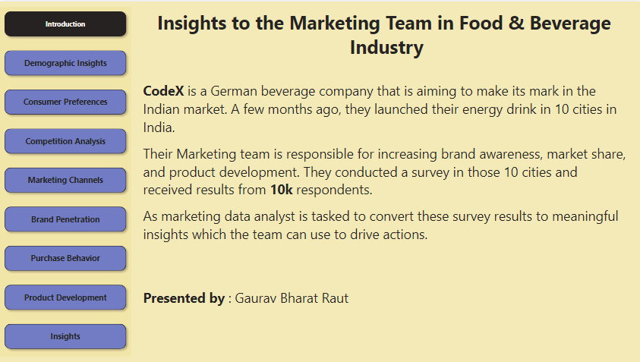

Slide 2
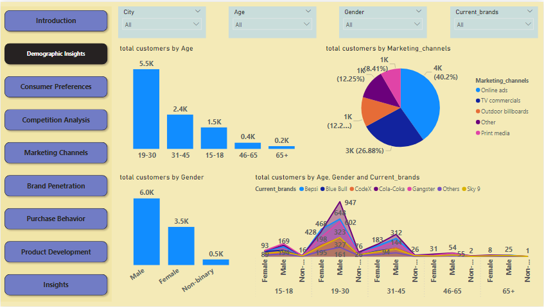

Slide 3
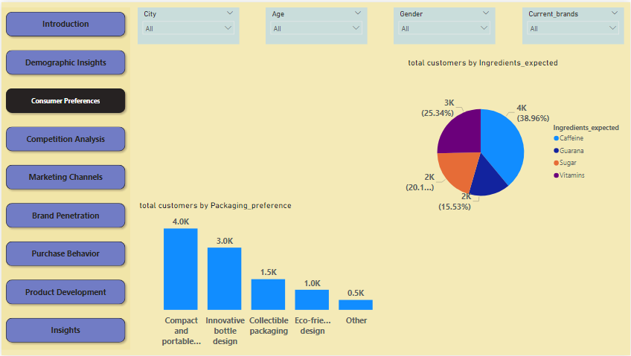

Slide 4
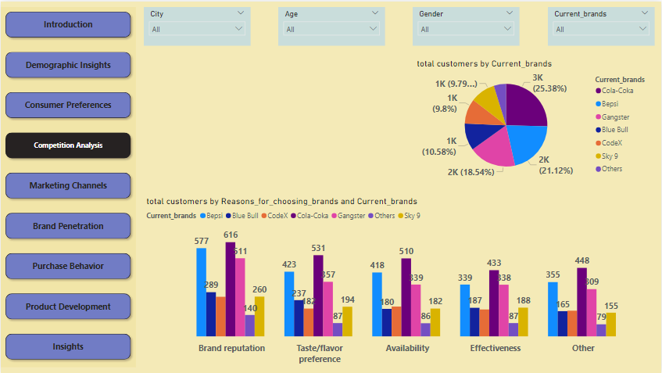

Slide 5
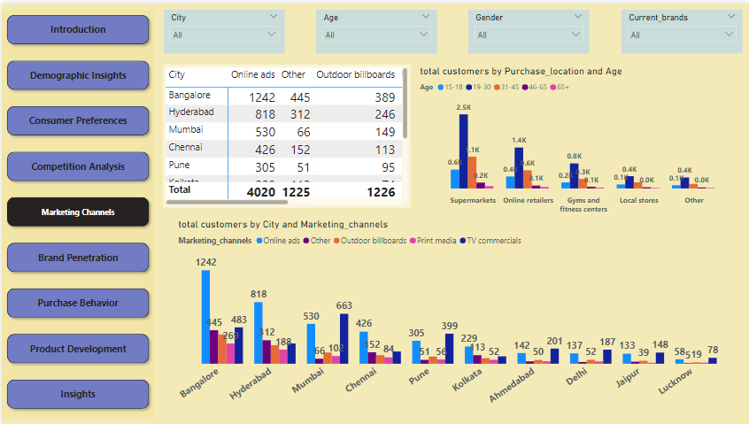

Slide 6
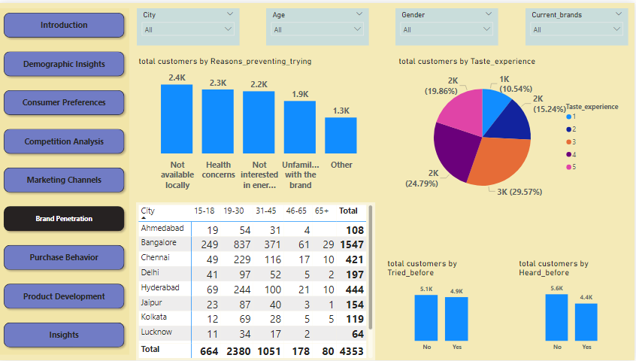

Slide 7
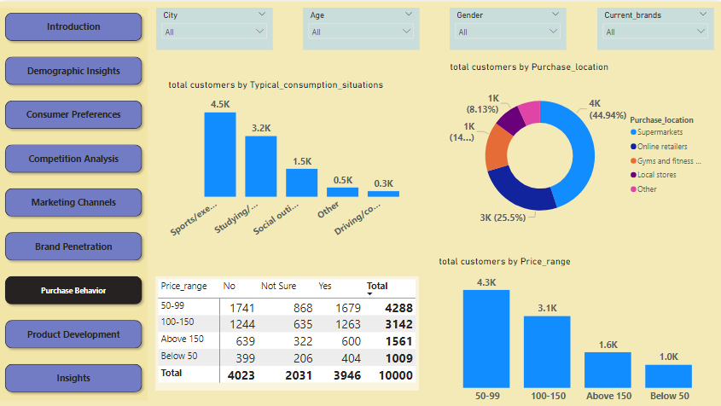

Slide 8
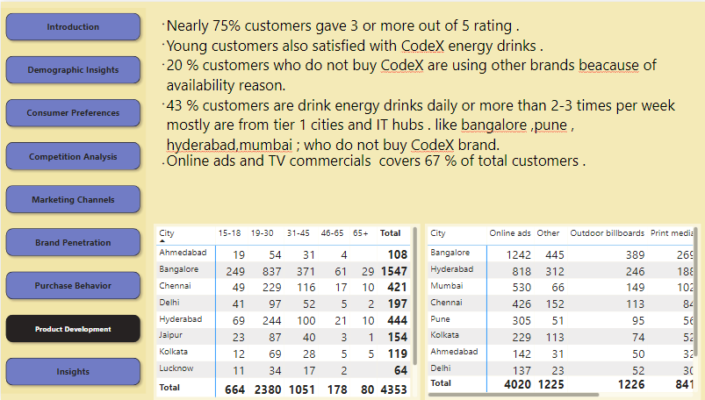

Slide 9
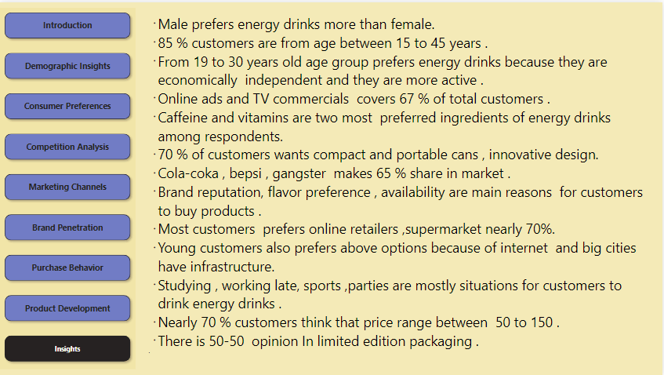

Slide 10
What should be the ideal price of our product?
73% of CodeX customers wanted price to be within range from 50-150 Rupees. So ideal price would be 70-120 rupees.
Who should be our target audience, and why?
Customers age from 15-30 ,tier 1 cities bengaluru , mumbai , hyderabad , pune . beacause most of these cities are IT hub and customers are from mid-income class.
Internet connectivity is also available in these , marketing on digital platforms would be easy for CodeX company.

Slide 11
What immediate improvements can we bring to the product?
with creating different types of flavor of energy drink .
Online retailers and supermarkets are most suitable options for customers to buy energy drinks .
Energy drinks cans design must be innovative , compact and portable.

Slide 12
THANK YOU

