Slide 1
Provide Insights For Telangana Government Tourism Department
Telangana is one of India’s leading states and has published its tourism data under its open data policy.
As a data analyst, find the patterns in the given data, do additional research, and give data-informed recommendations to the Telangana government which can be used to increase their revenue by improving administrative operations.
Presented by : Gaurav Bharat Raut

Slide 2
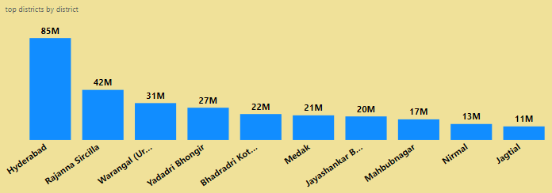
List down top 10 districts that have highest number of domestic visitors overall (2016 – 2019)?
Hyderabad being the first among top 10 districts that stand with regard to highest number of domestic visitors from 2016 – 2019, followed by Rajanna Siricilla, Warangal (Urban).

Slide 3
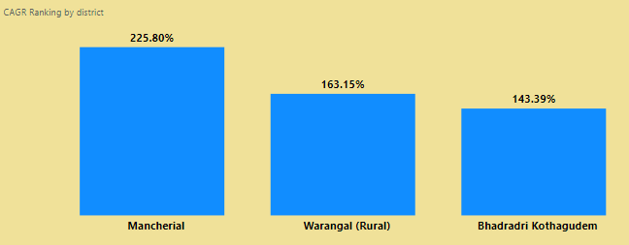
List down top 3 districts based on compounded annual growth rate (CAGR) of visitors between (2016 – 2019)?
Based on CAGR the top 3 districts of visitors from 2016 – 2019 are Mancherial , Warangal(Rural) , Bhadradri Kothagudem

Slide 4
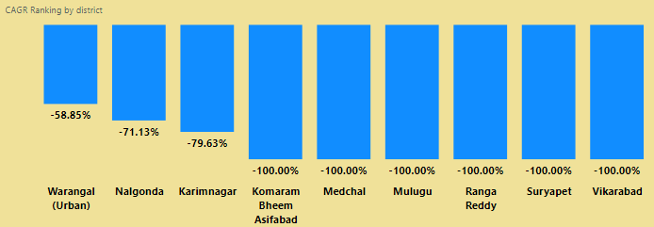
List down bottom 3 districts based on compounded annual growth rate (CAGR) of visitors between (2016 – 2019).
Based on CAGR the bottom 3 districts of Visitors from 2016 – 2019 are Karimnagar , Nalgonda , Warangal (Urban)

Slide 5
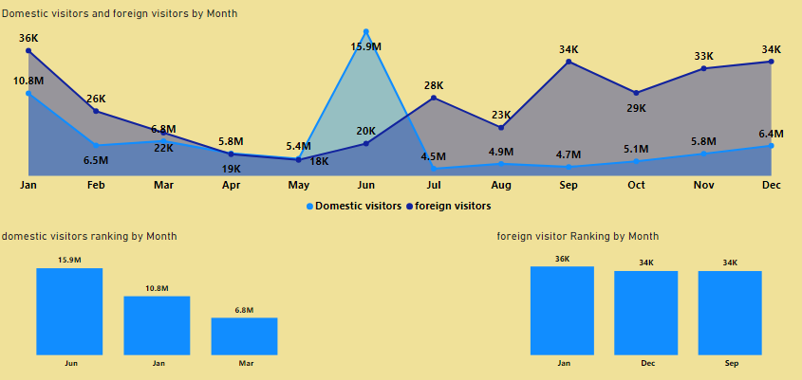
What are the peak and low season months for Hyderabad based on the data from 2016 – 2019 for Hyderabad district ?
June is the peak month due to the celebration of Telangana Formation Day.

Slide 6
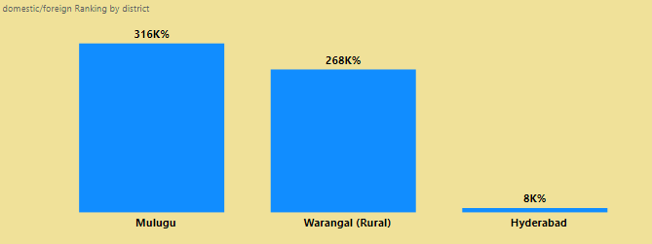
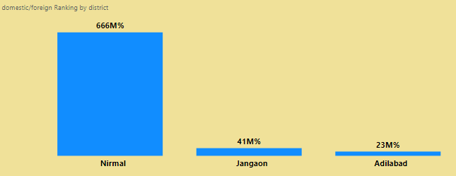
Show top and bottom 3 districts with high domestic to foreign tourist ratio?
The top and bottom districts based on domestic to foreign ratio are as follows :
BOTTOM
TOP

Slide 7
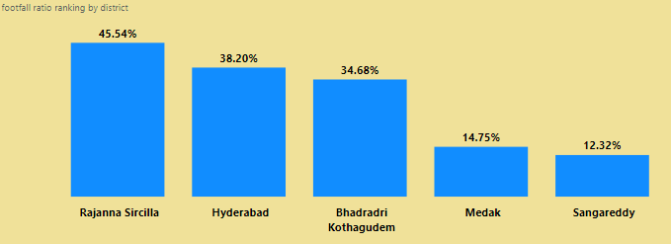
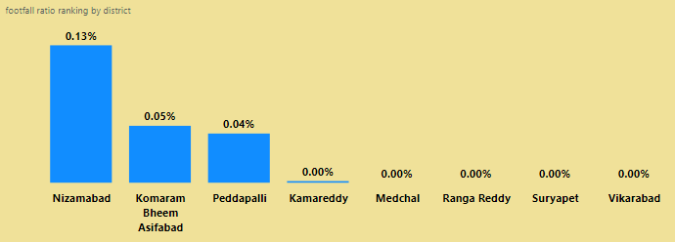
List down top and bottom 5 districts based on ‘population to tourist footfall ratio’ in 2019?
The top and bottom districts based on population to tourist footfall ratio in 2019 are as follows :
TOP
BOTTOM

Slide 8
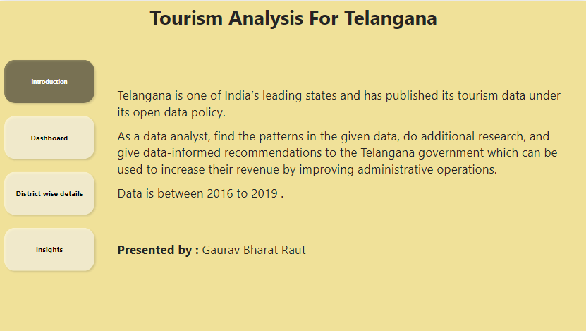

Slide 9
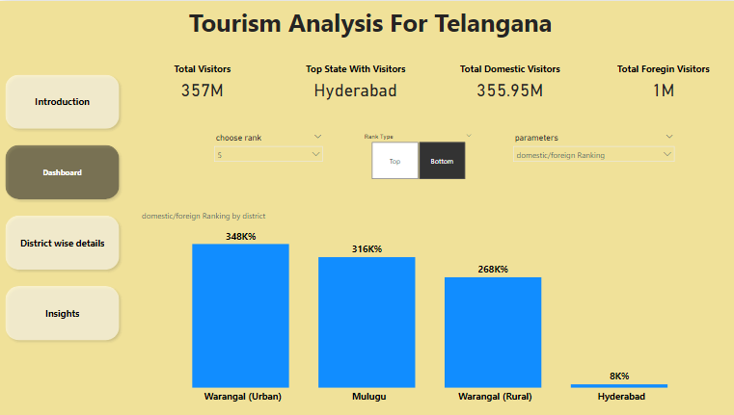

Slide 10
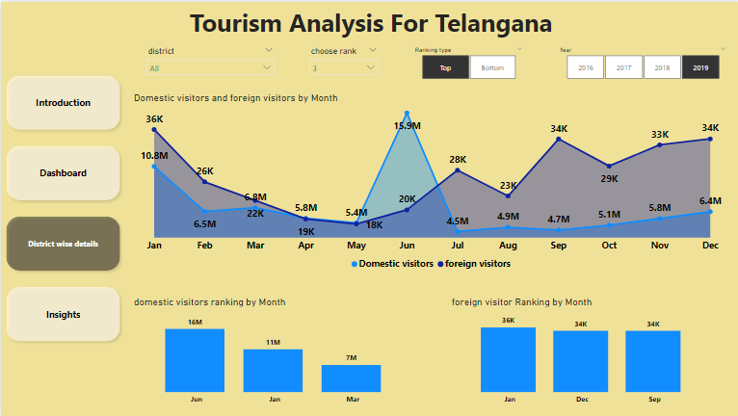

Slide 11
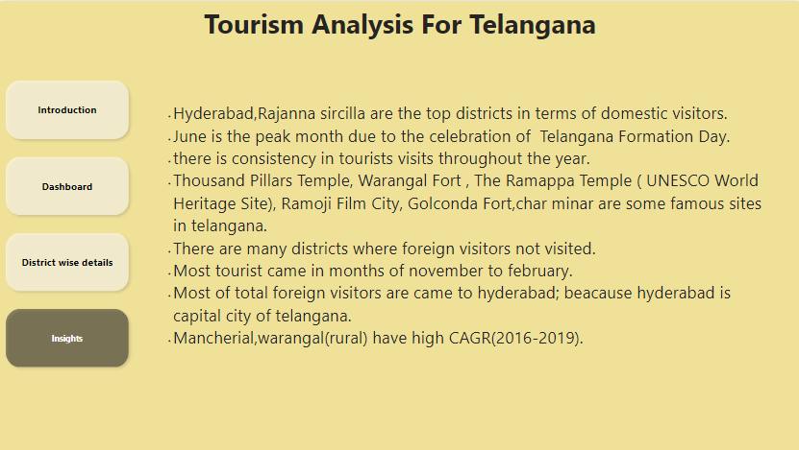

Slide 12
THANK YOU

