Slide 1
Tweet analysis and visualization
Rajyash Gosalia
Gaurav Shah
Ashish Patel

Slide 2
Project Overview
400 million tweets / day recorded by tweeter in SEP 2013.
Tweets tells us about individual’s thinking.
Main idea behind collecting tweets is to come up with numerical analysis.
We are collecting tweets of ,
Google
Yahoo
eBay
Amazon

Slide 3
Data Collection
Tweets collected using Tweepy API.
Primarily data was too bulky.
So collected data was cleaned and only the relevant fields are retained.
Date
Tweet
Timezone
Location
Language

Slide 4
Analysis
MapReduce jobs were run on the accumulated data to come up with specific results.
Analysis List :
Tweets / second
Followers count
Languages used in tweets

Slide 5
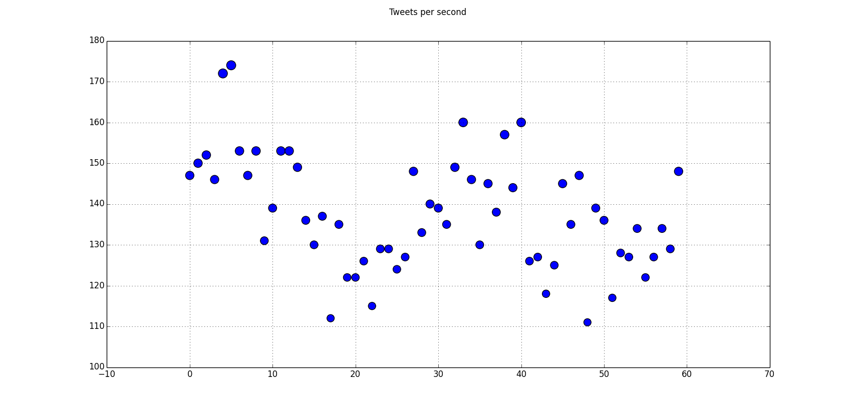
Scatter Plot (Tweets per second) - Google

Slide 6
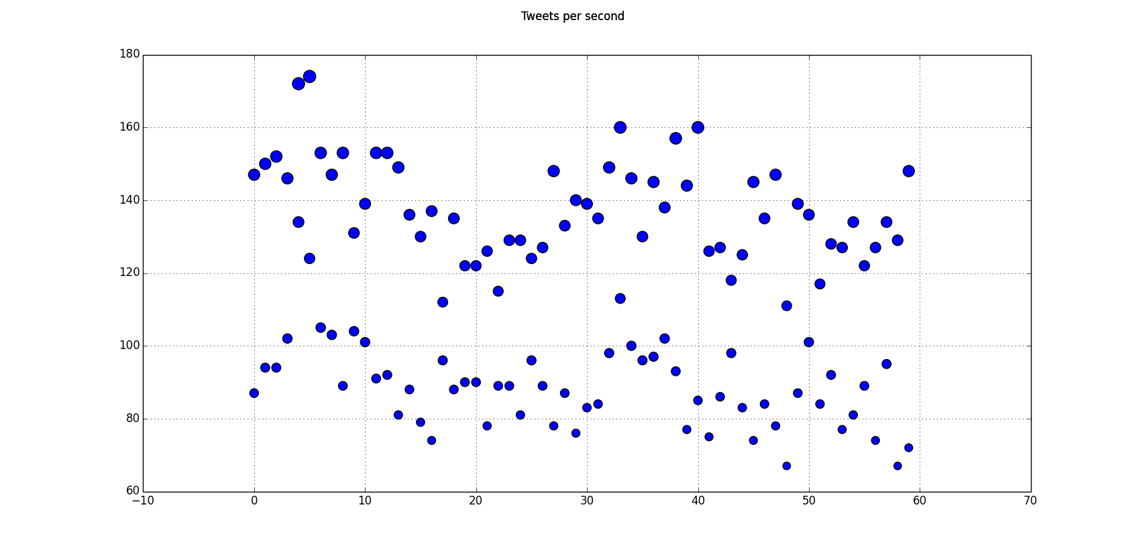
Scatter Plot (Tweets per second) - Yahoo

Slide 7
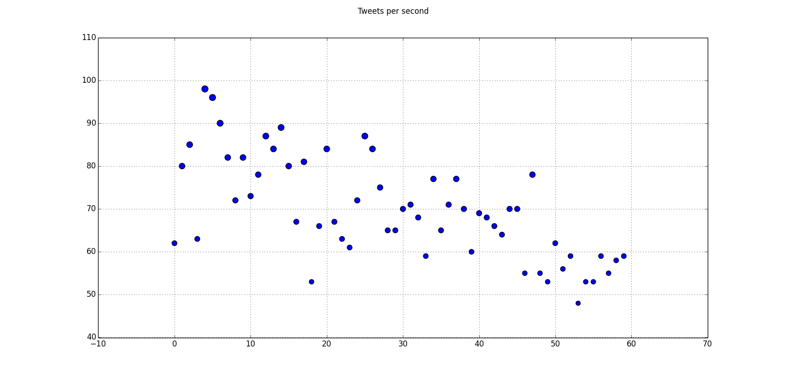
Scatter Plot (Tweets per second) - Amazon

Slide 8
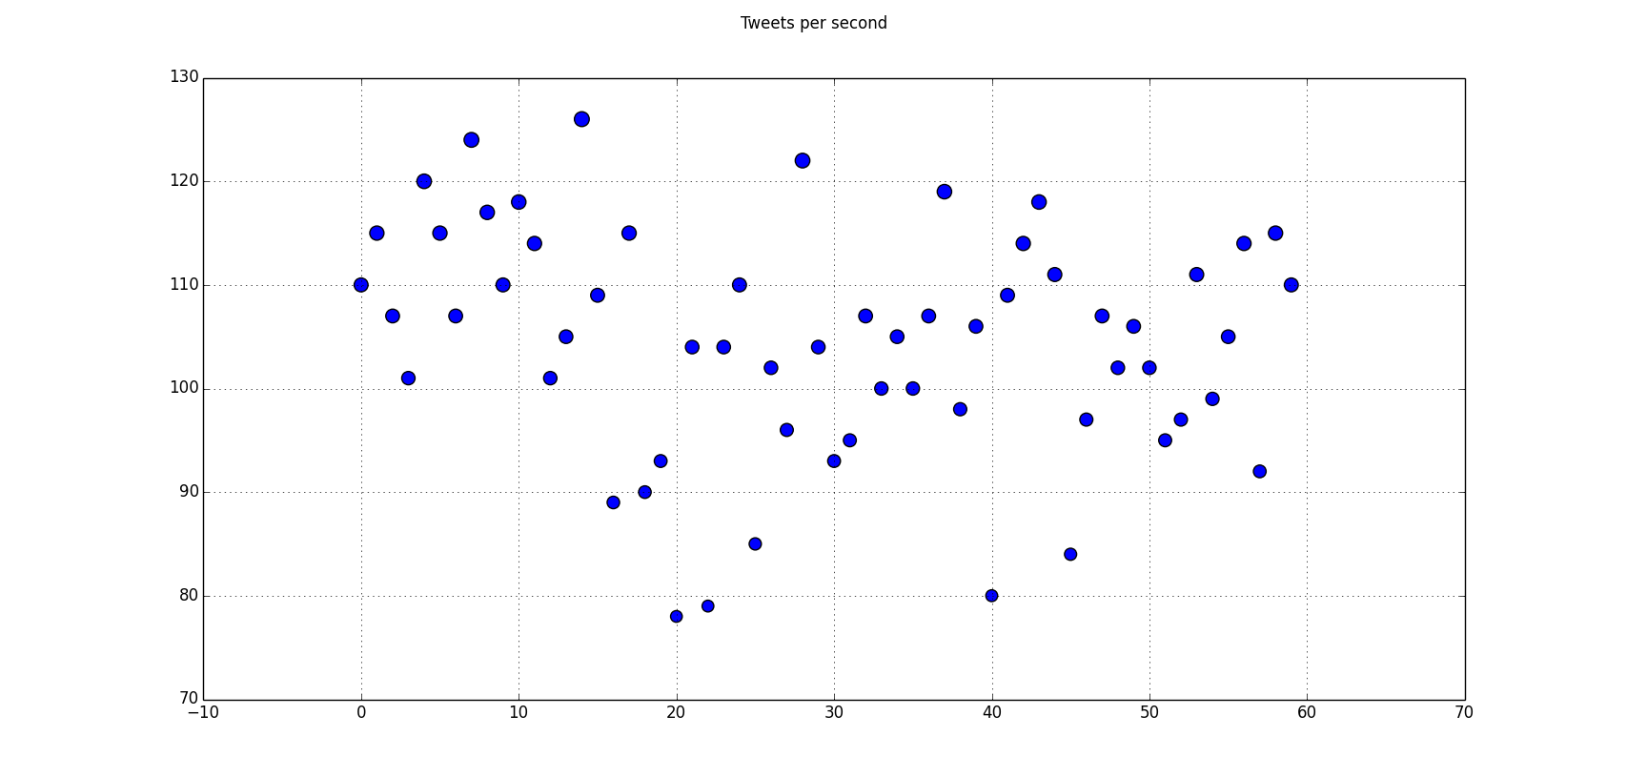
Scatter Plot (Tweets per second) - eBay

Slide 9
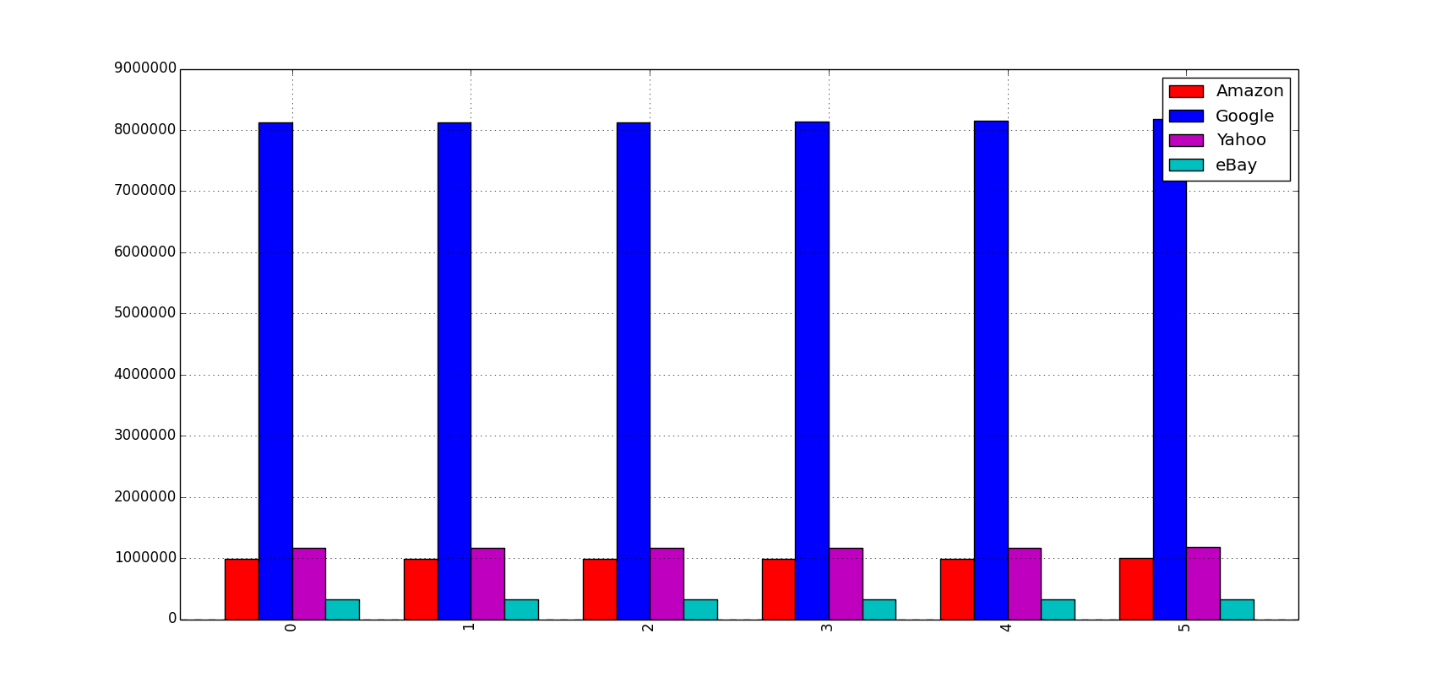
Histogram (Followers count)

Slide 10
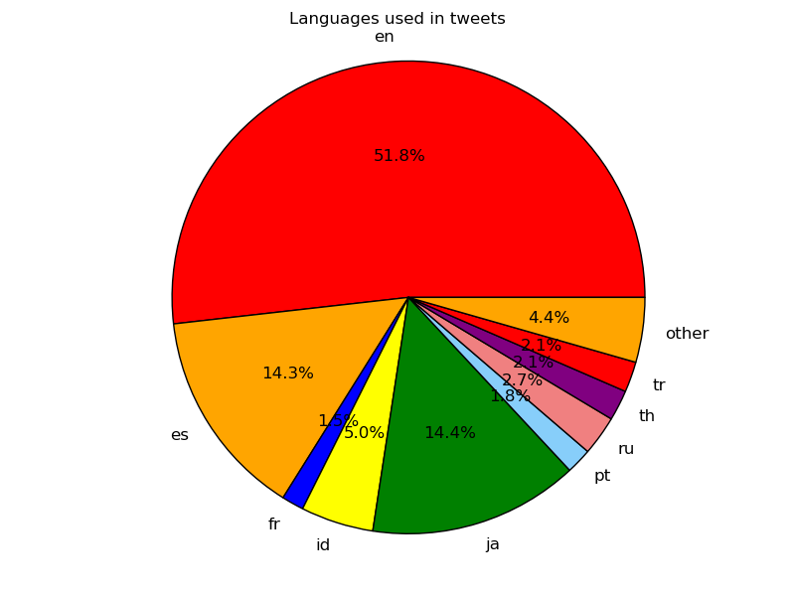
Pie chart (Language used in tweets) - Google

Slide 11
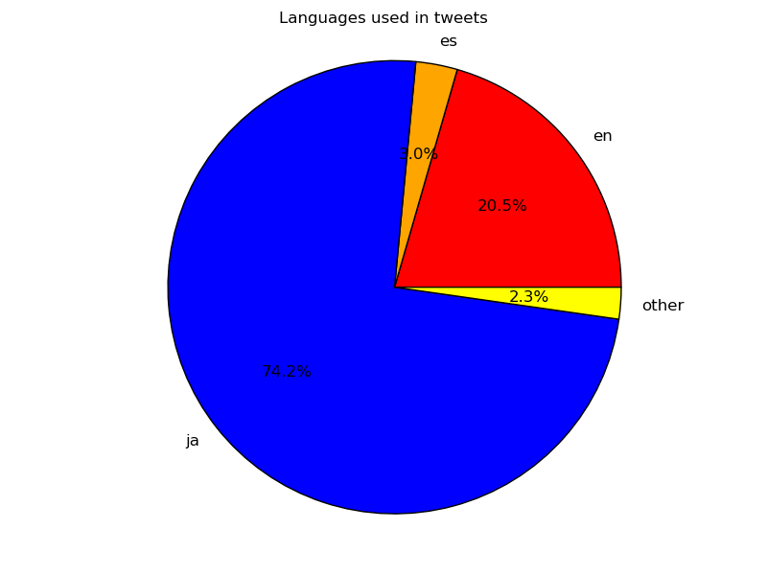
Pie chart (Language used in tweets) - Yahoo

Slide 12
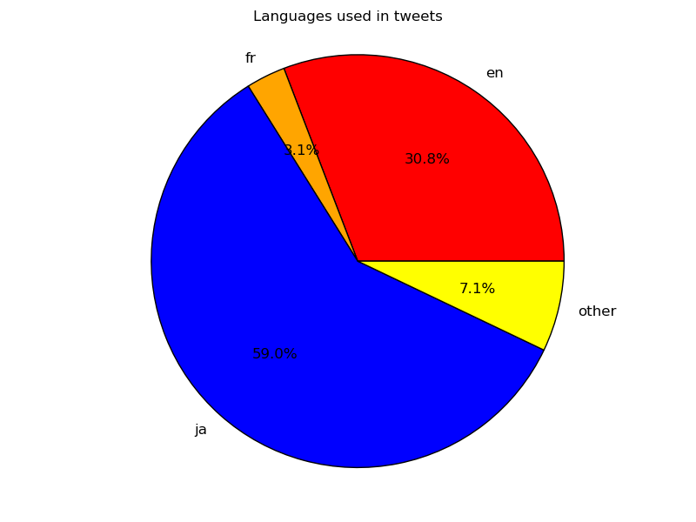
Pie chart (Language used in tweets) - Amazon

Slide 13
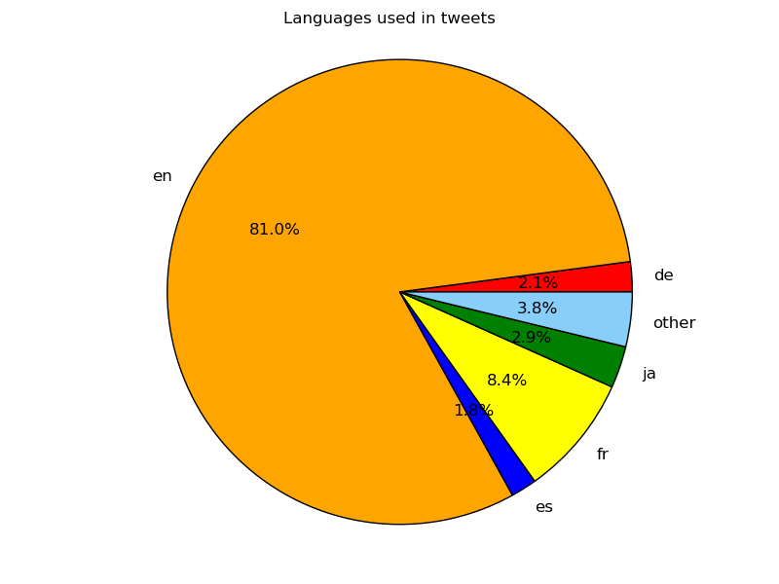
Pie chart (Language used in tweets) - eBay

Slide 14
Thank you

