Slide 1

Professionalism & Power Skills Job Simulation
INTERNSHIP PRESENTATION
Gaurav Mishra
Roll No.: 25SCS1003000831
B.Tech (CSE) | Batch 2025–2029
School of Computer Science and Engineering
IILM University, Greater Noida, U.P.

Slide 2
Candidate & Activity Overview
Student
Academic Programme
Gaurav Mishra | Roll No. 25SCS1003000831
B.Tech (CSE) | Batch 2025–2029
Simulation
Completion
Professionalism & Power Skills Job Simulation
September 9, 2026
Verified task areas
First impressions and communication • Teamwork and problem solving

Slide 3
Certificate-Supported Scope
• The uploaded certificate identifies the activity as a Forage Professionalism & Power Skills Job Simulation.
• It records practical tasks in first impressions and communication.
• It records practical tasks in teamwork and problem solving.
• The certificate does not state an employer department, technical stack, live project, or production deployment.

Slide 4
Why These Skills Matter
First impressions
Communication
Teamwork
Professional introductions, confidence, appropriate tone and attentive listening.
Clear purpose, concise wording, respectful language and active listening.
Shared goals, coordination, reliability and task ownership.
Problem solving
Reflection
Define the issue, consider options and choose a constructive next step.
Review performance and convert feedback into a specific improvement action.

Slide 5
Project Introduction
Project title
Core idea
Professional Workplace Communication and Team Problem-Solving Simulation An academic representation of the verified learning areas in the certificate.
Scenario → skill identification → response planning → communication → collaboration/problem solving → reflection → improvement action.

Slide 6
Problem Statement & Proposed Solution
Problem
Proposed solution
Students may know communication and teamwork concepts but lack a repeatable method for applying them in realistic situations.
Use a six-stage scenario workflow that makes professional behaviour observable, explainable and reviewable.

Slide 7
Project Objectives
• Turn professional-skills concepts into observable actions.
• Provide a consistent process for communication and teamwork scenarios.
• Apply structured problem solving to workplace-style situations.
• Use reflection to identify strengths and improvement areas.
• Build confidence for academic teamwork and an initial professional role.

Slide 8
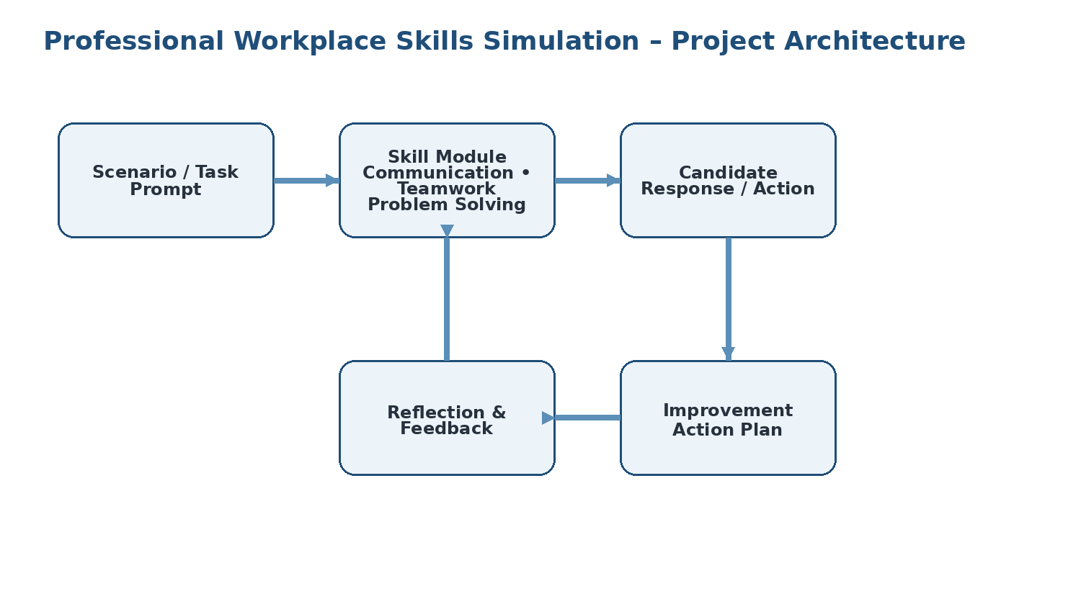
Project Architecture

Slide 9
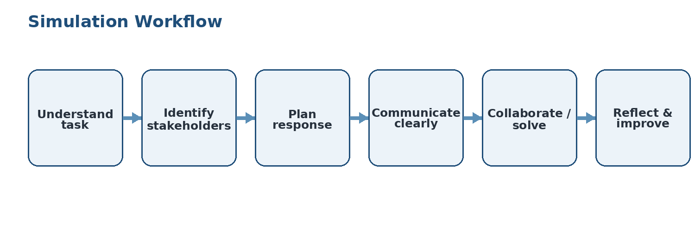
Methodology / Workflow
The cycle can be repeated with new scenarios to build consistency and confidence.

Slide 10
Major Modules
01
02
03
04
05
First Impressions Practical scenario-based application.
Communication Practical scenario-based application.
Teamwork Practical scenario-based application.
Problem Solving Practical scenario-based application.
Reflection Practical scenario-based application.
Integrated outcome
Professional response + constructive collaboration + actionable reflection.

Slide 11
Implementation Logic
START
Receive workplace scenario
Identify objective and stakeholders
Select relevant skill
Plan and communicate response
Collaborate / solve
Review outcome and feedback
Record improvement action
END

Slide 12
Testing & Results
Scenario review
Evaluation criteria
Result
Five review cases were defined: first impression, communication, teamwork, problem solving and reflection.
Clarity • Respect • Cooperation • Ownership • Logic • Actionability
The framework is suitable for repeated practice and aligns with the two task areas explicitly recorded on the certificate.

Slide 13
Challenges & Solutions
• Unclear situation → clarify the objective before responding.
• Professional tone → use neutral, respectful and concise language.
• Competing team priorities → focus on the shared goal and take ownership of a realistic task.
• Assumptions in problem solving → separate known facts from assumptions and compare options.

Slide 14
Skills & Learning Outcomes
• Professional communication and active listening
• Positive first-impression awareness
• Team coordination and task ownership
• Structured and constructive problem solving
• Self-reflection and continuous improvement
• Greater confidence for academic and early-career situations

Slide 15
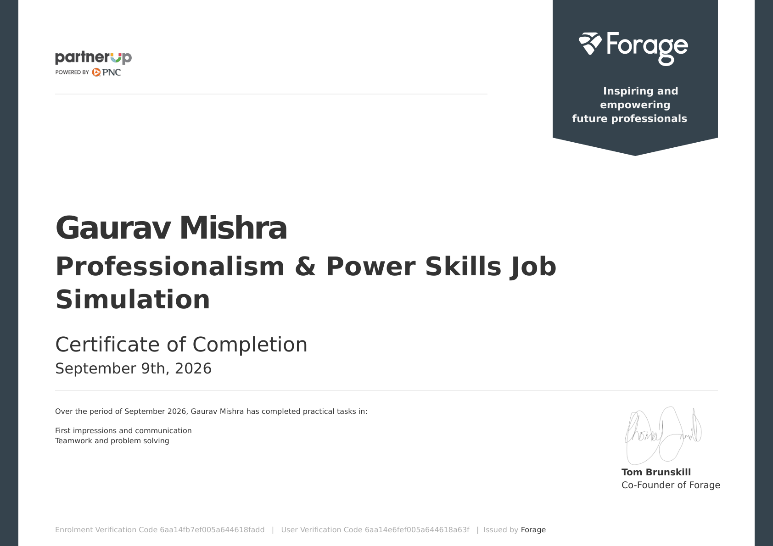
Certificate of Completion

Slide 16
Future Scope & Conclusion
Future scope
Conclusion
Add conflict-resolution and meeting scenarios; use peer/mentor rubrics; track repeated attempts; combine professional-skills practice with technical projects.
The simulation strengthened practical communication, teamwork and problem-solving behaviours. These skills complement technical education and support readiness for future academic and professional work.

Slide 17
Thank You!
Gaurav Mishra
Roll No: 25SCS1003000831
School of Computer Science & Engineering
IILM University, Greater Noida, U.P.

