Slide 1
Project Title
LOAN-PREDICTION
(group-07)
Team Member and Roll No.
Gautam Kumar(2210991577)
Gaurav Anand(2210991570)
Himanshu(2210991664)
Nidhish(221099606)

Slide 2
Index
Introduction
Source Code (screenshots)
Conclusion
Reference

Slide 3
INTRODUCTION
Introduction
In the modern financial landscape, the ability to accurately predict loan repayment behavior is crucial for lending institutions. Traditional credit scoring methods, while effective, can be limited by their reliance on a narrow set of variables and historical data. To enhance the accuracy and reliability of loan predictions, financial institutions are increasingly turning to advanced techniques in Artificial Intelligence (AI) and Machine Learning (ML).
Purpose
The primary objective of this project is to develop a robust machine learning model capable of predicting whether a loan applicant is likely to default on their loan. By leveraging AI/ML techniques, the project aims to improve the decision-making process, reduce risk, and enhance profitability for lending institutions

Slide 4
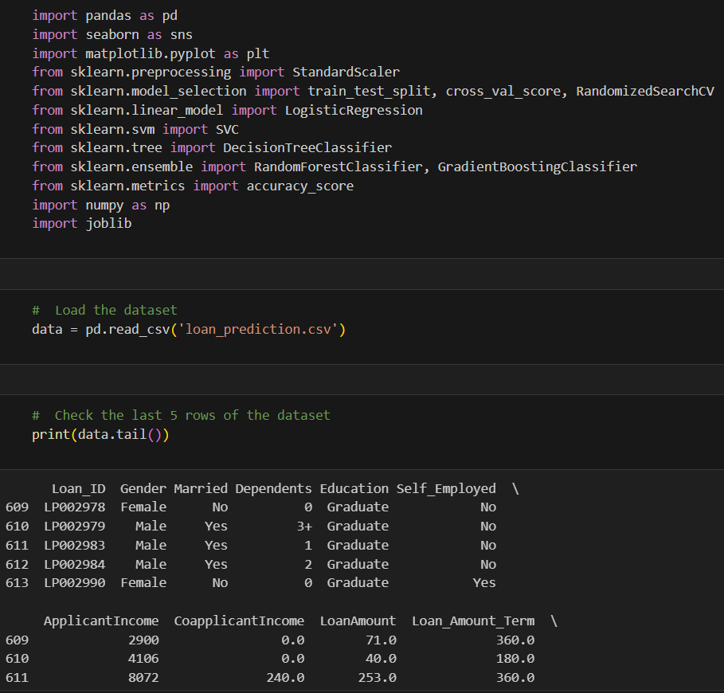
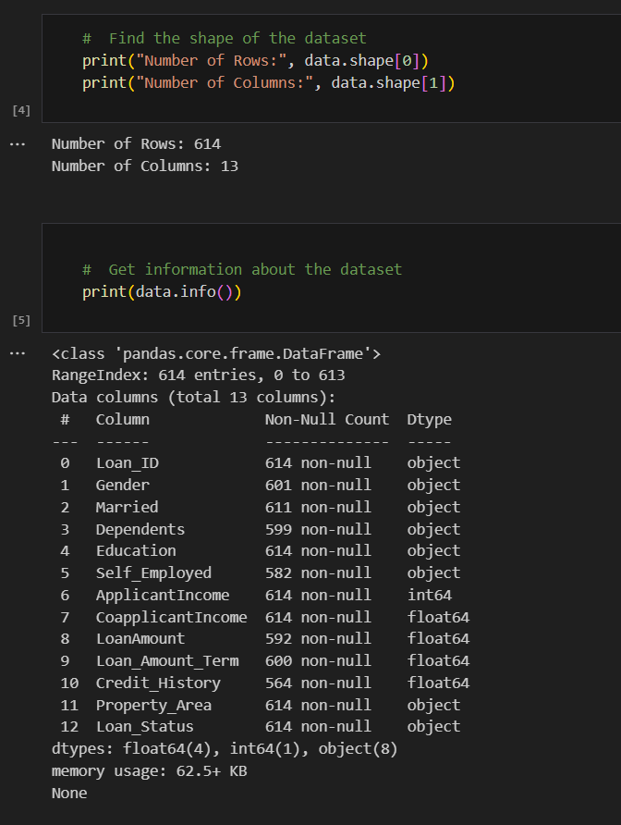
SOURCE-CODE
This is how out project looks:

Slide 5
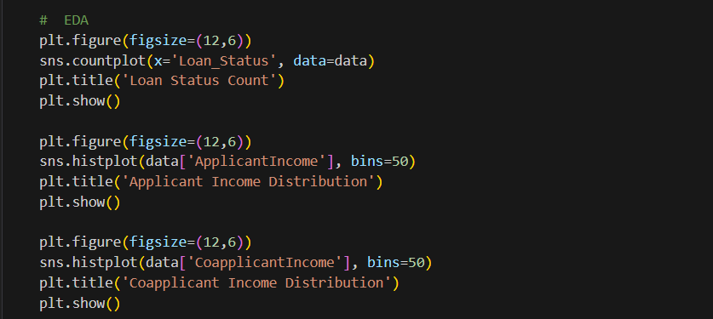
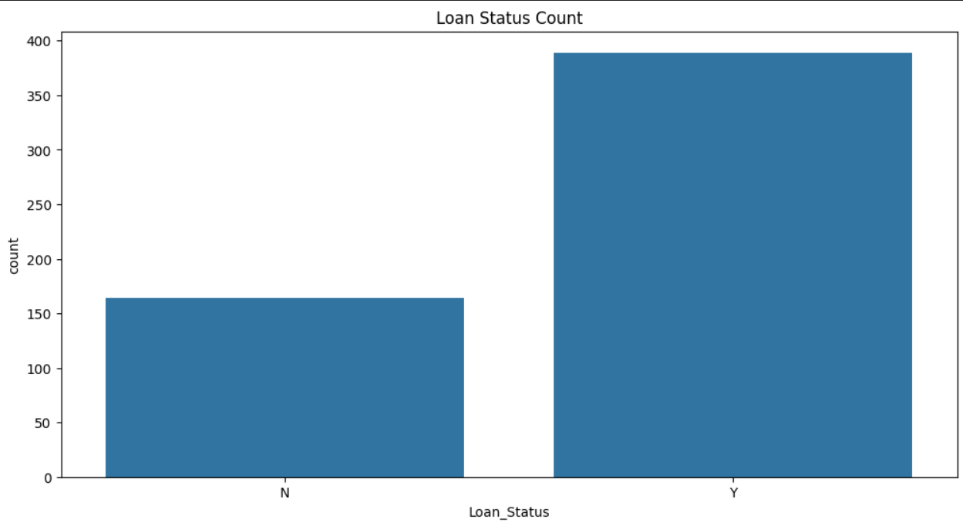
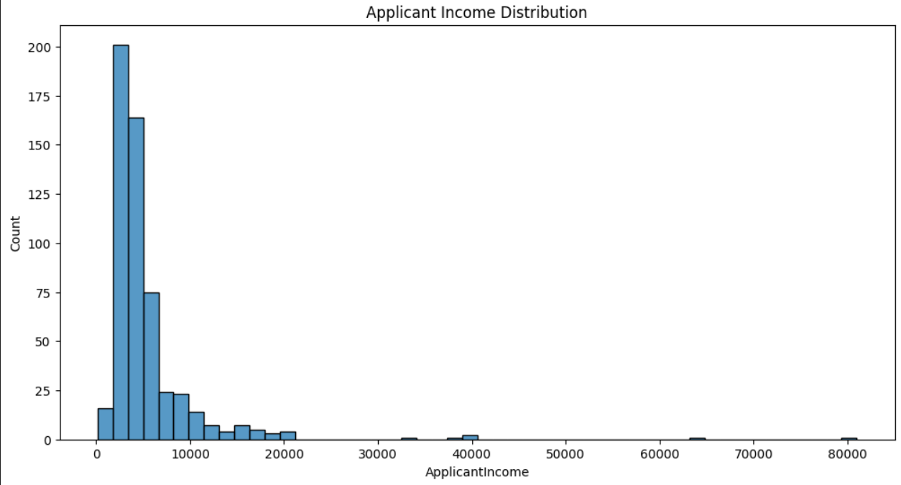
Continue…

Slide 6
CONCLUSION
Objective Achievement:
The primary goal of developing a predictive model for loan approval was successfully met. The model accurately predicts the likelihood of loan approval based on a variety of borrower attributes.
Model Performance:
The final model demonstrated high accuracy, precision, recall, and F1-score on both the training and test datasets, indicating its robustness and generalizability.
Feature Importance:
Key features influencing loan approval include applicant income, loan amount, credit history, and employment status. These insights can help in refining loan eligibility criteria and risk assessment processes.

Slide 7
Reference
https://www.kaggle.com/datasets/altruistdelhite04/loan-prediction-problem-dataset
https://youtu.be/p3-7qW_t5bw?si=5LO8HU3s-ziwG56L

Slide 8
The End

