Slide 1
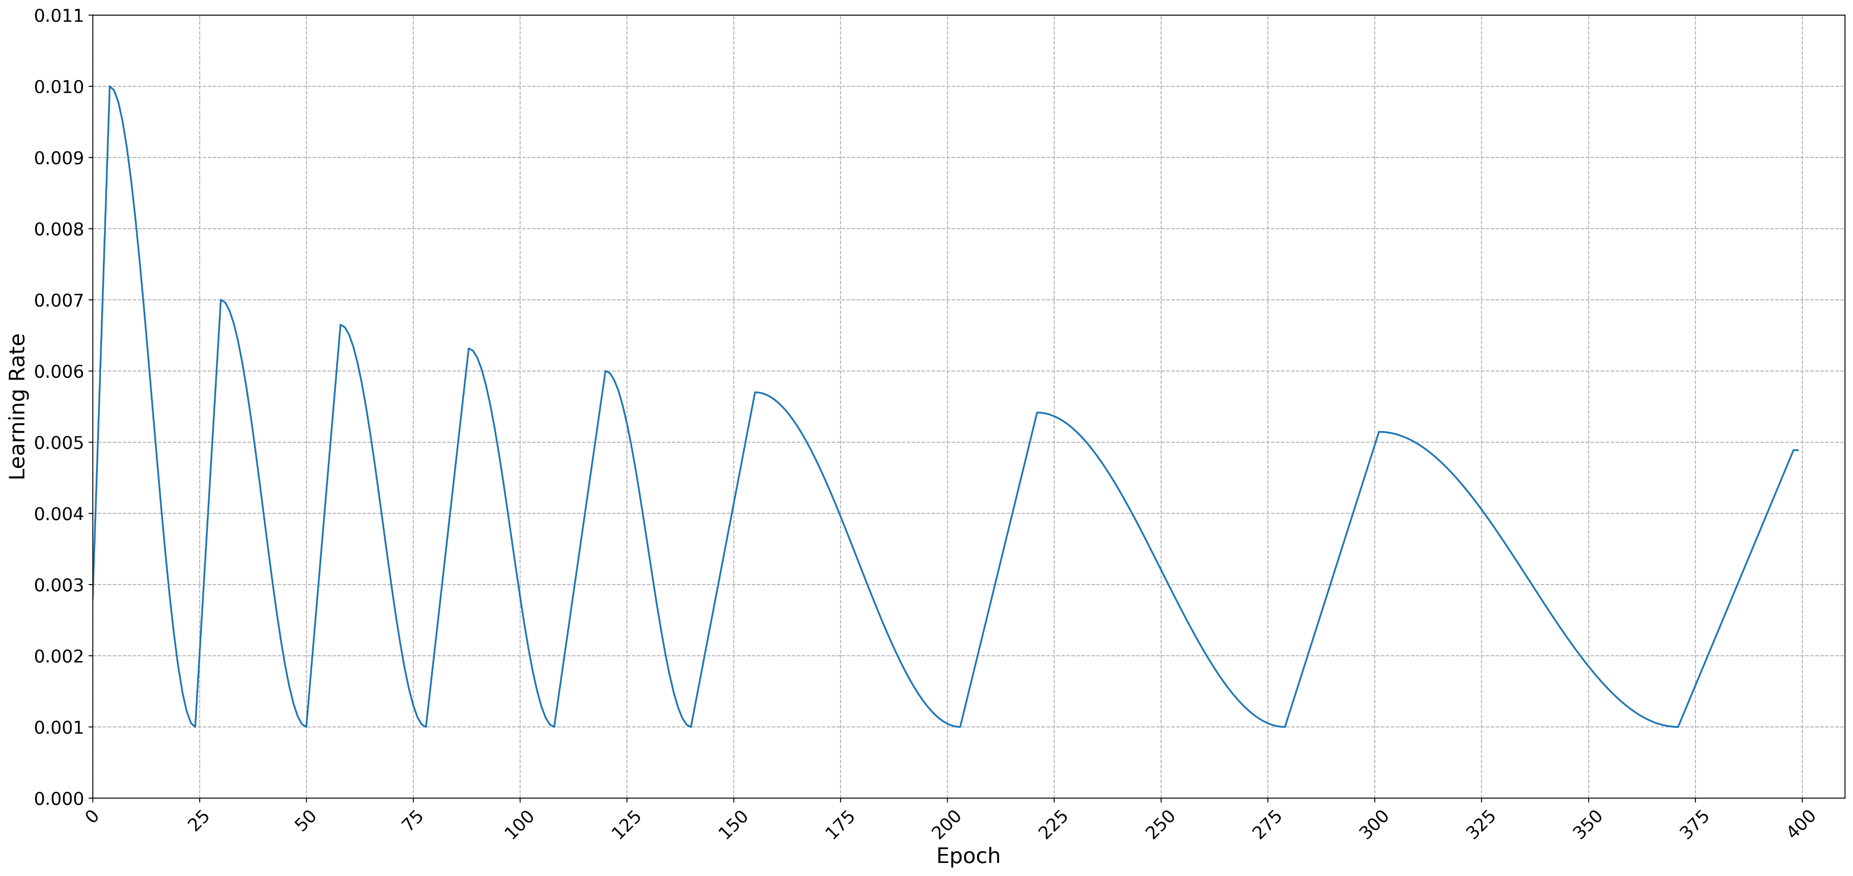
if_warmup_or_cooldown_start = 0
(0 for warmup start, 1 for cooldown start)
max_lr
first_lr_drop_mult
general_lr_decay
if_post_warmup = 1
(0 for no warmup after first cycle, 1 for warmup after first cycle)
warmup_length (W₅)
W_{t} = W_{t-1} * warmup_mult_factor
min_lr
init_cooldown_length (T₀)
T_{i} = T_{i-1} * init_cooldown_mult_factor
new_cooldown_length (nT₀)
nT_{i} = nT_{i-1} * new_cooldown_mult_factor
number_of_cooldowns_before_switch = 6
(number of cooldowns when switch to a new cooldown length)

