Slide 1
Hardware accelerated sorting
CPE-593 Applied Data Structures and Algorithms – (FaLL 2022)
23
43
34
4-element sorter
FIFO
26
34
43
63
>?
26
63
Finite state machine
20
MUX 2:1
27
4-element sorter
FIFO
2
13
20
26
27
34
43
63
2
13
20
27
13
2
Gaurav Dubey & Michael Salek

Slide 2
Outline
What is hardware acceleration?
Why hardware acceleration?
When to use hardware acceleration?
Merge Sort
Illustration
Hardware implementation
FIFO-based merge sorter
Bitonic sorter
Implementation I
Implementation II
Implementation III
Result and Conclusion

Slide 3
What is hardware acceleration?
Hardware acceleration refers to the process by which an application will offload certain computing tasks onto specialized hardware components within the system, enabling greater efficiency than is possible in software running on a general-purpose CPU alone.

Slide 4
Why hardware acceleration?
Running software requires computing resources that are typically shared with other tasking on the system. Depending on the other tasks being performed on the system run times can vary
When software is compiled to machine code, additional instructions may be added
Hardware acceleration can provide dedicated computing resources for a specialized task/function
Hardware provides the ability to implement parallelism
Amdahl’s law

Slide 5
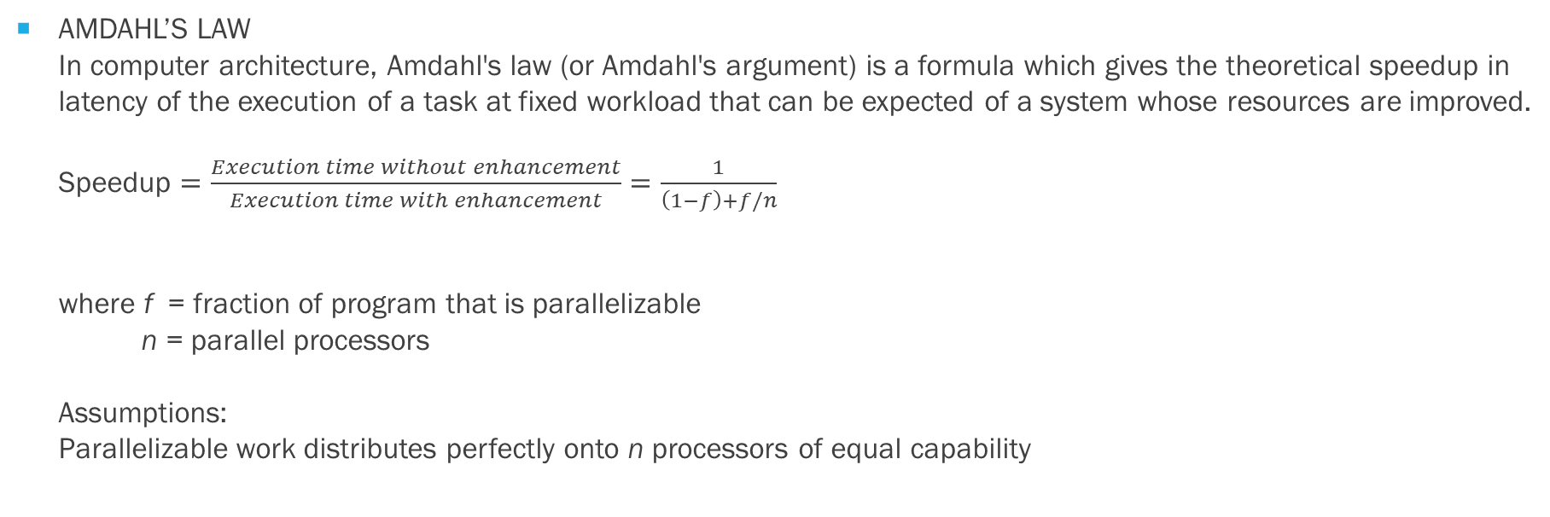
When to use hardware acceleration?
AMDAHL’S LAW In computer architecture, Amdahl's law (or Amdahl's argument) is a formula which gives the theoretical speedup in latency of the execution of a task at fixed workload that can be expected of a system whose resources are improved. Speedup $=\frac{Execution time without enhancement}{Execution time with enhancement}=\frac{1}{\left(1−f\right)+f/n}$ where f = fraction of program that is parallelizable n = parallel processors Assumptions: Parallelizable work distributes perfectly onto n processors of equal capability

Slide 6
Merge SORT
Merge Sort is a Divide and Conquer algorithm. Implementation of this algorithm involves three steps i.e. divide, conquer and merge.
The algorithm divides the input array into two sublists, then it separates these two sublists into four sublists, this process is continued until the lists are broken down until they can no longer be divided, leaving N sublists with just 1 element each, these N sublists can be considered as sorted. Here N is the length of the input array to be sorted.
Once these lists cannot be broken down further, it starts merging these N sublists such that merged lists are sorted in a particular order (say ascending order), conquering sort problem one step at a time.

Slide 7
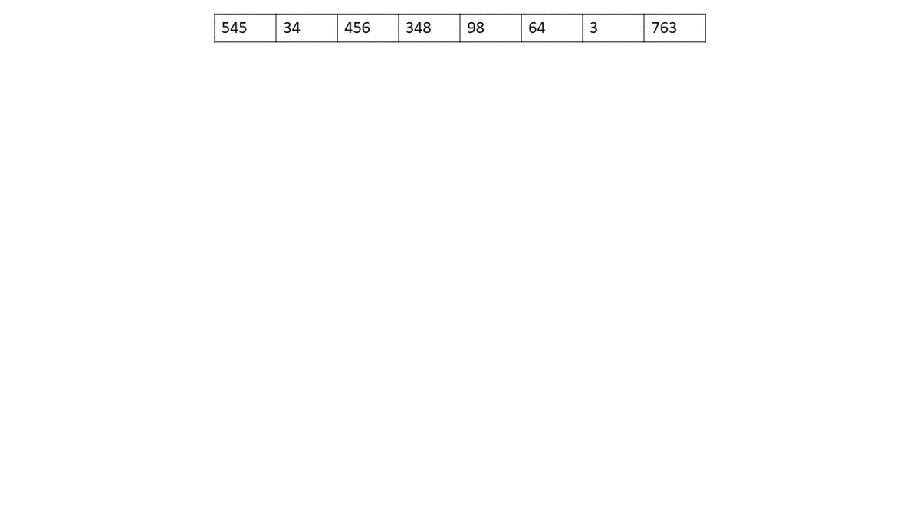
Merge SORT (illustration)

Slide 8
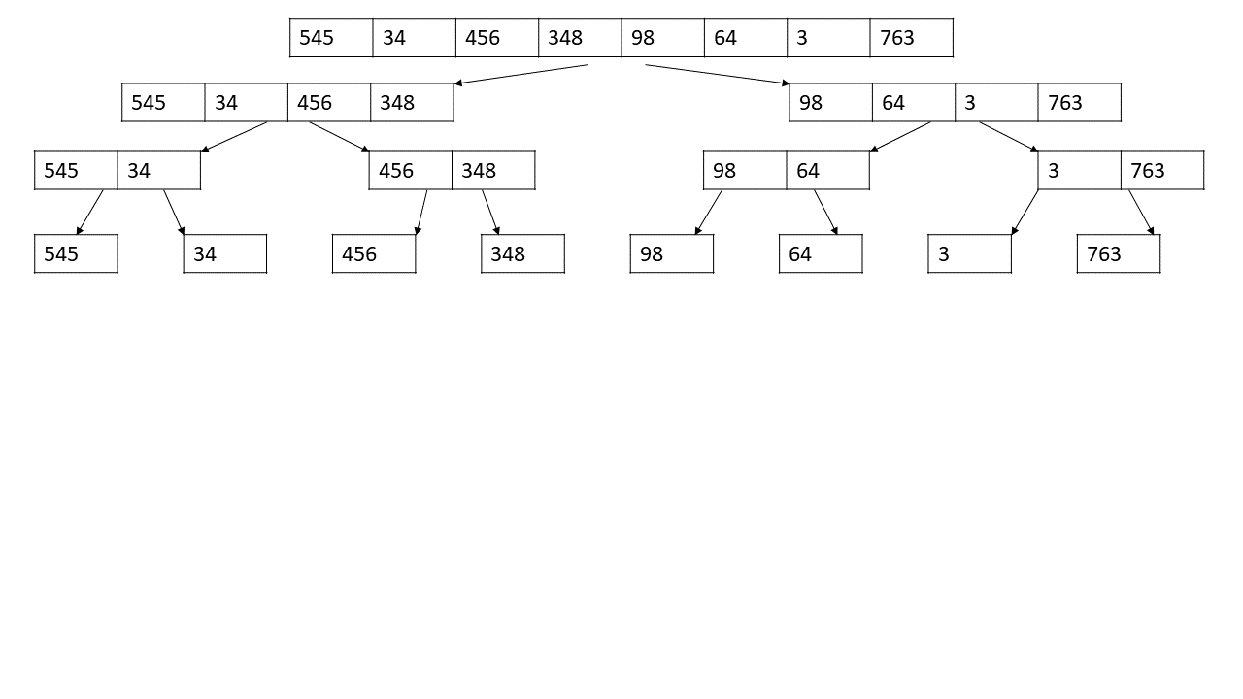
Merge SORT … Hardware implementation

Slide 9
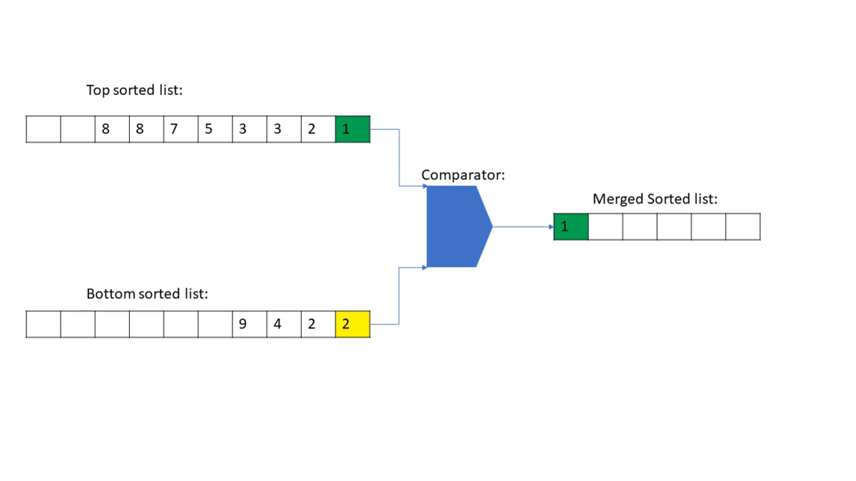
Merge SORT … Hardware implementation
This hardware can produce only one output at a time and so result write back to memory cannot be parallelized even though input array data can be written in parallel.

Slide 10
Merge SORT … Hardware SPEEDUP
Computation time : N (log₂N)
Reading of array elements can be parallelized
Writing of merge list cannot be parallelized → no effect
Odd-even batcher sorter or Bitonic sorter network can reduce the number of times

Slide 11
Merge SORT … Hardware SPEEDUP
Implementation I : no enhancements
Implementation II : W-width Bitonic sorter;
Division stops when sub-lists are of length <= W
Implementation III : W-width Bitonic sorter; W RAMs to parallelize reads
Division stops when sub-lists are of length <= W
Write operations when Bitonic sorter is active are parallelized.

Slide 12
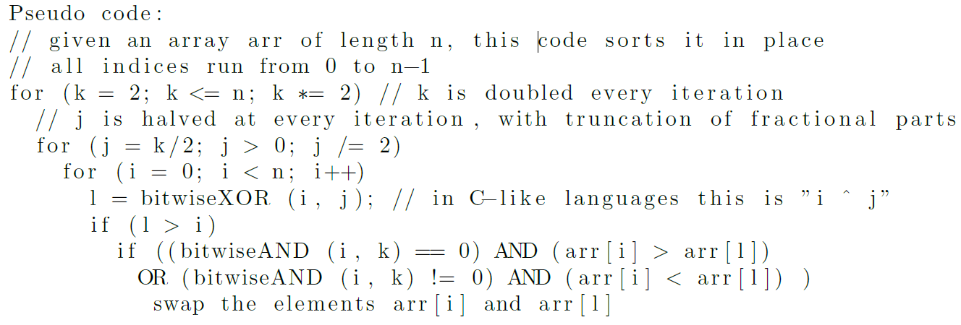
BITONIC SORTER
Bitonic mergesort is a parallel algorithm for sorting. It is also used as a construction method for building a sorting network. The algorithm was devised by Ken Batcher.

Slide 13
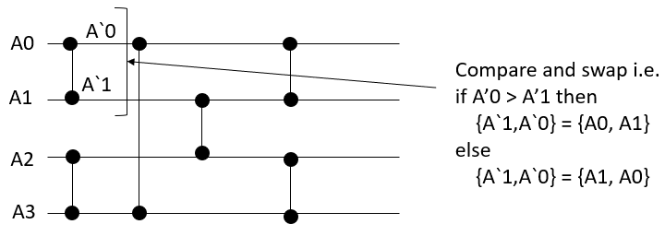
BITONIC SORTER

Slide 14
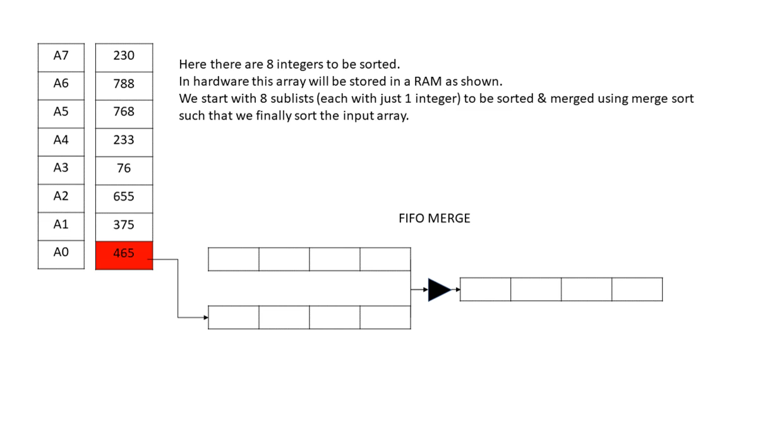
Implementation I : serial merge sort
Computation time: 2N (logN-1)

Slide 15
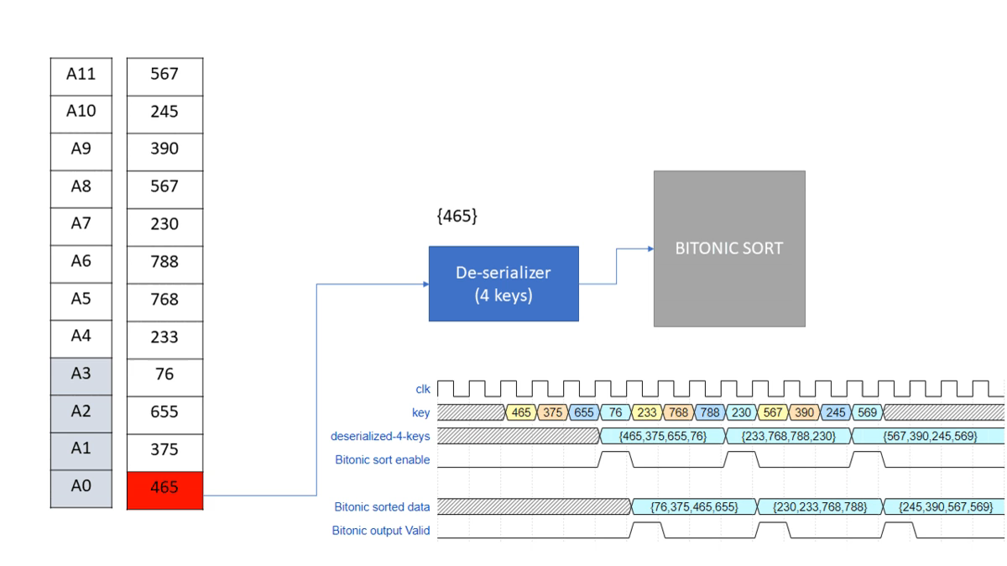
Implementation II : Hybrid merge sort
Computation time: 2N (log(N/2^{M})+1)

Slide 16
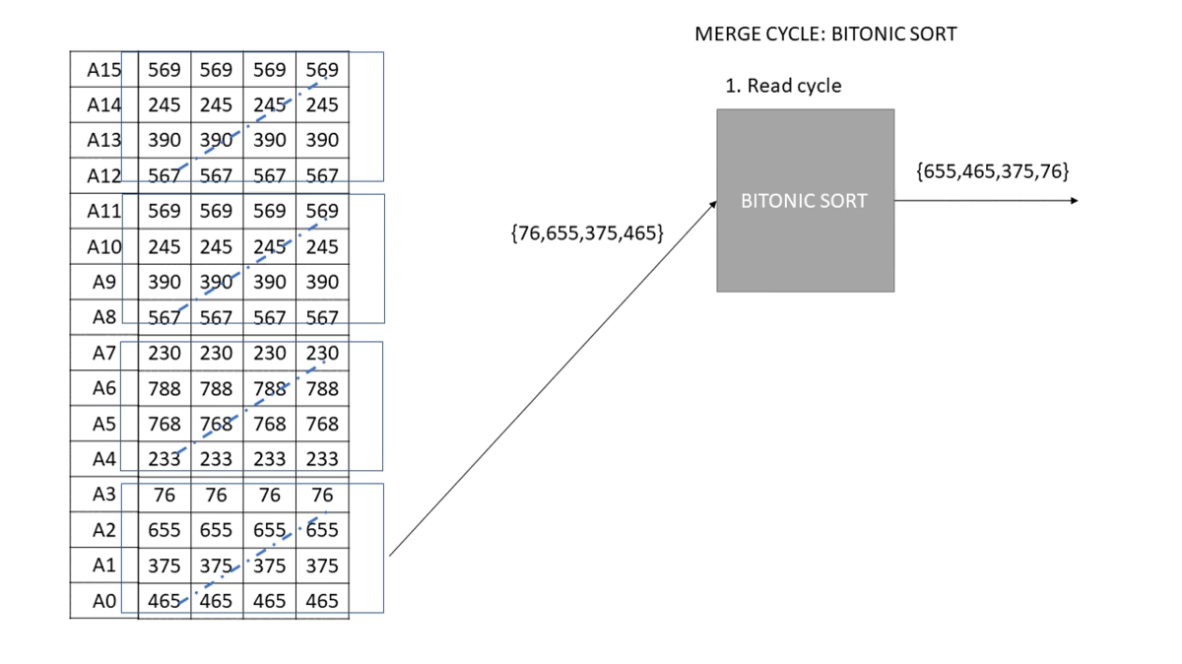
Implementation III : IMPROVED Hybrid merge sort
Computation time: (N + (N/2^{M} )) ∗ (log_{M}N)

Slide 17
Results
Hardware implementation (1024 element sorter) | Computation time in clock cycles | Speed Up
Implementation I | 18432 | 1.0
Implementation II | 14336 | 1.3
Implementation III | 5384 | 3.4

Slide 18
Conclusion
Higher the parallelism greater is reduction in the execution time for sorting.
Parallelism increases design complexity
Increasing width of Bitonic sorter network is desirable but it increases area of design
Other sorter network must be explored to parallelize write operations.

Slide 19
THE END
Questions!

Slide 20
Backup

Slide 21
What is a FIFO?
write
read
FIFO (first in first out) buffer is a elastic storage between two sub-systems. It is used when read and write events are independent of each other. Unlike software circular buffers, hardware buffer capacity cannot be increased once it is full. Flow control is required in order to avoid underflow and overflow scenarios.
7
0
6
1
5
2
4
3

Slide 22
FIFO-BASED MERGE SORTER
QueueA (FIFO)
QueueO (FIFO)
QueueB (FIFO)
QueueA.pop= (!QueueA.empty && !QueueO.full&& ((QueueB.empty )||(QueueA.data < QueueB.data)));
QueueB.pop = (!QueueB.empty && ! QueueO.full && ((QueueA.empty)||(QueueA.data > QueueB.data)));

