Slide 1
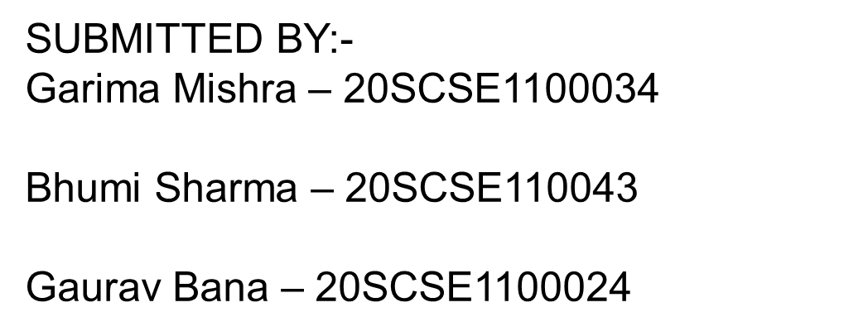
School of Computing Science and Engineering
Course Code : BSCS2470 Course Name: CRYPTOGRAPHIC AND NETWORK SECURITY
Firewall In Cryptography And Network Security
Name of the Faculty : Dr.Saket Sir Program Name: B.Sc.(CS)

Slide 2
INDEX
What is a Firewall?
Functions of Firewall
Firewall is categorized into three basic types −
Packet filter (Stateless & Stateful)
Application-level gateway
Circuit-level gateway

Slide 3
What is a Firewall?
A firewall can be defined as a special type of network security device or a software program that monitors and filters incoming and outgoing network traffic based on a defined set of security rules. It acts as a barrier between internal private networks and external sources (such as the public Internet).
The primary purpose of a firewall is to allow non-threatening traffic and prevent malicious or unwanted data traffic for protecting the computer from viruses and attacks. A firewall is a cybersecurity tool that filters network traffic and helps users block malicious software from accessing the Internet in infected computers.

Slide 4
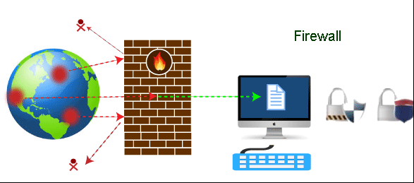

Slide 5
Functions of Firewall
Network Threat Prevention
Application and Identity-Based Control
Hybrid Cloud Support
Scalable Performance
Network Traffic Management and Control
Access Validation
Record and Report on Events

Slide 6
Types of Firewall
Firewall is a network device that isolates organization’s internal network from larger outside network/Internet. It can be a hardware, software, or combined system that prevents unauthorized access to or from internal network.
All data packets entering or leaving the internal network pass through the firewall, which examines each packet and blocks those that do not meet the specified security criteria.

Slide 7
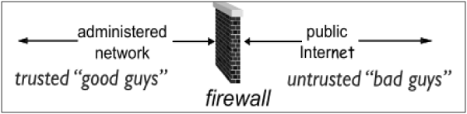

Slide 8
Firewall is categorized into three basic types −
Packet filter (Stateless & Stateful)
Application-level gateway
Circuit-level gateway

Slide 9
Packet filter (Stateless & Stateful)
A packet filtering firewall is a network security feature that controls the flow of incoming and outgoing network data. The firewall examines each packet, which comprises user data and control information, and tests them according to a set of pre-established rules. If the packet completes the test successfully, the firewall allows it to pass through to its destination. It rejects those that don't pass the test. Firewalls test packets by examining sets of rules, protocols, ports and destination addresses.

Slide 10
Packet filter rule has two parts −
Selection criteria − It is a used as a condition and pattern matching for decision making.
Action field − This part specifies action to be taken if an IP packet meets the selection criteria. The action could be either block (deny) or permit (allow) the packet across the firewall.

Slide 11
Static packet filtering firewall
A static packet filtering firewall requires you to establish firewall rules manually. Similarly, internal and external network connections remain either open or closed unless otherwise adjusted by an administrator. These firewall types allow users to define rules and manage ports, access control lists (ACLs) and IP addresses. They're often simple and practical, making them an apt choice for smaller applications or users without a lot of criteria.

Slide 12
Stateful packet filtering firewall
Unlike stateless packet filtering options, stateful firewalls use modern extensions to track active connections, like transmission control protocol (TCP) and user datagram protocol (UDP) streams. By recognizing incoming traffic and data packets' context, stateful firewalls can better identify the difference between legitimate and malicious traffic or packages.

Slide 13
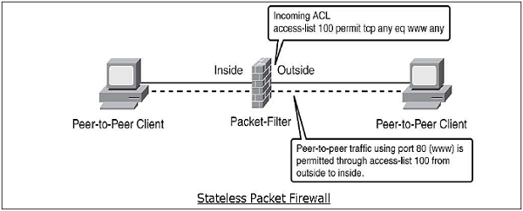

Slide 14
Application Gateways
An application-level gateway acts as a relay node for the application-level traffic. They intercept incoming and outgoing packets, run proxies that copy and forward information across the gateway, and function as a proxy server, preventing any direct connection between a trusted server or client and an untrusted host.
The proxies are application specific. They can filter packets at the application layer of the OSI model.

Slide 15
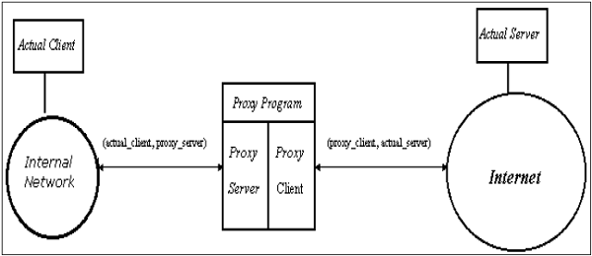

Slide 16
Application-level gateway is also called a bastion host. It operates at the application level. Multiple application gateways can run on the same host but each gateway is a separate server with its own processes.
Example: Consider FTP service. The FTP commands like getting the file, putting the file, listing files, and positioning the process at a particular point in a directory tree. Some system admin blocks put command but permits get command, list only certain files, or prohibit changing out of a particular directory. The proxy server would simulate both sides of this protocol exchange. For example, the proxy might accept get commands and reject put commands.

Slide 17
It works as follows:
Step-1: User contacts the application gateway using a TCP/IP application such as HTTP.
Step-2: The application gateway asks about the remote host with which the user wants to establish a connection. It also asks for the user id and password that is required to access the services of the application gateway.
Step-3: After verifying the authenticity of the user, the application gateway accesses the remote host on behalf of the user to deliver the packets.

Slide 18
Application-level Filtering
An application-level proxy gateway, examines and filters individual packets, rather than simply copying them and blindly forwarding them across the gateway. Application-specific proxies check each packet that passes through the gateway, verifying the contents of the packet up through the application layer. These proxies can filter particular kinds of commands or information in the application protocols.

Slide 19
Circuit-Level Gateway
The circuit-level gateway is an intermediate solution between the packet filter and the application gateway. It runs at the transport layer and hence can act as proxy for any application.
Similar to an application gateway, the circuit-level gateway also does not permit an end-to-end TCP connection across the gateway. It sets up two TCP connections and relays the TCP segments from one network to the other. But, it does not examine the application data like application gateway. Hence, sometime it is called as ‘Pipe Proxy’.

Slide 20


