Slide 1

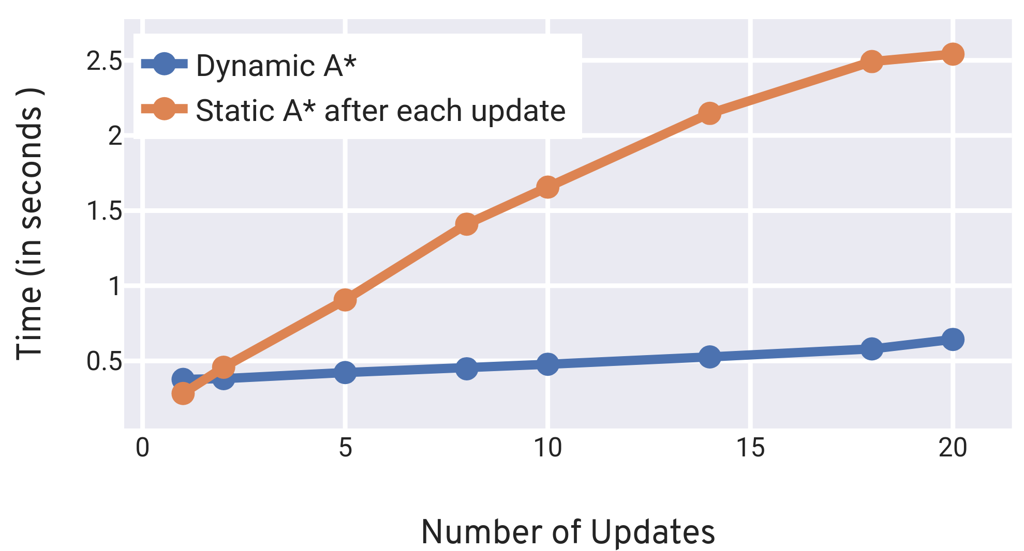
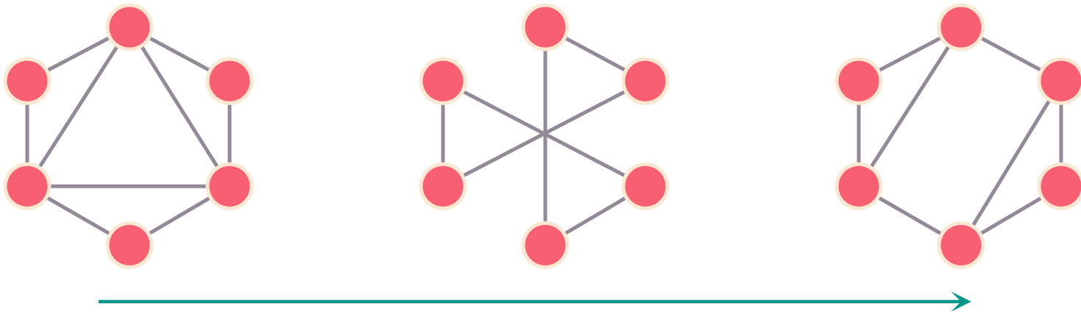
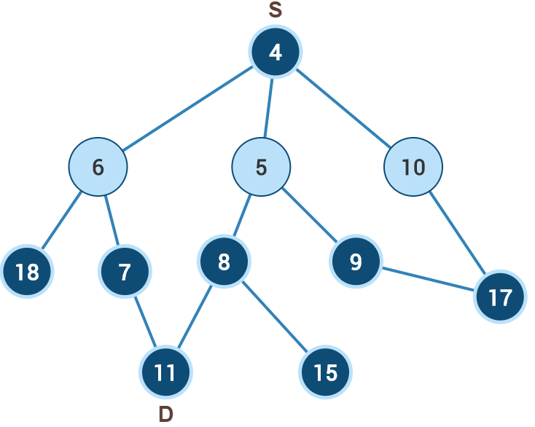

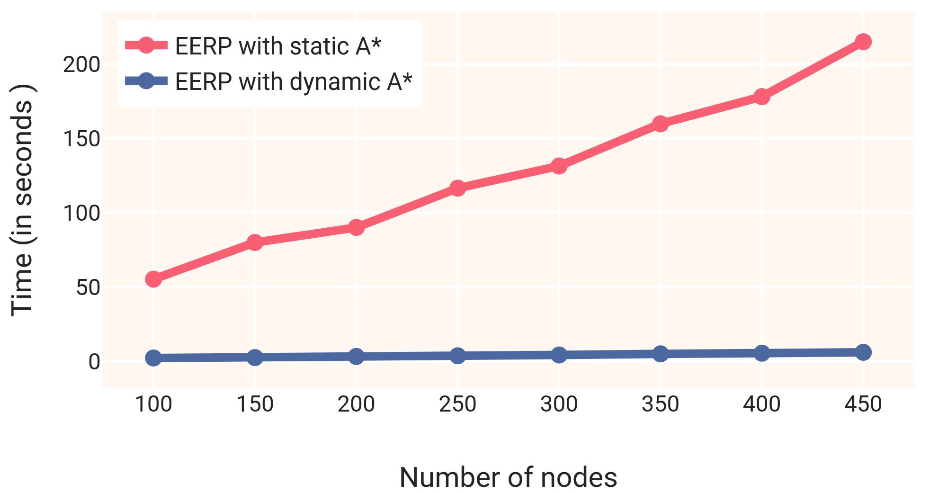
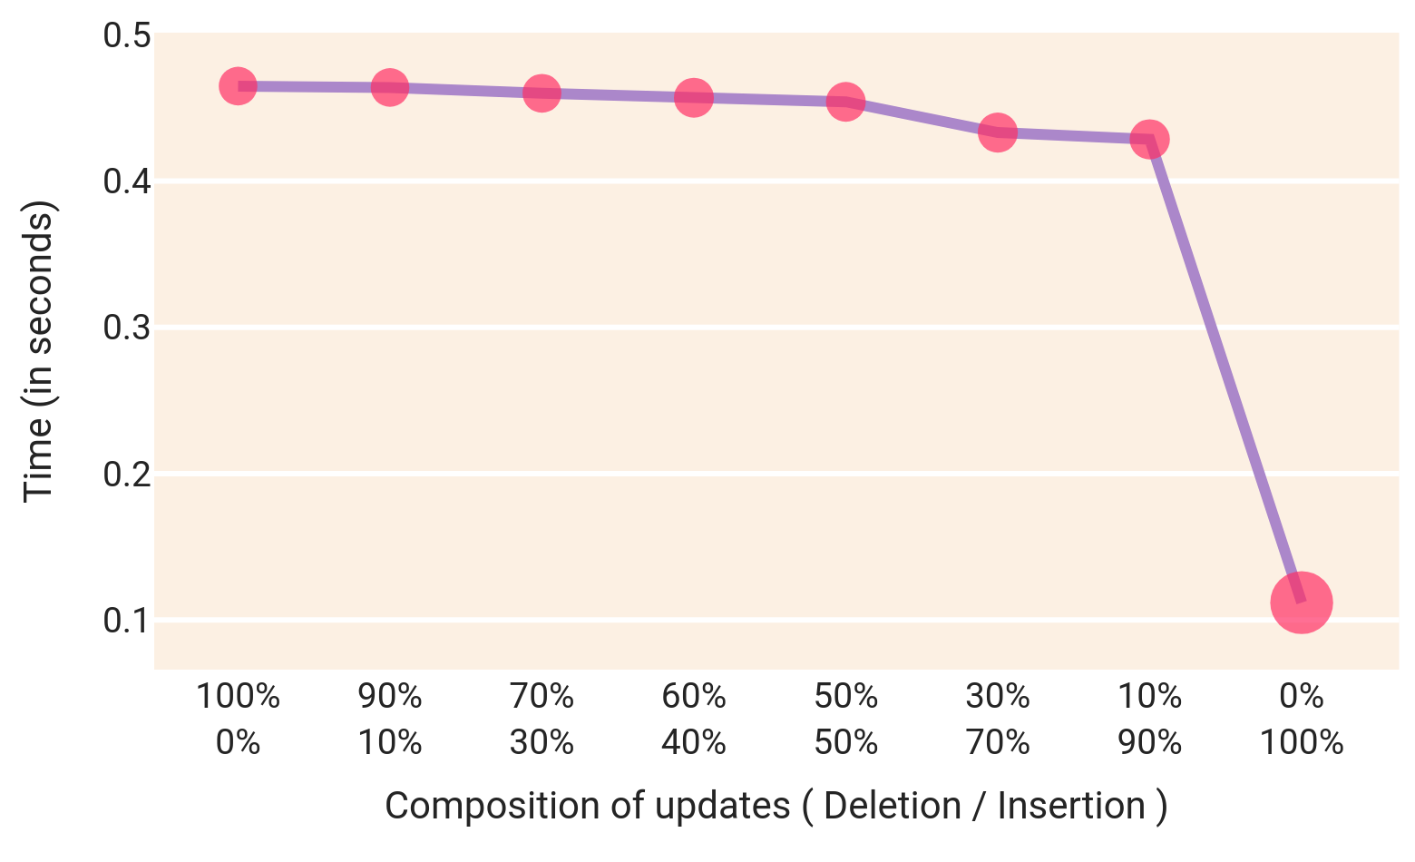


Path Planning for Dynamic Graphs using A* on GPU
Lokesh Koshale, Rupesh Nasre
Indian Institute of Technology Madras, Chennai, India
Abstract
Dynamic A*: Insertion + Deletion
A* is one of the widely used path planning algorithms applied in a diverse set of problems in robotics and video games.
Here we present A* for dynamic graphs (dynamic A*) on GP-GPUs which achieves 5x-8x speedup than existing methods on the SNAP dataset [2].
Our implementation is freely available on GitHub¹.
The update contains both insertion and deletion of edges.
Propagate insertions and deletions of edges separately.
Performs better than re-executing static A* algorithm after each update.
Graph : Superuser
Dynamic Graphs
5x
5x Speedup by using
dynamic A*
Fig 3 : Execution time vs number of updates In the graph
Time
Results
Static A* Algorithm on GPU [ 1 ]
The below table shows execution time (in seconds) and speedup of dynamic A* compared to re-executing static A* every time.
Find the optimal path from source to destination .
Sequential in nature, minimum cost nodes are extracted from the priority queue and processed.
Keep multiple priority queues (PQ) to extract many nodes in parallel to process.
No. | Graph | Edges | Queries | Dynamic A* | Static A* | Speedup
1 | Live Journal | 34,681,189 | 10 | 6.01 | 33.93 | 5x
2 | Wiki Talk | 7,833,140 | 10 | 12.24 | 24.84 | 2x
3 | Ask Ubuntu | 964,437 | 10 | 0.25 | 1.31 | 5x
4 | YouTube | 2,987,624 | 10 | 0.81 | 5.78 | 7x
5 | Math Overflow | 506,550 | 10 | 0.09 | 0.67 | 7x
6 | Live Journal | 34,681,189 | 100 | 11.41 | 424.06 | 37x
PQ 1
PQ 2
6
10
-
5
-
-
Applications
We have applied dynamic A* on energy efficient routing protocol (EERP) and achieved 35x speedup from static A*.
Fig 1: Multiple threads executing A* on graph
Dynamic A*: Insertion of edges
35x
Newly added edges can alter the optimal path.
To find the new optimal path instead of executing A* from scratch, we propagate the change to the affected nodes of the graph.
Inserted edges are batched and sent to GPU for processing.
Applications and Future work
35x Speedup by using
dynamic A*
Fig 4: Comparison b/w static A* and dynamic A* on EERP algorithm
Dynamic A*: Deletion of edges
Future Work
Deleting only that edge which belongs to the optimal path can create a new optimal path.
For all such affected nodes recompute the cost and select the neighbour with the least cost.
Propagate the updated cost to all the affected nodes.
In the future, we plan to incorporate the change in heuristic values of nodes as graph changes and how it affects the optimal path.
We also plan to integrate the proposed algorithm on different applications of A* and analyse the performance improvements.
Insertions
References
Deletions
Yichao Zhou and Jianyang Zeng. “Massively Parallel A* Search on GPU”. In: Twenty-Ninth AAAI Conference on Artificial Intelligence (2015).
Jure Leskovec and Andrej Krevl. SNAP Datasets: Stanford Large Network Dataset Collection. http://snap.stanford.edu/data. June 2014.
80%
80% of execution time used in
processing deletions
Deletion :
Insertion :
Fig 2: Execution time vs insertion / deletion
Lab IIT Madras
¹GitHub: github.com/lkoshale/DA_STAR
²Email : lksohale@gmail.com

