Slide 1
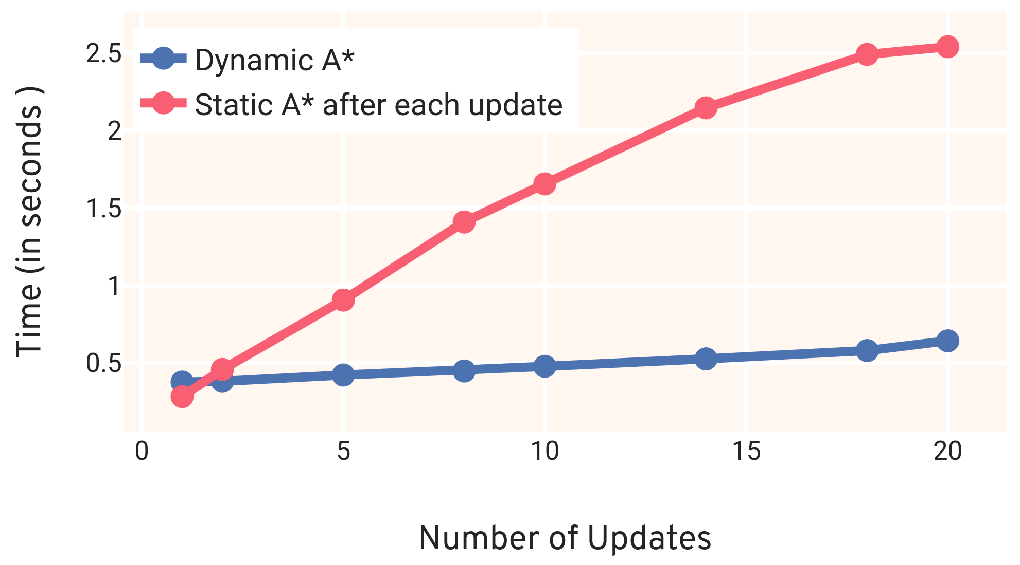
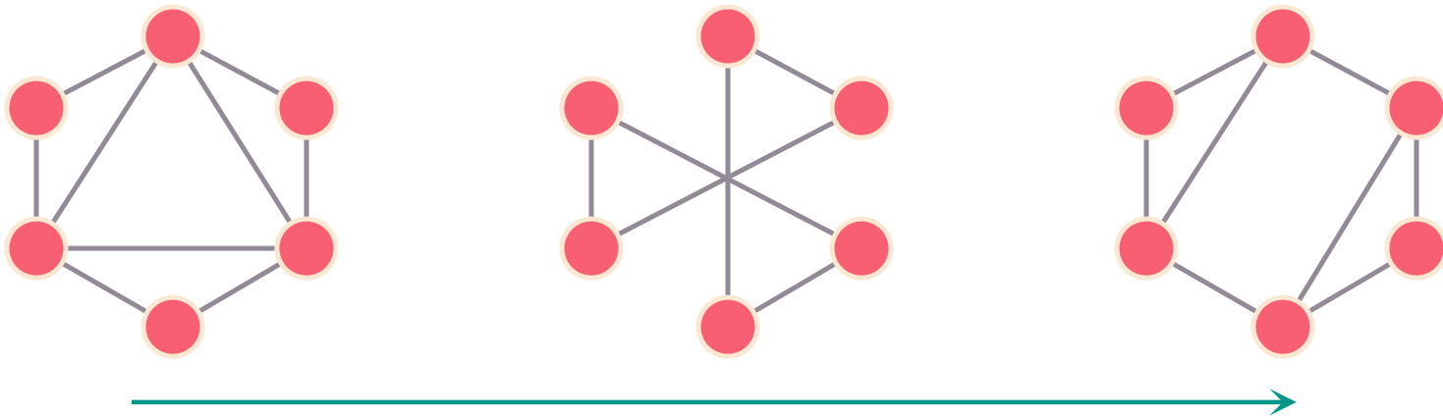
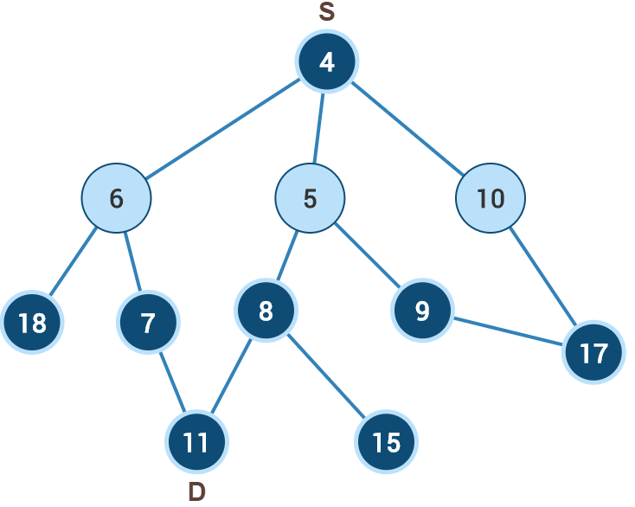

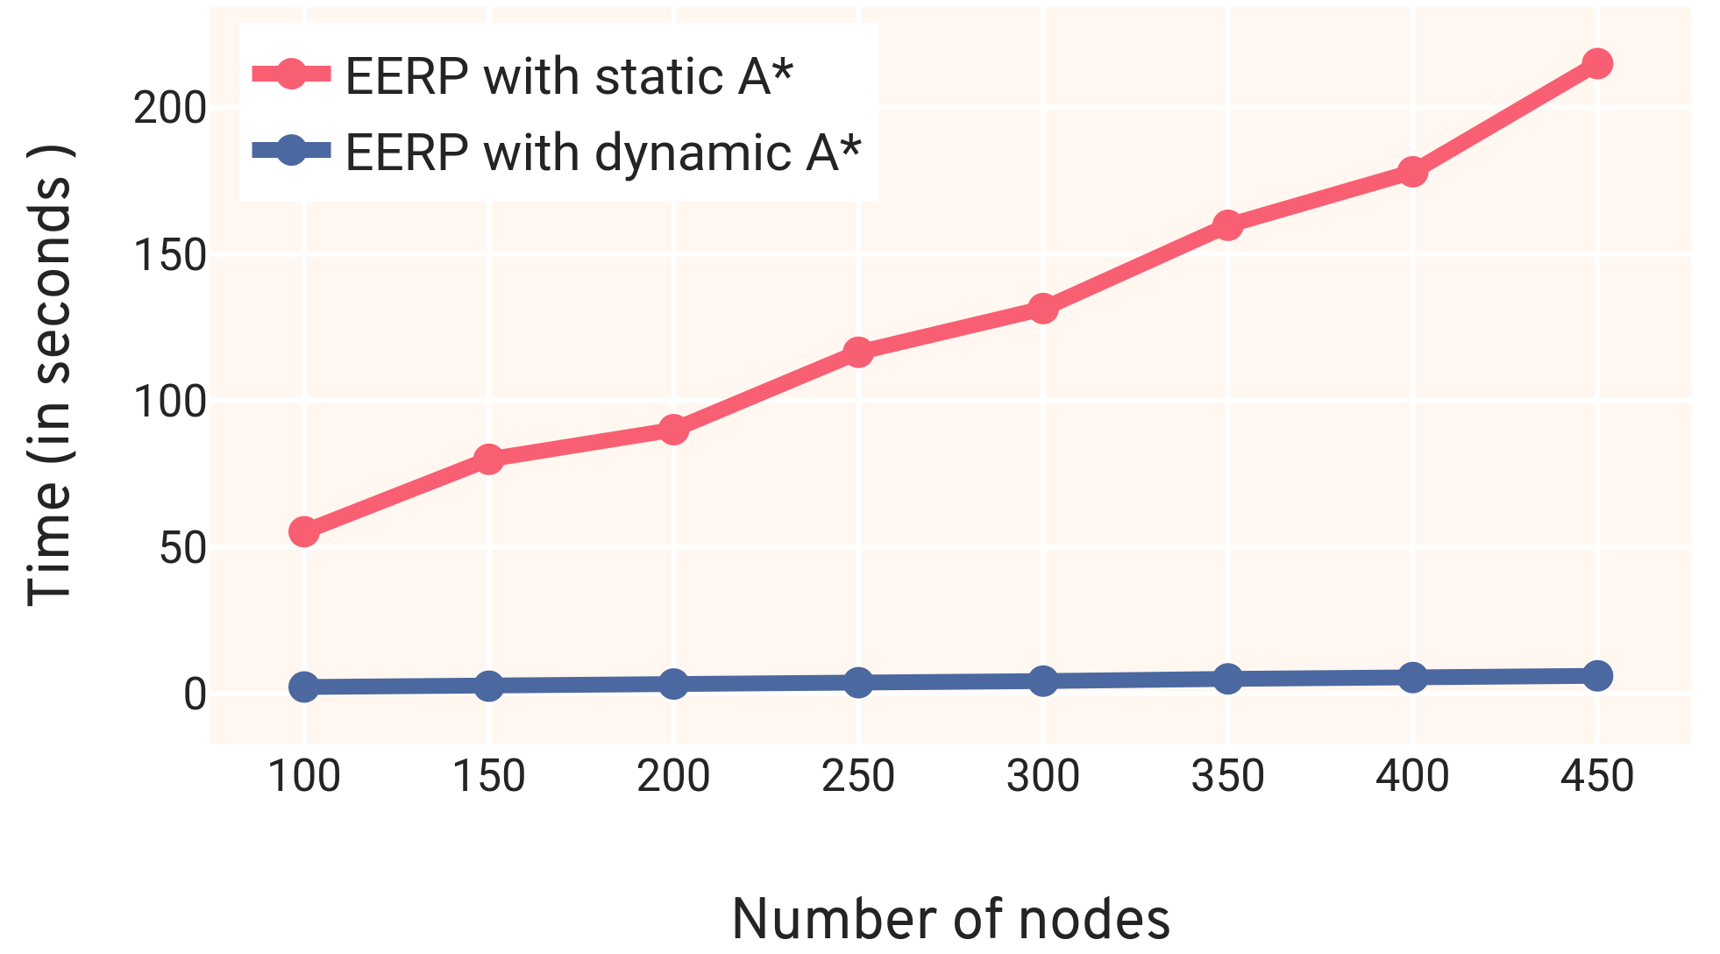





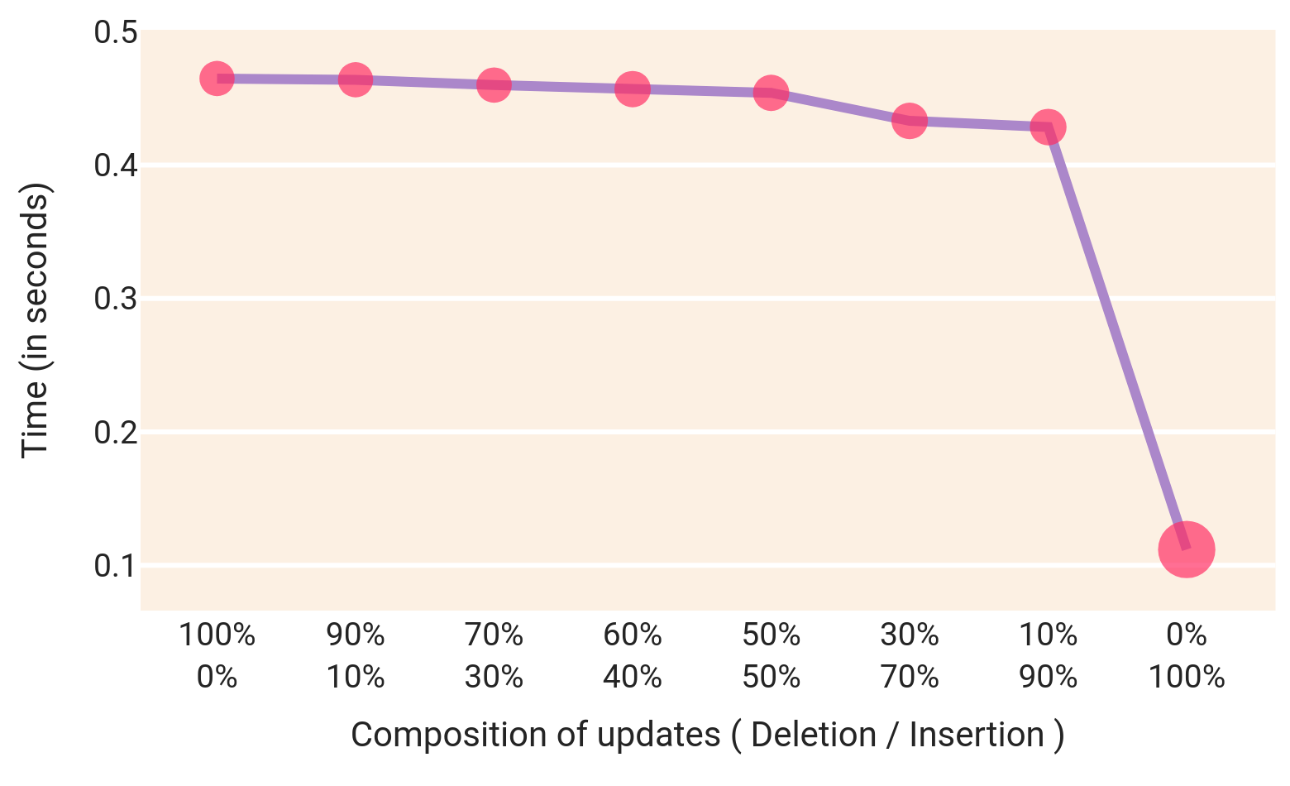
Path Planning for Dynamic Graphs using A* on GPU
Abstract
Dynamic A*: Fully Dynamic
A* is one of the widely used path planning algorithms applied in a diverse set of problems in robotics and video games.
Here we present A* for dynamic graphs (dynamic A*) on GP-GPUs which achieves 2x-7x speedup than static A* on the SNAP dataset [2].
Our implementation is freely available on GitHub.
The update contains both insertion and deletion of edges.
Propagate insertions and deletions of edges separately.
Performs better than re-executing static A* algorithm after each update.
Graph : Superuser
Dynamic Graphs
5x
5x Speedup by using
dynamic A*
Time
Fig 4 : Execution time vs number of updates In the graph
Static A* Algorithm on GPU [ 1 ]
Results
Find the optimal path from source to destination .
Sequential in nature, minimum cost nodes are extracted from the priority queue and processed.
Keep multiple priority queues (PQ) to extract many nodes in parallel to process.
The below table shows execution time (in seconds) and speedup of dynamic A* compared to re-executing static A* every time.
No. | Graph | Edges | Queries | Dynamic A* | Static A* | Speedup
1 | Live Journal | 34,681,189 | 10 | 6.01 | 33.93 | 5x
2 | Wiki Talk | 7,833,140 | 10 | 12.24 | 24.84 | 2x
3 | Ask Ubuntu | 964,437 | 10 | 0.25 | 1.31 | 5x
4 | YouTube | 2,987,624 | 10 | 0.81 | 5.78 | 7x
5 | Math Overflow | 506,550 | 10 | 0.09 | 0.67 | 7x
6 | Live Journal | 34,681,189 | 100 | 11.41 | 424.06 | 37x
PQ 1
PQ 2
6
10
-
5
-
-
Fig 1: Multiple threads executing A* on graph
Applications
Dynamic A*: Insertion of edges
1. We have applied dynamic A* on energy efficient routing protocol (EERP) and achieved 35x speedup from static A*.
Newly added edges can alter the optimal path.
To find the new optimal path instead of executing A* from scratch, we propagate the change to the affected nodes of the graph.
Inserted edges are batched and sent to GPU for processing.
35x
19.1 s
19.1 sec
Static A*
Applications and Future work
\
Dynamic A*
35x Speedup by using
dynamic A*
3.4 s
Fig 2: Execution time of static A* and dynamic A* on graph Wiki-Talk
Fig 5: Comparison b/w static A* and dynamic A* on EERP algorithm
0
5
10
15
20
2. On applying dynamic A* for pathfinding in the maze, we achieved 8x speedup.
Time (in seconds)
9.1s
Dynamic A*: Deletion of edges
Static A* Algorithm
Deleting only that edge which belongs to the optimal path can create a new optimal path.
For all such affected nodes recompute the cost and select the neighbour with the least cost.
Propagate the updated cost to all the affected nodes.
1.2s
86.8 %
Dynamic A*
reduction in execution time by using
Dynamic A* algorithm.
Grid Size: 5000 x 5000 Nodes : 25M Edges: 49.9M
Time in seconds
Insertions
References
Deletions
80%
Yichao Zhou and Jianyang Zeng. “Massively Parallel A* Search on GPU”. In: Twenty-Ninth AAAI Conference on Artificial Intelligence (2015).
Jure Leskovec and Andrej Krevl. SNAP Datasets: Stanford Large Network Dataset Collection. http://snap.stanford.edu/data. June 2014.
80% of execution time used in
processing deletions
Deletion :
Insertion :
Fig 3: Execution time vs insertion / deletion

