Slide 1
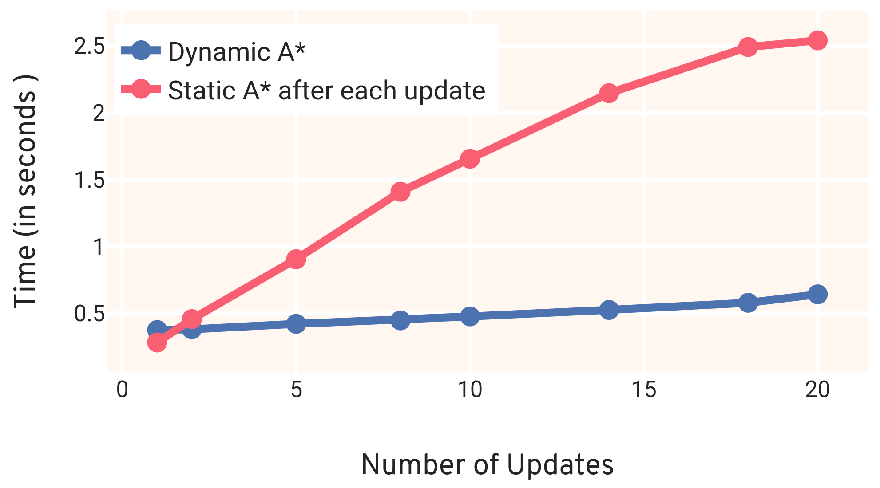
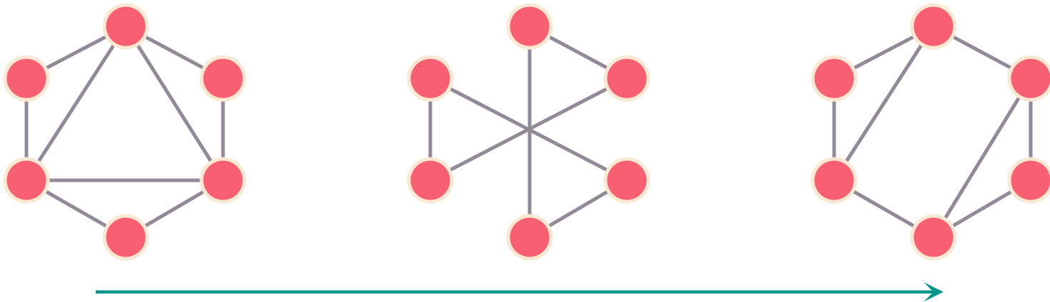
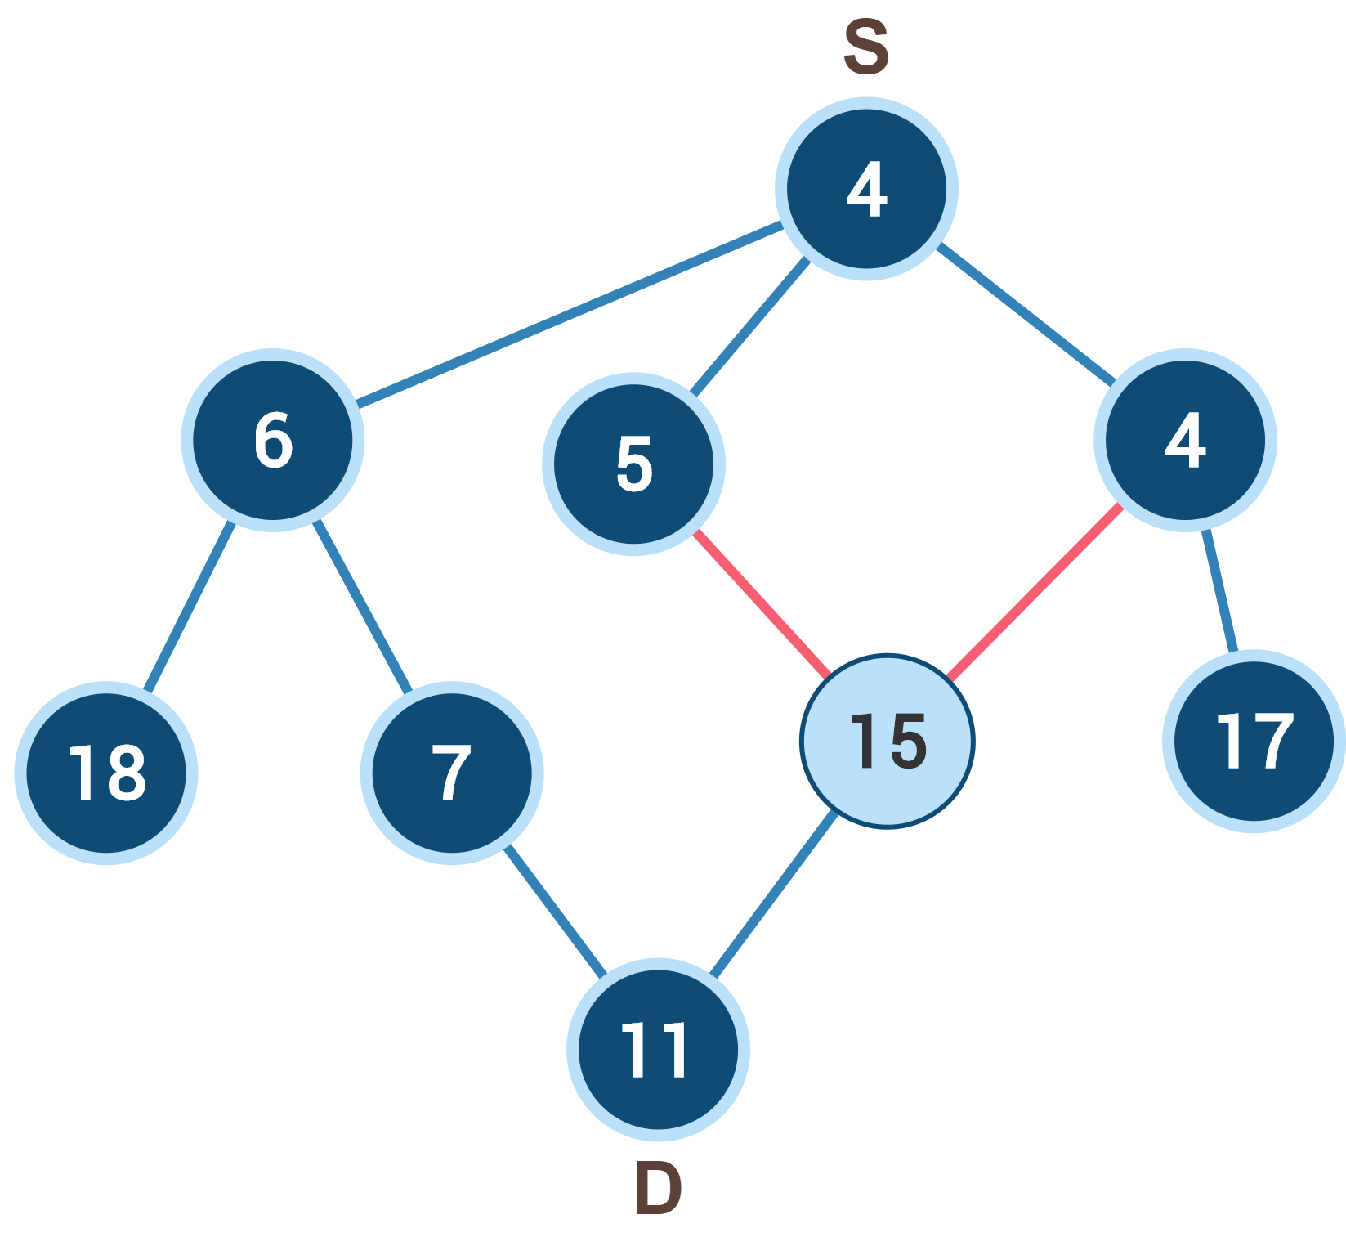




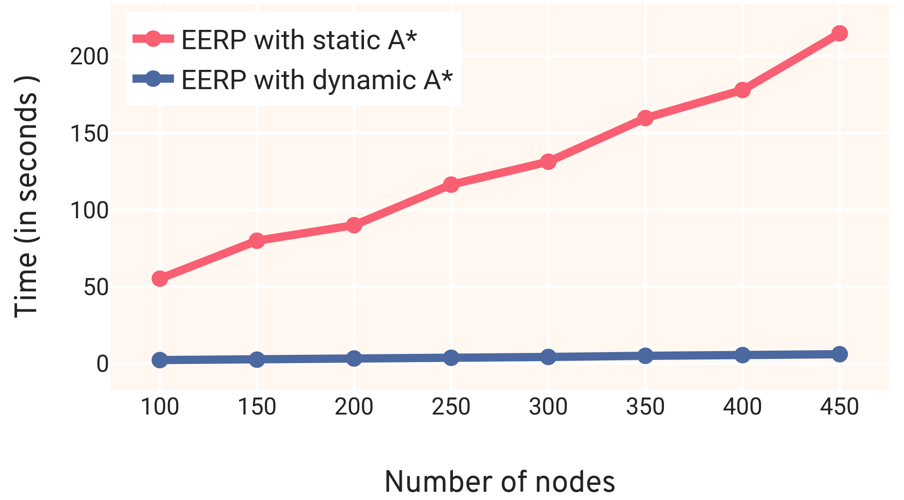
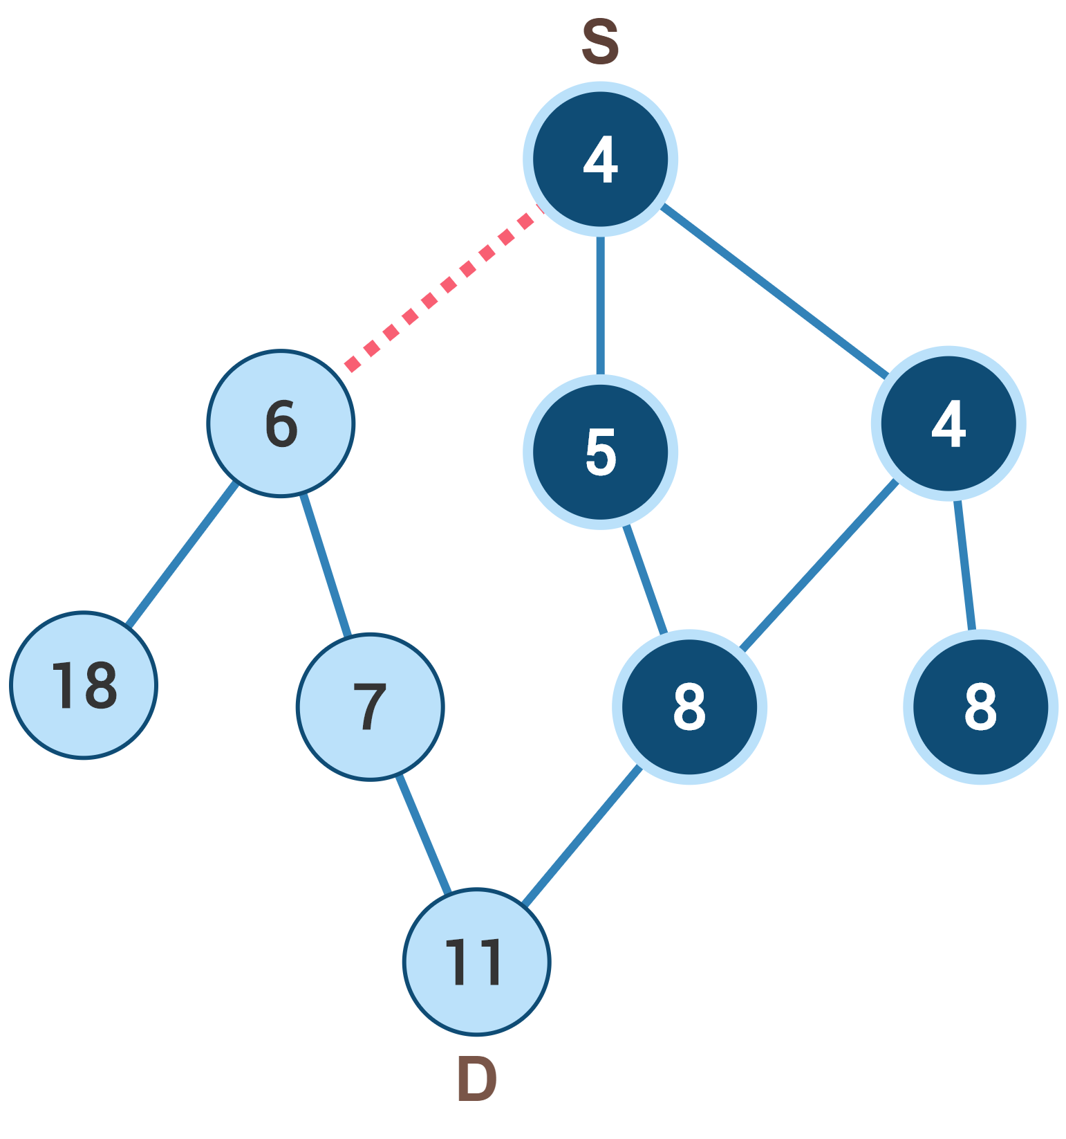



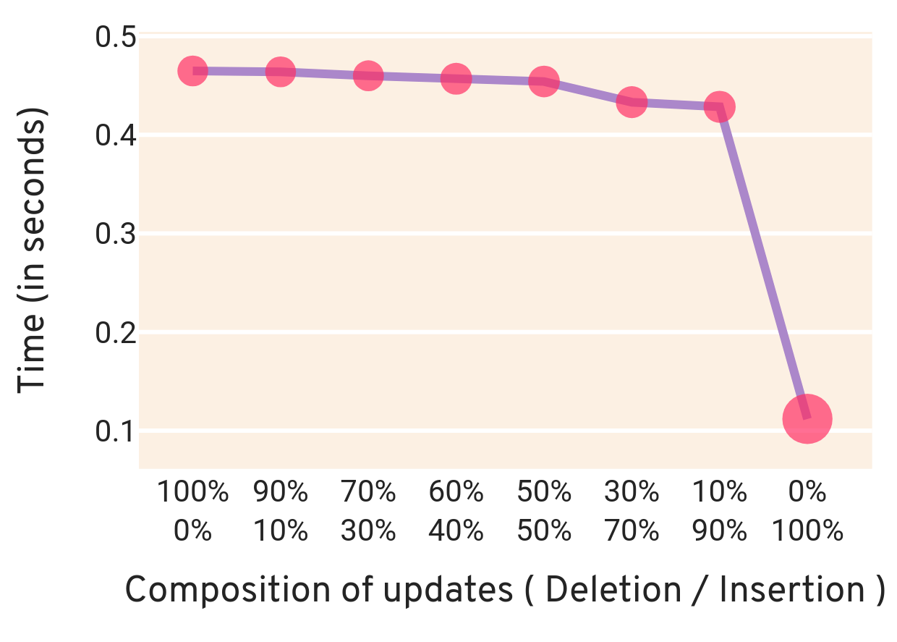
Path Planning for Dynamic Graphs using A* on GPU
Abstract
Dynamic A*: Fully Dynamic
A* is one of the widely used path planning algorithms applied in a diverse set of problems in robotics and video games.
Zhou and Zeng [1] proposed a parallel variant of A* for GPU, which keeps multiple priority queues to find the optimal path in a static graph ( static A*).
Here we present A* for dynamic graphs (dynamic A*) on GP-GPUs which achieves 2x-7x speedup than static A* on the SNAP dataset [2]
The update contains both insertion and deletion of edges.
Propagate insertions and deletions of edges separately.
Performs better than re-executing static A* algorithm after each update.
Graph : Superuser
Dynamic Graphs
5x
5x Speedup by using
dynamic A*
Time
Fig 4 : Execution time vs number of updates In the graph
Dynamic A*: Insertion of edges
Results
Newly added edges can alter the optimal path.
To find the new optimal path instead of executing A* from scratch, we propagate the change to the affected nodes of the graph.
The below table shows execution time (in seconds) and speedup of dynamic A* compared to re-executing static A* every time.
No. | Graph | Edges | Queries | Dynamic A* | Static A* | Speedup
1 | Live Journal | 34,681,189 | 10 | 6.01 | 33.93 | 5x
2 | Wiki Talk | 7,833,140 | 10 | 12.24 | 24.84 | 2x
3 | Ask Ubuntu | 964,437 | 10 | 0.25 | 1.31 | 5x
4 | YouTube | 2,987,624 | 10 | 0.81 | 5.78 | 7x
5 | Math Overflow | 506,550 | 10 | 0.09 | 0.67 | 7x
6 | Live Journal | 34,681,189 | 100 | 11.41 | 424.06 | 37x
Pseudocode!
For edges(u, v) inserted, add node v to update_list, if f(v)_{new} < f(v)_{old}.
While update_list not empty:
a. Extract node n from update_list.
b. For each child of n:
i. lock(child)
ii. if f(child)_{new}< f(child)_{old}, add child
to update_list.
iii. unlock(child)
f(v): cost from source to v + heuristics value of v
Fig 1: Two threads processing newly added edge
( shown in red )
19.1 s
Applications
19.1 sec
Static A*
1. We have applied dynamic A* on energy efficient routing protocol (EERP) and achieved 35x speedup from static A*.
\
Dynamic A*
( Insertions )
0
3.4 s
5
10
15
20
Time (in seconds)
Fig 2: Execution time of static A* and dynamic A* (for only insertions) on graph Wiki-Talk
35x
Dynamic A*: Deletion of edges
Deleting only that edge which belongs to the optimal path can create a new optimal path.
For all such affected nodes recompute the cost and select the neighbour with the least cost.
Propagate the updated cost to all the affected nodes.
Applications and Future work
35x Speedup by using
dynamic A*
Fig 5: Comparison b/w static A* and dynamic A* on EERP algorithm
2. On applying dynamic A* for pathfinding in the maze, we achieved 8x speedup.
Pseudocode!
9.1s
Deleted edge
For each deleted edge u → v:
a. Compute f(v) from the neighbours of v.
b. Add v to update_list.
2. While update_list is not empty:
a. Extract node n from update_list.
b. For each child of n such that
optimal_parent(child) = n:
i. If f(child) > f(child)_{new} then compute cost of child from each of its neighbour and add it to update_list.
Static A* Algorithm
Dynamic A*
1.2s
86.8 %
reduction in execution time by using
Dynamic A* algorithm.
Grid Size: 5000 x 5000 Nodes : 25M Edges: 49.9M
Nodes affected by deletion of the edge
optimal_parent(v): neighbour of node v with least f(v)
Fig 6: Comparison b/w static A* and dynamic A* on solving 5000 x 5000 maze
Time in seconds
Insertions
References
Deletions
Yichao Zhou and Jianyang Zeng. “Massively Parallel A* Search on GPU”. In: Twenty-Ninth AAAI Conference on Artificial Intelligence (2015).
Jure Leskovec and Andrej Krevl. SNAP Datasets: Stanford Large Network Dataset Collection. http://snap.stanford.edu/data. June 2014.
80%
Deletion:
80% of execution time used in
processing deletions
Insertion:
Fig 3: Execution time vs composition of updates
!
Pseudocode described above is to give a basic idea of the algorithm. It does not cover all the cases, for more information please refer to GitHub.

