Slide 1
LENDING CLUB CASE STUDY
Group –
Gaurav Parmar

Slide 2
Introduction
A consumer finance company which specialises in lending various types of loans to urban customers.
When the company receives a loan application, the company has to make a decision for loan approval based on the applicant’s profile.
Two types of risks are associated with the bank’s decision:
If the applicant is likely to repay the loan, then not approving the loan results in a loss of business to the company
If the applicant is not likely to repay the loan, i.e. he/she is likely to default, then approving the loan may lead to a financial loss for the company

Slide 3
Objective
We need to analyse the data and get to pattern/conclusion on which all factors we can decide if a particular customer who is applying for a loan will fall under defaulter’s category, and based on that the lending company can take a call like – reject the loan, increase the interest percentage, or reducing the loan amount, inc/dec the loan tenure.
We need to analyse the loan, customer parameters and get insight out of it.
Also lending company should be getting details on factors which can help in decision making.

Slide 4
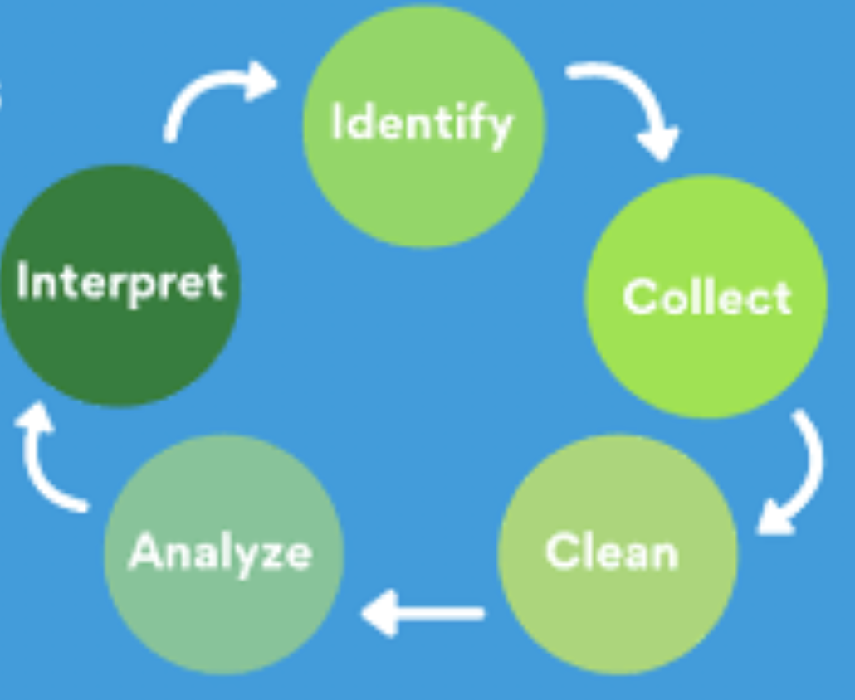
Data Analysis

Slide 5
Steps
Read the data.
Understand the columns available and there definition.
Remove column with all blank/null values.
Generate list of columns having max count of missing data and purge those columns.
Fix missing values for available columns based on mean/median.
Generate derived columns if required.
Fix data type for required columns.
Retain columns which can actually generate insight and purge behavioural columns.
Find outliers and fix them.
Plot the data and do comparision.
Generate univariant, bivariant, multivariant plot and understand the pattern.
Understand the results of all plots and patterns.
Final verdict.

Slide 6
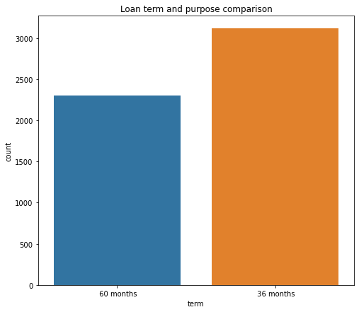

Slide 7
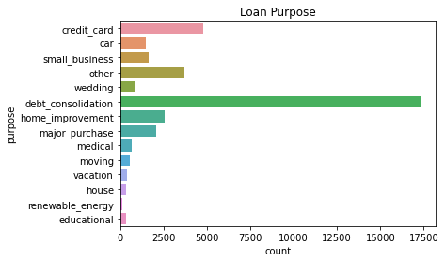

Slide 8
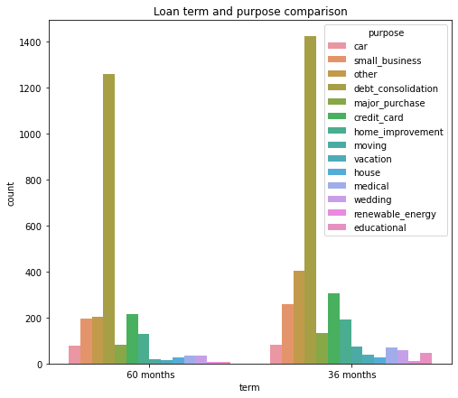

Slide 9
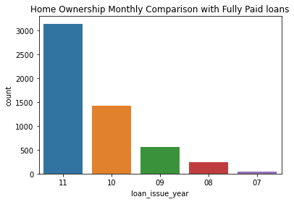

Slide 10
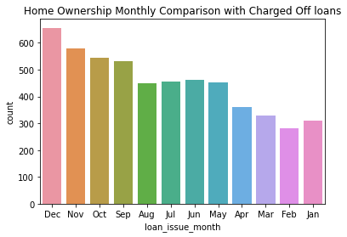

Slide 11
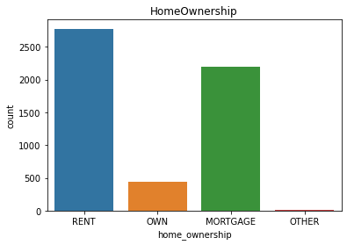

Slide 12
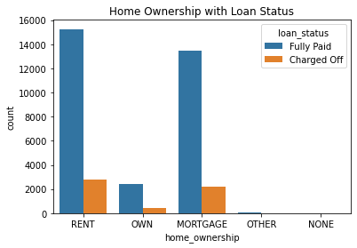

Slide 13
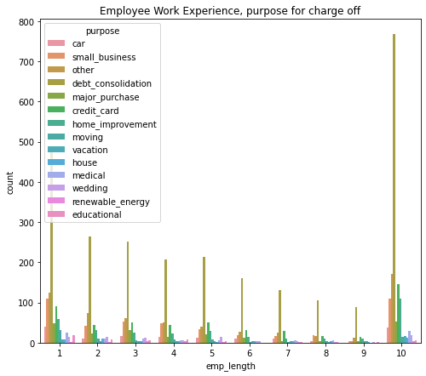

Slide 14
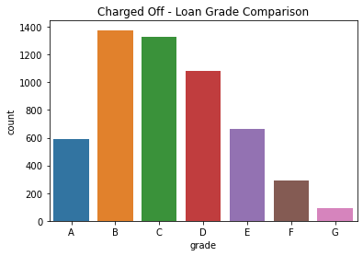

Slide 15
Conclusion
Under below condition there is high likely chances that the person will fall under defaulter list and the loan will be charged off
If the tenure of loan is 36 months - then the changes of defaulter is more.
If the grade is 'B' then chances are more for being defaulter.
Debt-consolidation purpose is the one where we have majority of defaulters.
Also is employee is 10+year experience and purpose of loan - "debt-consolidation" then chances are high for being defaulter
Home_ownership with rent status has high change of defaulter
Loan applied/sanctioned in month of december has high change of defaulter
Every year the count of defaulter is increasing as a pattern and majority of them comes from debt-consolidation

