Slide 1

CE499 END-SEMESTER EVALUATION
SEISMIC BEHAVIOUR OF MULTISTORIED RC FRAME BUILDINGS WITH BASEMENT STORIES
Submitted
By
Gaurav Mali
Under the supervision of
Prof. Kaustubh Dasgupta
Department of Civil Engineering
Indian Institute of Technology Guwahati
May 2022

Slide 2
Introduction
Many multi-storeyed Reinforced Concrete (RC) frame building have basement floors, below ground level, to provide parking space and other utilities.
RC shear walls are provided along the perimeter of building to increase the strength and stability of the underground part of the building.
Basement walls provide significant lateral stiffness and lateral strength during earthquake shaking, by virtue of its box-type rigidity.
Transfer of load from the superstructure to the basement part determines the overall seismic behaviour.
Nonlinear, dynamic analysis are performed to examine the seismic behaviour of the RC frame building with basement storey.

Slide 3
Objective
To study the Seismic behaviour of RC frame building with basement walls, designed as per Indian Standard of Practice.
To understand how different parameters affect the structural behaviour in different ways.
Provide possible guidelines on building configuration from earthquake resistance point of view.

Slide 4
Literature Review
Study on Basement Walls
Seismic response of basement walls is investigated by developing a numerical model using finite element method by simulating the interaction between basement wall, backfill and foundation soils and bedrock motion.
This study shows the interdependence between peak acceleration response and peak seismic thrust and straining actions.
Model structure is four-storey building with floor height of 3.0 m, width is 20.0 m distributed over 5 equal span of spacing 4.0m. Column size is 0.3x0.6 m, roof thickness is 0.2 m. Basement wall thickness varies from 0.2 to 0.5 m.
Model was subjected to acceleration time history of Loma Prieta 1989 earthquake.
Earthquake duration and peak ground acceleration (PGA) was taken as 20sec and 0.15 g respectively.
The study provides a seismic design framework for basement walls considering full interaction between basement walls and backfill and foundation soils.
Peak seismic thrust on basement walls is located at 0.61 times the clear height above the basement floor level or 0.72 times the total wall height above the wall bottom

Slide 5
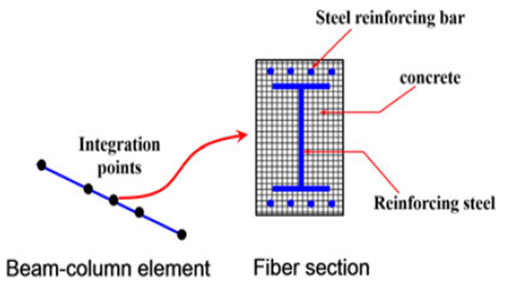
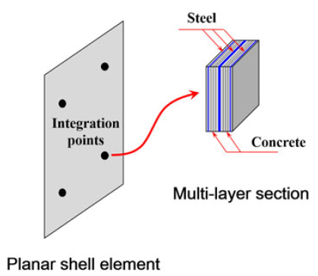
Study on Composite beams and columns
Tall buildings are exposed to lateral loads like wind loads or seismic loads, so RC column and shear walls are constructed to resist these lateral loads.
Composite Structural member can be used that takes advantage of both steel member and RC member. Performance of many composite structural members are better than RC and steel members.
In composite structural members, reinforced concrete provides the stiffness and prevent buckling whereas steel members improves the bearing capacity and ductility.
Displacement-based fiber beam-column element for beams and columns and multilayer shell element for shear walls is used to investigate the interaction between steel and concrete.
It was observed that the steel plate reinforced shear wall reduces the inter-storey deformation of the whole structure in an effective way
Fiber beam-column element (Ren et al., 2017)
Multilayer shell element (Ren et al., 2017)

Slide 6
Study on Soil Structure Interaction
Design and analysis of soil-structure interaction (SSI) ranges from complete analysis of total combined system of foundation, soil and structure to approximate models of the system.
Complete analysis of the total combined system is rarely practical because structural analysis programs used cannot handle the nonlinear soil continuum directly.
Three simplified model are illustrated here.
In first model, the building was assumed to rest on rigid base, where there was no interaction between the soil and the basement walls.
In second model, the building was rested on a rigid base, but some passive lateral restrained was imposed on the basement walls by springs.
In third model, structure was assumed to be on a rigid base at ground surface and structure below were ignored.
Mononobe–Okabe (M–O) method was used for determining seismic lateral pressures acting on the retaining walls.
Time history of the resultant force against the wall due to 1979 Imperial Valley Earthquake is also shown below.

Slide 7
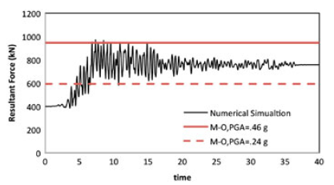
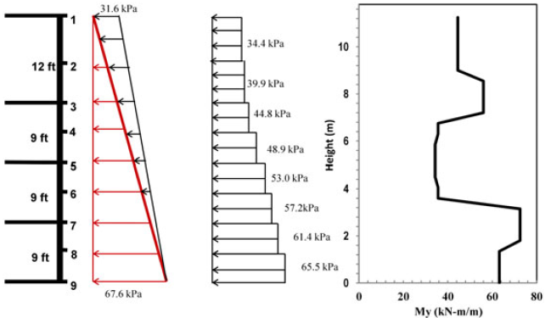
Time history of maximum force against the wall compared with M–O seismic forces (Finn et al., 2011)
Distribution of the design lateral pressure along the height of the wall (Finn et al., 2011)
The design lateral earth seismic pressure distribution for the basement wall for a friction angle of ${33}^{0}$ and PGA = 0.24 g is shown above.

Slide 8
Modelling and Analysis
A five-storied RC frame building without unreinforced brick masonry infill walls will be considered to be located in Seismic Zone V as per the Indian Earthquake Code IS:1893 (Part 1) – 2016 (BIS, 2016a). The plan dimensions are 15 m in length and 9 m in width, and the height of the superstructure is 15 m. The height of each story is 3 m, and the foundation story height is 2 m. The building is assumed to be founded on hard rock.
For the initial analysis, the sizes of the columns and beams are assumed to be 400 mm × 400 mm and 250 mm × 400 mm respectively. The thickness of the slab is considered to be 110 mm. The grades of concrete and steel reinforcement are assumed as M30 and Fe500 respectively.
The building frame was modelled using the computer program, SAP2000 (CSI, 2019), considering two-noded frame elements.
In each floor, all the nodes are constraints through diaphragm, so that all the nodes move by equal distance when load is applied, just like real slab behaviour.
Seismic loads to be applied are calculated using IS: 1893-2016, equivalent static method is used to calculate horizontal load in both X and Y direction

Slide 9
A Linear static analysis is carried out for the model to obtain the design forces and the design moments.
The same building will be again considered with the same floor plans in the superstructure but having three basement stories with each basement storey height being 3 m. At basement level, the additional bay of 3 m is considered to occur both along length and width of the building. Basement wall thickness to be considered is 200 mm.
Modelling for building with basement is same as before but during modelling of shear walls, we consider shell elements for modelling it.
The same methodology for analysis and design, as mentioned above, is followed for the building with basement stories.
Monotonic displacement-controlled nonlinear static analysis is carried out on the building models, with and without basement stories, using lumped plastic hinges for modelling material nonlinearity.
In SAP 2000, we use the section designer to input the detail of beams and columns. We also change the hinge properties, and provide hinge length as per the building we are designing

Slide 10
The analysis provides the estimates of the lateral shear capacity and lateral displacement capacity during earthquake shaking.
SAP 2000 model of five storied RC frame building with no basement
SAP 2000 model of five storied RC frame building with three basement stories

Slide 11
Results
For the building without basement
Beams detailing: Provide 4 numbers of 16 mm diameter main bars both at the top and bottom of the beams. For stirrups, provide 8 mm diameter bar at 75 mm spacing over a length of 2d = 708 mm and 8 mm diameter bar at 150 mm spacing over the remaining length of beam.

Slide 12
Columns detailing from Ground to 2nd Floor: Provide 4 numbers of 16 mm diameter and 4 numbers of 20 mm diameter main bars. For confining links, provide 8 mm diameter bar at 95 mm spacing over a length of lo = 450 mm and for nominal links, provide 8 mm diameter bar at 170 mm spacing over the middle portion of columns.

Slide 13
Columns detailing from 3rd to 5th Floor: Provide 8 numbers of 16 mm diameter main bars. For confining links, provide 8 mm diameter bar at 95 mm spacing over a length of lo = 450 mm and for nominal links, provide 8 mm diameter bar at 150 mm spacing over the middle portion of columns.

Slide 14
Pushover Analysis
Initially the base shear increases linearly with displacement, and then it started to slow down its increase in base shear due to beginning of formation of hinges. After some more displacement, the base shear starts to decrease because the hinges of beams start to collapse i.e., in the region C to D. The yellow dots in the figure shows the collapsing of hinges.
Deflected shape of the RC frame building with basement stories for pushover analysis
Base shear vs displacement curve

Slide 15
For the building with basement stories
Beams detailing for and above the Ground Floor: Provide 5 numbers of 16 mm diameter main bars both at the top and bottom of the beams. For stirrups, provide 8 mm diameter bar at 70 mm spacing over a length of 2d = 718 mm and 8 mm diameter bar at 150 mm spacing over the remaining length of beam.

Slide 16
Columns detailing for and above the Ground Floor: Provide 4 numbers of 16 mm diameter and 4 numbers of 20 mm diameter main bars. For confining links, provide 8 mm diameter bar at 95 mm spacing over a length of lo = 450 mm and for nominal links, provide 8 mm diameter bar at 110 mm spacing over the middle portion of columns.

Slide 17
Beams detailing for the Basement Floors: Provide 3 numbers of 16 mm diameter main bars both at the top and bottom of the beams. For stirrups, provide 8 mm diameter bar at 80 mm spacing over a length of 2d = 718 mm and 8 mm diameter bar at 150 mm spacing over the remaining length of beam.

Slide 18
Columns detailing for the Basement Floors: Provide 8 numbers of 20 mm diameter main bars. For confining links, provide 8 mm diameter bar at 100 mm spacing over a length of lo = 450 mm and for nominal links, provide 8 mm diameter bar at 180 mm spacing over the middle portion of columns.

Slide 19
Conclusion
After comparing the results of both the buildings analysis and design, we obtained that the base shear for building with basement stories is more than the building with no basement
Beams of basement floors requires less reinforcements as compare to upper stories and building with no basement because of shear wall.
Shear wall reduces the load and moments acting on the beams in the basement floors
In the non-linear analysis of building with no basement stories, the maximum shear capacity of the building is found to around 1.7 × 10^{^3} KN from pushover analysis. After a certain displacement, base shear starts to decrease due to the collapsing of hinges.

Slide 20
Future Scope
Results of non-linear analysis from both the buildings should be compare to find the resistance provided by basement and shear walls from that of regular RC frame buildings with no basements.

Slide 21
Thank You

