Slide 1
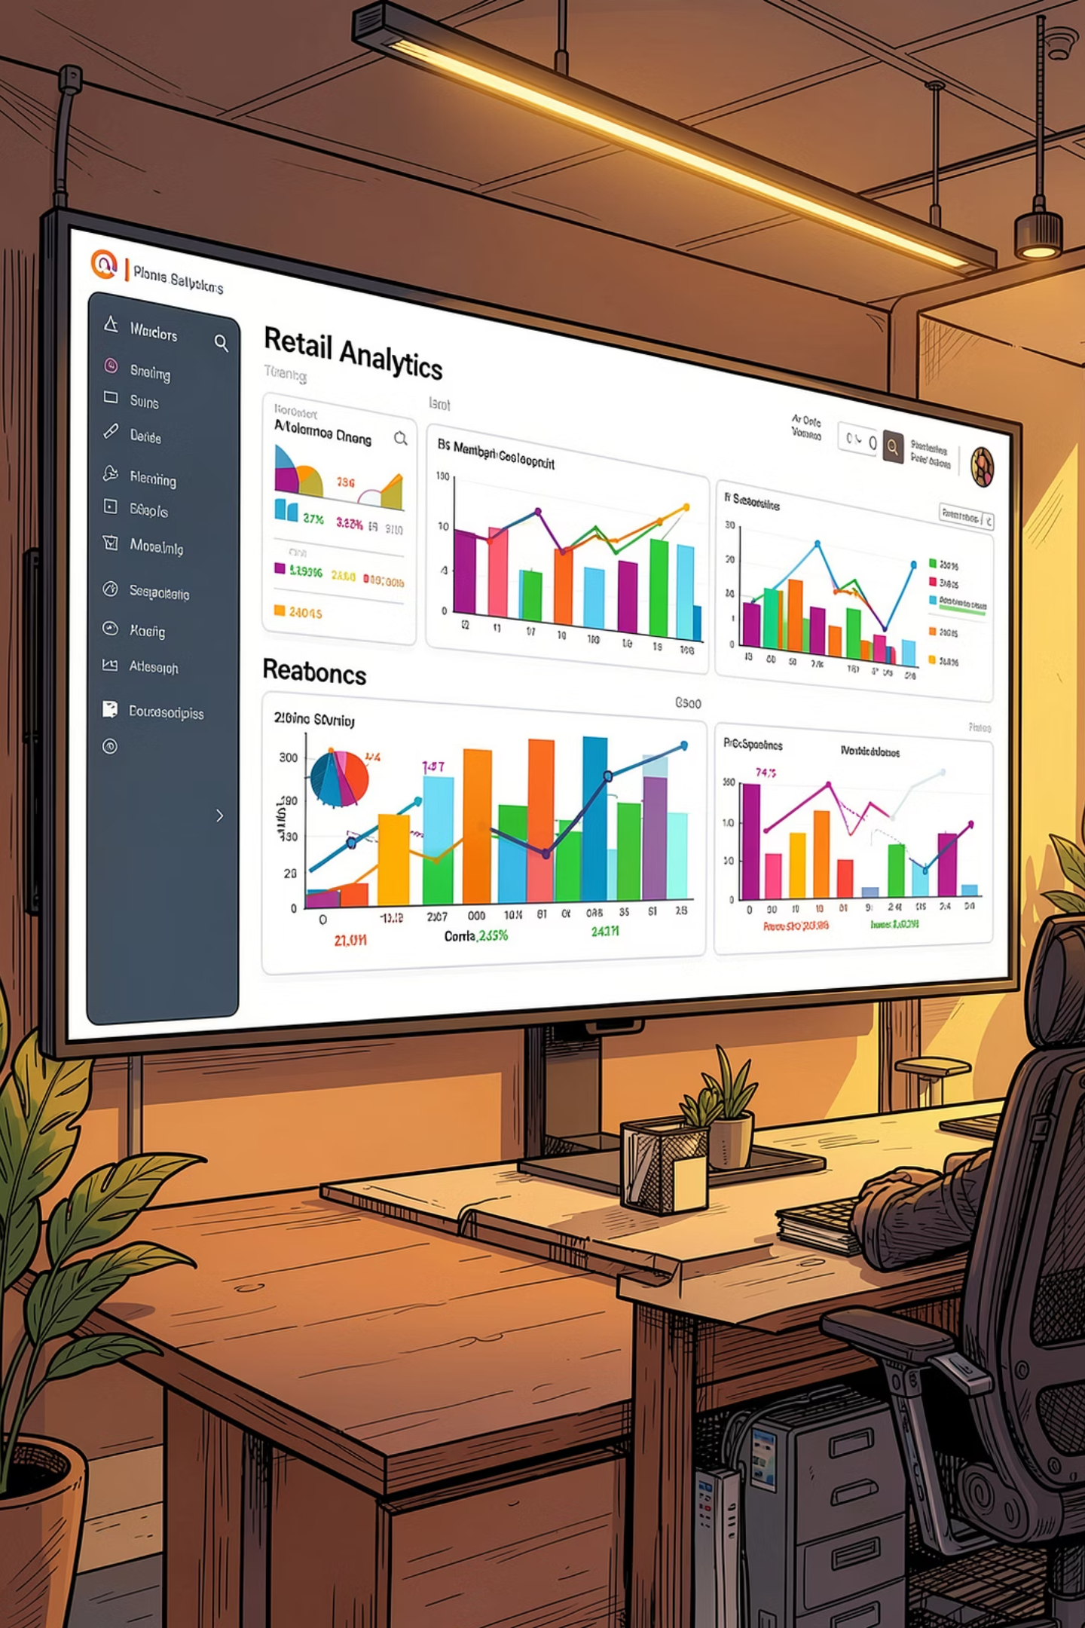
Customer Shopping Behavior Analysis
An in-depth analysis of 3,900 transactions across product categories — uncovering spending patterns, customer segments, product preferences, and subscription behavior to guide strategic business decisions.

Slide 2
DATASET OVERVIEW
Dataset at a Glance
The dataset contains 3,900 rows and 18 columns, covering customer demographics, purchase details, and shopping behavior. Only 37 values were missing — all in the Review Rating column.
3,900
18
Transactions
Features
Total purchase records analyzed
Columns spanning demographics, purchases & behavior
37
$59.76
Missing Values
Avg. Purchase
All in Review Rating — imputed by category median
Mean purchase amount across all transactions
Customer Demographics
Purchase & Behavior
Age, Gender, Location
Subscription Status
Item, Category, Amount, Season, Size, Color
Discount Applied, Promo Code, Frequency, Review Rating, Shipping Type

Slide 3
DATA PREPARATION
Exploratory Data Analysis in Python
The analysis began with data preparation and cleaning in Python before loading into PostgreSQL for SQL analysis.
01
02
03
Data Loading & Initial Exploration
Missing Data Handling
Column Standardization
Checked for null values and imputed missing Review Rating values using the median rating of each product category.
Renamed all columns to snake_case for better readability and documentation.
Imported the dataset using pandas. Used df.info() to check structure and .describe() for summary statistics.
04
05
Feature Engineering
Database Integration
Created age_group by binning customer ages and purchase_frequency_days from purchase data. Verified discount_applied and promo_code_used were redundant; dropped promo_code_used.
Connected Python script to PostgreSQL and loaded the cleaned DataFrame into the database for SQL analysis.

Slide 4
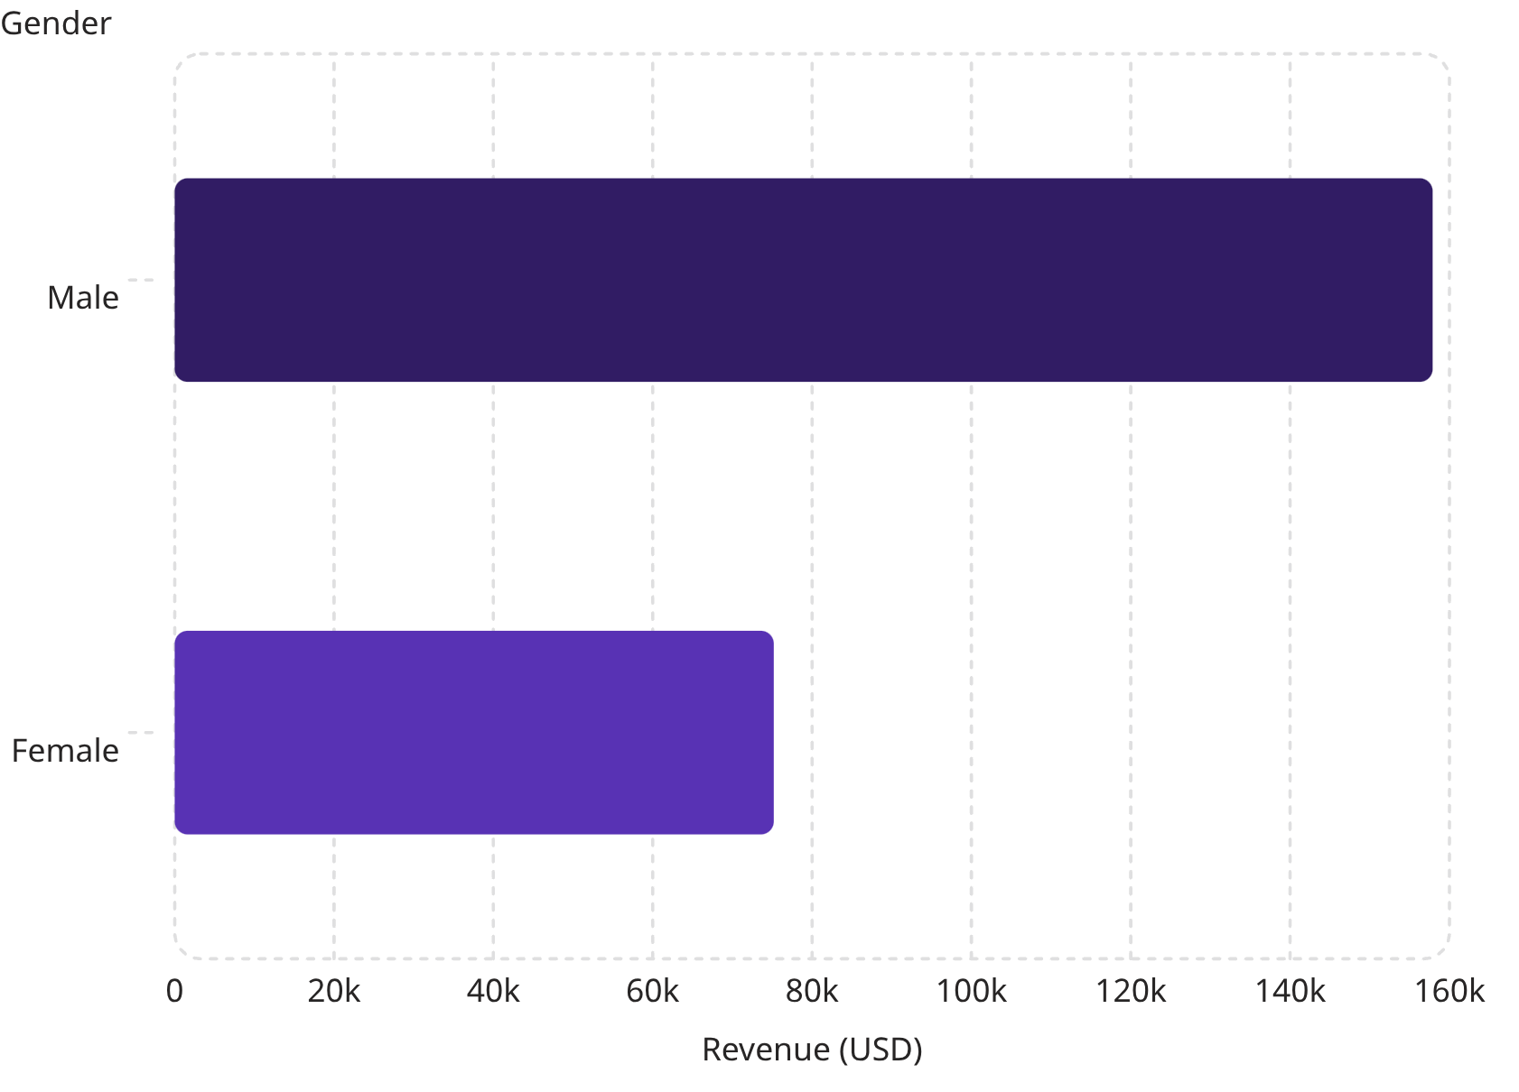

SQL ANALYSIS
Revenue Insights & High-Spending Discount Users
Revenue by Gender
Male customers generated more than double the revenue of female customers — $157,890 vs. $75,191 — despite females comprising a larger share of total customers.
High-Spending Discount Users: 839 customers used discounts yet still spent above the average purchase amount — indicating strong price sensitivity paired with above-average spending power.

Slide 5
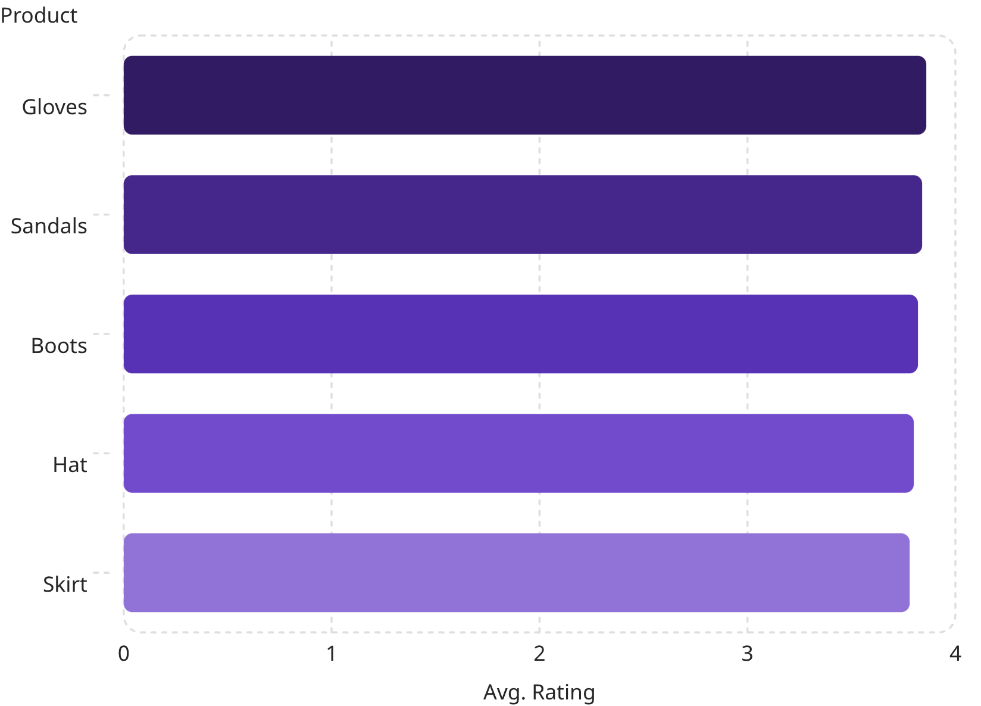
SQL ANALYSIS
Product Ratings & Shipping Behavior
Top 5 Products by Average Review Rating
Shipping Type: Average Purchase Amount
Express shipping customers spend slightly more on average ($60.48) compared to Standard shipping ($58.46), suggesting higher purchase intent among express users.
Standard Shipping
Express Shipping
Avg. $58.46
Avg. $60.48

Slide 6
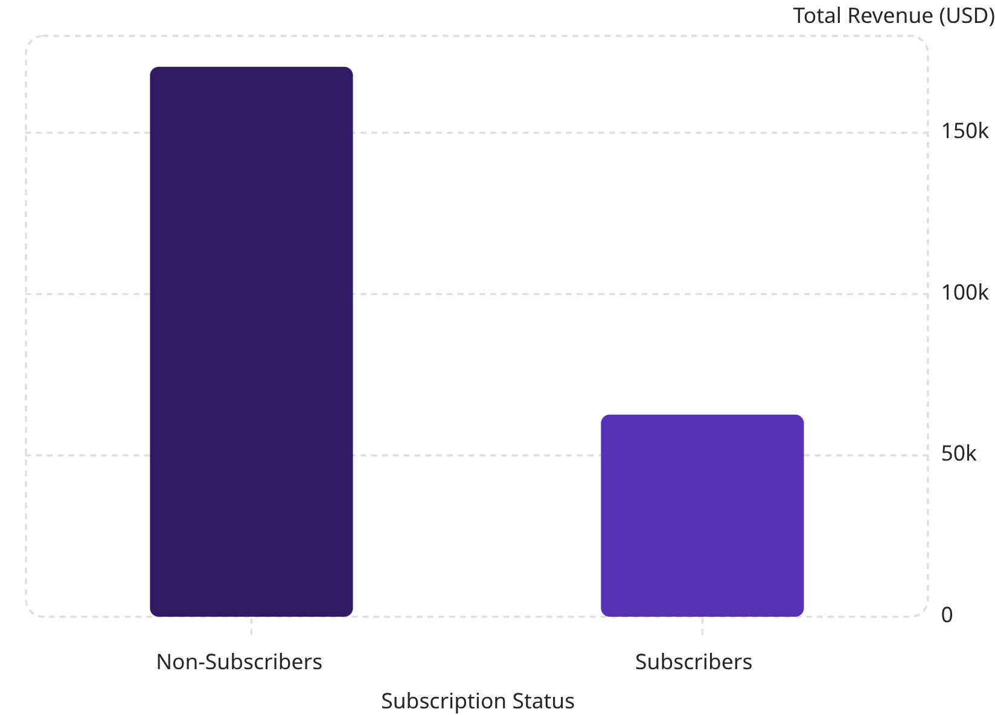

SQL ANALYSIS
Subscribers vs. Non-Subscribers
Key Findings
Only 27% of customers are subscribers (1,053), yet they generate $62,645 in total revenue. Non-subscribers (2,847) account for $170,436 — over 73% of total revenue.
Average spend is nearly identical: $59.49 (subscribers) vs. $59.87 (non-subscribers). This suggests subscription status does not significantly influence per-transaction value, but subscriber growth remains a major untapped revenue opportunity.
Subscribers represent a high-potential segment — increasing subscription adoption could meaningfully boost recurring revenue.

Slide 7
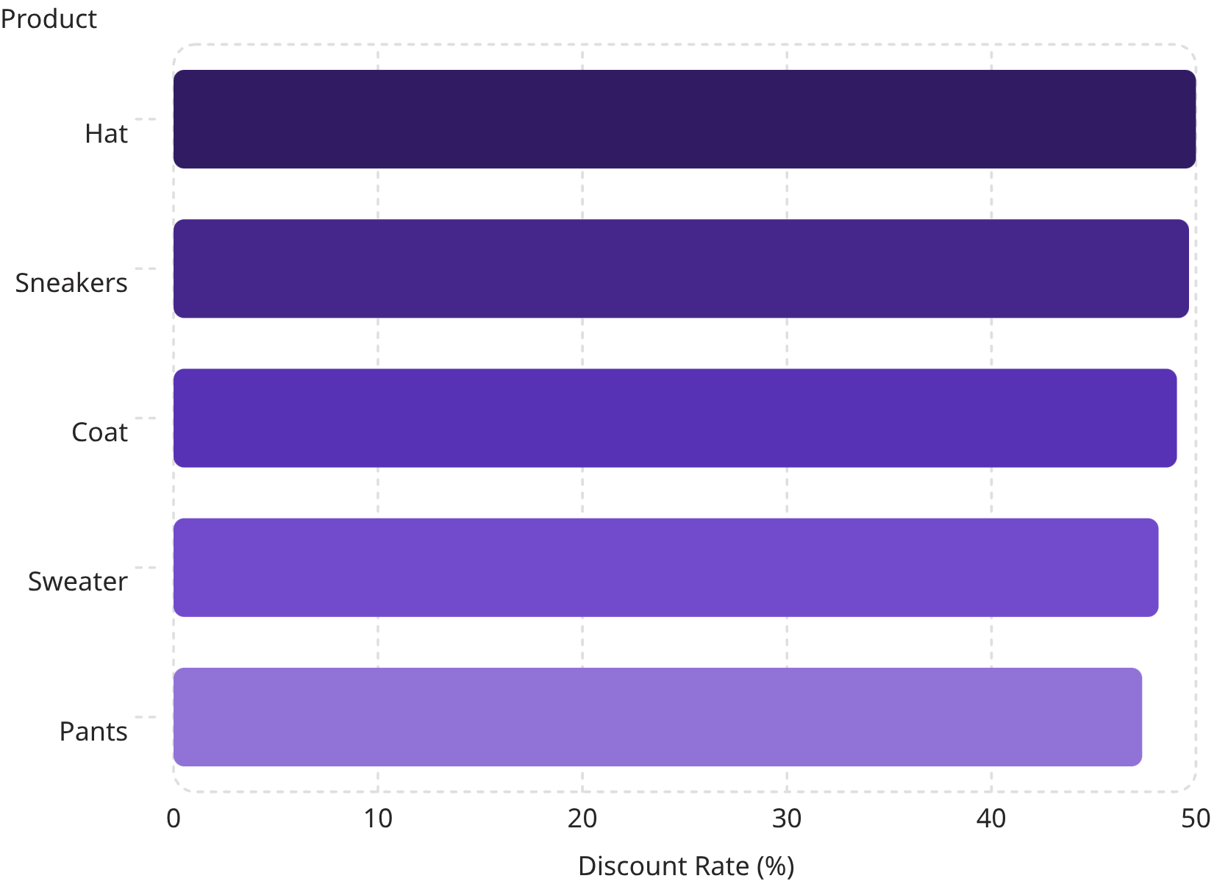
SQL ANALYSIS
Discount-Dependent Products & Customer Segmentation
Top 5 Products by Discount Rate
Customer Segmentation by Purchase History
Customers were classified into three segments based on purchase history:
Loyal
Returning
3,116 customers
701 customers
New
83 customers
Of customers with more than 5 purchases, 958 are subscribers vs. 2,518 non-subscribers — indicating repeat buyers are not yet converting to subscriptions at scale.

Slide 8
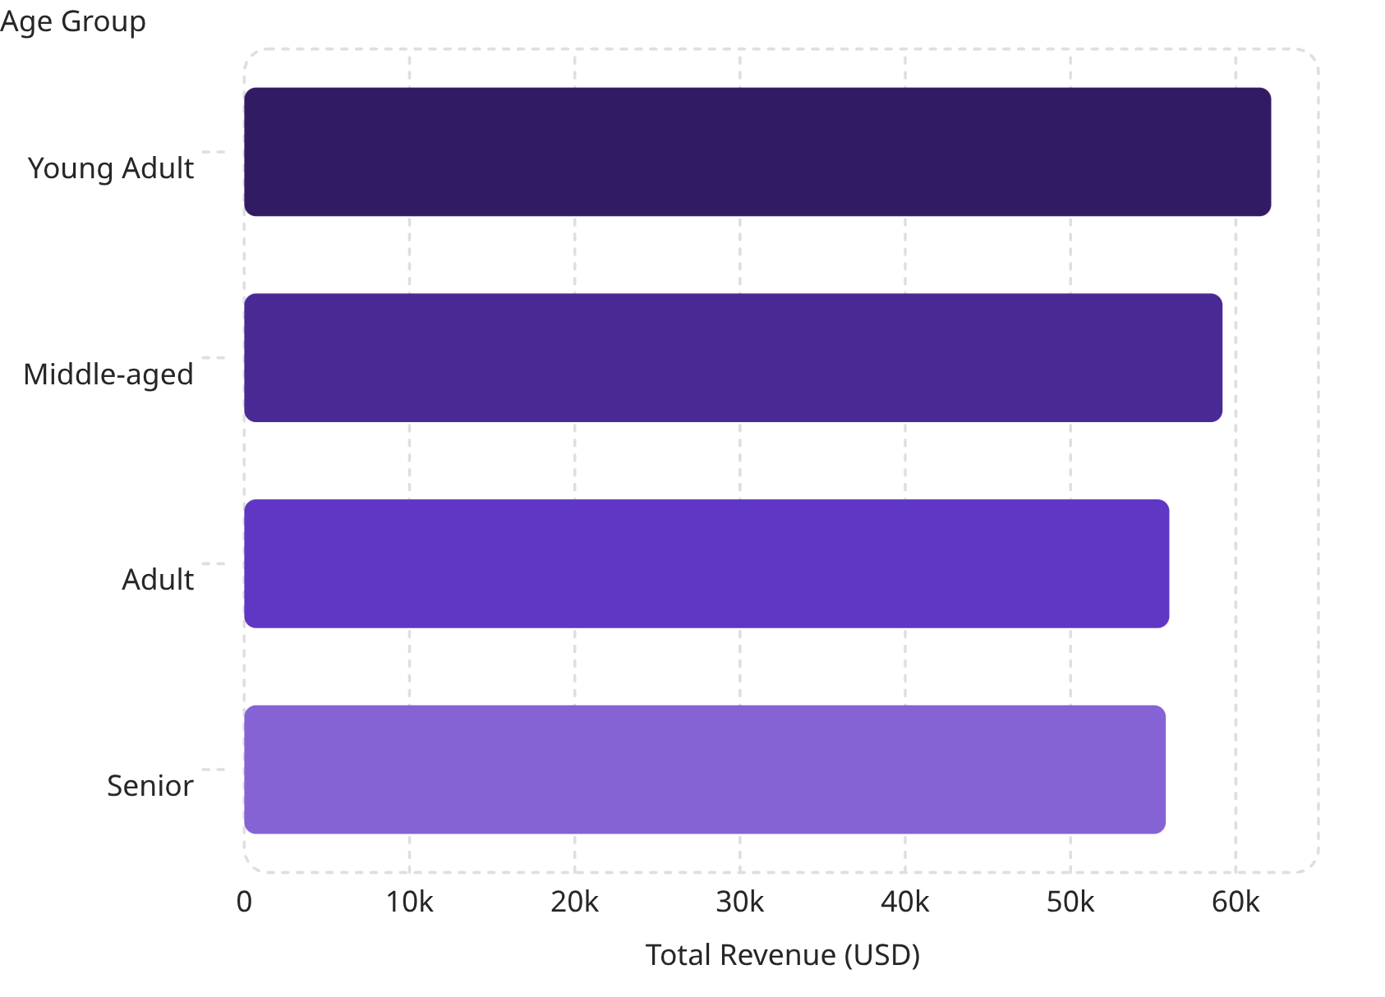
SQL ANALYSIS
Top Products by Category & Revenue by Age Group
Top 3 Products per Category
Revenue by Age Group
Category
Product
Orders
Accessories
Jewelry
171
Accessories
Sunglasses
161
Accessories
Belt
161
Clothing
Blouse
171
Clothing
Pants
171
Clothing
Shirt
169
Footwear
Sandals
160
Footwear
Shoes
150
Footwear
Sneakers
145
Outerwear
Jacket
163
Young Adults lead revenue contribution at $62,143, with revenue declining gradually across older age groups — a relatively even distribution overall.
Outerwear
Coat
161

Slide 9
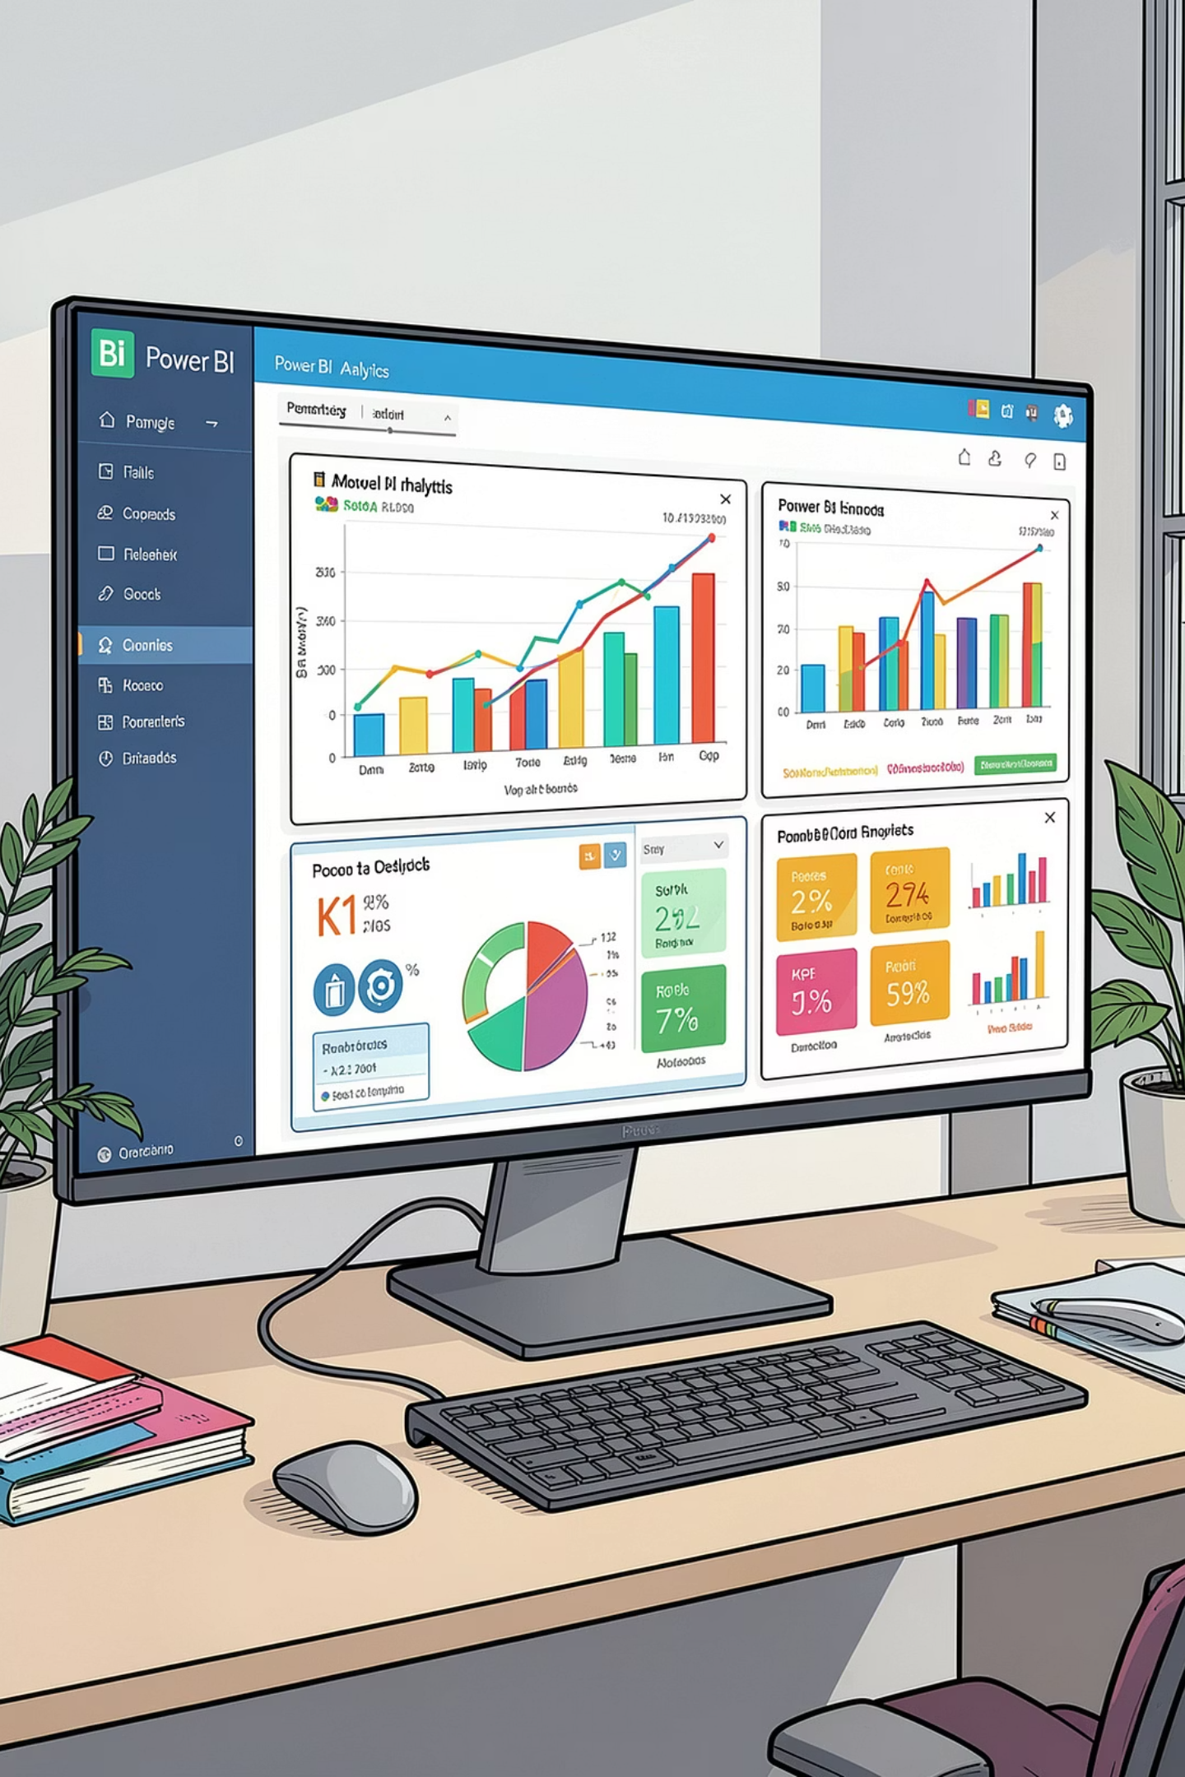

POWER BI DASHBOARD
Interactive Customer Behavior Dashboard
An interactive Power BI dashboard was built to present all insights visually, with filters for Subscription Status, Gender, Category, and Shipping Type.
Key Metrics
3.9K Customers · $59.76 Avg. Purchase · 3.75 Avg. Review Rating
Subscription Breakdown
Donut chart showing 27% subscribers vs. 73% non-subscribers
Revenue & Sales by Category
Bar charts comparing Clothing, Accessories, Footwear, and Outerwear performance
Revenue & Sales by Age Group
Horizontal bar charts showing contribution from Young Adult, Middle-aged, Adult, and Senior segments

Slide 10
STRATEGIC RECOMMENDATIONS
Business Recommendations
Boost Subscriptions
Customer Loyalty Programs
Review Discount Policy
Promote exclusive subscriber benefits to convert the 73% non-subscriber base, especially among loyal repeat buyers.
Reward repeat buyers to move them into the "Loyal" segment. Only 83 customers are classified as "New" — focus on retention.
Hats, Sneakers, and Coats have ~50% discount rates. Balance sales boosts with margin control.
Product Positioning
Targeted Marketing
Highlight top-rated products (Gloves, Sandals, Boots) and best-sellers (Blouse, Jewelry, Jacket) in campaigns.
Focus on high-revenue age groups — especially Young Adults ($62,143) — and express-shipping users who spend more per transaction.

