Slide 1
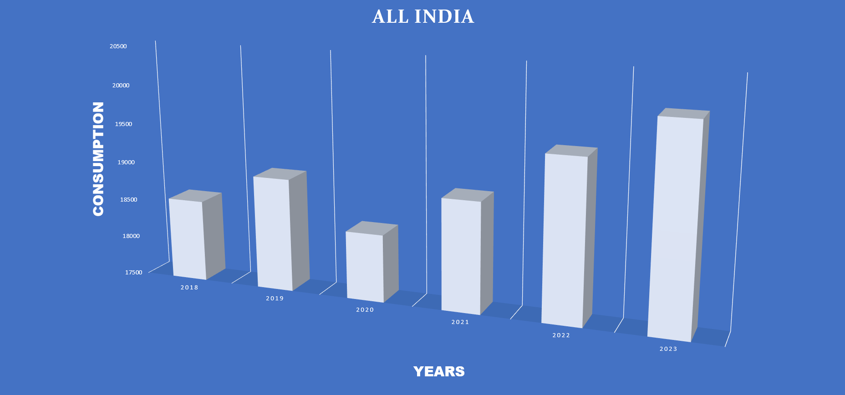
ALL VALUES ARE IN MMT

Slide 2
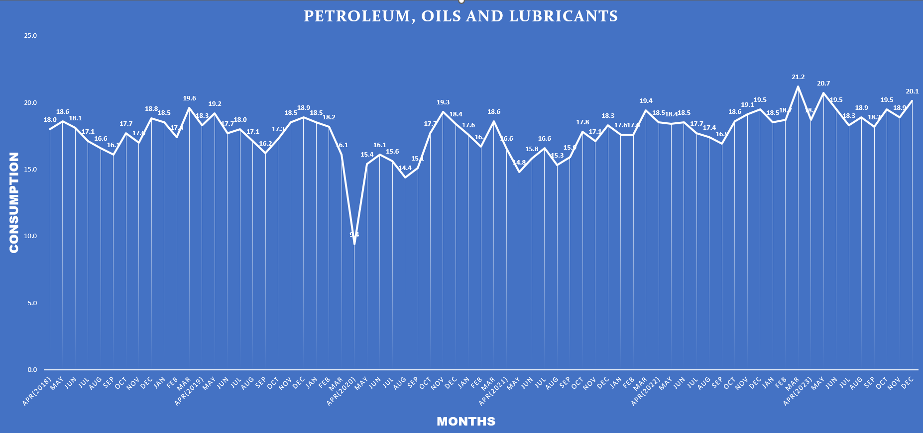
ALL VALUES ARE IN MMT

Slide 3
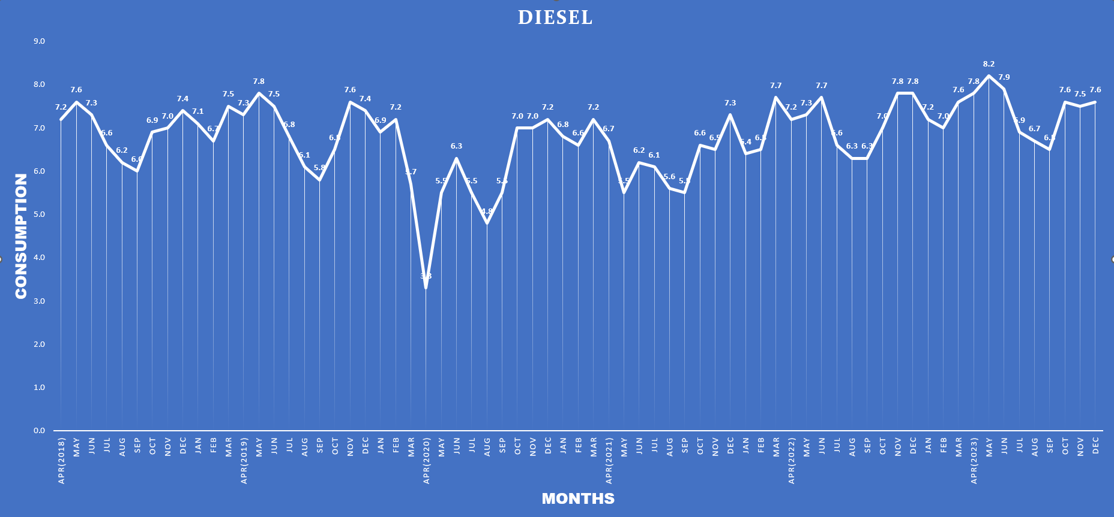
ALL VALUES ARE IN MMT

Slide 4
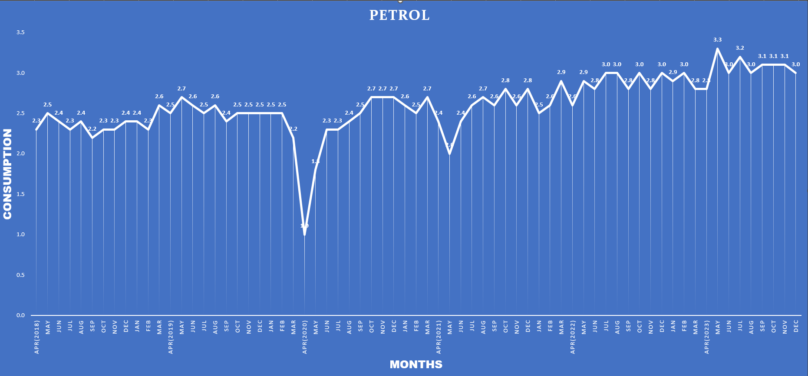
ALL VALUES ARE IN MMT

Slide 5
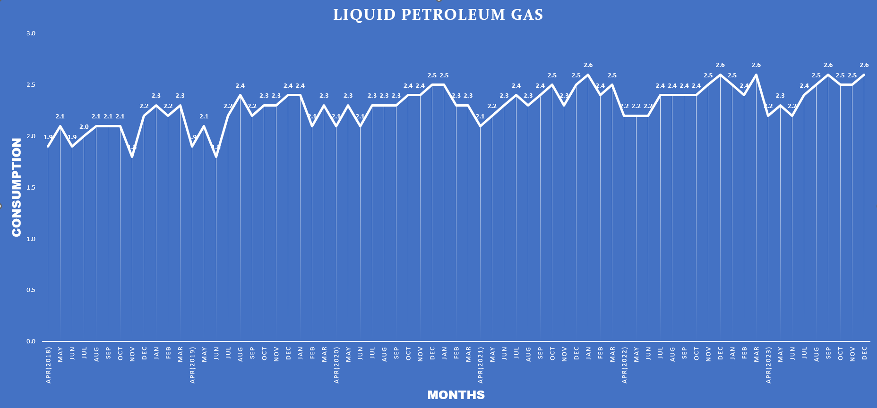
ALL VALUES ARE IN MMT

Slide 6
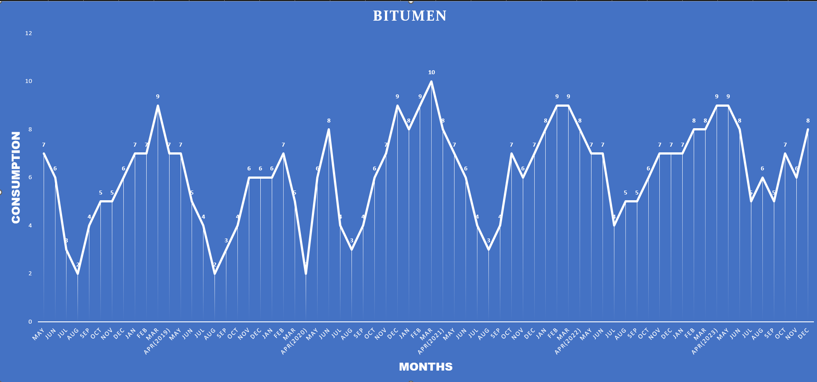
ALL VALUES ARE IN MMT

