Slide 1
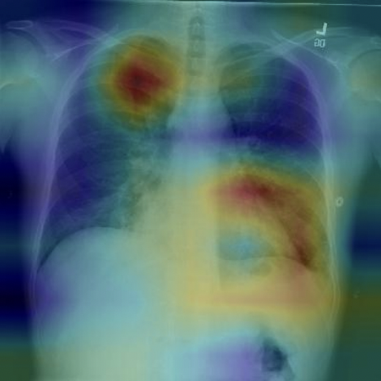
Pneumonia Detection on Chest X-rays
Gaurav Singh [305353434]
MS, Electrical and Computer Engineering

Slide 2
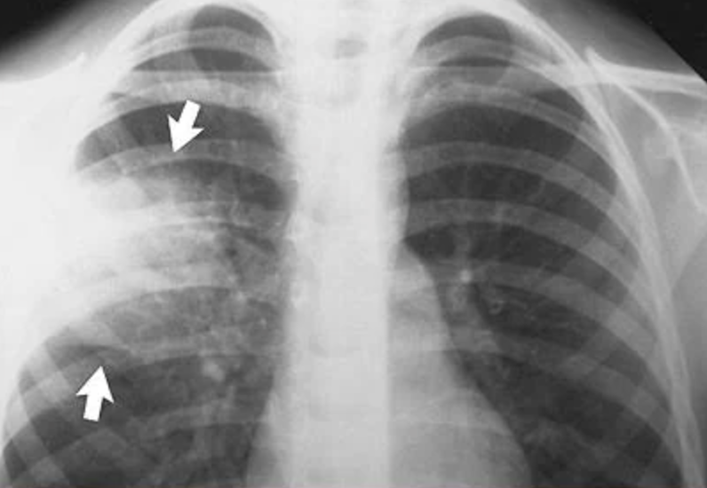
Background
Pneumonia?
Infection of the lungs causing inflammation of air sacs called alveoli
Can be bacterial, fungal, or viral
Symptoms include coughing, fever, difficulty in breathing and is life-threatening
One of the major causes of death in corona virus affected patients
Detection?
Reviewing Chest X-rays (CXR)
Present in an area of increased opacity in CXR.
Requirements: Highly qualified specialist, laboratory tests, vital signs, clinical history.
Expensive and time consuming.
Notes:
For the start why I chose this data?
So, I was looking for good time series data on different government-supplied datasets and came across this one. It appeared to me interesting given during this summer I had a lot of opportunities to use these Yellow cabs in New York city, they really help when you can't get Uber obviously if you are able to spot one. Also, they are kind of iconic for NY city. We all have seen them in different movies.
Interesting fact, there were around 13.5K such taxis in service around 10 years back and now there are only 9000 of them left.
The data is provided by NYC taxi and Limousine commission. Raw data is provided per 10 min basis so for our use case I aggregated it by day for three years from 2017 to 2019. Covid times is not taken into consideration given at that time there were only 700 taxis in service.
The data has mean of around 438 thousand passengers / day. Seems like a lot.

Slide 3
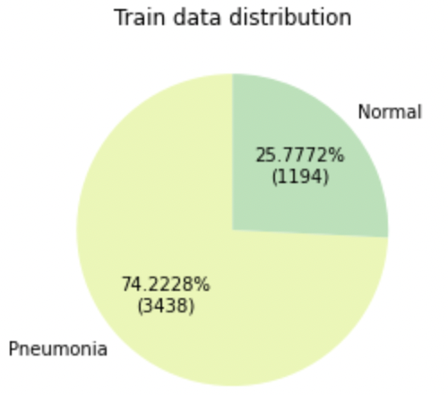
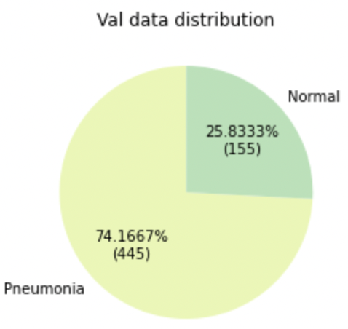
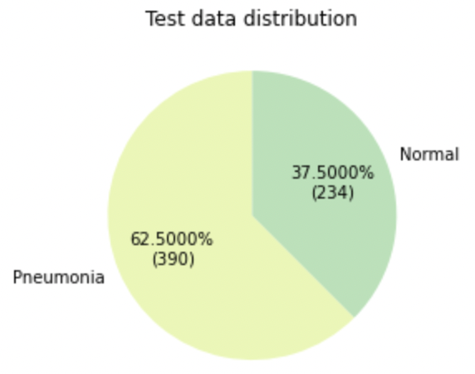
Data
Open source data from Kaggle. Link
Three folders containing train(5216), test(624) and validation(16) images
Validation images increased to 600 from training set using Stratified sampling.
Skewed with more positives than normal patients
Notes:
For the start why I chose this data?
So, I was looking for good time series data on different government-supplied datasets and came across this one. It appeared to me interesting given during this summer I had a lot of opportunities to use these Yellow cabs in New York city, they really help when you can't get Uber obviously if you are able to spot one. Also, they are kind of iconic for NY city. We all have seen them in different movies.
Interesting fact, there were around 13.5K such taxis in service around 10 years back and now there are only 9000 of them left.
The data is provided by NYC taxi and Limousine commission. Raw data is provided per 10 min basis so for our use case I aggregated it by day for three years from 2017 to 2019. Covid times is not taken into consideration given at that time there were only 700 taxis in service.
The data has mean of around 438 thousand passengers / day. Seems like a lot.

Slide 4
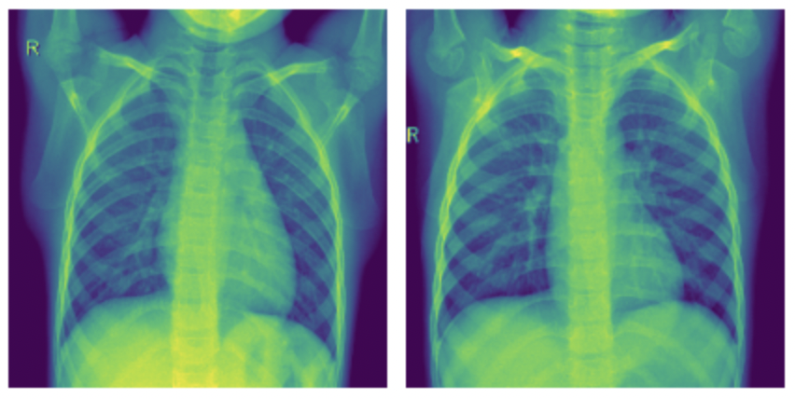
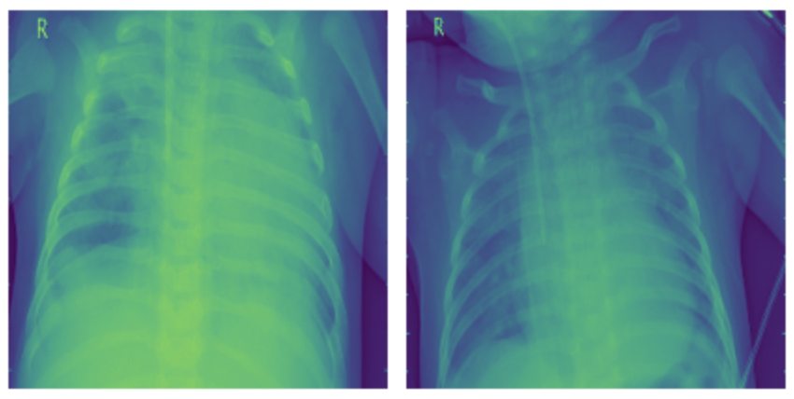
Data Visualisation
Mix of RGB and Grayscale images of varying dimensions
# RGB images: 251, #Grayscale images: 4381 (for Train dataset)
All images read as grayscale i.e. with one channel
Read size fixed at (256 x 256), all downscaled.
Normal Patients
Infected Patients
Notes:
For the start why I chose this data?
So, I was looking for good time series data on different government-supplied datasets and came across this one. It appeared to me interesting given during this summer I had a lot of opportunities to use these Yellow cabs in New York city, they really help when you can't get Uber obviously if you are able to spot one. Also, they are kind of iconic for NY city. We all have seen them in different movies.
Interesting fact, there were around 13.5K such taxis in service around 10 years back and now there are only 9000 of them left.
The data is provided by NYC taxi and Limousine commission. Raw data is provided per 10 min basis so for our use case I aggregated it by day for three years from 2017 to 2019. Covid times is not taken into consideration given at that time there were only 700 taxis in service.
The data has mean of around 438 thousand passengers / day. Seems like a lot.

Slide 5
Goal
Can we detect Pneumonia infections by just looking at the X-Rays?
A lot of work is already done in this field using Machine Learning(ML) and Deep Learning(DL)
Using methods and evaluation criteria learnt in this course, and other DL approaches can we achieve reasonable results?
Are they feasible for real time analysis?
Notes:
For the start why I chose this data?
So, I was looking for good time series data on different government-supplied datasets and came across this one. It appeared to me interesting given during this summer I had a lot of opportunities to use these Yellow cabs in New York city, they really help when you can't get Uber obviously if you are able to spot one. Also, they are kind of iconic for NY city. We all have seen them in different movies.
Interesting fact, there were around 13.5K such taxis in service around 10 years back and now there are only 9000 of them left.
The data is provided by NYC taxi and Limousine commission. Raw data is provided per 10 min basis so for our use case I aggregated it by day for three years from 2017 to 2019. Covid times is not taken into consideration given at that time there were only 700 taxis in service.
The data has mean of around 438 thousand passengers / day. Seems like a lot.

Slide 6
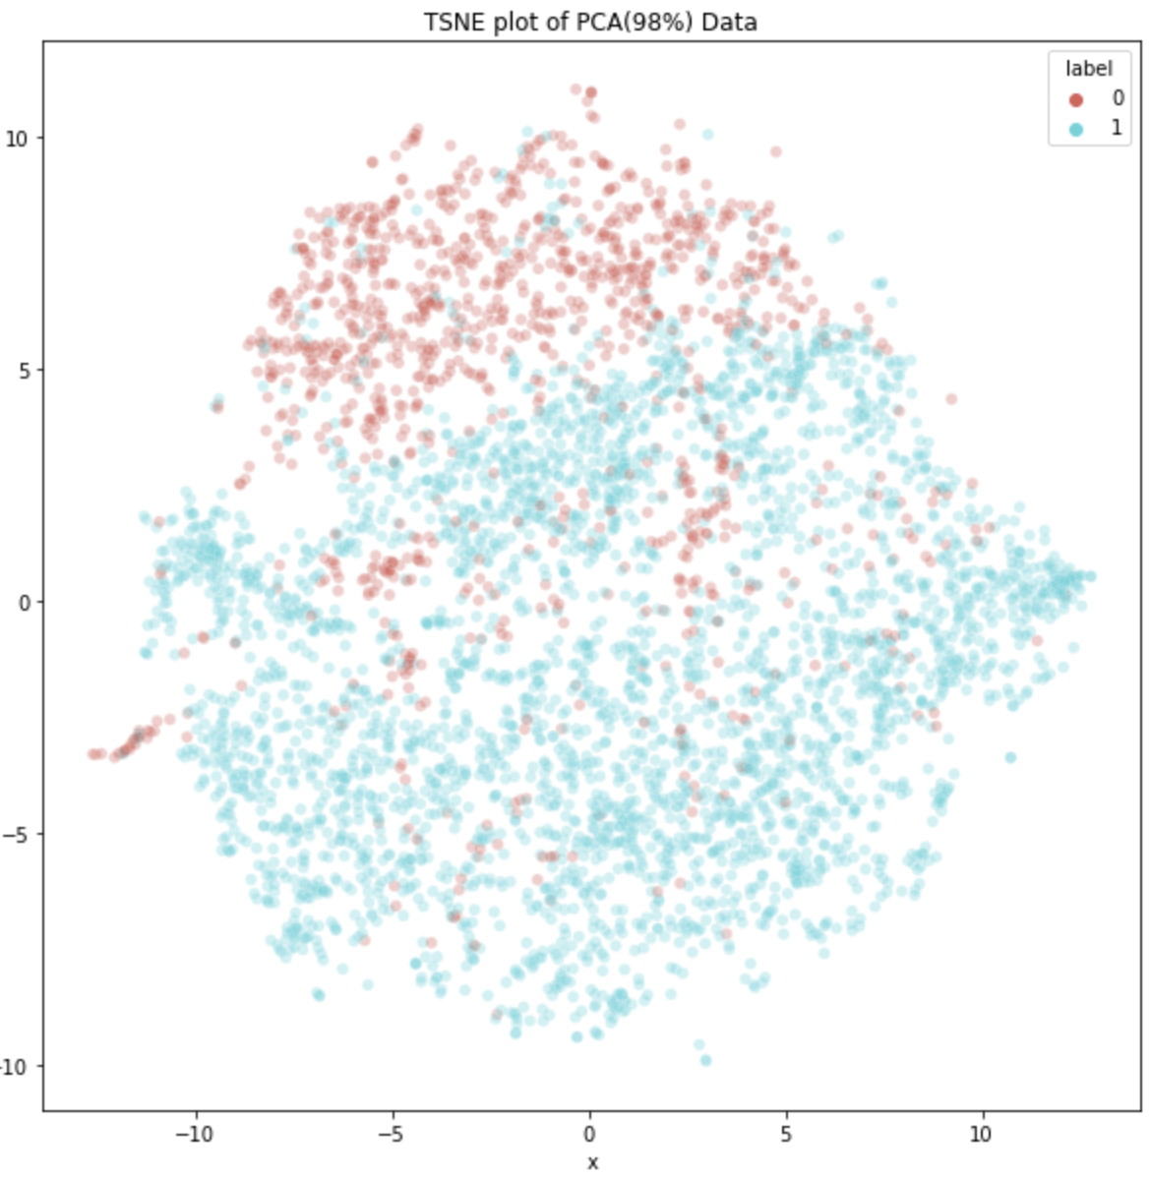
Unsupervised Method
PCA with 98% variance on flattened and scaled train image vectors
Output vector dimensions: (256 X 256) => 1 X 1648
K-means clustering with 2 clusters on reduced dimensions on the test set.
Chose appropriate cluster assignments using distance from cluster centroids.
Train Data visualized using TSNE
Notes:
For the start why I chose this data?
So, I was looking for good time series data on different government-supplied datasets and came across this one. It appeared to me interesting given during this summer I had a lot of opportunities to use these Yellow cabs in New York city, they really help when you can't get Uber obviously if you are able to spot one. Also, they are kind of iconic for NY city. We all have seen them in different movies.
Interesting fact, there were around 13.5K such taxis in service around 10 years back and now there are only 9000 of them left.
The data is provided by NYC taxi and Limousine commission. Raw data is provided per 10 min basis so for our use case I aggregated it by day for three years from 2017 to 2019. Covid times is not taken into consideration given at that time there were only 700 taxis in service.
The data has mean of around 438 thousand passengers / day. Seems like a lot.

Slide 7
Supervised Methods (ML)
Two approaches are used:
Both involved breaking the image structure into flattened vectors keeping principal components
Logistic Regression with l2 regularization of 0.001, with class weight balancing
Support vector classifier with rbf kernel and weight balancing
Limitations:
Linear decision boundary
Kernel based implementation not feasible for large number of samples or features
Spatial structure is lost during flattening
Notes:
For the start why I chose this data?
So, I was looking for good time series data on different government-supplied datasets and came across this one. It appeared to me interesting given during this summer I had a lot of opportunities to use these Yellow cabs in New York city, they really help when you can't get Uber obviously if you are able to spot one. Also, they are kind of iconic for NY city. We all have seen them in different movies.
Interesting fact, there were around 13.5K such taxis in service around 10 years back and now there are only 9000 of them left.
The data is provided by NYC taxi and Limousine commission. Raw data is provided per 10 min basis so for our use case I aggregated it by day for three years from 2017 to 2019. Covid times is not taken into consideration given at that time there were only 700 taxis in service.
The data has mean of around 438 thousand passengers / day. Seems like a lot.

Slide 8
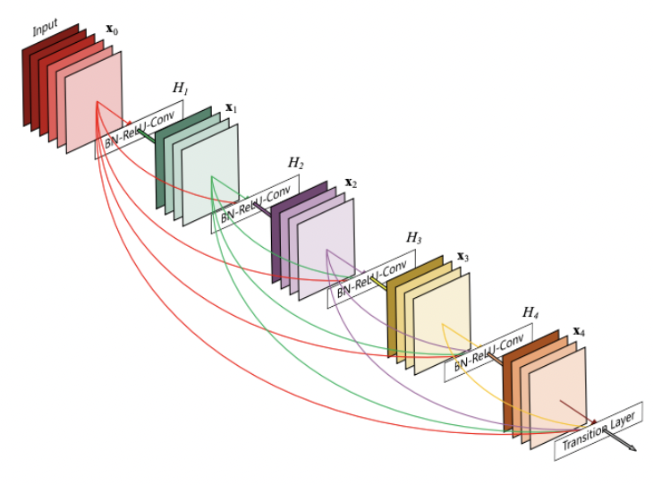
Supervised Methods (CNN)
Two architectures are used:
LeNet inspired:
- Added BatchNorm and Max Pool
- 2D (3 x 3) conv filters used with 4 convolution layers (32, 64, 128, 128)
- 3 Fully connected layers
- 9,744,578 trainable parameters
- Xavier and Kaiming Initialisation used
DenseNet -121:
- Connects each layer to every other layer in feed-forward fashion using Dense Block
- Has 4 such Dense blocks with [6,12,24,16] layers
- Solves the problem of vanishing gradient in long networks
- 6,955,906 trainable parameters
- Pretrained weights from Imagenet used as Initialisation
- Used by CheXNet
Notes:
For the start why I chose this data?
So, I was looking for good time series data on different government-supplied datasets and came across this one. It appeared to me interesting given during this summer I had a lot of opportunities to use these Yellow cabs in New York city, they really help when you can't get Uber obviously if you are able to spot one. Also, they are kind of iconic for NY city. We all have seen them in different movies.
Interesting fact, there were around 13.5K such taxis in service around 10 years back and now there are only 9000 of them left.
The data is provided by NYC taxi and Limousine commission. Raw data is provided per 10 min basis so for our use case I aggregated it by day for three years from 2017 to 2019. Covid times is not taken into consideration given at that time there were only 700 taxis in service.
The data has mean of around 438 thousand passengers / day. Seems like a lot.

Slide 9
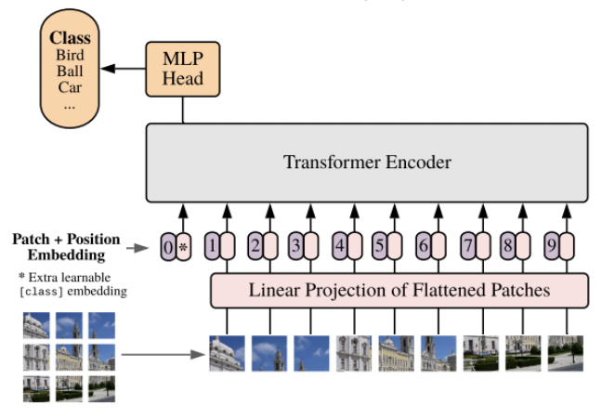
Supervised Methods (Vision Transformers)
Vision Transformers (ViT) use transformer architecture used in NLP tasks
Patches are analogous to words and embeddings are analogous to flattened patch vectors.
Everything else i.e. positional encodings and encoder blocks remain the same.
Architecture used:
Deep ViT – have more no. of layers >= 12. (Parameters: 127,040,834)
Compact Convolution Transformer (CCT) – Patches + convolution outputs are fed as input (Parameters: 26,845,123)
Cross ViT – Two transformers working on different scales of same image. (Parameters: 75,863,620)
Notes:
For the start why I chose this data?
So, I was looking for good time series data on different government-supplied datasets and came across this one. It appeared to me interesting given during this summer I had a lot of opportunities to use these Yellow cabs in New York city, they really help when you can't get Uber obviously if you are able to spot one. Also, they are kind of iconic for NY city. We all have seen them in different movies.
Interesting fact, there were around 13.5K such taxis in service around 10 years back and now there are only 9000 of them left.
The data is provided by NYC taxi and Limousine commission. Raw data is provided per 10 min basis so for our use case I aggregated it by day for three years from 2017 to 2019. Covid times is not taken into consideration given at that time there were only 700 taxis in service.
The data has mean of around 438 thousand passengers / day. Seems like a lot.

Slide 10
Evaluations - ML
Model | Acc(%) | Precision | Recall | Train Time(s) | Test Time(s)
PCA + Clustering | 58.17 | 68.48 | 61.28 | 279.53 | 2.21
Logistic Regression | 71.16 | 68.04 | 94.46 | 105.65 | 0.035
SVC | 75.00 | 71.64 | 93.94 | 5.99 | 0.803
Notes:
Moving to the results.
We can see that the simplest of the models i.e AR(1) gave us the least Train and test RMSE.
Complex models like ARMA(9, 9) which gave lowest AIC, gave the worst errors and slightly simple model chosen using BIC score, gave us slightly better results.
This adjustment thing which is like adding a constant to the final results. I will discuss about it in next slide.
Also on comparison with simple models, like just the mean or simple regression we can see ARMA models are necessary for this kind of data.
Also if we would have just fitted a simple AR(1) without cycle removal, results would not be as good. Which shows cycle and trend removal is really important.

Slide 11
Evaluations - DL
Initializations - Xavier, Kaiming, Imagenet
Loss function – Cross Entropy
Data Processing – Normalisation (mean = 0.48, std = 0.22), Resize (224 x 224), Horizontal Flip, Shift (0.1), Scale (0.1), Rotate (5 degrees)
Trainer: Optimizers(Adam, AdamW), weight decay(1e-6), learning rate (1e-4), warmup steps (580), momentum(0.9), Scheduler(Cosine with warmup, fixed, linear decay)
Batch size: 32
** All models are trained using data parallelism, on 6 NVIDIA Tesla K80 GPU
Notes:
Moving to the results.
We can see that the simplest of the models i.e AR(1) gave us the least Train and test RMSE.
Complex models like ARMA(9, 9) which gave lowest AIC, gave the worst errors and slightly simple model chosen using BIC score, gave us slightly better results.
This adjustment thing which is like adding a constant to the final results. I will discuss about it in next slide.
Also on comparison with simple models, like just the mean or simple regression we can see ARMA models are necessary for this kind of data.
Also if we would have just fitted a simple AR(1) without cycle removal, results would not be as good. Which shows cycle and trend removal is really important.

Slide 12
Evaluations - DL
Model | Acc(%) | Precision | Recall | Epochs | Train Time(s) | Test Time(s)
Mod. LeNet | 77.40 | 73.44 | 1.0 | 50 | 150 | 3
DenseNet-121 | 83.05 | 79.80 | 99.74 | 50 | 4000 | 16
Deep-ViT | 80.60 | 78.01 | 99.23 | 20 | 3060 | 13
CCT | 84.08 | 81.17 | 1.0 | 20 | 1200 | 7
Cross ViT | 88.25 | 84.02 | 99.42 | 20 | 3780 | 18
Notes:
Moving to the results.
We can see that the simplest of the models i.e AR(1) gave us the least Train and test RMSE.
Complex models like ARMA(9, 9) which gave lowest AIC, gave the worst errors and slightly simple model chosen using BIC score, gave us slightly better results.
This adjustment thing which is like adding a constant to the final results. I will discuss about it in next slide.
Also on comparison with simple models, like just the mean or simple regression we can see ARMA models are necessary for this kind of data.
Also if we would have just fitted a simple AR(1) without cycle removal, results would not be as good. Which shows cycle and trend removal is really important.

