Slide 1

IPL Data Analysis
Data-Driven Decision Making for Auction Strategy for RCB
Created by,
Gaurav Agrawal

Slide 2
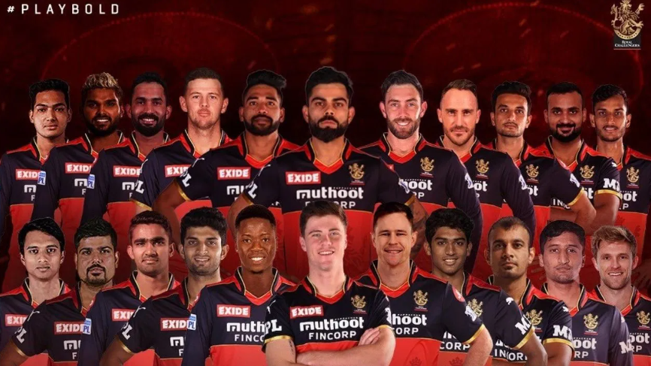
Winning with Data: RCB Auction Goals
Problem Statement -> RCB needs to identify the top-performing, reliable, and cost-effective players for the 2017 mega auction. Provide strategies to optimize player selection and investments.
Objective -> Analyze player performance data to identify key contributors who can strengthen RCB's squad. This includes evaluating consistency, match-winning impact and reliability across batting, bowling, and all-rounder roles.

Slide 3

Analysis – Identifying Players and Strategies
Key Performance Indicators (KPIs)
Batting and Bowling Averages
Strike Rates and Economy Rates
Consistency in Batting and Bowling
Boundaries Scored
Versatility in Batting and Bowling
Home-Ground Advantage
Team Performance
Season-wise Runs and Wickets.
Age Factor

Slide 4
Data Overview
Ball by Ball
Match_id: Unique identifier for a cricket match
Over_id: Unique identifier for an over in a cricket match
Ball_id: Unique identifier for a ball in an over
Innings_No: The innings number in a cricket match
Team_Batting: The team batting in a particular innings
Team_Bowling: The team bowling in a particular innings
Striker_Batting_Position: The batting position of the striker batsman
Striker: The batsman currently on strike
Non_Striker: The batsman currently at the non-striker's end
Bowler: The bowler bowling the current delivery
Batting style
Batting_id: Unique identifier for a batsman's batting record
Batting_hand: The batting hand (right or left) of a batsman
Bowling style
Bowling_id: Unique identifier for a bowler's bowling record
Bowling_skill: The bowling skill (e.g., right-arm fast, left-arm spin) of a bowler
City
City_id: Unique identifier for a city
City_Name: The name of a city
Country_id: Unique identifier for a country

Slide 5
Data Overview
Extra Type
Extra_Type_Id: Unique identifier for the type of extra runs scored in a cricket match.
Extra_Runs: The number of extra runs scored in a particular delivery.
Innings_No: The innings number in a cricket match.
Extra_Id: Unique identifier for an instance of extra runs scored.
Extra_Name: The name or description of the type of extra runs scored (e.g., byes, leg byes, wides, no-balls).
Season
Season_Id: Unique identifier for a particular season or tournament.
Venue_Id: Unique identifier for the venue or stadium where the match is played..
Win_By
Win_Type: The type of win (e.g., runs, wickets) achieved by the winning team.
Win_Margin: The margin of victory (e.g., runs or wickets) for the winning team.
Outcome
Outcome_type: The type of outcome or result of the match (e.g., win, loss, tie, no result).
Match_Winner: The team that won the match.
Man_of_the_Match: The player awarded the Man of the Match award.
Out_Type
Out_Id: Unique identifier for the type of dismissal or way a batsman got out.
Out_Name: The name or description of the type of dismissal (e.g., caught, bowled, lbw, run out).
Outcome_Id: Unique identifier for the outcome or result of a match.

Slide 6
Data Overview
Rolee
Role_Id: Unique identifier for a player's role or skills (e.g., batsman, bowler, all-rounder).
Role_Desc: Description of a player's role or skills.
Man_of_the_Series: The player awarded the Man of the Series award for a particular tournament.
Orange_cap: The player awarded the Orange Cap (for most runs scored) in a particular tournament.
Purple_cap: The player awarded the Purple Cap (for most wickets taken) in a particular tournament.
Team
Team_Id: Unique identifier for a team.
Team_Name: The name of a team.
Umpire
Umpire_id: Unique identifier for an umpire officiating the match.
Umpire_name: The name of an umpire.
Umpire_country: The country or nationality of an umpire.
Toss Decision
Toss_Name: The name or description of the toss (e.g., heads or tails).
Player
Player_Id: Unique identifier for a player.
Player_Name: The name of a player.

Slide 7
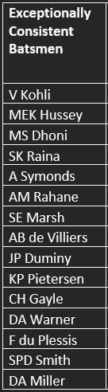
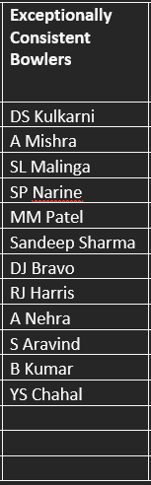
Description: Tracks the total count of restaurants, filterable by country and year.
Consistent Players (Bat & Bowl)
These lists highlight players who were exceptionally consistent throughout their previous seasons.
Their consistency is measured by the below factors.
Exceptionally Consistent Batsmen
No of seasons played > 3
Total Runs scored > 800
Batting Average > 35
Exceptionally Consistent Bowlers
No of seasons played > 3
Total Wickets taken > 35
Bowling Average > 23

Slide 8
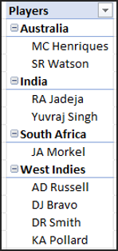
Description: Tracks the total count of restaurants, filterable by country and year.
Versatile Players (All-Rounders)
West Indies lead in producing the highest number of all-rounders. Following closely are Australia and India.
Effectiveness in Batting is measured by:
Number of seasons played > 3
Total runs scored > 500.
Effectiveness in Bowling is measured by:
Number of seasons played > 3
Total wickets taken > 20
Total Bowling_average < 30

Slide 9
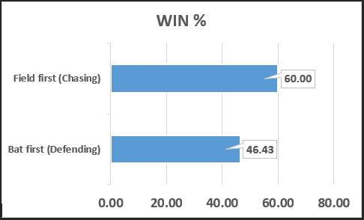
Description: Tracks the total count of restaurants, filterable by country and year.
Home-Ground Advantage
Strength in Chasing: RCB performs better when fielding first with a high winning average of 7 wickets.
Weaker Defending: The win percentage while batting first is consistently lower with again high winning average of 57 runs.
Strategy Optimization: Focus on fielding first to capitalize on RCB’s strength in defending targets..

Slide 10
Description: Tracks the total count of restaurants, filterable by country and year.
Home-Ground Advantage
Batting First Improvement: Powerplay (1-6 overs): Aim for a quick 75+ runs in the powerplay while ensuring crucial wickets are not lost.
Middle Overs (7-14 overs): Target a steady 60+ runs during the middle overs to build momentum for the final attack.
Death Overs (16-20 overs): Focus on power hitting to accelerate and reach a total of around 200 runs, setting a competitive target.
Toss Decisions: In favourable conditions (such as dry pitches or when there is dew), prioritize fielding first to gain an early advantage and put pressure on the opposing team to set a target. When batting first, ensure the conditions are optimal for a high-scoring total.
Improving Fielding First Win Percentage:
Analyze opponent weaknesses in defending targets, focusing on bowling strategies to exploit top-order and chasing vulnerabilities.
Strengthen death-over fielding and key boundary positions for high-pressure situations.
Restrict big partnerships by rotating bowlers and applying constant fielding pressure.

Slide 11
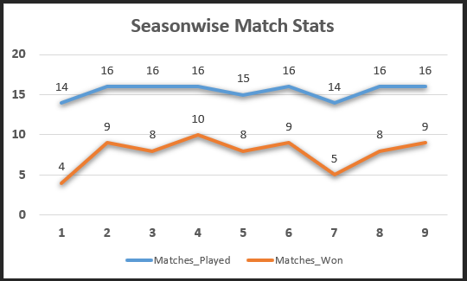
Description: Tracks the total count of restaurants, filterable by country and year.
Team Performance
Struggles in 2008
Improvement in 2009
Steady Performance (2010-2013)
Decline in 2014
Recovery (2015-2016)

Slide 12
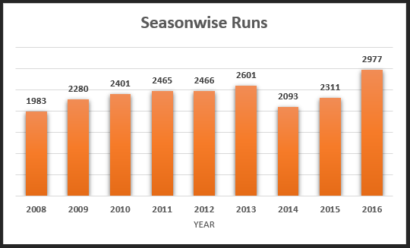
Description: Tracks the total count of restaurants, filterable by country and year.
Season-wise Runs Scored
Steady Growth (2008-2013)
Drop in 2014
Recovery (2015)
Record High (2016)
Consistency (2011-2013)

Slide 13
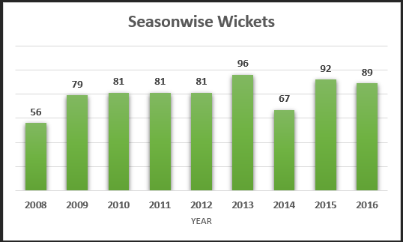
Description: Tracks the total count of restaurants, filterable by country and year.
Season-wise Wickets Taken
Initial Improvement (2008-2010)
Consistency (2010-2012
Peak (2013)
Dip in 2014
Recovery and Stability (2015-2016)

Slide 14
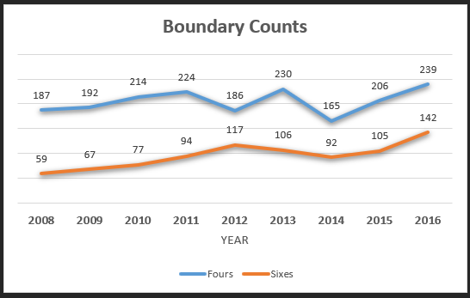
Description: Tracks the total count of restaurants, filterable by country and year.
Boundary Counts
Improvement (2008-2011)
Power-Hitting Focus (2012)
Peak Performance (2016)
Dip in 2014
Strong Finish (2015-2016)

Slide 15
Description: Tracks the total count of restaurants, filterable by country and year.
Strategies for Auction
Retain Proven Match-Winners: Focus on players who have consistently delivered impactful performances, especially in critical moments. Prioritize individuals who can win games single-handedly with bat or ball.
Enhance Squad Flexibility: Invest in versatile players who can adapt to different roles, such as all-rounders who can contribute in both batting and bowling departments.
Address Bowling Weaknesses: Strengthen the bowling attack, particularly with reliable death bowlers. Analyze performance data to identify bowlers who excel under pressure and in high-scoring conditions.
Reinforce the Middle Order: Secure middle-order batsmen who can anchor the innings, stabilize after early setbacks, and accelerate during the final overs. Focus on experienced finishers.
Invest in Emerging Talent: Target young, promising players from domestic circuits or T20 leagues who can bring fresh energy to the squad. Look for potential future stars to groom.
Balance Experience and Youth: Maintain a healthy mix of seasoned players and dynamic youngsters. Experienced
players provide leadership, while younger players bring agility and long-term potential.

Slide 16
Description: Tracks the total count of restaurants, filterable by country and year.
Conclusion
Exceptionally Consistent Batsmen | Exceptionally Consistent Bowlers | Highly effective All-Rounders | Young Talents
V Kohli | SL Malinga | AD Russell | SV Samson
MEK Hussey | SP Narine | DJ Bravo | AR Patel
MS Dhoni | Sandeep Sharma | DR Smith | VH Zol
SE Marsh | DJ Bravo | JA Morkel | SS Iyer
AB de Villiers | S Aravind | KA Pollard | DJ Hooda
JP Duminy | YS Chahal | MC Henriques | J Suchith
KP Pietersen |  | RA Jadeja | SN Khan
CH Gayle |  | SR Watson | Ishan Kishan
DA Miller |  | Yuvraj Singh | NS Naik
 |  |  | RR Pant
 |  |  | KC Cariappa
 |  |  | S Kaushik
 |  |  | Kuldeep Yadav
Based on the analysis above,
RCB can target
2-3 consistent batsmen,
2-3 bowlers, and
3-4 all-rounders for the Mega Auction.
Additionally, investing in 1-2 Indian youngsters will strengthen the squad for long-term success while aligning with the team’s competitive goals.

Slide 17
Description: Tracks the total count of restaurants, filterable by country and year.
Strategies for Auction
Optimize Home-Ground Advantage: Choose players who thrive in high-scoring venues like M. Chinnaswamy Stadium. For example, power-hitters and bowlers with excellent control in challenging conditions.
Prioritize Stability: Build a core team that can perform together over multiple seasons, ensuring continuity and better team dynamics.
Enhance Net Run Rate(NRR): Aggressive Batting - Set ambitious targets in each phase to increase total scores and positively impact NRR.
Maintain Scoring Rate - Avoid periods of low scoring; encourage calculated risks to keep the scoreboard moving.
Fielding Efficiency - Minimize runs conceded through strong fielding, leading to dot balls and wickets that lower the opposition's scoring rate.
Chasing Targets - Develop clear plans based on required run rates, adapting approaches as needed to chase efficiently without losing too many wickets.
Target Big-Game Performers: Look for players with a strong track record in playoffs and high-pressure matches to enhance
the squad’s ability to perform when it matters most.

