Slide 1

Restaurant Data Analysis
Data-Driven Decision Making for New Restaurant Locations
Created by,
Gaurav Agrawal

Slide 2

Zomato's Ambitious Expansion: Unlocking Global Opportunities
Business Problem -> Our goal is to identify optimal locations for opening new restaurants to expand our business. We need to find cities and countries with high potential based on several criteria, including customer preferences, cost efficiency, and competition analysis.
Objective -> Leverage data analytics to uncover insights that guide our decision-making for choosing the most promising locations.

Slide 3
Analysis – Opening new Restaurant
Key Performance Indicators (KPIs)
Finding Countries and Cities for opening new restaurant.
Ratings – in the suggested country.
Total expenditure on food – in the suggested countries.
Online delivery / table booking choice
Competitors.
Cuisines.
Restaurants in different price range.
Dashboard.

Slide 4
Restaurant ID: Unique identifier for each restaurant. Restaurant Name: The name of the restaurant. Country Code: Country code of the location where the restaurant is situated. City: The city where the restaurant is located. Address: The specific address of the restaurant. Locality: The locality or neighborhood where the restaurant is situated. Locality Verbose: Detailed information about the locality. Longitude: The geographical longitude coordinate of the restaurant. Latitude: The geographical latitude coordinate of the restaurant. Cuisines: The type of cuisine offered by the restaurant. Currency: The currency used for transactions in the restaurant. Has_Table_booking: Indicates whether the restaurant has a table booking option (Yes/No).
Data Overview
Has_Online_delivery: Indicates whether the restaurant offers online delivery (Yes/No).
Is_delivering_now: Indicates whether the restaurant is currently delivering (Yes/No).
Switch_to_order_menu: Indicates whether users can switch to the order menu (Yes/No).
Price_range: A numeric value indicating the price range category of the restaurant.
Votes: The number of votes or ratings/(feedback) received by the restaurant.
Average_Cost_for_two: The average cost for two people dining at the restaurant.
Rating: The overall rating of the restaurant is based on user reviews.
Datekey_opening: The date when the restaurant was opened.

Slide 5
Analysis
Pivot Table Analysis - A pivot table was generated to display a comparison of countries and their respective cities based on three key parameters: average price range, average rating, and the number of restaurants in each city.
Key Insights for Restaurant Location - The analysis revealed that the suitability for opening a new restaurant globally is directly proportional to the average price range and inversely proportional to the average rating.
Optimal Location Criteria - The ideal city or country for establishing a new restaurant is one where existing restaurants have a high average price range and a moderately low average rating (approximately 2.5-3.5), along with a relatively low number of restaurants meeting these criteria.
Strategic Positioning - A new restaurant could be launched at a slightly lower price range, aiming to achieve higher ratings by optimizing additional factors such as table booking availability, online delivery options, current delivery status, and the switch to order menu feature.
Correlation Analysis - A calculated column named "Ratio" was introduced, representing the ratio of price range to rating. This correlation ratio was analyzed, with average values displayed.
Further Classification - Cities and countries were further classified based on an average ratio higher than 0.85 and a low number of existing restaurants, minimizing competition and highlighting prime locations for new restaurant ventures.

Slide 6
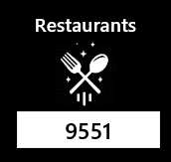
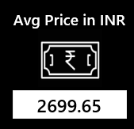
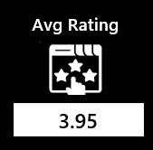
Description: Tracks the total count of restaurants, filterable by country and year.
Key – Performance Indicators (KPIs)
Description: Tracks the total count of restaurants, filterable by country and year.
Insight: Helps identify market saturation and growth trends.
Description: Shows average customer ratings, filterable by country and year.
Insight: Highlights regions with high customer satisfaction, ideal for new openings.
Description: Monitors the average cost for two, filterable by country and year.
Insight: Aligns pricing strategy with local market expectations for competitiveness.

Slide 7
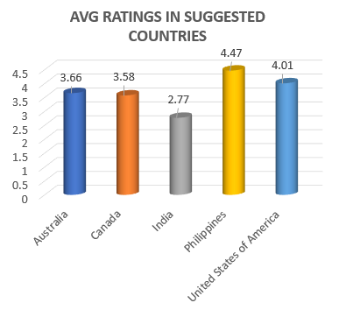
Ratings in Suggested Countries
Philippines – Highly recommended since the customers are very much satisfied with the dining experiences available. These customers value quality so maintaining this will be crucial.
United States of America – Strongly consider since this country demonstrates a favourable, well-established yet competitive market. A new restaurant here could thrive if it offers something unique -- whether it's an innovative cuisine, a novel dining concept, or exceptional service.
Australia & Canada – Consider these countries since the average ratings are around 3.60, which is decent, but suggest there might be room for improvement in the current offerings. Opening a restaurant here could be successful if you can identify gaps in the market.
India – Approach with caution since it has the lowest average rating of 2.77, India may represent a more challenging market for a new restaurant. It would be essential to conduct thorough market research to understand the underlying reasons for the low ratings.

Slide 8
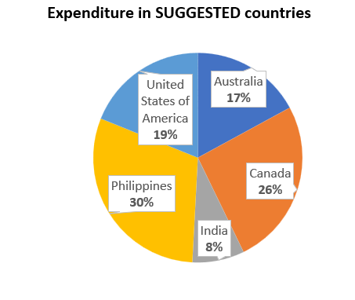
Expenditure on Food in Suggested Countries
Philippines (INR 2346): The highest average cost for two suggests a premium dining market. A high-end restaurant focused on luxury, exclusivity, and exceptional service is recommended.
Canada (INR 1995): Canada supports higher spending, ideal for a mid-to-high-end restaurant. A unique or trendy concept emphasizing quality and innovation would resonate with customers.
USA (INR 1467): The USA's diverse market with mid-range pricing offers flexibility. Targeting a specific niche with value, diversity, and strong customer engagement could be successful.
Australia (INR 1325): Mid-range pricing in Australia suggests a preference for casual dining. A restaurant offering good value, quality, and local ingredients at competitive prices would likely do well.
India (INR 624): India’s price-sensitive market favours budget-friendly options. A high-volume quick service or casual dining model focused on affordability and taste is most suitable.

Slide 9
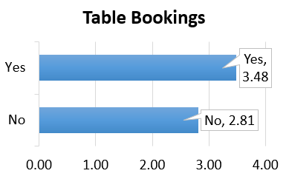
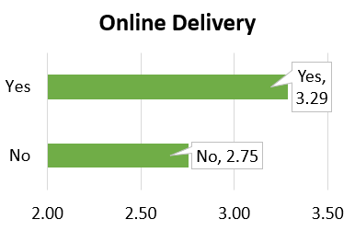
Restaurant Features
Table Bookings - Customers rate restaurants with table booking options significantly higher (3.48) compared to those without (2.81). This suggests that table booking positively impacts customer satisfaction and ratings.
Online Delivery - Restaurants offering online delivery receive higher ratings (3.29) than those without (2.75). This indicates that online delivery also enhances customer satisfaction and ratings.

Slide 10
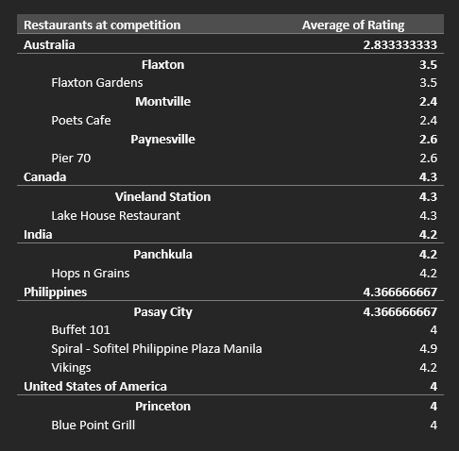
Competitors
Buffet 101, Spiral - Sofitel Philippine Plaza Manila, Vikings are our biggest competitors when opening a restaurant in Philippines’ Pasay City because of their high ratings (AVG = 4.36). Also, Philippines is the highly recommended country based on rating.
Blue Point Grill restaurant will be the biggest competitor in Princeton city since USA’s market is well established and competitive, and is strongly considered based on rating.
Lake House Restaurant in Canada’s Vineland Station (4.3) and Hops n Grains restaurant in Panchkula city of India (4.2) marks them as the sole competitor in respective cities.

Slide 11
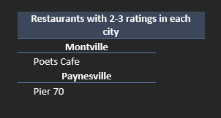
Competitors
Poets Café in Montville and Pier 70 in Paynesville are still competitive in Australia because they have decent ratings in the range 2-3.

Slide 12
Philippines - Filipino, Mexican, and Seafood cuisines are highly recommended due to their popularity and high ratings. With an average rating of 4.85 for Filipino and Mexican cuisine and 682 upvotes, these cuisines indicate strong customer preference. Emphasizing these options will likely resonate well with the local population and enhance the restaurant's appeal.
Cuisines Diversified
United States of America - American, Steak, and Desserts should be the key focus areas. These cuisines not only enjoy high ratings (up to 4.9) but also receive a substantial number of upvotes, reflecting widespread popularity. Including Bar Food or Brazilian cuisines as additional options could further broaden the restaurant's appeal.
Australia - Mediterranean, Seafood, and Modern Australian cuisines should be prioritized. These options have received strong ratings and decent upvotes, indicating their popularity in the Australian market. Adding Pizza or Bar Food as supplementary offerings could attract a wider customer base.
Canada - Italian, Mediterranean, and Pizza should be the primary focus for a new restaurant in Canada. These cuisines have high ratings (average rating of 4.3) and are likely to perform well in the Canadian market.
India - Italian, American, and Pizza should be at the forefront, with North Indian or Continental cuisine as additional options to cater to local tastes. The significant number of upvotes, especially for Italian and American cuisines, reflects strong customer approval.

Slide 13
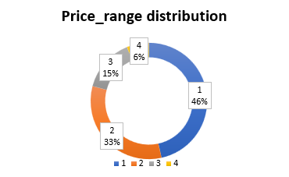
Restaurants in different Price Range
Price Range 1 (46% of restaurants, 4,444 total) –
The largest segment, indicating high demand for budget-friendly dining, but also intense competition. Differentiate with unique offerings or superior value to stand out in this crowded market.
Price Range 2 (33% of restaurants, 3,113 total) –
A significant mid-range segment, appealing to those seeking a balance between cost and quality. Introduce innovative, quality-driven concepts to attract customers in this established market.
Price Range 3 (15% of restaurants, 1,408 total) –
A smaller, niche segment catering to customers willing to pay for a premium experience. Focus on providing a premium, enhanced dining experience to capture this specialized market.
Price Range 4 (6% of restaurants, 586 total) –
The smallest, high-end segment, targeting affluent customers with less competition. Emphasize luxury and exclusivity to attract high-end clientele in this lucrative market.

Slide 14
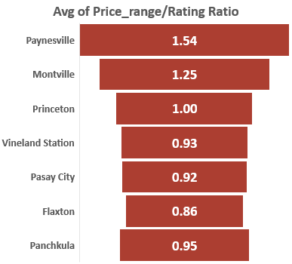
Conclusion
1. Vineland Station – Canada
High Price Range and Low Competition: Only one restaurant with a price/rating ratio near the threshold suggests a good market entry opportunity.
2. Pasay City – Philippines
High Price Range, Moderate Rating, and Low Competition: The price/rating ratio is favourable, and with only three restaurants, there’s room for a new entrant.
3. Flaxton – Australia
Moderate Price Range and Low Competition: The price/rating ratio is close to the threshold, and the single restaurant indicates minimal competition.
4. Montville – Australia
Low Rating and High Price/Rating Ratio: High ratio and low rating present an opportunity to capture market share with improved offerings.
5. Paynesville – Australia
High Price Range and Low Rating: Very high price/rating ratio and only one restaurant suggest a chance to attract customers with better service.
6. Princeton - United States
Balanced Ratio and Low Competition: High price range with a balanced ratio and only one restaurant make it a promising location.
7. Panchkula – India
High Price Range and Low Competition: High price range and moderate rating with just one restaurant present an opportunity for a new entry.

Slide 15
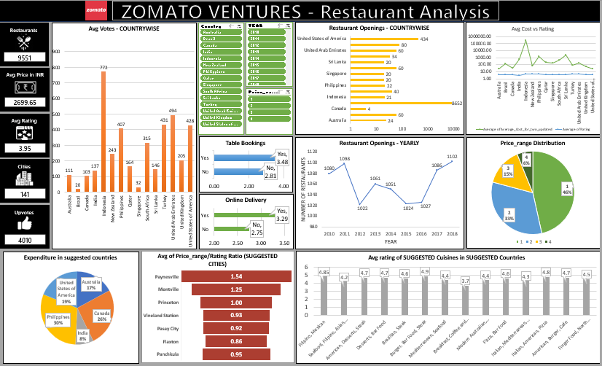
Dashboard

