Slide 1
Food Truck Locator

Slide 2
Agenda
01. Motivation
02. Idea
03. Requirements
04. Implementation
05. Development & Sprint Strategy

Slide 3

Motivation
Food trucks have become increasingly popular in recent years.
However, finding these food trucks can be a challenge, as they often move around from location to location.
To solve this problem, an application called "Food Truck Locator" has been developed.

Slide 4

Idea

Slide 5
Idea !
The Food Truck Locator application allows users to locate nearby food trucks based on their current location.
To develop a web-based extendable platform for finding the food trucks around us that are moving every day.
This application will be used by food trucks to indicate their everyday location and also used by the food truck loving customers who can track which food trucks are nearby and get their daily updated location.

Slide 6
Requirements
Our UI must be simple and easy to use for both food truck owners and users.
The maximum time to locate food trucks will be 1 minute.
Food truck owners’ registration with the application will require manual validation by the admin.

Slide 7
Technical Stack
Frontend : React JS, Material-UI, Axios
Backend : Java and the Spring framework
Database : MySQL
IDE : IntelliJ IDEA
Repository : Git Repository

Slide 8
Implementation
Use ReactJS for our front-end application. Along with it, we will use some external node modules to provide an interactive experience for both consumers and food truck team.
Use REST APIs with Spring for implementing backend, to render all functionalities and interactions provided through our frontend of our web application.
MySQL will be used to store our data related to consumers and food trucks.

Slide 9
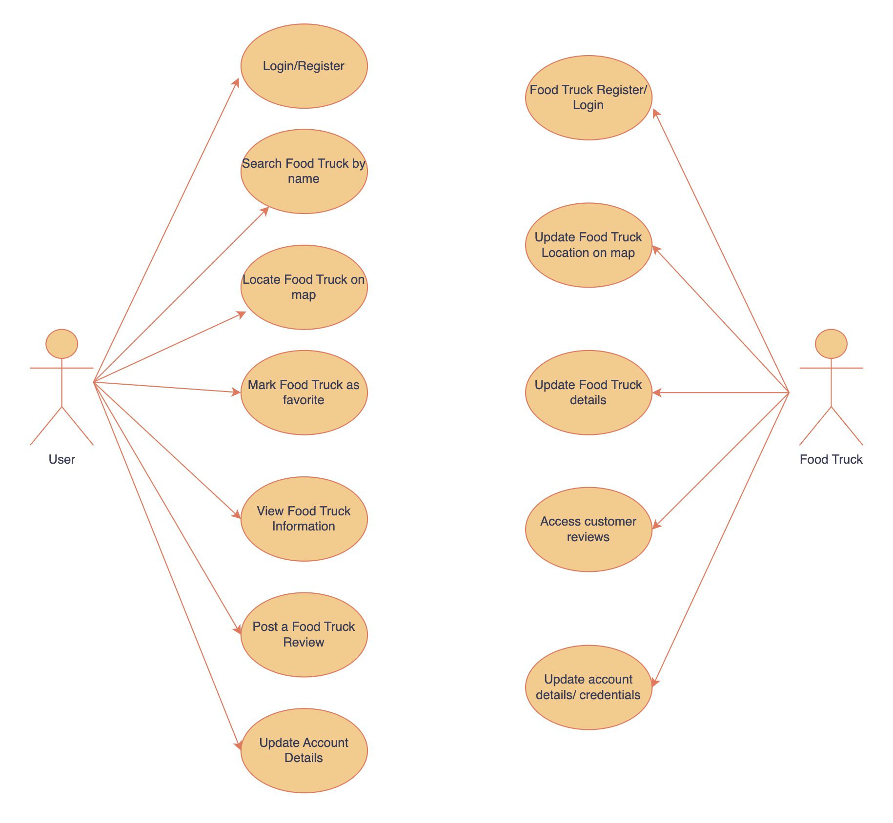
Use Case Diagram

Slide 10
User Stories - User
Login or register in the food truck locator, so that user can use all the features of the application.
View a map of user’s current location and the locations of the nearby food trucks, so that he can find food trucks near me either searching by location or by name.
View details of a specific food truck, so that user can see its menu, operating hours, and customer reviews.
Able to access the reviews, so that other user can add a review to a specific food truck to share his experience with other users.

Slide 11
User Stories – Food Truck Owner
Register and login in the food truck locator application and add the food truck location to the map, so that users can use all features of the application.
Access the food truck details, so that owner can update the menu, operating hours, and other details of the food truck.
Change the food truck location on the map, so that if he is moving then he can update the location and users can find it.
Schedule the food truck locations for the future, so that users can find the food trucks in their location ahead of time.

Slide 12
User Stories - Developer
Create an interface between food trucks and customers for locating moving food trucks and helping improve food truck businesses.
Implement an user- friendly screen for customers which can store their preferences for locating the food trucks with ease.
Develop a screen for food trucks so that they can update their details on the go.
Create some REST API endpoints for connecting the database and the front end of the application.

Slide 13
Development & Sprint Strategy

Slide 14
Sprint Strategy
In the first sprint, we focused on the development of the primary functionalities for both the consumer and food truck owners. That includes allowing the consumer or food truck owner to register and create accounts, enabling customers to find nearby food trucks, enabling owners to set their truck location on a map.
For the second sprint, we developed the functionalities for food truck owners to manage their business operations efficiently. These features include displaying food truck details and menus, feature to update these details, update current location of the truck and schedule future locations of the truck.
For the third sprint, we developed the functionalities targeting the customers’ needs for the usage of the application. These features allow the user to search for a food truck using name, post reviews about recently visited food trucks for other consumers to see/refer to, allow the consumers and food truck owners to manage the login credentials of their account.

Slide 15

Thank you
Any Questions?
Pixel Mavericks

