Slide 1
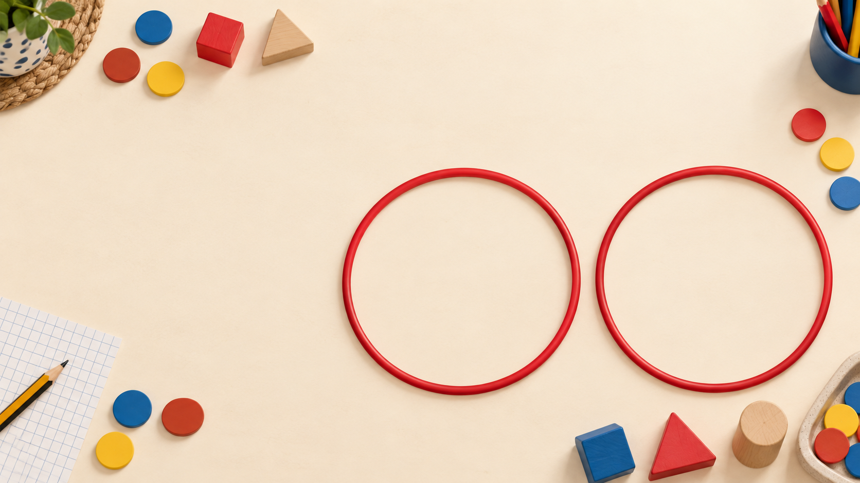
Date: __ / __ / ____
L.I.
To sort objects into groups
READY? ✓ sharp pencil ✓ mini whiteboard ✓ sorting objects or counters ✓ listening partner
Notes:
Editable opening slide. Change the date before teaching. Read the learning intention together. Check pupils have a sharp pencil, mini whiteboard, sorting objects or counters, and a listening partner. Ask: What do you think the two hoops might help us do?

Slide 2
YEAR 1 MATHS • AUTUMN • WEEK 1 • DAY 1
2 / 15
TEACH
What does sorting mean?
Sorting means putting objects into groups using one clear rule.
RED
BLUE
NOT A CLEAR SORT
The first two groups follow colour. The last box has no stated rule.
BrightPath Primary Learning
Sort objects into groups
Notes:
This is the core teaching definition. Read it aloud, then model the contrast. The red and blue groups use one clear property: colour. The mixed box is not automatically wrong, but without a stated rule we cannot check it. Emphasise that a good sort can be explained and checked.

Slide 3
YEAR 1 MATHS • AUTUMN • WEEK 1 • DAY 1
3 / 15
REVISIT
Previous learning: same and different
Look carefully. What is the same? What is different?
THINK
PAIR
SHARE
BrightPath Primary Learning
Sort objects into groups
Notes:
Allow 20 seconds of silent noticing. Then partners use: ‘The ___ and ___ are the same because…’ and ‘They are different because…’. Listen for colour and shape language. This checks prior knowledge before the new lesson.

Slide 4
YEAR 1 MATHS • AUTUMN • WEEK 1 • DAY 1
4 / 15
REVEAL
Check our noticing
Same colour
Same shape
Different size or type
An object can have more than one property.
A property is something we can notice about an object — for example its colour, shape, size or type.
Teacher check: ask three pupils to give one property each.
BrightPath Primary Learning
Sort objects into groups
Notes:
Click to this slide after pupils have shared. Accept accurate everyday language, then recast it using the word property. If pupils struggle, hold up two real objects and ask one binary question at a time: same colour? same shape?

Slide 5

YEAR 1 MATHS • AUTUMN • WEEK 1 • DAY 1
5 / 15
VOCABULARY
Words we will use
I’m Pip. Sometimes I sort things wrongly. Can you spot my mistakes?
SORT
put things into groups
GROUP
things that belong together
PROPERTY
something we notice
RULE
how we decide where things go
SAME
matching in one way
DIFFERENT
not matching in that way
BrightPath Primary Learning
Sort objects into groups
Notes:
Pre-teach pupils may already know colour and shape; emphasise sort, group, property and rule. Add gestures: sweep hands apart for sort; make a circle with arms for group; point to an object detail for property; draw an imaginary line for rule.

Slide 6
YEAR 1 MATHS • AUTUMN • WEEK 1 • DAY 1
6 / 15
TEACH
Four steps for a careful sort
1
2
3
4
NOTICE
CHOOSE
SAY + PLACE
CHECK
Look at the objects and name their properties.
Choose one property, such as colour.
Say the rule, then place one object at a time.
Check every object against the same rule.
Remember: one object can have many properties. The rule tells us which one matters now.
BrightPath Primary Learning
Sort objects into groups
Notes:
Teach and rehearse these four steps before the worked model. Use gestures and point to each card. Ask pupils to say the sequence back. Keep this language consistent in future Maths lessons so pupils can become independent.

Slide 7
YEAR 1 MATHS • AUTUMN • WEEK 1 • DAY 1
7 / 15
MODEL
Teacher model: sort by colour
RED GROUP
BLUE GROUP
My rule: I am sorting by colour.
BrightPath Primary Learning
Sort objects into groups
Notes:
Use real objects beside the slide. Think aloud: 1) I choose one property. 2) I say my rule. 3) I place one object at a time. 4) I check every object follows the same rule. Ask pupils to repeat the rule before each placement.

Slide 8
YEAR 1 MATHS • AUTUMN • WEEK 1 • DAY 1
8 / 15
GUIDED
Your turn: where should it go?
Point, then explain using the sentence stem.
RED
BLUE
The blue triangle belongs in the ______ group because ______.
BrightPath Primary Learning
Sort objects into groups
Notes:
No calling out. Pupils point first, then rehearse with a partner. Cold-call after rehearsal. Expected response: ‘The blue triangle belongs in the blue group because it is blue.’ Ask: Would its shape change our colour rule?

Slide 9
YEAR 1 MATHS • AUTUMN • WEEK 1 • DAY 1
9 / 15
MISCONCEPTION
Pip’s mistake: spot it and explain
I sorted by colour. I think every object is correct!
RED
BLUE
Think → point to the mistake → tell your partner why
BrightPath Primary Learning
Sort objects into groups
Notes:
Give silent think time. The blue triangle is in the red group. Probe: What rule did Pip say? Which property matters for this rule? Do not move the shape until pupils explain.

Slide 10
YEAR 1 MATHS • AUTUMN • WEEK 1 • DAY 1
10 / 15
REVEAL
Correct Pip’s sort
RED
BLUE
We moved the blue triangle because the rule was colour, not shape.
BrightPath Primary Learning
Sort objects into groups
Notes:
Reveal the correction. Ask for a full explanation. Then deliberately suggest moving the red square because it is not a circle; pupils should reject this by restating the colour rule. This checks that the sorting rule stays consistent.

Slide 11
YEAR 1 MATHS • AUTUMN • WEEK 1 • DAY 1
11 / 15
TEACH + TRY
Same objects, new rule: sort by shape
CIRCLES
SQUARES
What changed? What stayed the same?
BrightPath Primary Learning
Sort objects into groups
Notes:
Mix the same four physical objects and sort again by shape. Emphasise that the objects did not change; the chosen rule changed. Ask pupils to say both valid rules: by colour and by shape.

Slide 12
YEAR 1 MATHS • AUTUMN • WEEK 1 • DAY 1
12 / 15
EXPLAIN
Talk partner challenge
PARTNER A
PARTNER B
Choose a rule and explain how you would sort four objects.
Listen. Repeat your partner’s rule, then ask one helpful question.
I sorted by ______. I know ______ belongs here because ______.
BrightPath Primary Learning
Sort objects into groups
Notes:
Use four real objects per pair. Encourage precise language. Questions pupils can ask: Does every object follow your rule? Could you use a different rule? Is any object difficult to place?

Slide 13
YEAR 1 MATHS • AUTUMN • WEEK 1 • DAY 1
13 / 15
DEEPEN
Challenge: one set, two correct sorts
Make or draw a set of six objects that can be sorted in two different ways.
RULE 1
RULE 2
Draw the two groups.
Write: I sorted by…
Use the same objects.
What changes?
Prove both rules work for every object.
BrightPath Primary Learning
Sort objects into groups
Notes:
Early-finisher reasoning. A suitable set contains at least two colours and two shapes. Ask pupils to compare which rule creates equal groups, if either. Accept other valid properties such as size or type when consistently applied.

Slide 14
YEAR 1 MATHS • AUTUMN • WEEK 1 • DAY 1
14 / 15
PRACTISE
Independent practice
Your teacher will give you the worksheet that helps you learn best today.
●
● ●
● ● ●
PRACTISE WITH OBJECTS
WORK INDEPENDENTLY
DEEPER THINKING
Sort one set using the shown rule. Say the rule aloud.
Sort the picture sets and explain the rule you used.
Find two possible rules and explain how the groups change.
The detailed group choices and adaptations are in the teacher plan.
BrightPath Primary Learning
Sort objects into groups
Notes:
This slide appears only after the teaching sequence. Select the worksheet before the lesson using current learning need, not a fixed pupil label. Keep the detailed lower, expected and higher guidance in the teacher plan. Circulate with: ‘What is your rule? Does every object follow it?’

Slide 15
YEAR 1 MATHS • AUTUMN • WEEK 1 • DAY 1
15 / 15
ASSESS
Exit check: ready for tomorrow?
1. What does sort mean?
2. Name one property we could use.
3. Why must the rule stay the same?
Show me: SECURE | NEARLY THERE | NEED MORE PRACTICE
BrightPath Primary Learning
Sort objects into groups
Notes:
Expected answers: 1) put objects into groups; 2) colour, shape, size or type; 3) so every object can be checked fairly. Record initials of pupils who need tomorrow’s pre-teach. Do not use confidence alone—combine with explanations and the independent task.

