Slide 1
Discovering Chinese restaurants in the New York city neighborhood

Slide 2
Discovering Chinese restaurants in NYC
New York city is home to a lot of diverse.
There are many restaurants and food joints in NYC catering to different categories like Mexican, Indian, Chinese to name a few.
The goal of this project is to visualize parts of NYC where there is presence of Chinese cuisine restaurants.

Slide 3
Data acquisition
New york city data that contains list Boroughs, Neighborhoods along with their latitude and longitude.
Data source : https://cocl.us/new_york_dataset
Description : This data set contains the required information. And we will use this data set to explore various neighborhoods of new york city.
We will also explore the number of Chinese restaraunts in each borough and neighborhood of new york city.
Data source : Fousquare API Description : By using this api we will get all the venues in each neighborhood. We can filter these venues to get only Chinese restaurants.

Slide 4
Methodology
Collect the new york city data from https://cocl.us/new_york_dataset (https://cocl.us/new_york_dataset)
Create dataframes using the above dataset.
Using FourSquare API and the dataframe created in the earlier step, we will find all venues for each neighborhood. Filter out all venues that are Chinese Resturants.

Slide 5
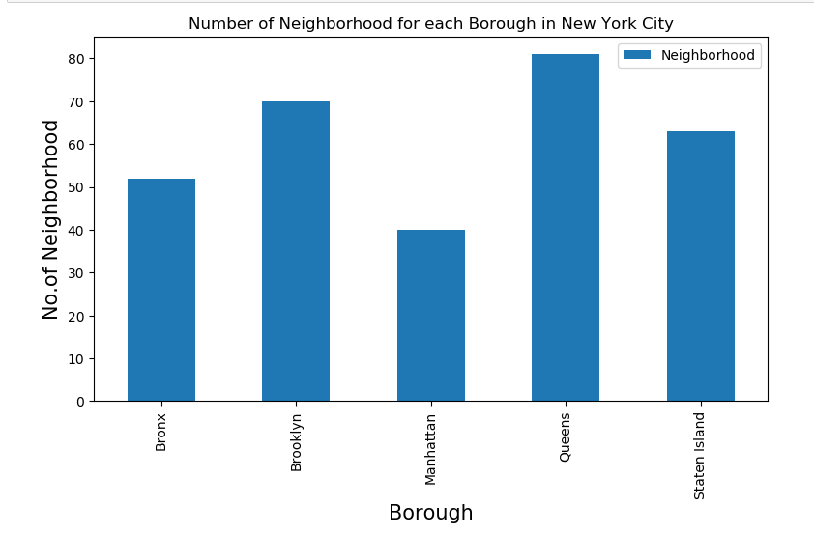

Slide 6
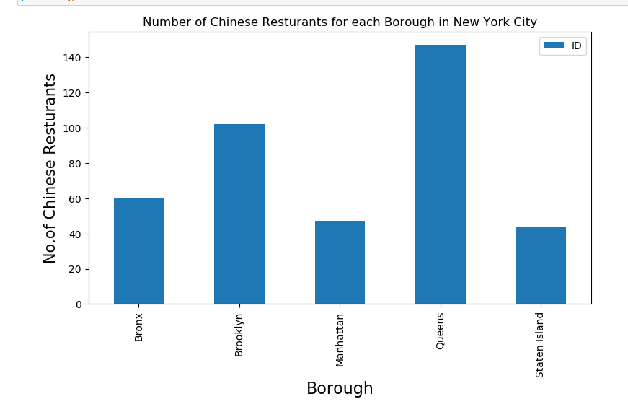

Slide 7
Conclusion and future directions
Queens borough has the most number of Chinese restaurants followed by Broklyn, Bronx, Staten Island and Manhattan.
Flushing followed by Queensboro Hill, Georgetown, Douglaston and Elm park are the neighborhoods which has the most number of Chinese restaurants
Further scope
We could further use the new york city dataset alongwith foursquare apis to figure out the ratings, tips of the restaurants in various neighborhoods.
This would help us to determine which neighborhood could be the best if you are looking for a Chinese cuisine.

