Slide 1

DISSERTATION ON ORDER MANAGEMENT SYSTEM (MCA – VI SEMESTER; BATCH 2018-21)
Internal Guide
Dr. Sunil Pratap Singh (Asst. Prof., BVICAM, New Delhi)
Presentation by
Name of the Student (Enrollment Number)
Date of Presentation
Notes:
1

Slide 2
Contents
About the Company
Problem Description
Aim and Objectives
Methodology and Technology Used for Project Development
Project Modules and My Role
Design Documents (Use Case, Data Flow Diagram, Entity-Relation Diagram, etc.)
Screenshots
Testing of Project
Conclusion
Future Scope
Bibliography

Slide 3
About the Company
Company Name: HCL Technologies, Noida
Foundation Year: 2002
No. of Employees in the Company: 4,000
Presence: India, Australia
Clients: Hero, Netflix, Amazon, Indian Rail, etc.

Slide 4
Problem Description
At present, the e-Commerce company manages the customers’ order in an Excel sheet. It is very difficult to process the order efficiently.
Therefore, an online automated system is required to handle the orders efficiently.
Other statements related to the problem should be written here.

Slide 5
Aim and Objectives
Aim:
To develop a web-based application for customer management system for an e-commerce application.
Objectives:
To design of a relational database for managing orders.
To design user-friendly interfaces to interact with the system.
To develop business logic as per the client’s requirement.
To test the developed system.

Slide 6
Methodology and Technology Used
Methodology used for Project Development:
Waterfall Model of SDLC
Technology used for Project Development:
Front-End: HTML 5.0, CSS 3.0, Bootstrap 4.0, React 7.4, Angular 5
Back-End: NodeJS 4.0, NPM, PHP 7.2
Integrated Development Environment (IDE): VS Code, Visual Studio 2019
Database: MongoDB, MySQL 5.8
Web Server: Glass Fish 3.0

Slide 7
Project Modules and My Role
Project Modules:
Order Management
Customer Management
My Role in the Project:
Design of Web Forms (User Interface)
Design of Database Schema
Development of Business Logic
Testing (Unit Testing and Integration Testing)
If Required

Slide 8
System Design

Slide 9
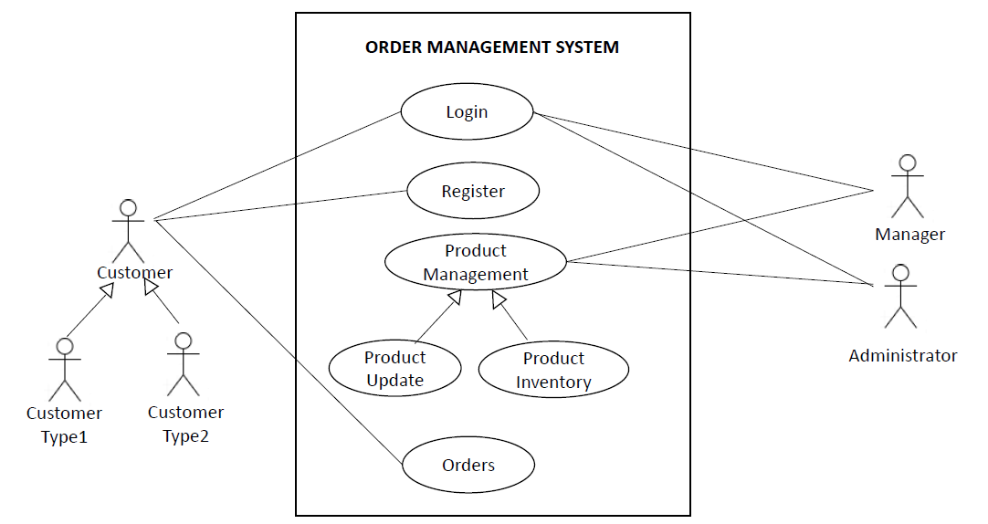
Use Case Diagram

Slide 10
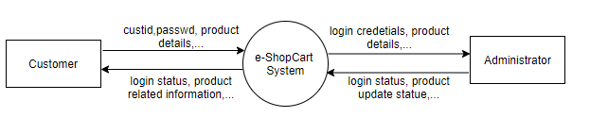
Data Flow Diagram (Level - 0)

Slide 11
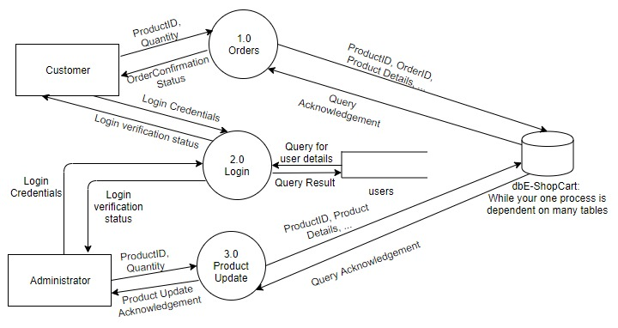
Data Flow Diagram (Level - 1)

Slide 12
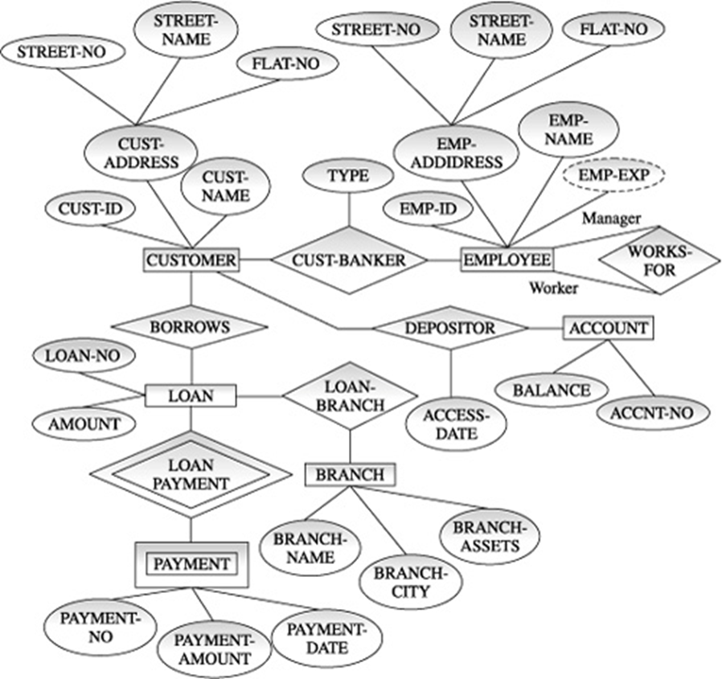
Entity-Relationship (E-R) Diagram

Slide 13
Title of Diagram
Depending upon the Nature of Project, Draw the Following Diagrams:
Control Flow diagrams
State Diagrams/Sequence Diagrams
Class Diagrams
Collaboration Diagrams/Activity Diagrams
NOTE: If applicable in the Project, the above diagram(s) is/are required.

Slide 14
Screenshots

Slide 15
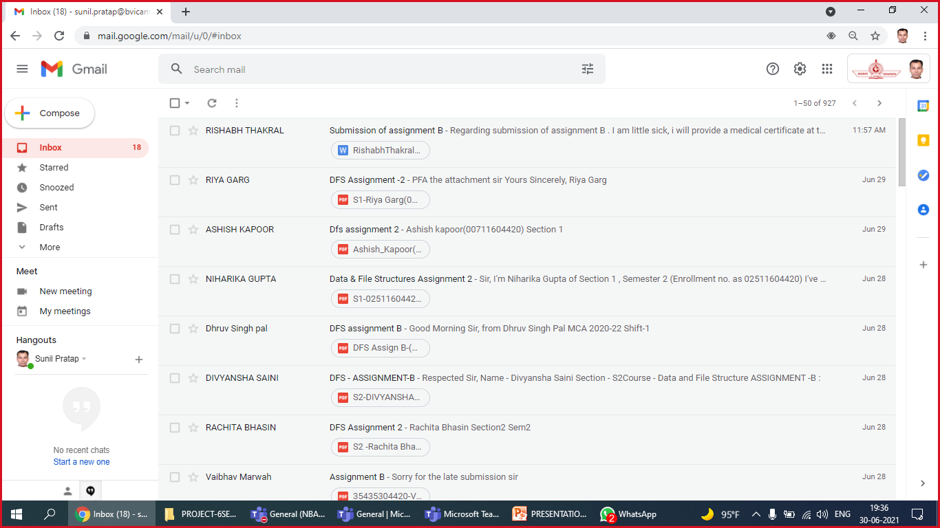
Screenshot - 1: Inbox

Slide 16
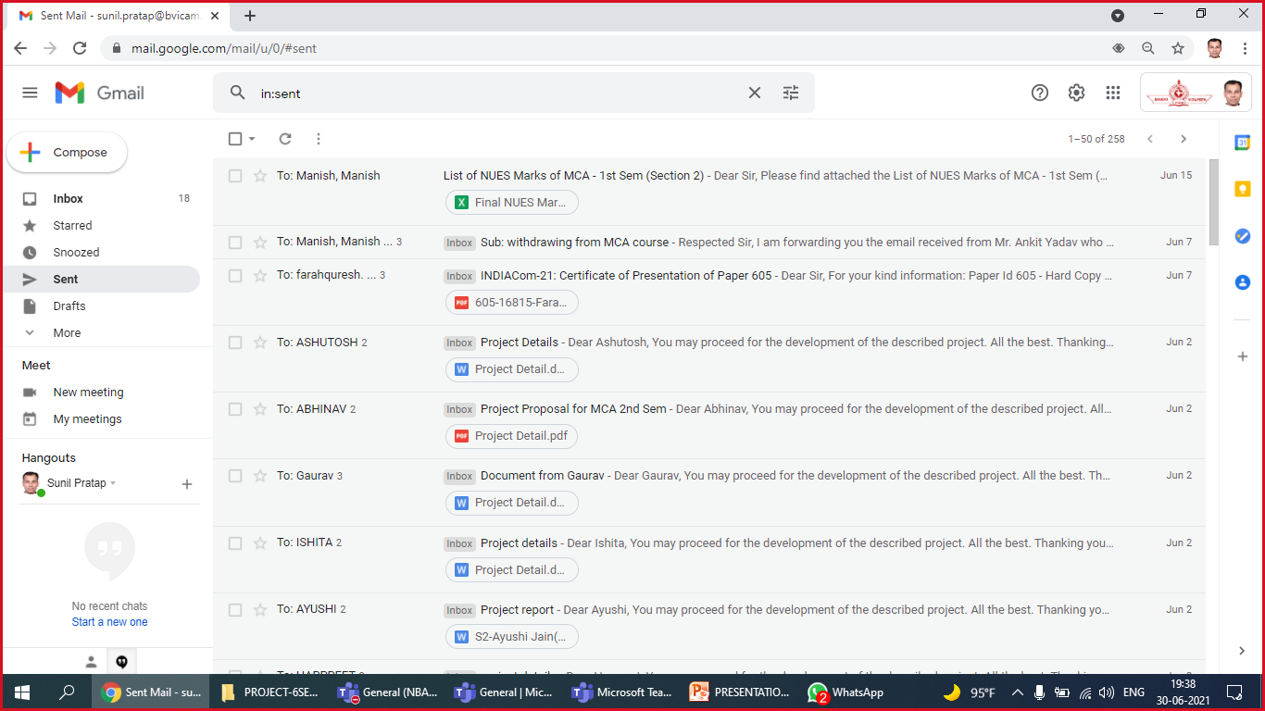
Screenshot - 2: Sent Emails

Slide 17
Screenshot - 3
NOTE: At least 5 screenshots are required (at least one from each module). Students may give at most 15 screenshots of different modules/forms of the running application/project.

Slide 18
Screenshot - 4
NOTE: At least 5 screenshots are required (at least one from each module). Students may give at most 15 screenshots of different modules/forms of the running application/project.

Slide 19
Screenshot - 5
NOTE: At least 5 screenshots are required (at least one from each module). Students may give at most 15 screenshots of different modules/forms of the running application/project.

Slide 20
Testing of the Project
Depending upon the Nature of Project, Design and Present the Test Cases
Id | Test Case Description | Test Case Input | Test Results |  | Status | Corrective Measure
 |  |  | Expected | Actual
1 | Billing person/Admin can successfully create the order | All the fields asked in the create order page are filled properly. | Order is created successfully | Order is created successfully | Pass | None
2 | All the orders that are successfully created should be displayed here. | No input | Successfully created orders are displayed. | Successfully created orders are displayed. | Pass | None
3 | Label with correct QR code and item no. is generated. | Warehouse ID, Item no. | Label is printed correctly. | Label is printed correctly | Pass | None
NOTE: If applicable in the Project, the required Test Cases need to be presented.

Slide 21
Conclusion
A web-based application developed for customer management in e-Commerce.
ASP.NET and C#.Net Programming is used for System Development.
Waterfall model of SDLC has been followed for development of the project.
The developed application has following features:
Online accessibility.
Responsive user-friendly interfaces to interact with the system.
Three-tier architecture.
Other features as per the project’s nature.

Slide 22
Future Scope
Multi-language support can be provided for different regional customers.
The developed project may be converted to a Mobile Application.
Mobile Wallets can be embedded for more payment options.
Other scope may be written as per the need.

Slide 23
Bibliography
Books:
E. Balaguruswamy, “Programming with C#.Net”, 4th ed., McGraw Hill Publication, 2016.
Book 2
Websites:
www.bvicam.in/index.html, [Accessed on 30 June, 2021].
Other Website

