Slide 1
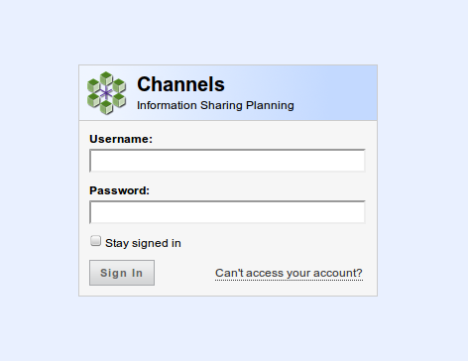
Sets an authentication cookie
Go to new password request page

Slide 2
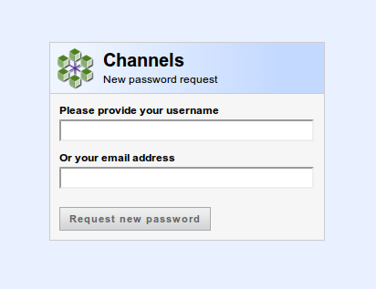
Give valid user name
or valid email address
Resets password and sends it by email with user name

Slide 3
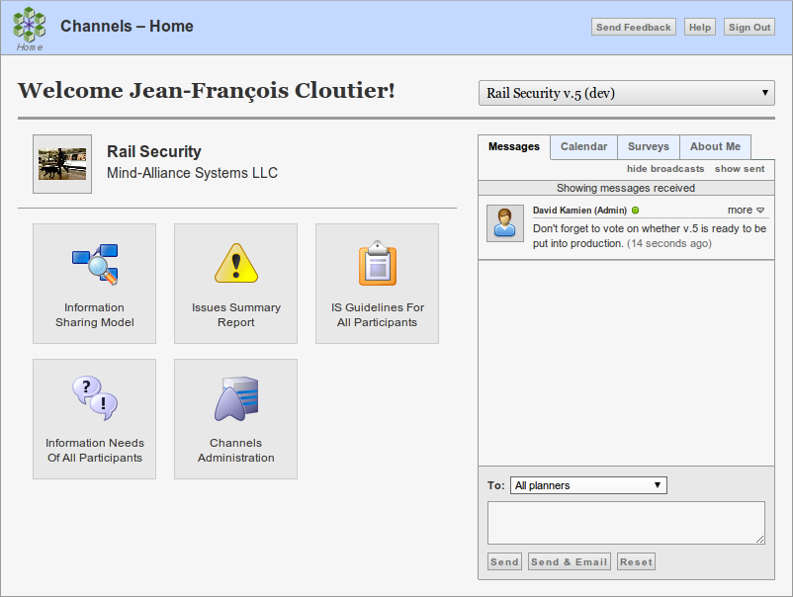
Send feedback about Channels
Opens Planner's Guide
To logout
Selection of authorized plans
Image attached to the plan
Collaboration support and user settings
Only for administrators

Slide 4
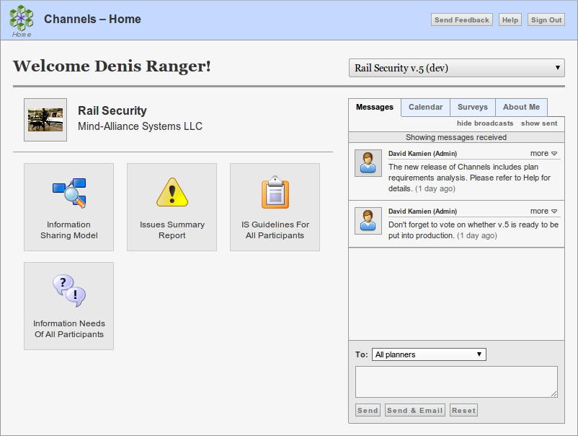
Access to plan editing page
Issue metrics report
Participants list: All info need reports
Participants list: All IS guidelines, user-agent assignations

Slide 5
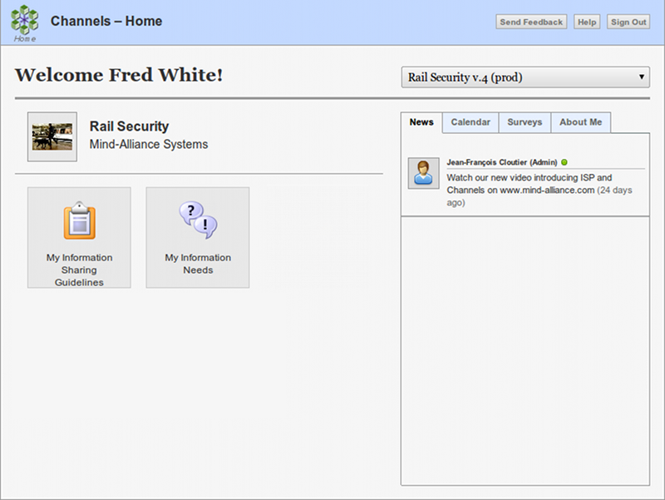
Participant can only access production versions
Participant can only read broadcast messages
Access to the IS guidelines of the agent assigned to the user
Access to the info needs report of the agent assigned to the user

Slide 6
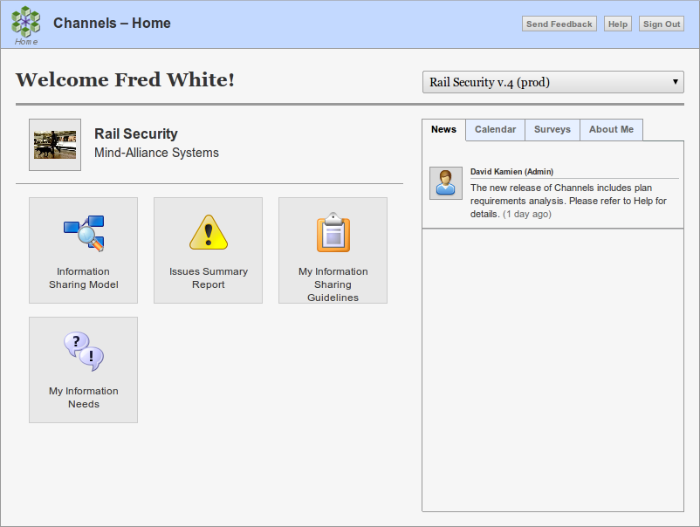
Participant can only access production versions
Read-only access to plan editing page
Participant can only read broadcast messages
Issue metrics report
Access to the IS guidelines of the agent assigned to the user
Access to the info needs report of the agent assigned to the user

Slide 7
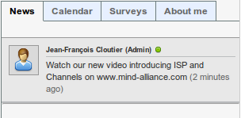
Participant can only read broadcast messages
Message sent to “Everyone”

Slide 8
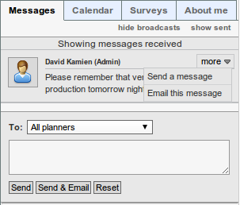
Show only personal messages vs all
Show messages sent vs received
Planners can both read and send messages
“Mouse-over” menu
Sender
Send to sender
Resend message to email
Recipient(s)
Message
New message composer
Send message within Channels
Send message within Channels and via email

Slide 9
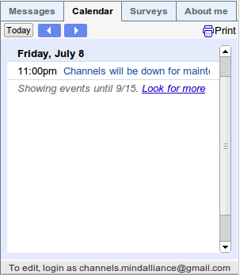
Event from the plan's Google calendar
Click for more details
Link to Google calendar visible to planners

Slide 10
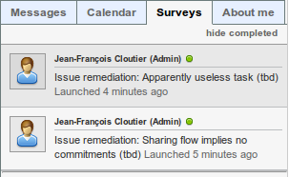
Hide/show completed surveys
Survey sent by planner
Survey status
Click to open survey page

Slide 11
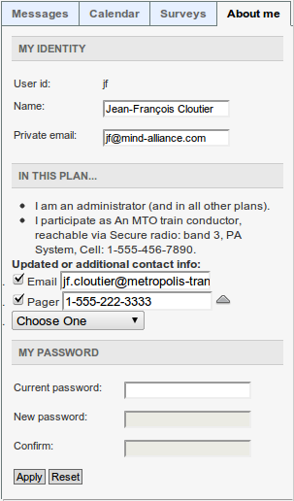
User name for logging in
Editable user's full name
Editable email address used by Channels to communicate with the user
User role for this plan
Agent associated with user in this plan
Corrections and updates to the agent's contact info
A user can change password

Slide 12
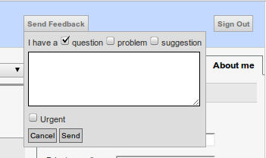
Click to open feedback panel
Type of feedback
Text of feedback
Set to mark feedback email as urgent
Click to cancel and close
Click to email and close

Slide 13
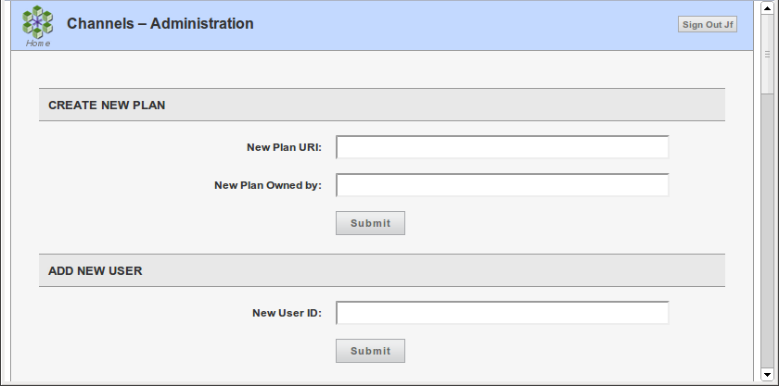
A unique resource identifier
The name of the organization
owning the plan
A unique user name

Slide 14
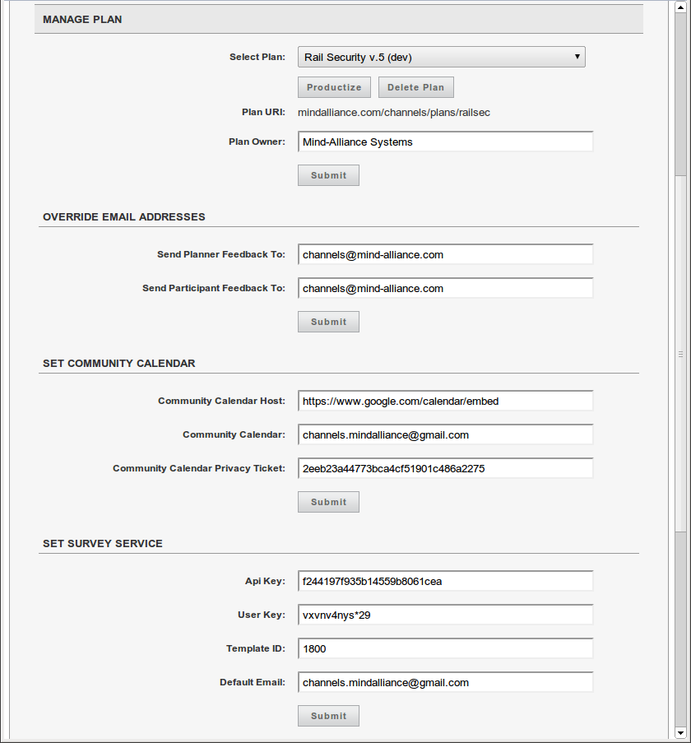
Selector with all hosted plans
The selected plan's URI
Plan owner can be changed
Where to email feedback from planners
Where to email feedback from participants
Google Calendar™ service
URL of embedded calendar
Private ticket to access the calendar without logging in
SurveyGizmo™ service
ID of customized survey template
SMTP service to send survey requests

Slide 15
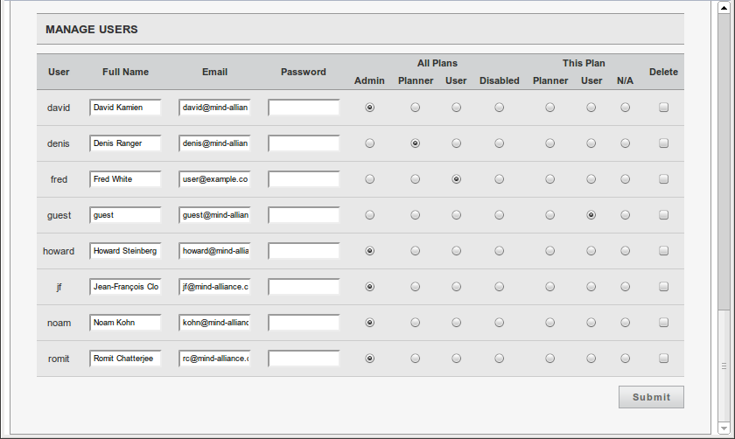
Privileges for all plans
Privileges for selected plan only
To assign initial password or change current

Slide 16
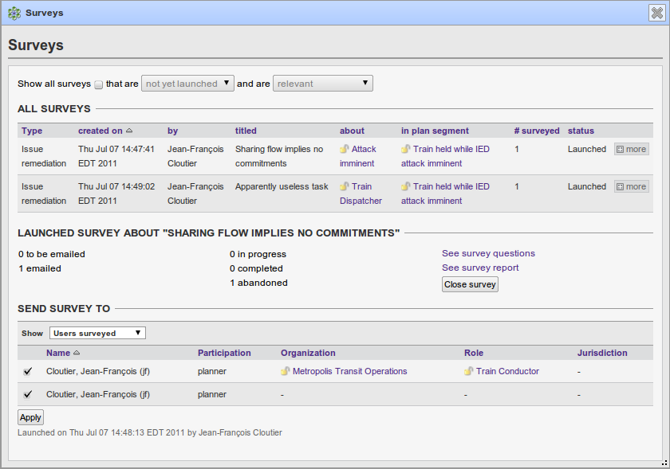
To see the details of the survey
Opens sample survey page
Opens survey reports page

Slide 17
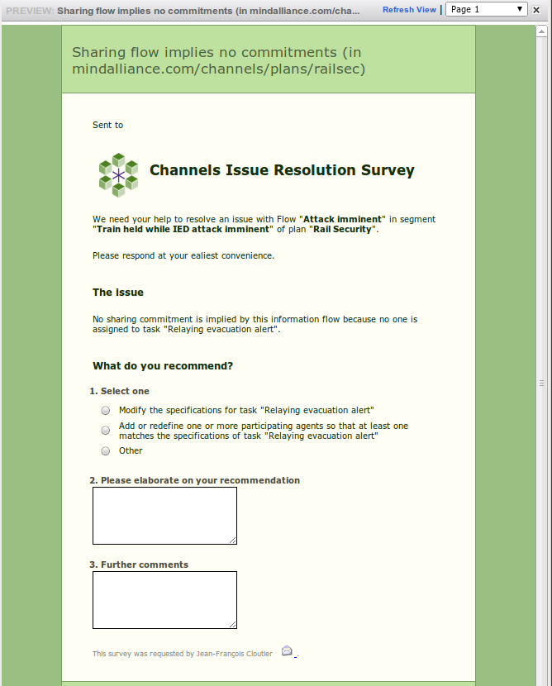
Issue description
Issue remediation options
Email link to planner who sent survey

Slide 18
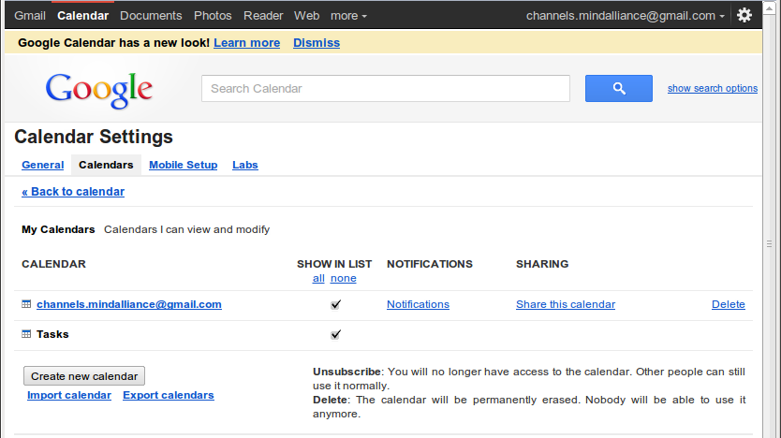
Go to settings
Select calendars
Select plan's calendar

Slide 19
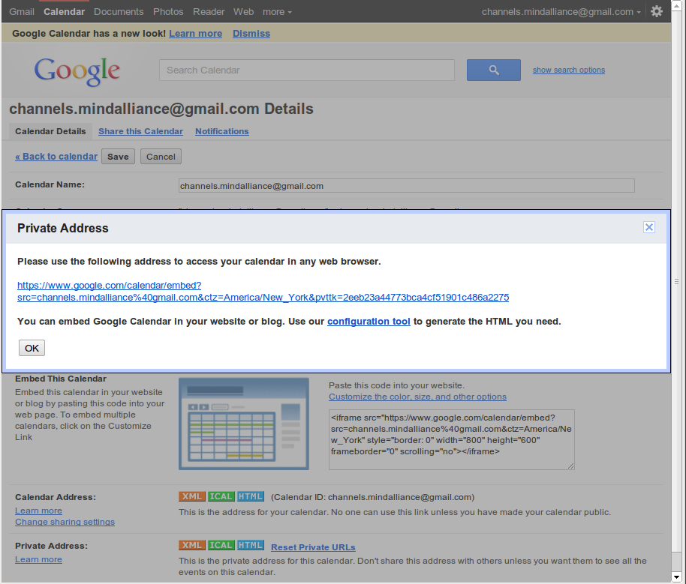
Calendar name
Calendar's private key
Calendar's embed URL

Slide 20
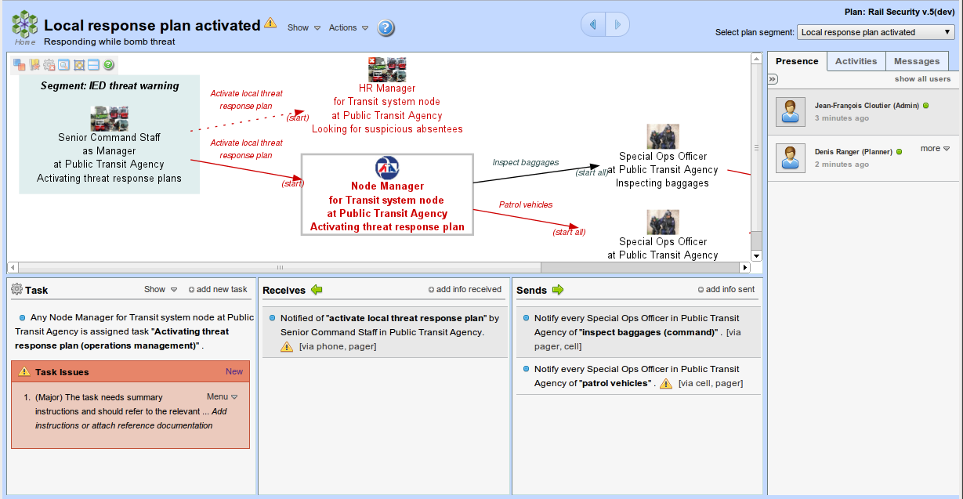
Flow map
Segment bar
Task panel
Receives panel
Sends panel
Collaboration tab panels

Slide 21
Segment name
(click to open segment details)
Show menu
(mouse over to open)
Plan version being edited (click to open plan details)
Go to home page
Help
Indicator of issue(s) on segment itself (mouse over for summary)
Actions menu
(mouse over to open)
Go back/forward
Switch segment

Slide 22
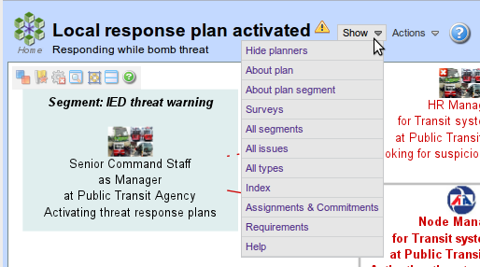
Show/hide collaboration tab panels
Open plan details panel
Open plan details panel
Open segment details panel
Open surveys panel
Open segments map panel
Open all-issues panel
Open typologies panel
Open plan index
Open IS procedures visualization panel
Open requirements panel
Open Channels help

Slide 23
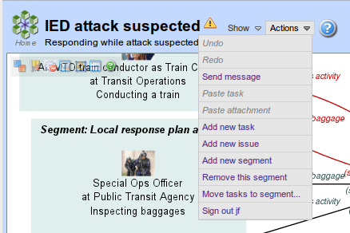
Redo user's last undone change to the plan
Undo user's last change to the plan
Send a message about the segment
Add last copied or cut task to segment
Add new task to segment
Paste copied or cut attachment to segment
Add new segment to plan
Add ad hoc issues to segment
Open task mover panel
Remove segment from plan
Logout user

Slide 24
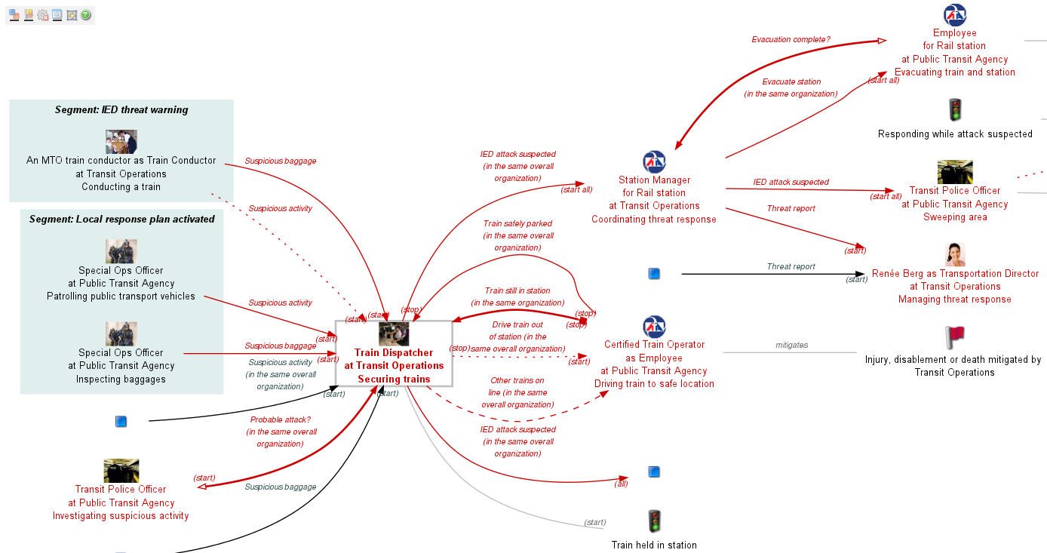
Flow map view controls
Info flow – reply
Info flow – request
Task in other segment
Info flow - notification
Info need of task
Task in this segment
Info flow that for some reason can't be realized
On failure info flow
Info capability of task
Risk mitigated by task
Event caused by task

Slide 25
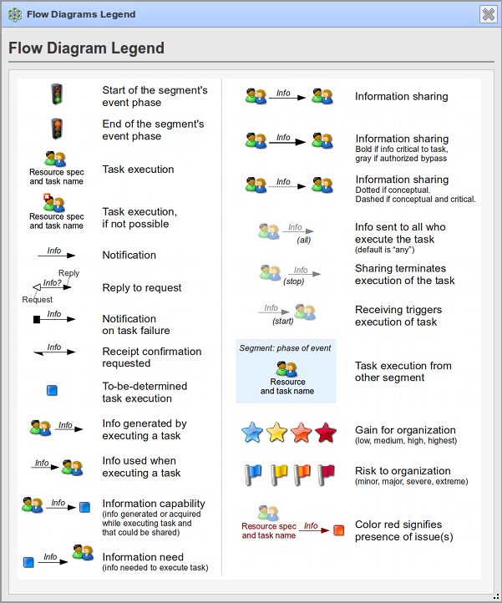
Move
Close
Resize

Slide 26

Show/hide goals achieved by tasks
(Un)Maximize flow map
(Un)Stretch task/receives/sends panels
Show/hide info needs and capabilities
Underline indicates shown
Show/hide non-operational tasks and flows
(Un)resize flow map to fit
Show flow map legend

Slide 27
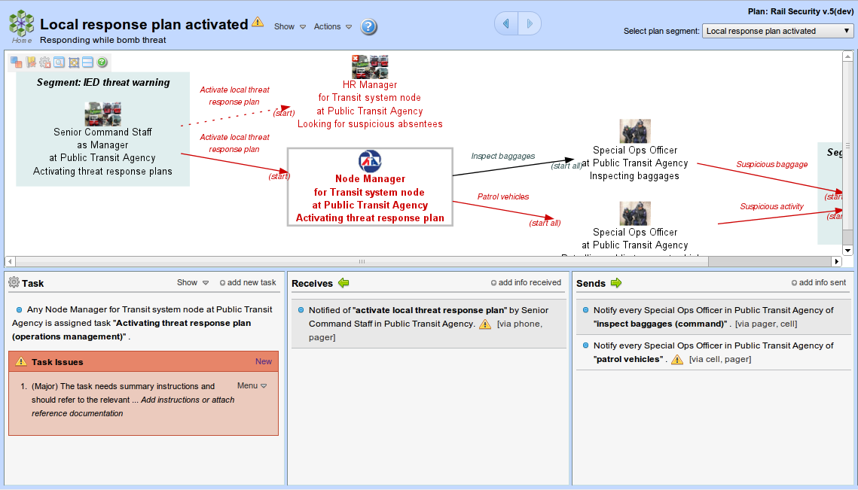
Flow map does not fit

Slide 28
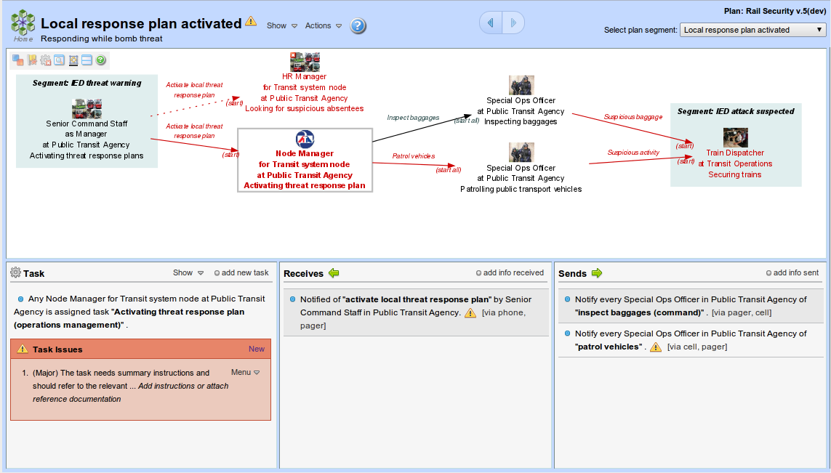
Flow map fits
Resize-to-fit control

Slide 29
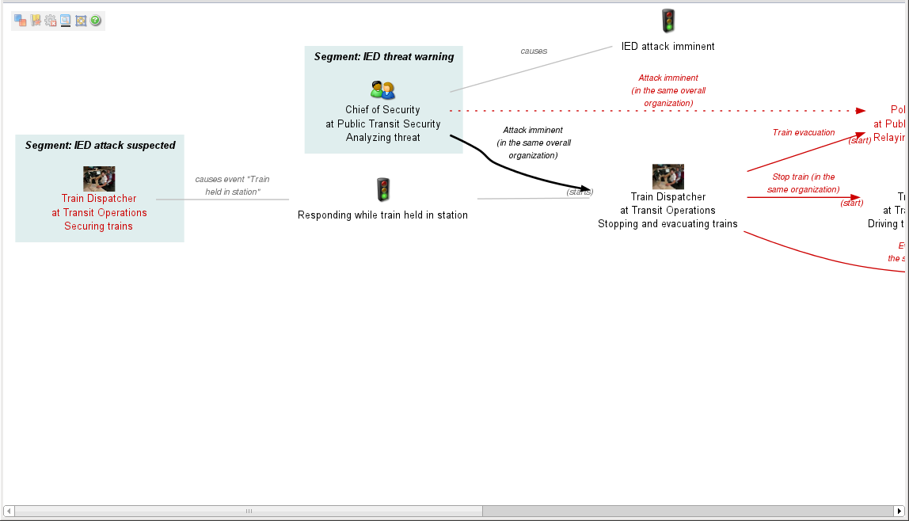
Maximize control

Slide 30
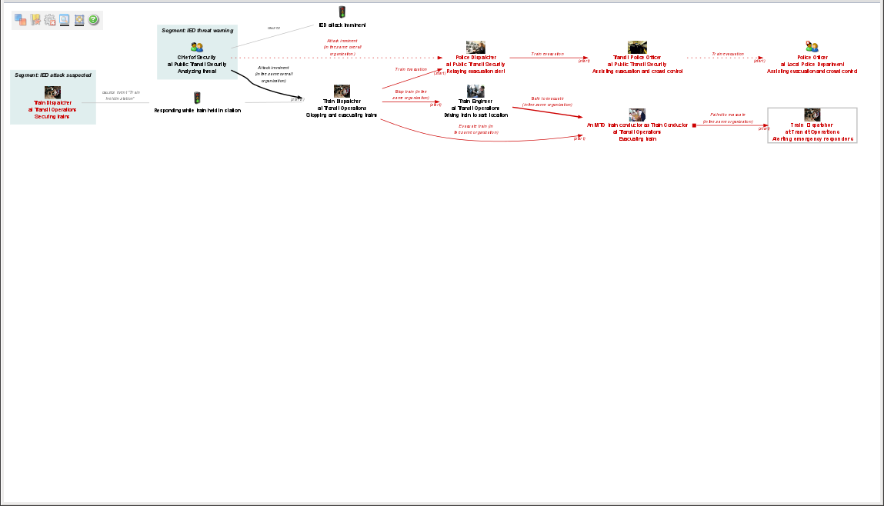
Maximize control
Resize-to-fit control

Slide 31
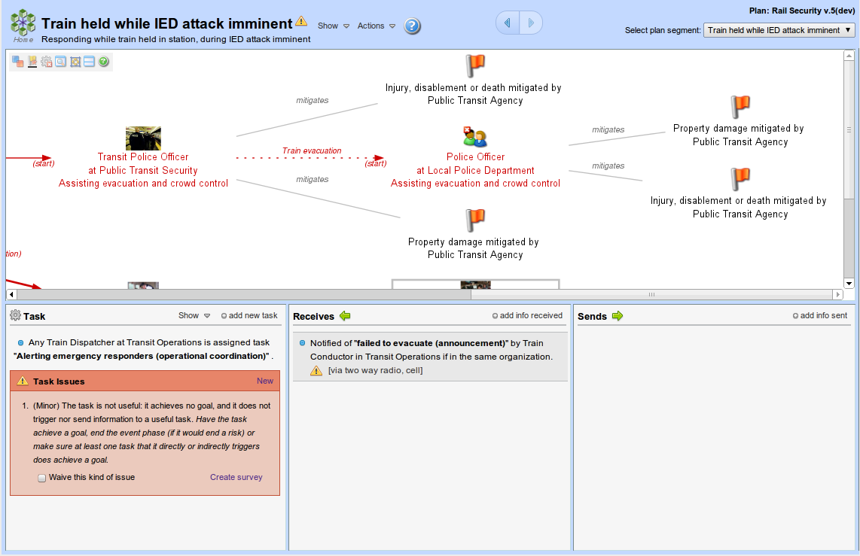
Show goals control

Slide 32
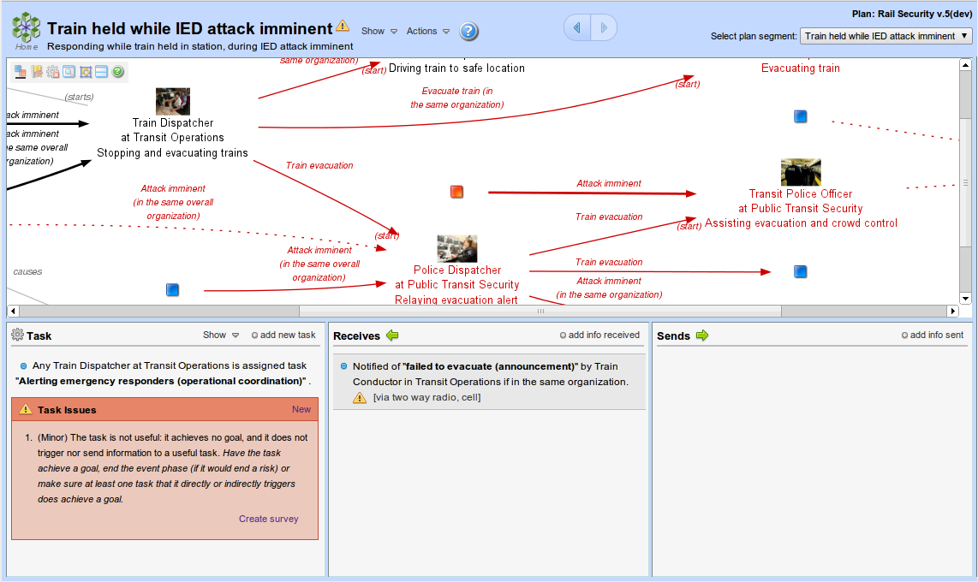
Show info needs and capabilities control
Info capability
Info need

Slide 33
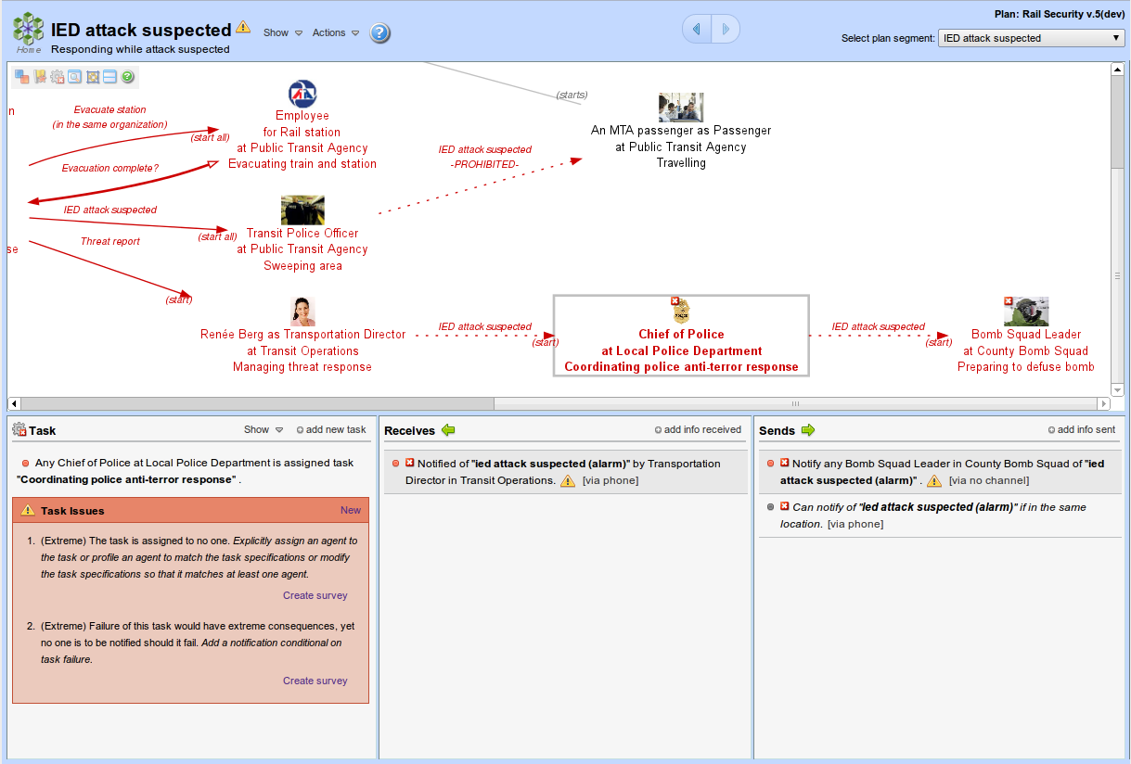
Task can not be executed
Flow can not be realized
Task can not be executed
Flow can not be realized

Slide 34
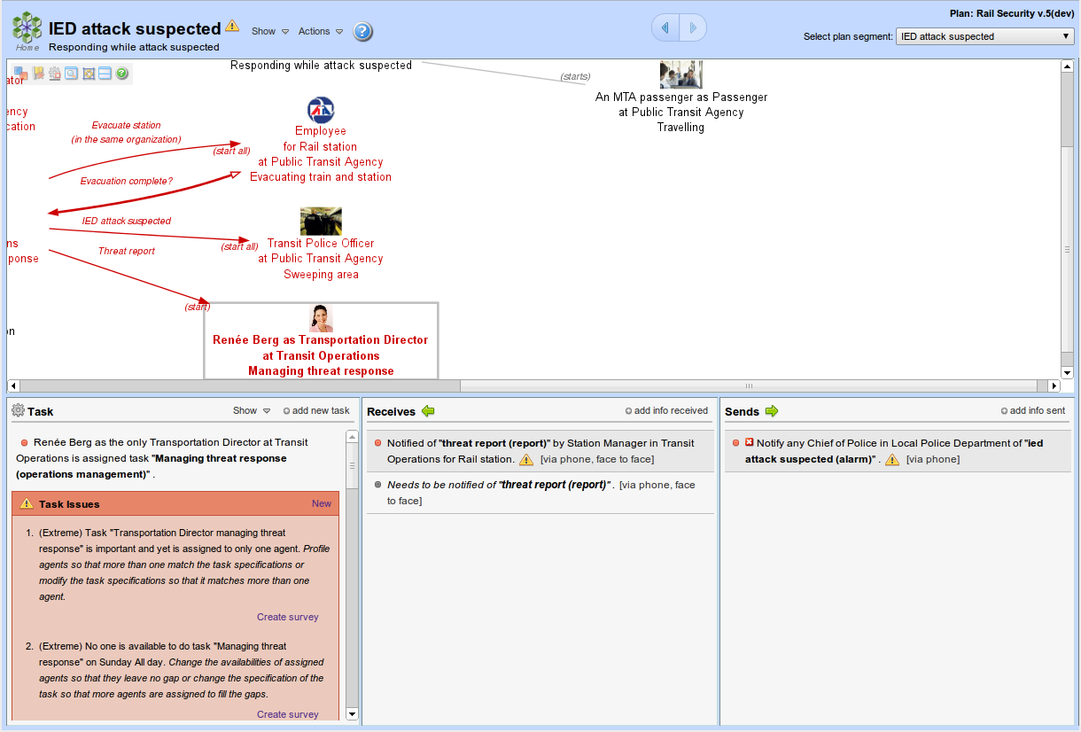
Hide non-realizable view control
Non-realizable task and flows hidden

Slide 35
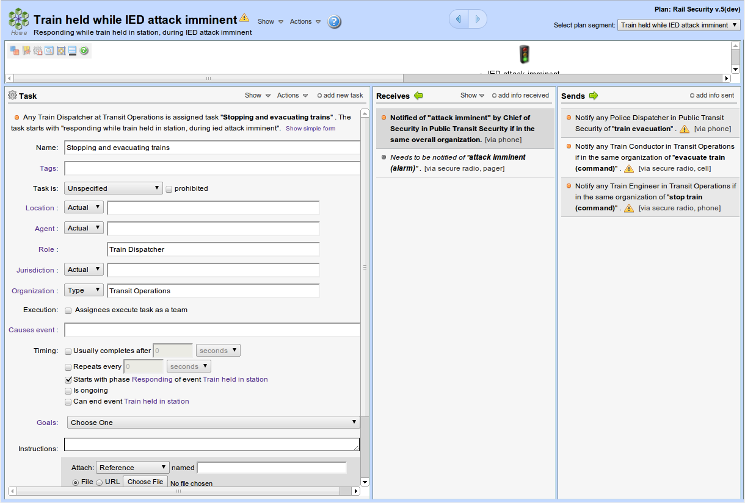
Minimize flow map view control

Slide 36
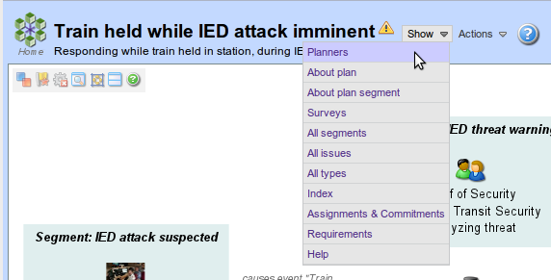
Expand collaboration panel

Slide 37
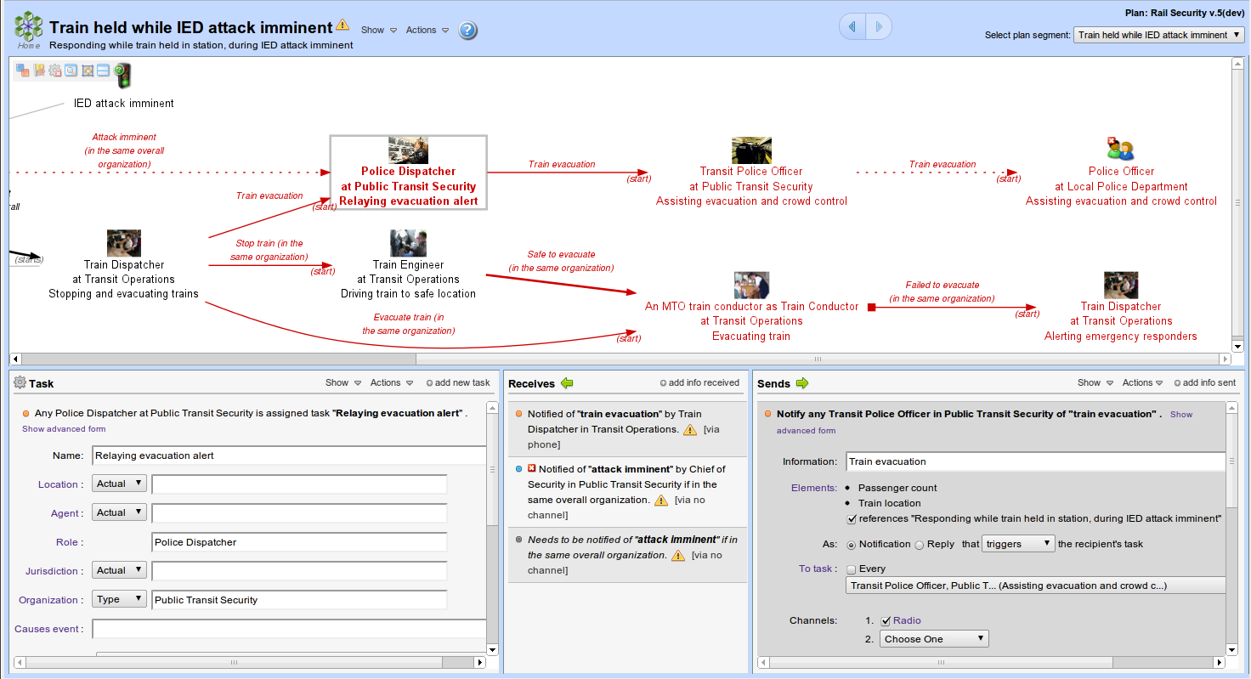
Selected task
Failure to send would be severe
Expanded task edit form
Expanded “send” edit form
Flow can not be realized
Click to show advanced form
Failure to receive would be minor

Slide 38
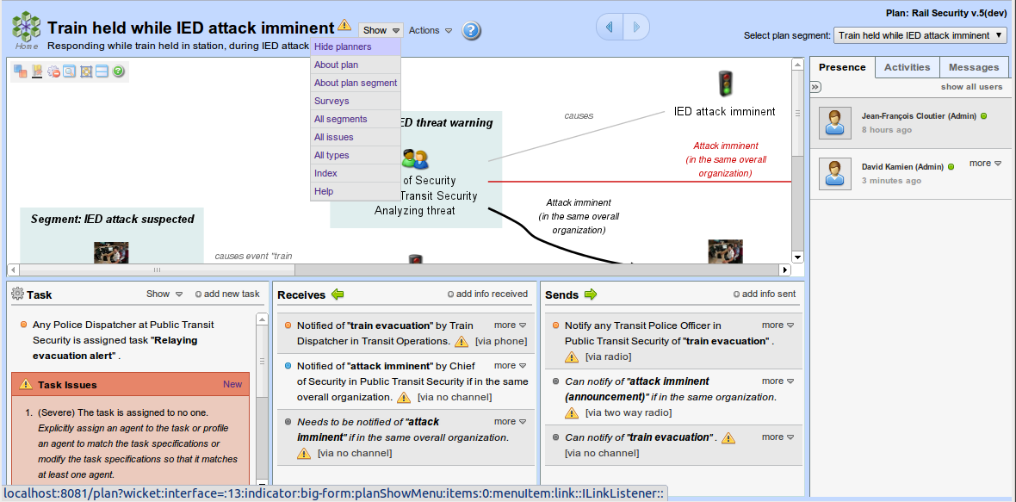
Planner messaging
Who's working on the plan
Recent planner activities
Collapse collaboration panel
Collapse collaboration panel
Expanded collaboration tabs

Slide 39
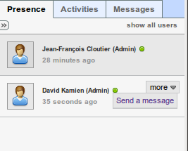
To all registered users whether logged in or not
Users currently logged in who selected this plan
Shortcut for sending a message to planner

Slide 40
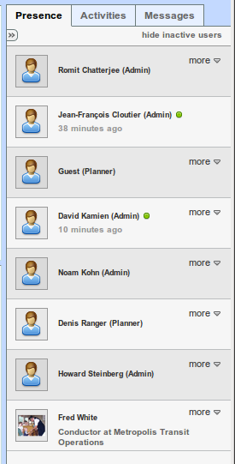
Hide users not online
Currently online
All registered users with access to this plan
Currently online

Slide 41
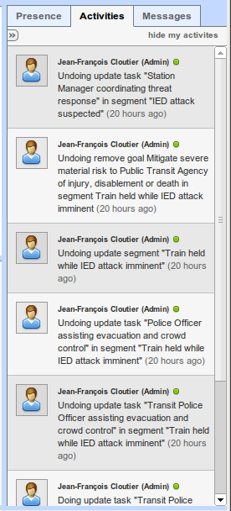
To see only the activities of others
Who
Change made
When
Click to go to changed plan element (if applicable)

Slide 42
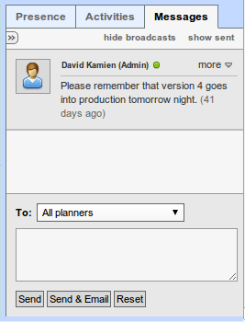
Only show personal messages
Only show messages I sent
Sender is online
Sender
Message
When
Send message to...
Message composer
Message
Send in Channels only
Send in Channels and via email

Slide 43
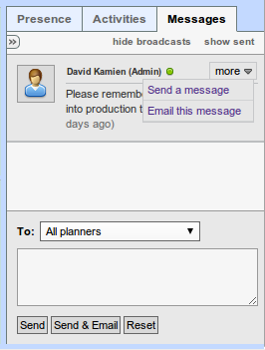
Send message to sender
Forward to self via email

Slide 44
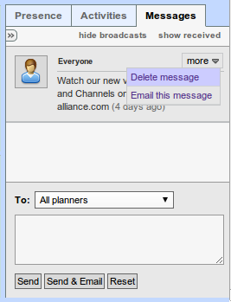
Delete message sent internally in Channels
Message I sent
Resend internal message via email

Slide 45
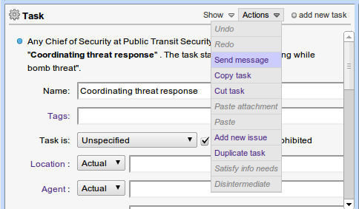
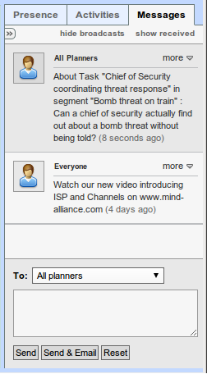
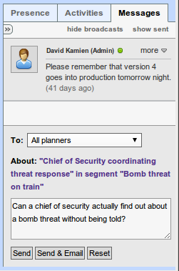
Sending message from a plan element
Message received with link to plan element
Reference to plan element
Message text

Slide 46
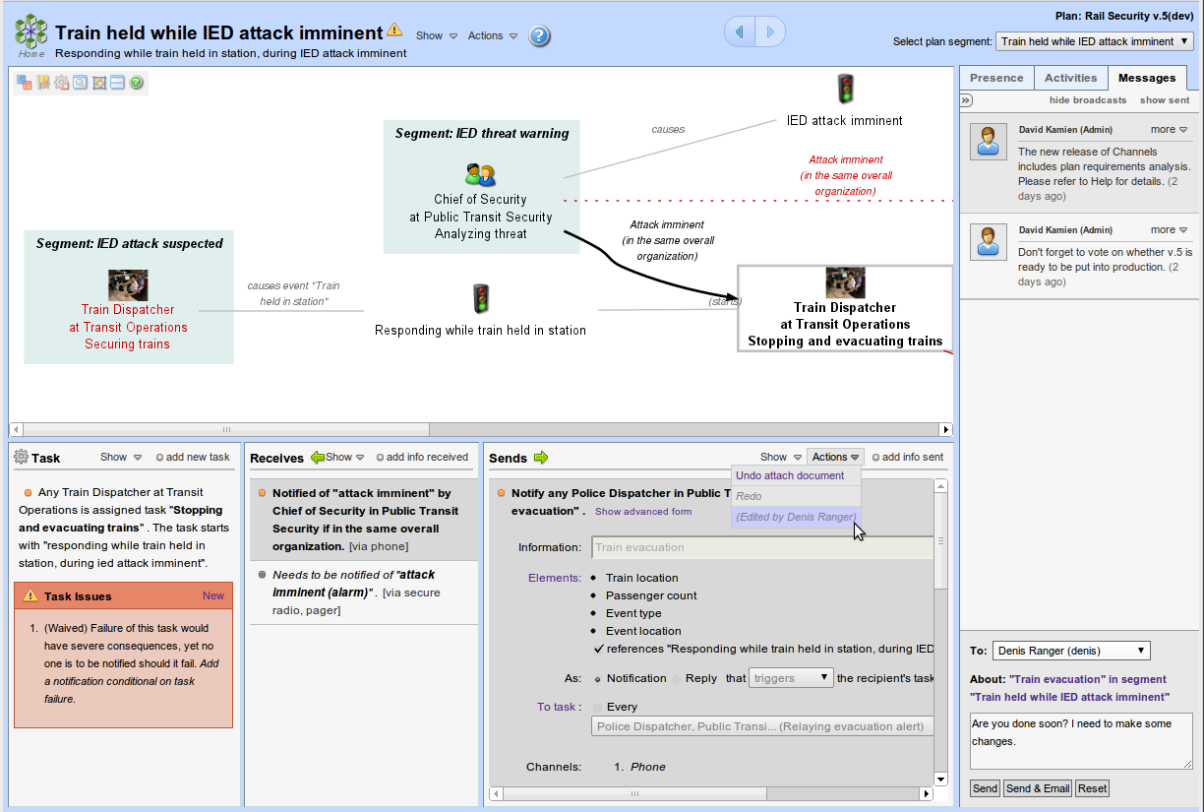
Flow locked by other planner
Message to other planner about locked flow
Click to send message to owner of lock

Slide 47
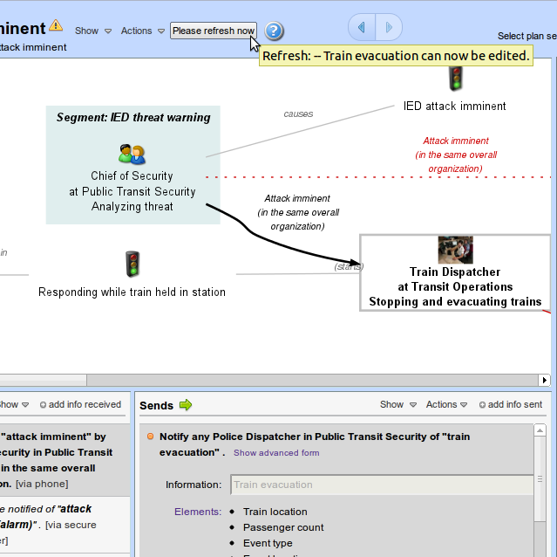
Click to refresh and acquire edit lock released by other planner
Other planner releasing wanted lock causes refresh notice

Slide 48
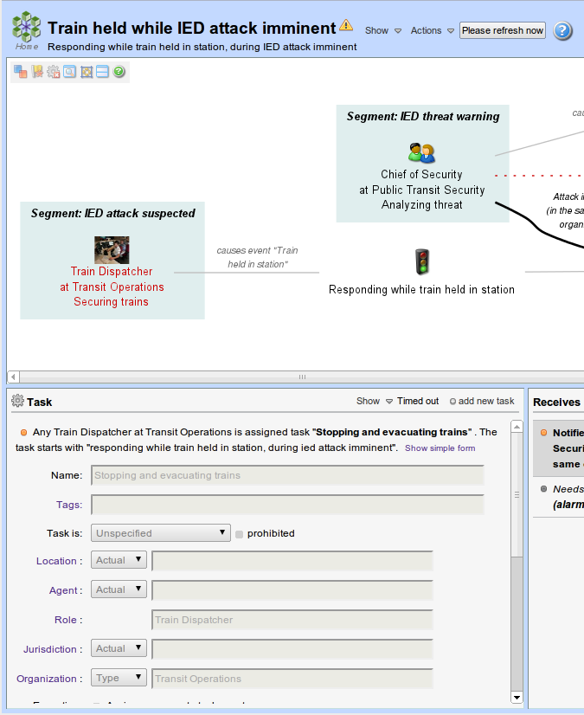
Click to refresh to re-acquire the edit lock
Timed out indicator replaces the Actions menu
The form fields are disabled

Slide 49
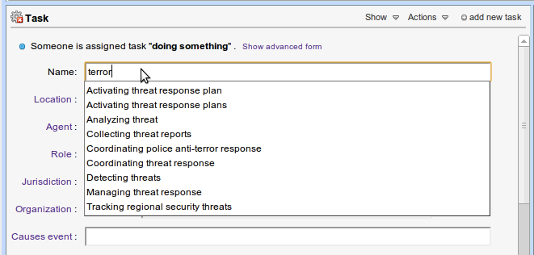
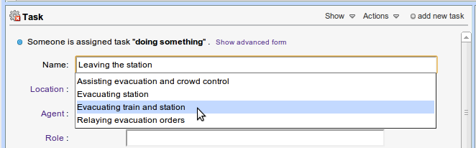



Suggestions are task names already used in the plan that have similar meaning
Click on a suggestion to use it
Proximity is about meaning, not spelling
Proximity matching leads to shared vocabulary
Entering a blank causes all possibilities to be suggested

Slide 50

All edit forms allow for attaching documents

Slide 51

Attachment type is picture
Uploaded document
Copy attachment
Detach document
Attachment type is reference
Linked document
Name attachment
Set type of attachment
Upload document
Opens file chooser

Slide 52

Link to document
Enter URL

Slide 53

Click and drag in menu bar to move panel
Floating panel for all profiles
Close button
Same as close button
Panel is confined to the plan editor, under the segment bar
Floating panel for task assignments
Click and drag corner to resize panel

Slide 54

Click to add a new task to the segment
Color-coded failure impact
Summary
Click to show simple form
Identify, categorize, tag, flag
Locate
Characterize assignees
Consequences
Timing
Documentation
Issues

Slide 55

Click to show advanced form

Slide 56

Click to add a new info need for the task
Name, tags, intent
Click to edit elements of information
Push vs pull, and impact
Unidentified source => info need
Restriction on allowable source
Preferred channels
Timeliness requirement
No instructions for info needs (disabled)
Attach documentation here

Slide 57

Click to add a new info capability for the task
Name, tags, intent
Could share only on task failure?
Click to edit elements of information
Push vs pull
Unidentified target => info capability
Restriction on allowable target
Preferred channels
Timeliness capability (term of service)
Instructions for sharing info
Would sharing info complete the task?
Attach documentation here

Slide 58

Color-coded failure impact
Click to add a new info capability for the task
Name, tags, intent
Prohibited?
Click to edit elements of information
Push vs pull, and impact on recipient
Recipient task
Restriction on allowable recipients
Preferred channels
Timeliness capability (term of service)
Does the request trigger the task? Would replying info complete the task?
Can intermediate be bypassed? Is receipt confirmation requested?
Ad hoc instructions for sharing info (disabled for reply)
Attach documentation here

Slide 59

Link/unlink classifications
Auto-populate
See planned dissemination of element
Uncheck to remove
Uncheck to remove element
Click to remove classification
Remove element transformed
Set transformation
Name new element
Add element transformed
Edit plan's secrecy classifications

Slide 60

Check to indicate time-sensitivity

Slide 61

Show all assignees
Show form
Show dissemination analysis
Show profile of entity referenced in task definition

Slide 62

Redo my last undone change to plan
Undo my last change to plan
Take a copy of this task
Send message about this task
Attach copied document
Copy and delete this task
Add ad hoc issue to this task
Apply definition of copied task to this one
Connect info capabilities to info needs
Add a copy of this task to segment
Remove this task as an intermediate in flows

Slide 63


Send message about info need
Hide edit form
Edit elements of information
Take a copy of the info need
Add a new, ad hoc issue
Add copied attachment
Remove this info need

Slide 64


Send message about info capability
Hide edit form
Edit elements of information
Take a copy of the info capability
Add a new, ad hoc issue
Add copied attachment
Remove this info capability

Slide 65


Hide edit form
Send message about info flow
Show derived info sharing commitments
Edit elements of information
Show info dissemination analysis
Show failure impact analysis
Take a copy of the info flow
Add info need or capability implied by this
Add an undefined, “middleman” task
Remove this info flow
Replace this info flow by implied info need and info capability

Slide 66

Open plan definition panel

Slide 67

Fixed plan unique identifier
Marking the plan as a template makes viewing it available to all authorized users, not just planners
To delete unreferenced phase
Click on phase name to open its profile panel
Name new phase
Name default locale (type or actual) of plan
Attached tag sub-domain definition file
Attached info standard tag definition file
Default language of agents in plan
Attached picture used in home page for plan

Slide 68

Show this view

Slide 69

Short cut to requirements

Slide 70

Requirements management
Requirements analysis
To edit the requirement
Sortable, filterable, paged table of all requirements
To add a requirement

Slide 71

Requirement editor
Requirement name, description and tags
Information specifications
Matches flow names and tags
Requirement attachments
Elements visible only if info is named
Issues about the requirement itself
To remove the requirement

Slide 72

Source agent specifications
Source (committer) specifications
Agent name or type
Agent role
Agent role jurisdiction
Agent's organization

Slide 73

When and how the information is acquired by the source agent
Name of task executed when acquired
Tags of task executed when acquired
Event phase when task executed

Slide 74

Count of source agents in organization
Minimum/ Can be zero or greater
Safe count. Equal to or greater than “At least”
Maximum. Unspecified (infinite) or equal to or greater than “Preferably”

Slide 75

Number of alternate source agents per beneficiary agents

Slide 76

Focus on requirement satisfaction is specific situations, or not
Number of requirements that apply to a pair
Edge is red if not all requirements are satisfied
All pairs of organizations to which requirements apply
Click on edge to focus on pair of organizations
Click on organization to focus on it
Table of all requirements applied to pairs of organizations

Slide 77

Focusing on the requirements applied to an organization

Slide 78

Focusing on the requirements applied to a pair of organizations
Click to see all commitments that contribute to satisfaction of requirement
Sortable, filterable, paged table of commitments

Slide 79


Focus requirement satisfactions during phase of event
Focus requirement satisfactions for specific event

Slide 80

Click to open event profile panel
Mark or unmark as incident
Name new event in scope (and mark it as incident to retain it)

Slide 81

Click to see details below
Name new classification system
Delete unused classification level
Show references to classification level
Search index of plan elements referencing classification level: filter by kind of elements, name, tags
Name new classification level in system
Bring classification level to top

Slide 82

Filter the list of known organizations
Click to show more below about organization
Add an organization to the scope
Open organization profile panel
Click to remove organization from scope
Filterable index of task assigned to organization

Slide 83

Sharing commitments between organization in the plan
Click on flow or organization to focus the flows indexed
Reduce diagram to fit
Index of all flows that generate the commitments
Click on lock to filter on plan element. Click again to unfilter
Click on header to sort on a column
Paged table
Click on any plan element in blue to be taken to it

Slide 84

Click on segment or flow/trigger to filter list of inter-segment connections
Select how to group segments
Flows across segments
Task in a segment affecting another segment

Slide 85

How to aggregate task assignment for other than the focus
Focus on an (actual) organization or agent
Click to display diagram of assignments and commitments
Select a segment or entire plan
Click on commitment to go to flow
Click on assignment to go to task
Sharing commitment involving agent in focus
Aggregated assignments of agents not in focus
Assignment of agent in focus

Slide 86

Assignments not summarized
Focus on organization
Focus on one segment

Slide 87

Groupings by first letter(s) of names
Group based on names of agents, organizations, roles or locations
Click on lock to filter out agents that do not have this role etc.
Click on the name of an entity to open a profile panel

Slide 88

Show all issues or only validity or completeness or robustness issues
From entire plan or a specific segment
Filter on name of issue
Include or exclude waived issues
Of a given severity or any
Create a survey on issue remediation

Slide 89

Show all types of documents or a specific type
Link to document

Slide 90

Show all kinds of plan elements or a specific kind
Filter by name or comma-separated tags
Click to go to plan element
Multiple elements with same name

Slide 91

Select kind of entity
Click to show details below
Layout as a tree or as a web
Show plan elements that reference the type or entities that match it
Reduce diagram to fit or show full size
Click to open profile panel
Click to go to the plan element

Slide 92

Click on tag to see details below
Index of plan elements tagged with selected tag
Click to go to the plan element

Slide 93

Overall evaluation
Issue metrics

Slide 94

Index on user ids, names or email addresses
Filter based on participation
Name agents user participates as
Click to see details below
Channels defined in agent profile
Update or add channels

Slide 95

Plan's active versions
Voted 'yes' is checked
To send message to planner
Check to vote 'yes'

Slide 96

Send a message referencing the current version of the plan

Slide 97

Clicking on segment name opens segment definition panel
Opens segment definition panel

Slide 98

Select a phase defined in the plan
Name event segment deals with
Give event severity threshold
Rate the event to complete (can be “any”)
Add event in context (past or present)

Slide 99

Show details view
View organizations involved in segment
View and edit goals
Move some tasks (and goals achieved) to another segment
Show map with located tasks

Slide 100

Send message about segment

Slide 101

Edit goal description and see tasks that achieve it
Remove goal
Add goal
Describe selected goal
Tasks achieving goal

Slide 102

Mouse over to see summary of task

Slide 103

Access to profiles of referenced entities from “show” menu
Access to profile of role
Access to profile of organization
Access to profile of event
Access to profile of phase
Access to profile of event

Slide 104


Index of all roles in plan
Click to open profile panel
All plan elements referencing profiled role
Click to open profile panel

Slide 105

Send message referencing entity profiled

Slide 106
Name the entity
Describe the entity
Add comma-separated tags
Name a categorizing entity type
Remove categorization
Open “All types” panel
Attach or detach documents
Expand analytical content
Index of all elements referencing or matching this entity

Slide 107

Collapse analytical content
Analytical content for role: who performs it

Slide 108

All agents in another role
All agents in profiled role
Aggregated sharing commitments
Click arrow or role to narrow list below
List of individual sharing commitments

Slide 109

Add issues about agents in this role
Add issues about tasks and flows involving this role
Include waived issues
Validity, completeness, robustness or all

Slide 110

Describe the organization's mission
Contact info for organization as a whole
Name parent organization
Official location
Transmission media that are not deployed by the organization
Issues raised if applied constraints violated

Slide 111

Confirm job if only implied by task definition
Give job title
Show below all sharing commitments for a job
Name supervisor agent
Name agent
Name role
Add new job
Name jurisdiction
Open job transfer sub-panel
Sharing commitments of selected job

Slide 112

Transfer from what other organization
Move jobs or just copy them?
Job transfer sub-panel
Select jobs to transfer to this organization

Slide 113

Parent organization
Profiled organization

Slide 114

Is MOU attached to confirmed agreement?
Tasks as acceptable use of shared info
Confirmed sharing agreement
Click to see below commitments covered by agreement
Implied sharing agreement
Commitments covered by selected agreement
Document agreement with reference, policy or MOU

Slide 115

Click to collapse analytical content (assignments and commitments)
All task assignments for the organization
All sharing commitments for the organization

Slide 116

Describe the typical mission for this type of organization
Name the actual or type of organization that is the parent for this type of organization

Slide 117

Shows actual organizations in network
Sharing commitment network of an actual organization

Slide 118

Shows types of organizations in network
Sharing commitment network of a type of organization

Slide 119

Include issues of agents and roles of this organization
Include issues of tasks and flows involving this organization

Slide 120

Include issues of agents and roles of this type of organization
Include issues of tasks and flows involving this type of organization

Slide 121

Mark the agent as a system, or not
Mark agent as archetype, placeholder or neither
Uncheck before checking alternative
Contact info – can be updated or overridden by associated user
Uncheck to agent day-to-day availability
Remove language
Add language
Remove clearance

Slide 122

Either always available or available for specific time periods
Add or remove clearances
References to profiled agent

Slide 123

Click to collapse analytical content
Tasks assigned to profiled agent
Sharing commitments of profiled agent

Slide 124

Availability of this type of agent
Add language

Slide 125

Other (actual) agents in sharing commitments with profiled agent
Network of profiled agent
Click on agent to see the agent's network
Click on edges to focus on sharing commitments with another agent
Sharing commitments involving profiled agent

Slide 126

Include issues about roles played by profiled agent
Include issues from tasks and flows involving agent and roles if included

Slide 127

Identify the place containing this one
Give street address if applicable
Give postal code if applicable
Name geographical location
Disambiguate geo-location

Slide 128

Place inside the place profiled
Index of all plan elements referencing profiled place

Slide 129

The type of place profiled must within this place
The type of place profiled must contain this place
Index of plan elements that reference or match the profiled place type

Slide 130

Include issues about tasks and flows located in this place
Include issues about tasks and flows executed in this place

Slide 131

Set mode of transmission unless set via categorization
Set pattern of valid medium address (end point)
Identify media the profile medium delegates to
Set medium security in terms of secrecy classifications
Whether communication is “live”
Set type of agent who can operate it

Slide 132

Include issues of media the profile medium delegates to
Include issues of flows that use this medium

Slide 133

Set whether such an event terminates by itself
Name the actual or type of location such an event occurs

Slide 134

Include tasks that are triggered by, end or cause the profiled event

Slide 135

Set timing relative to events
Segments that focus on this phase of some event

Slide 136

Include all segments, tasks and flows that relate to the profiled phase

Slide 137

First, select a task
Then ask to see its assignments

Slide 138

Agents in roles of responsibility for organizations assigned to the task

Slide 139

To see the info sharing commitments for selected flow
Selected flow

Slide 140

All sharing commitments for a flow
Who is sharing
Sharing what
Sharing with who
Realizable? If not, why

Slide 141

Overriding task
Overridden task
Overriding task indicator
Open overrides panel

Slide 142

Overriding task
Overrides panel shows tasks that override or are overridden by this task
Overridden task

Slide 143

Overriding task
Overrides panel shows tasks that override or are overridden by this task
Overriding task
Overridden task
Overridden task

Slide 144

Selected task
Open task failure impact analysis panel

Slide 145

Hypothetically failed task
Hypothetically failed task
Goal not achieved
Cascaded failure caused by critical info not shared
Whether alternate flows are also assumed to fail (no redundancy)
A table listing all failures

Slide 146

Selected flow
Open failure impact analysis panel on flow

Slide 147

Failed task as a consequence
Hypothetically failed flow
A table listing all failures

Slide 148

Selected task
Open dissemination panel

Slide 149

Selected flow
Open dissemination panel

Slide 150

Dissemination from sources
Element of information with transformation
A source task
Select element of information reaching target task
The selected task
From sources selected
Table of all dissemination sources for selected element to selected target task

Slide 151

Dissemination to targets
Element of information with transformation
A target task
The selected task
Select element of information reaching target task
Dissemination to targets selected
Untimely dissemination
Table of all dissemination targets for selected element from selected source task

Slide 152

Open surveys panel

Slide 153
Filter surveys shown
Show only surveys not yet launched
Show only surveys for issues still outstanding
List of surveys and their contexts
Click to show details below
Open sample survey in new window
Advance lifecycle of survey (launch then close)
See results of survey
Filter list of users in plan based on inclusion in survey etc.
Check to include in survey
Click to apply changes to list of surveyed users

Slide 154

Set scope to a segment or entire plan
Set summarization level
Focus on an agent or an organization
Name agent or organization agents in focus
Switch to report view
Assignments of agent(s) in focus
Click to generate visualization
Summarized assignments of agents not in focus
Click to navigate to flow
Click to navigate to task
Click to reduce to fit or show full size
Commitments involving agent(s) in focus
Visualization focused one segment and all agents in an organization, and summarized by roles in types of organization

Slide 155

Click to go to the home page
Switch to visualization
Click to expand
Click to collapse
Click to open task view

Slide 156

Click to go to the home page
Switch to visualization
Task name
Click to go back to top of report
Click to open task view

Slide 157

Switch to visualization
Flow name
Click to go back to task view of report

Slide 158

Send feedback
Top-level metrics

Slide 159

Metrics for each kind of unwaived robustness issues in the plan

Slide 160

Metrics for each kind of unwaived completeness issues in the plan

Slide 161

Metrics for each kind of unwaived validity issue in the plan

Slide 162

Click to go to the home page
Click to remove association between user and agent
Click to access the participant's IS guidelines page
Click to associate a user to this agent
Click to access the unassigned agent's IS guidelines page
Indicates that many users can be associated with this agent

Slide 163

Click to send an email to this planner
Click to open the participants list page for this other plan

Slide 164

Click to go to the home page
Open feedback panel to send feedback about the report as a whole
Open feedback panel to send feedback about the participant's profile
Participant's profile with contact info
Jump to a relevant situation
Table of content of relevant situations

Slide 165

Send feedback about the situation
Send feedback about the task's guidelines
Jump to the task's guidelines

Slide 166

Send feedback about sharing guideline
Jump to targeted contact information

Slide 167

Send feedback about contact information
Click to send email

Slide 168

Click to open info needs report

Slide 169

Click to go to the home page
Open feedback panel to send feedback about the report as a whole
Open feedback panel to send feedback about the participant's profile
Participant's profile with contact info
Jump to a relevant situation
Table of content of relevant situations

Slide 170

Task for which info is needed
Send feedback about the info need
Info need

Slide 171

Click to open feedback panel

Slide 172

Click to open help window
Click to open feedback panel
Indicate nature of feedback
Feedback
Mark as urgent (if urgent)
Cancel and close
Send (via email) and close

