Slide 1
ClimComm
Platform to generate NFT for climate change volunteers

Slide 2
Humans loves appreciation!
Do you have an proof of the volunteer service you did to clean a beach or forest?

Slide 3
ClimComm offers
1
2
3
4
Event Creation and Funding
NFT/Badges for the volunteers
NFT /Badges for the Funders
Climate Warriors Community

Slide 4

1
Event Creation and Fundraiser
By filling in simple form
Create a smart contract with details about the event on Celo Network
If required, raise funds for the event
Show volunteers appreciation with NFTs/ Badges.

Slide 5

2
NFT/Badges for the volunteers
Collect NFTs/Badges for your efforts
Get token drops from annual/monthly contest
Get discounts with your profile ranking

Slide 6

3
NFT /Badges for the Funders
Easy to track climate change related donations
Collect NFTs/Badges for your funding
Get token drops from annual/monthly contest
Get discounts for your donations

Slide 7




Task Flow
Volunteers
Funders
Register for participation and get rewarded at the end of the event
Fund the event
Create a smart contract for the the event
ClimComm
Event Organiser

Slide 8
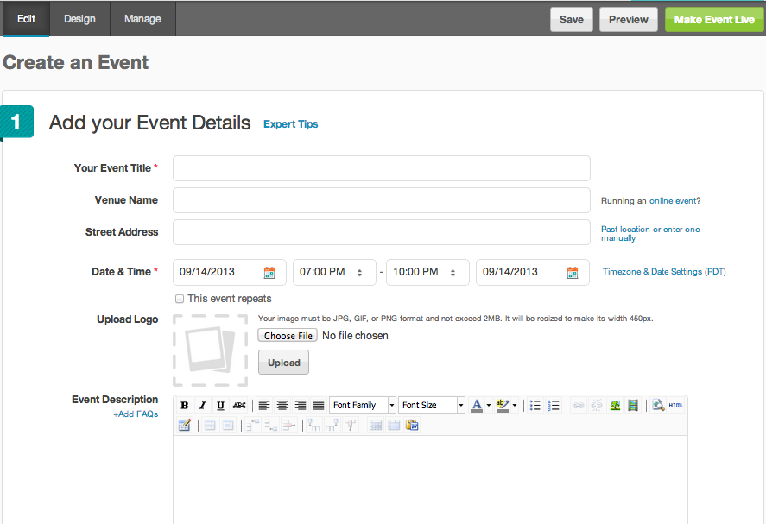
MVP
Event Creator Screen
Contract deployed on: Link

Slide 9
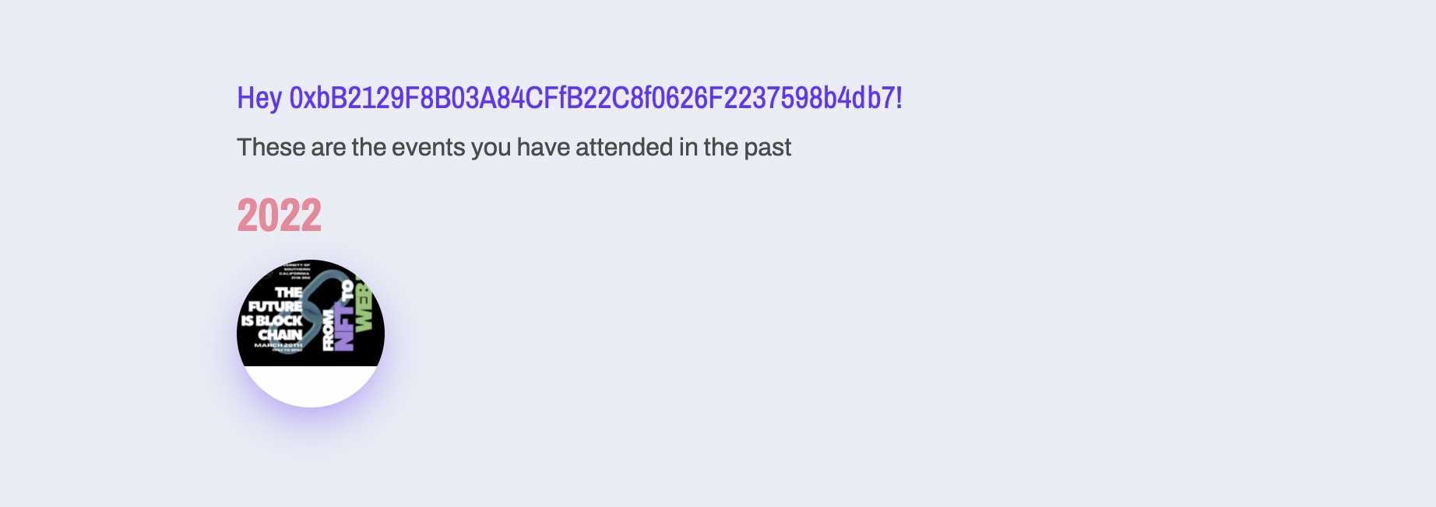
MVP
Volunteers Screen

Slide 10
Think Green

