Slide 1
Courseera – Week 2
Project Presentation

Slide 2
Business Problem
Dublin, Ireland is currently seeing an influx of immigrants due to a booming economy. This is resulting in housing crisis in Dublin and a number of potential immigrants are using online forums to inquire about areas to live in Dublin. This project aims to provide information on relatively safe areas in Dublin, show them on the map and provide information on 10 most common venues in those areas. This will help potential immigrant user to form an opinion on areas to live in Dublin.
Relative Safe area is defined as neighbourhood where average crime rate for past 10 years is less than 25 percentile of the yearly average crime rate in all neighbourhoods.

Slide 3
Datasets Used
For the purpose of this project, following datasets and API's will be used
CSO Json Dataset on Number of crimes, per year , per Garda Station in Ireland. This dataset will be downloaded programmatically from CSO JSON API and filtered for Garda Stations in Dublin.
Features based on Average crime rate and 25th percentile of the Average crime rate will be extracted from this data. This will be then used to select the top 3 neighbourhoods.
Geopy - geocoding for Dublin, and three relatively safe areas.
Folium API for maps visualization.
Foursqaure venues API for 10 most visited venues on three relatively safe areas.

Slide 4
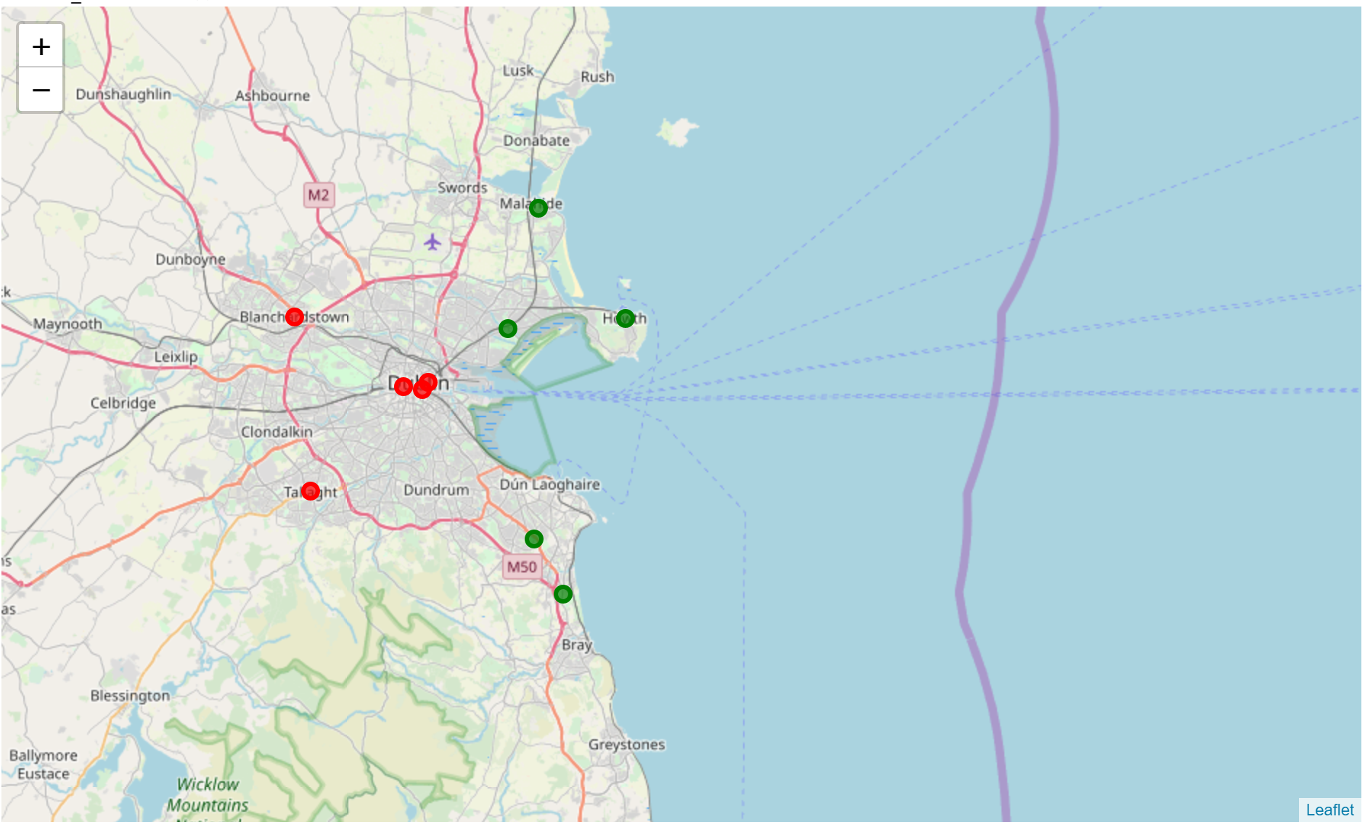
Observations
Observation 1: Visualization of relatively safer neighbourhoods in Dublin depicted as Green circles on the Dublin Map Vs Red circles (neighbourhoods with maximum crime rate)

Slide 5
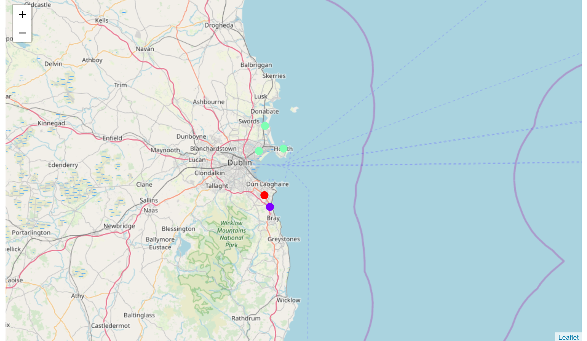
Observations
Observation 2: Clusters of the relatively safe areas by top 10 most visited venues. Areas in a cluster are depicted in same colour.

Slide 6
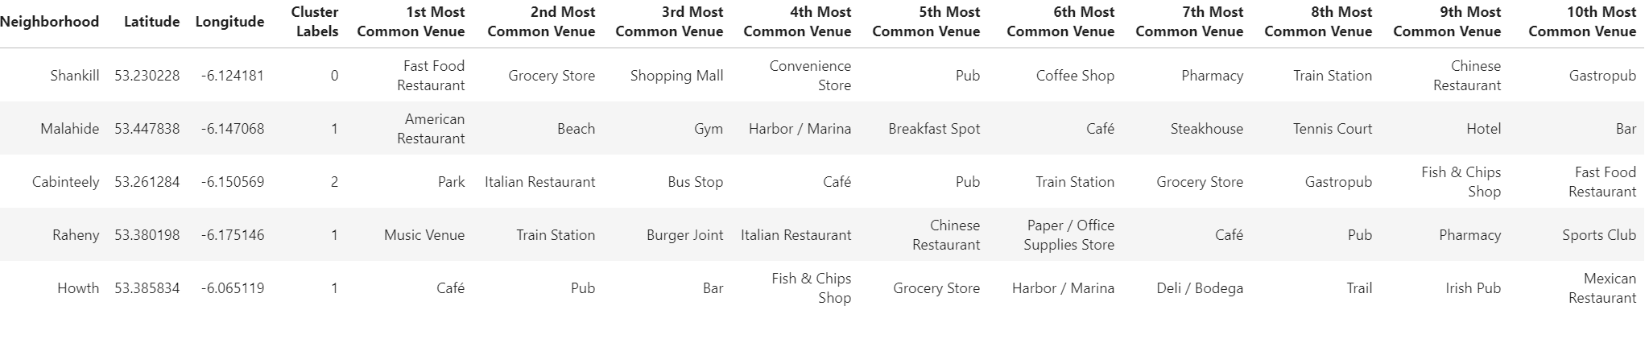
Observations
Observation 3: Top 10 most visited venues for relatively safer neighbourhoods.

Slide 7
Conclusions
Based on the capstone project, immigrants for whom safety of the neighbourhood is a primary concern should be interested in exploring accommodation in Northern and Southern regions of Dublin Metropolitan areas. These areas provide a balance of lifestyle facilities and lower mean yearly crime rate among the neighbourhoods in Dublin Metropolitan region.

