Slide 1
Team Name- Brick by Brick Title of Prototype- Harappan Civilization Subject- Social Science (History) Class- 6

Slide 2
Agenda
Introduction
Theory
Procedure
Sketch Files
Images
Flow Diagrams

Slide 3
Introduction
Objective:
This prototype aims to provide an engaging, educational experience through an immersive exploration of one of history's oldest urban cultures.
What to Expect:
Interactive Learning:
Experience Harappan city planning through simulations.
Virtually recreate iconic structures like the Great Bath and intricate drainage systems.
Dynamic Visuals:
Animations and 3D models showcasing daily life, trade, and craftsmanship.
Self-Evaluation Tools:
Assess your understanding through quizzes, activities, and creative challenges.

Slide 4
Theory
This chapter explores the ancient Harappan Civilization, detailing its remarkable urban planning, societal structure, and daily life.
Discovery and Importance:
First uncovered in Harappa (Pakistan) during railway construction. One of the oldest urban civilizations in South Asia, developed around 4700 years ago.
Urban Planning:
Cities divided into two parts:
Citadel: Smaller, higher, and fortified, hosting special structures like the Great Bath.
Lower Town: Larger, lower, and organized residential areas.
Advanced drainage systems, straight streets, and interlocking bricks for walls.
Special Features:
Craft production using materials like stone, shell, and metals (copper, bronze, gold, and silver).
Beads, seals, and tools showcasing artistic and technical expertise.
Trade connections for materials such as copper (Rajasthan/Oman) and tin (Afghanistan/Iran).
Decline:
Environmental changes, deforestation, and resource depletion led to the end of the civilization around 3900 years ago.

Slide 5
Procedure
Students will follow these steps to engage with the topic:
Explore the City Layouts:
Study diagrams of Harappan cities like Mohenjodaro and Lothal.
Identify key features of citadels and lower towns.
Analyze Artifacts:
Observe images of seals, beads, and tools.
Discuss their significance in Harappan trade and culture.
Compare Lifestyles:
Contrast life in Harappan cities with rural villages like Mehrgarh.
Activity:
Match sources of raw materials (e.g., tin, gold) with their origins.

Slide 6
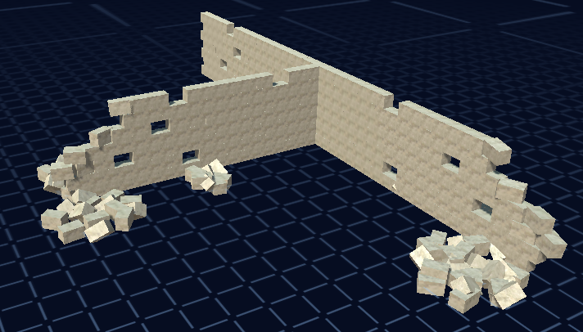
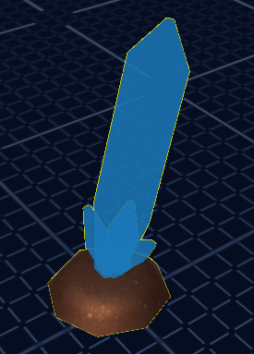
Sketch Files
Harappan Building Simulation
Artifact Simulation

Slide 7
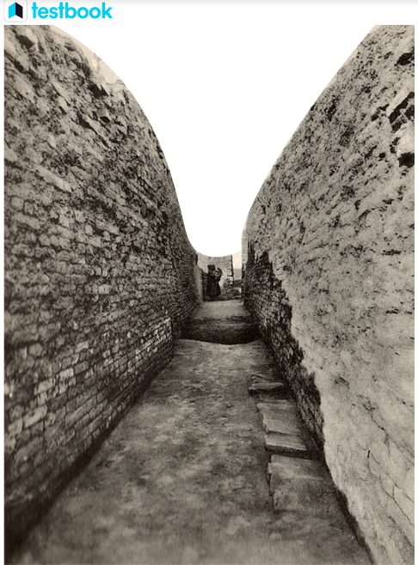
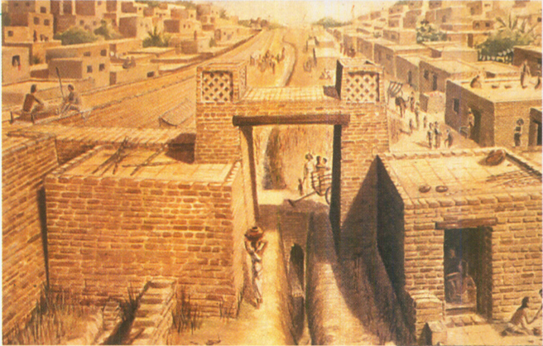
Images
Fig: Harappan Drainage System
Fig: A sketch of Indus Valley

Slide 8
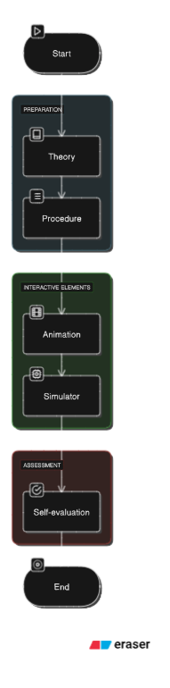
Flow Diagram
End Goal
The flowchart concludes with a well-rounded learning experience that combines theoretical knowledge, interactive exploration, and self-assessment. It ensures that users not only learn but also engage actively with the subject matter.

Slide 9
Thank you

