Slide 1

Amrutvahini College of Engineering, Sangamner
Image Captioning system using deep neural network based on encoder-decoder framework
Team members:
Mr. Mayur Gadakh (B190104240)
Mr. Gaurav Chaudhari (B190104219)
Ms. Akanksha Gaikwad (B190104245)
Ms. Shivanjali Dhage (B190104229)
Guide: Mr. R. S. Gaikwad

Slide 2
Domain: Deep Learning
Sub Domain: Computer Vision

Slide 3
Problem Statement:
Implementing Deep Neural Network Based Encoder-Decoder Framework for Image Captioning using EfficientNetV2 as encoder and GRU as decoder.

Slide 4
Motivation:
The motivation behind this project is to enhance the quality of image captions, making visual content more accessible and valuable. Our system aims to provide accurate and informative image descriptions.

Slide 5
Objectives :
To study the deep learning techniques like CNN and RNN.
To develop a deep-learning based image caption generator that can accurately describe the contents of an image in natural language.
To create a user-friendly interface for interacting with the image captioning system.
To compare efficiency and accuracy of our model with existing model.

Slide 6
Literature Review:
Sr no | Authors | Paper Name | Year | Gap identified
1 | Md. Mijanur Rahman, Ashik Uzzaman, Sadia Islam Sami | Implementing Deep Neural Network Based Encoder-Decoder Framework for Image Captioning | 2022 | Limited discussion of specific challenges and limitations in the proposed model
2 | Srivastava, Siddharth, Yash Chaudhari, Yash Damania, and Parul Jadhav. | Deep Learning Techniques for Automated Image Captioning | 2022 | Does not address real time performance or computational efficiency.
3 | Alam, Mohammad Shahnawaz, Vaishali Narula | An empirical study of image captioning using deep learning. | 2021 | Lacks a broader analysis of the applications and implications of the technology.

Slide 7
Feasibility:
Financial Feasibility: approximately 20k to 30k
Timeline: Two to Three Months.
Technical Feasibility: Convolutional Neural Network EfficientNetV2 and Recurrent Neural Network GRU(Gated Recurrent Unit) are available online to readily implement.
Software Essentials: Python, Keras, Tensorflow
User Experience and Quality: Capable to provide accurate image caption.

Slide 8
Feasibility:
Technical Risks –
Model overfitting
Limited data
Operational Risk –
Data management
Schedule risks –
Model training time
Business risks –
Market viability
Competition

Slide 9
Scope :
Content Generation
Visually impaired individual
Automatic image tagging
Image search
Content recommendation

Slide 10
Requirement analysis:
Functional Requirements:
Image Input: The system must allow users to provide images as input for caption generation.
Caption Generation: The system should generate natural language captions for the provided images using EfficientNetV2 and GRU-based models.
Training Module: The system should have a module for training the caption generation model.
Inference Module: The system should provide an inference module for generating captions in real-time using a trained model.
User Interface: The system should have a user-friendly interface for users to interact with and provide input images and display the generated captions.

Slide 11
Requirement analysis:
Non - Functional Requirements:
Performance: The system should generate captions within a reasonable time frame, with low latency during real-time inference.
Scalability: The system should be designed to handle a growing dataset and user base.
Accuracy: The system should aim for high accuracy in caption generation, as measured by evaluation metrics.
User Experience: The user interface should be intuitive, providing a positive user experience.

Slide 12
Requirement analysis:
System configurations:
Internal Interface Requirements:
Software Requirements:
Operating System: Windows, macOS, and Linux.
Software Frameworks/libraries: Python Tensorflow, Keras.
Hardware requirements:
GPU: Dedicated GPU is required
RAM: 8GB (16GB recommended)
External Interface Requirements:
Data Sources: The system will interface with external datasets, including Flickr8kfor training and evaluation.

Slide 13
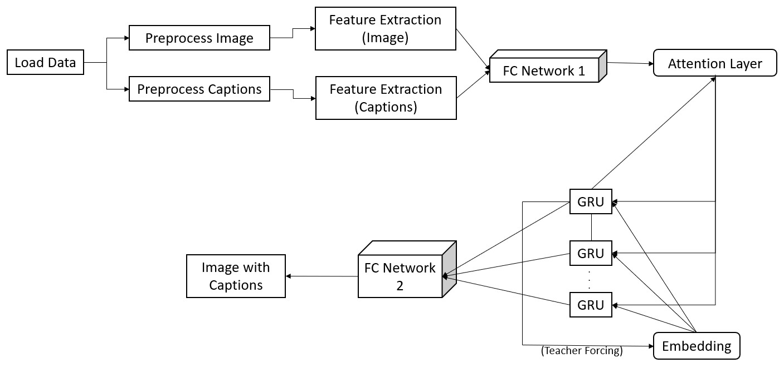
Architecture Diagram:

Slide 14
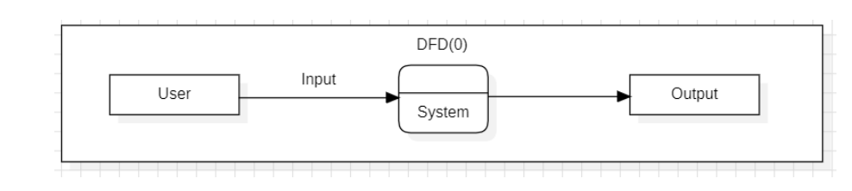
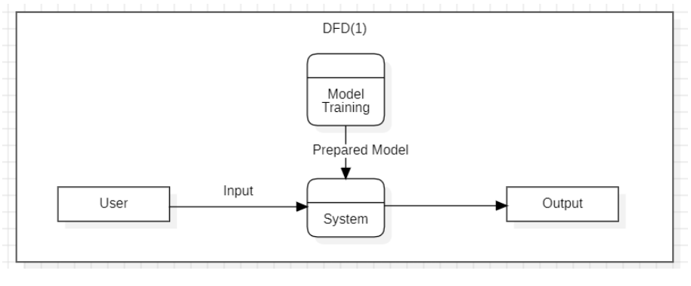
Data Flow Diagram:
Fig. DFD 1
Fig. DFD 2

Slide 15
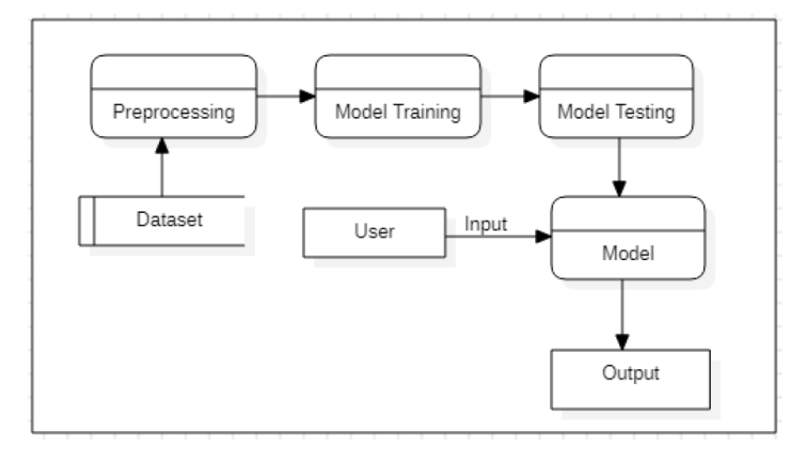
Data Flow Diagram:
Fig. DFD 3

Slide 16
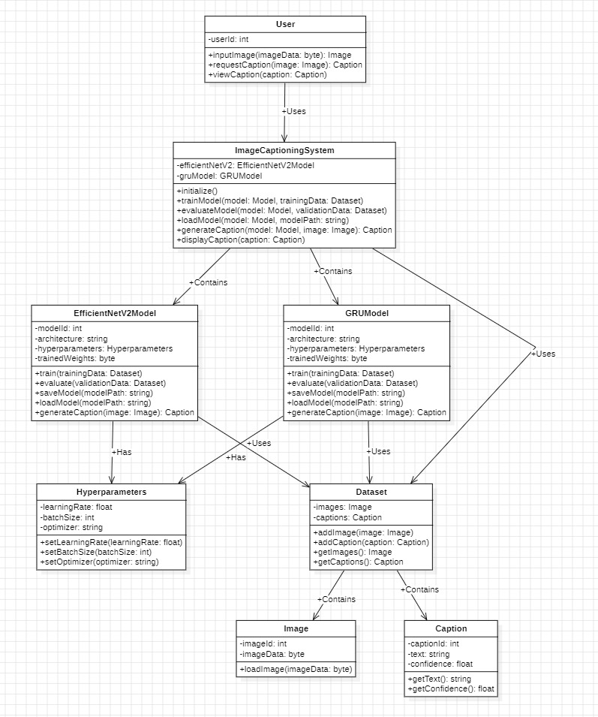
Class Diagram:

Slide 17
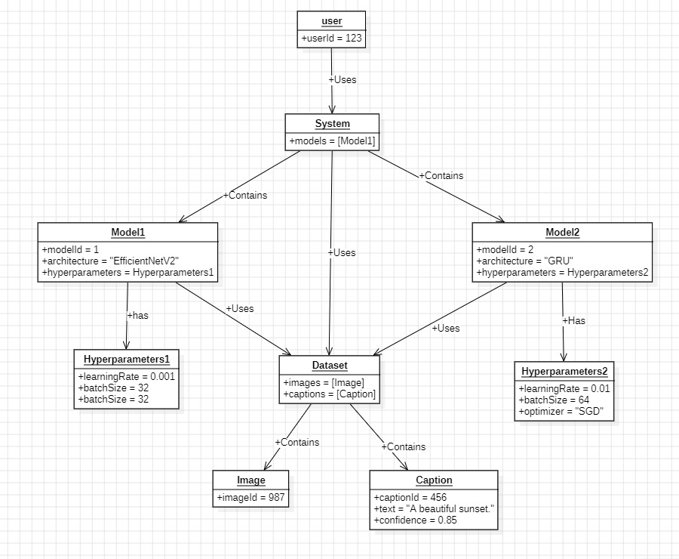
Object Diagram:

Slide 18
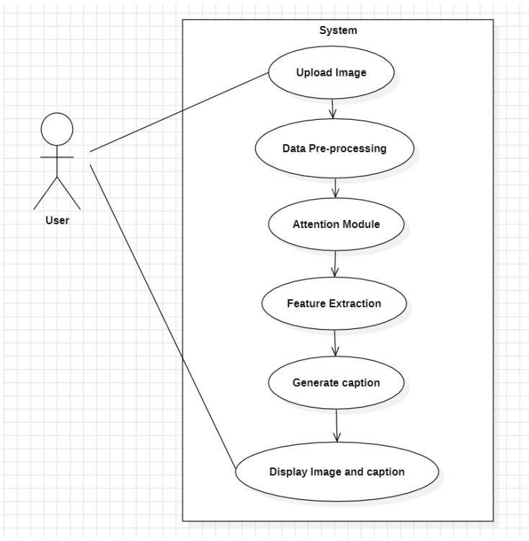
Use Case Diagram:

Slide 19
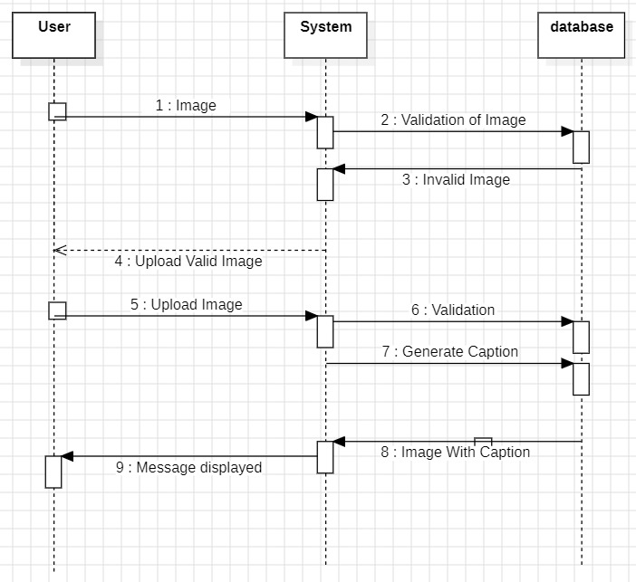
Sequence Diagram:

Slide 20
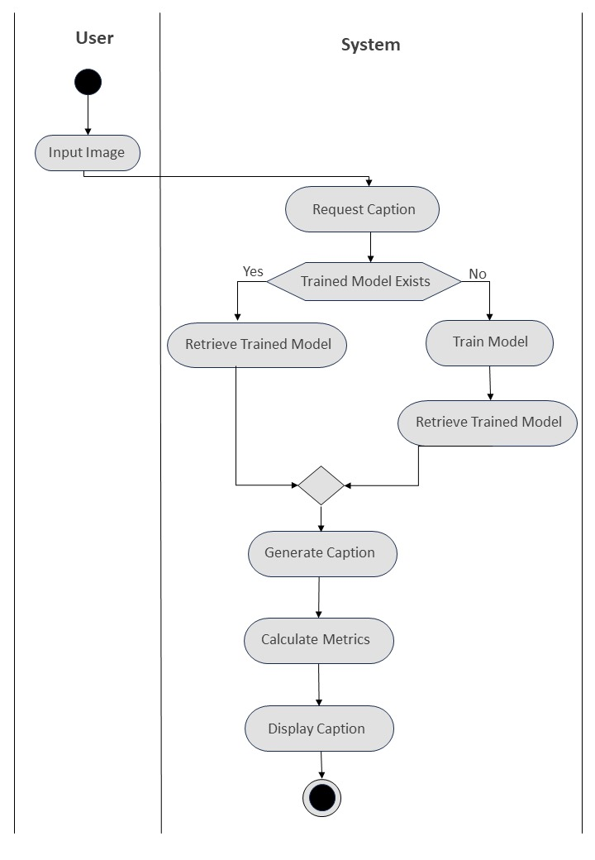
Activity Diagram:

Slide 21
THANK YOU!

