Slide 1

LLM Models Efficiency and Sustainability Analysis
Contributors: - Gaurav chugh - BiramE Mboup

Slide 2
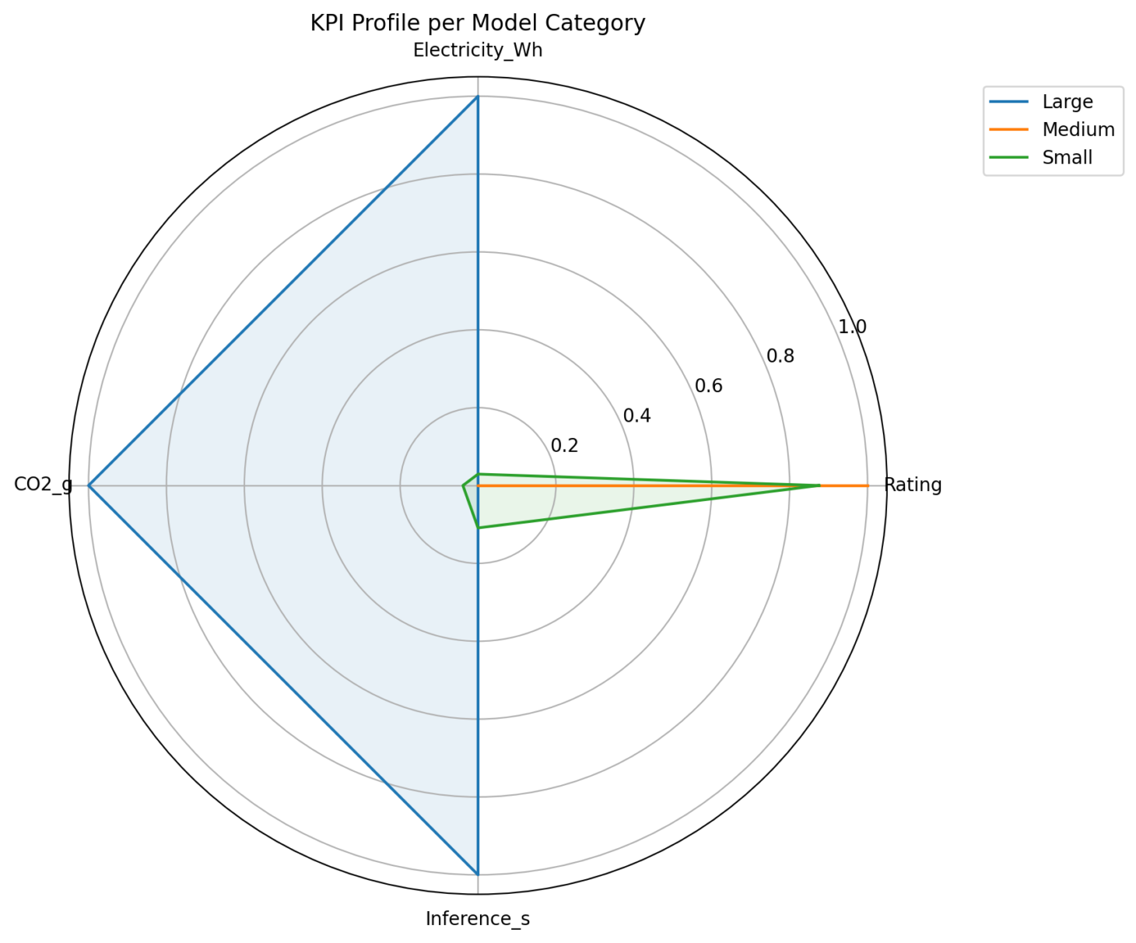
🕸️ KPI Profile per Model Category
This radar chart compares model categories across key performance metrics.
It shows that large models consume the most energy, emit the most CO₂, and have the longest latency, while medium and small models maintain strong ratings with far better efficiency.

Slide 3
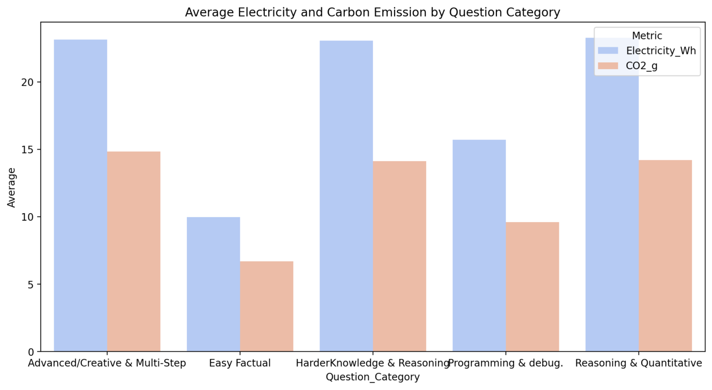
This chart compares the average electricity consumption (Wh) and CO₂ emissions (g) across different question categories. It shows that complex tasks—like Advanced/Creative, Harder Knowledge, and Reasoning & Quantitative questions—consume significantly more energy and produce higher carbon emissions than Easy Factual ones.

Slide 4
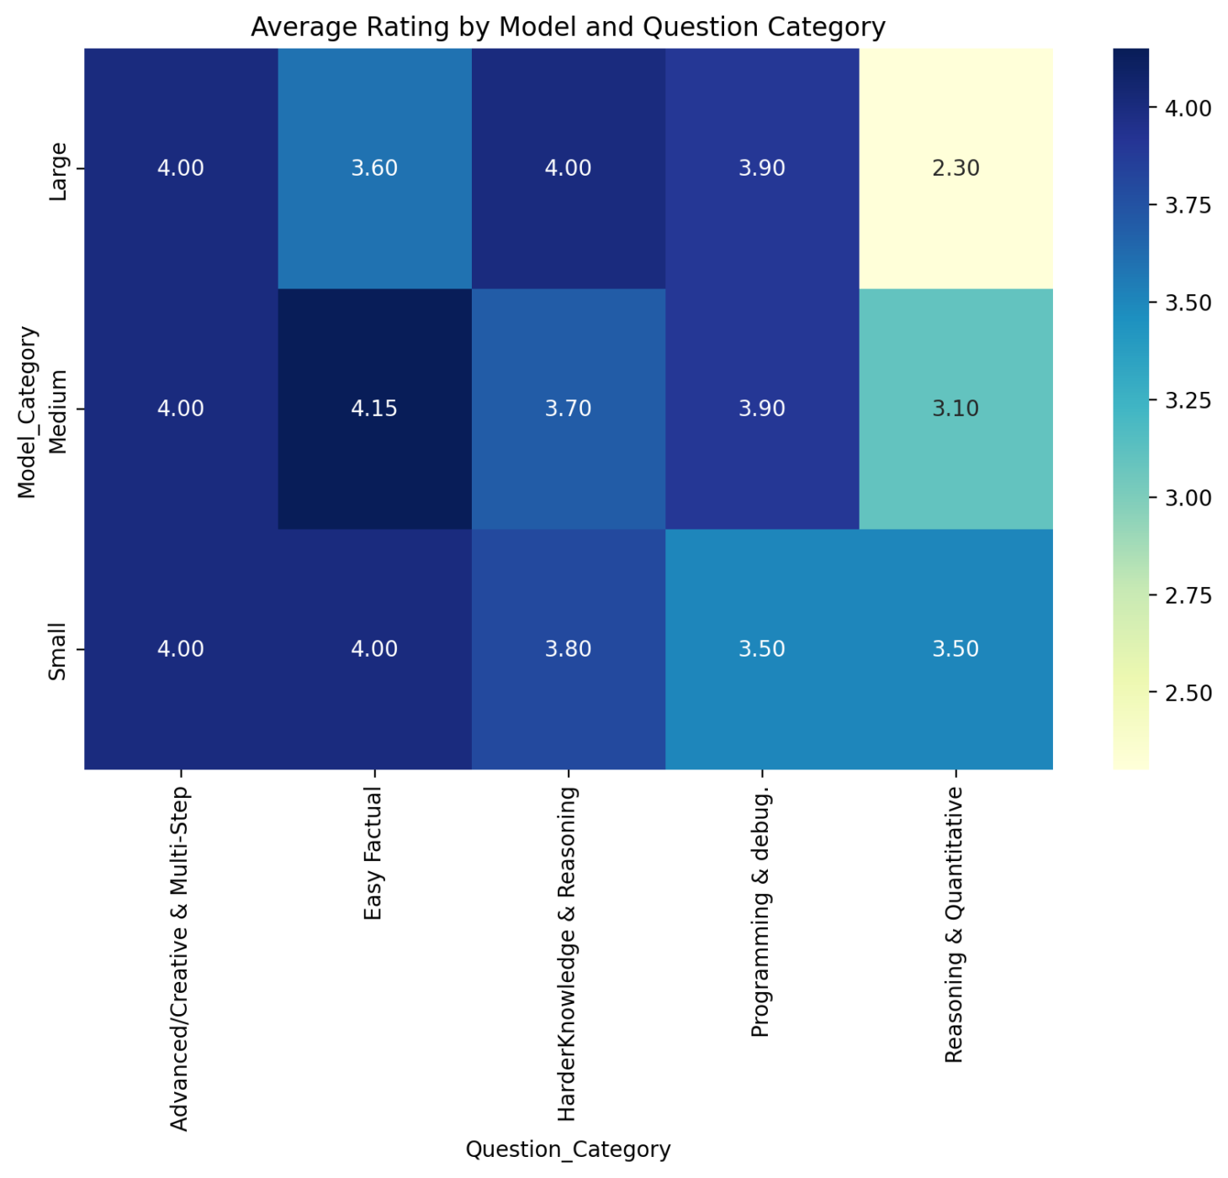
Average Rating by Model vs Question Category
Math and reasoning tasks show higher energy and latency costs.
Factual and descriptive questions are handled efficiently across small/medium models.

Slide 5
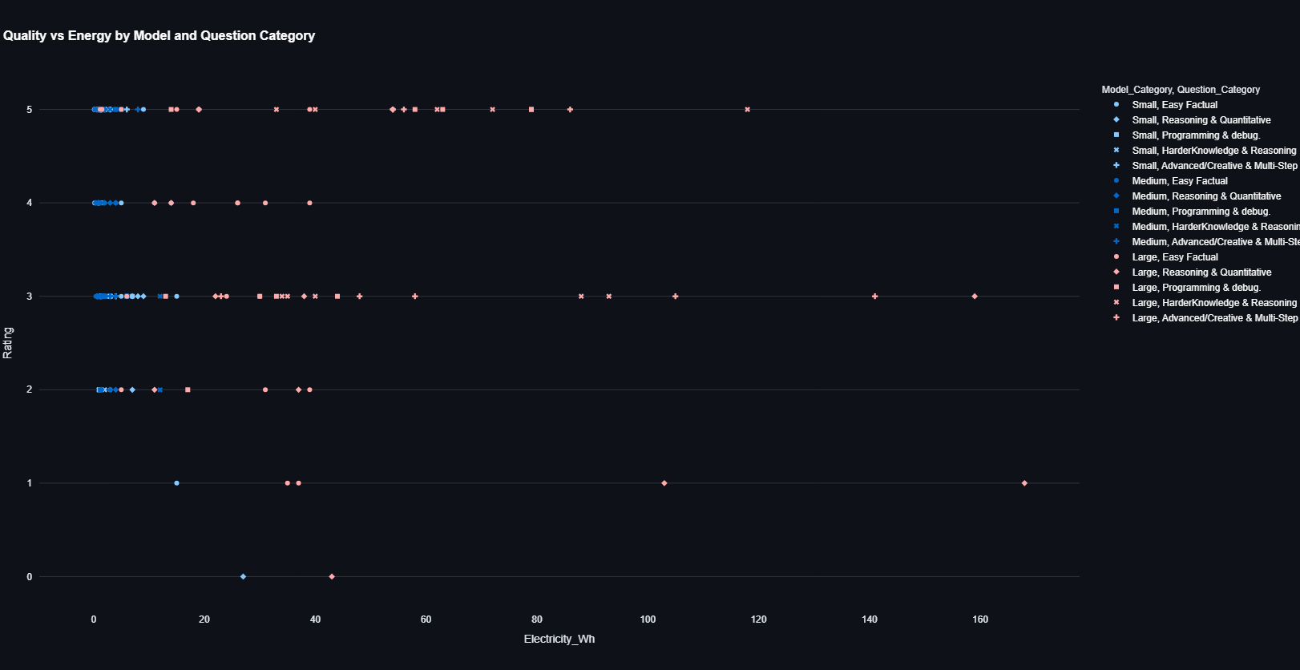
📈 Quality vs Energy Consumption (wh)
This scatter plot shows the relationship between model quality (Rating) and electricity consumption (Wh) across different model sizes and question categories. It reveals that small and medium models achieve high ratings (4–5) with low energy use, while large models consume significantly more energy for similar or lower quality outputs—indicating reduced efficiency at higher scales.

Slide 6
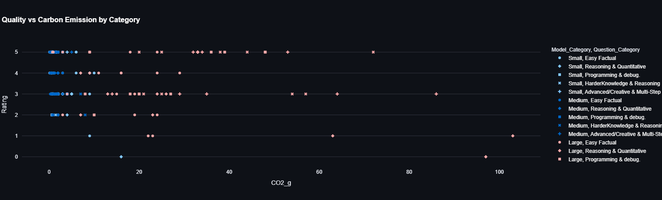
📈 Quality vs Carbon Emission (Cost Proxy)
This chart shows the relationship between model quality and carbon emissions across model sizes. Small and medium models deliver high-quality results with lower CO₂ emissions, while large models emit much more for similar quality.

Slide 7
⏱️ Latency Distribution by Model Category
This chart compares model quality with carbon emissions across different model and question types. It shows that smaller and medium models maintain high ratings with minimal CO₂ output, while larger models generate much higher emissions for similar performance.

Slide 8
Best Trade-Off Scores
Rank | Model | Score | Remarks
1 | Gemma 3nb | 7.00 | Best overall balance
2 | GPT 20 OSS | 5.23 | Strong trade-off model
3 | Mistral Small | 4.71 | Efficient but moderate performance
4–6 | Llama 3.1 / GPT-5 / DeepSeek R1 | Below 0 | High cost, poor efficiency
This table ranks models based on a combined trade-off score of quality, energy use, CO₂ emissions, and latency. Gemma 3nb achieved the best overall balance, while large models like GPT-5 and DeepSeek R1 scored lowest due to high energy and carbon costs.

Slide 9
Conclusion & Recommendations
Best Efficiency: Gemma 3nb and GPT 20 OSS
High Carbon/Energy Models: GPT-5 and DeepSeek R1
Trade-off Strategy: Favor medium/small models for sustainable AI inference.
Future Work:
Include training energy analysis
Explore hardware-level optimizations
Integrate green AI metrics in model benchmarking

