Slide 1
Recipe Recommendation assignment :-
By Gaurav Chaudhary, Gaganpreet Kaur, Malaika Goveas ( DSC- 59)
Problem Statement
Step into the shoes of an ML engineer working at food.com. Your job is to design a recommender system to recommend
recipes to users based on their choice and the current recipe they are looking at.
The recommendation engine is a way to increase the website's user engagement.
If a user is shown relevant recipes, they are more likely to spend more time on your site reading about recipes.
Higher user engagement will likely result in more business opportunities like collaborations, promotions, etc.
The performance of a recommendation engine will significantly impact the revenue your recipe site can generate.
Designing a recommender from scratch is a time-consuming task.
In this assignment, you are expected to explore the data and create features that will be used to build the recommender.
You will be working with the two CSV files linked below.
Raw_recipes_cleaned.csv - The first file is the Raw_recipes.csv file. It contains all the recipe-related information. Each row in this file describes a recipe
RAW_interactions_cleaned.csv - The second file we will be using is the RAW_interactions.csv. Each row in this data file is one user reviewing one recipe. One user can review more than one recipe, and each recipe can be reviewed by more than one user, so there is a many-to-many relationship between users and recipes, but the combination of user_id and reviewer_id in each row will be unique.

Slide 2
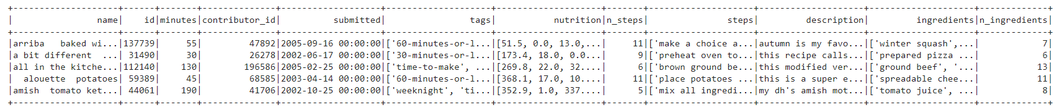
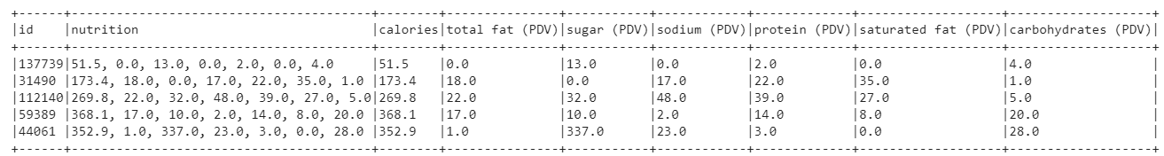
Task List
Task 1: Read the data
1. Read RAW_recipes.csv from S3 bucket.
2. Ensure each field has the correct data type.
Task 2: Extract individual features from the nutrition column.
Task 3: Standardize the nutrition values.
Convert the nutritional values to per 100 calories.

Slide 3
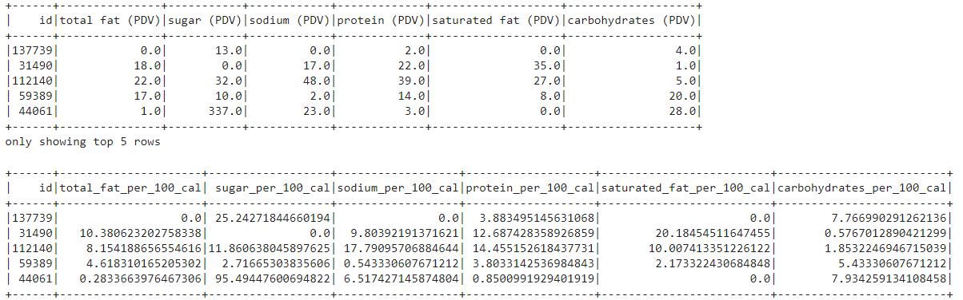
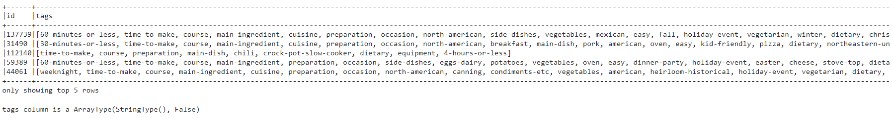
Task 4: Convert the tags column from a string to an array of strings.
Task 5: Read the second data file
Read the RAW_interaction.csv and join this interaction level file with the recipe level data frame.

Slide 4

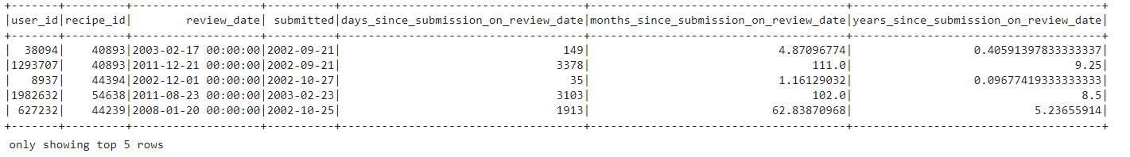
Task 6: Create time-based features.
Create features that capture the time passed between one review and the date on which the recipe was submitted.

Slide 5
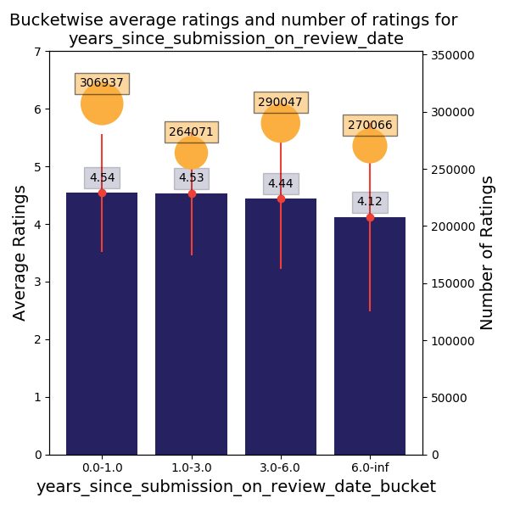
Task 7: Processing Numerical Columns & Exploratory Data Analysis

Slide 6
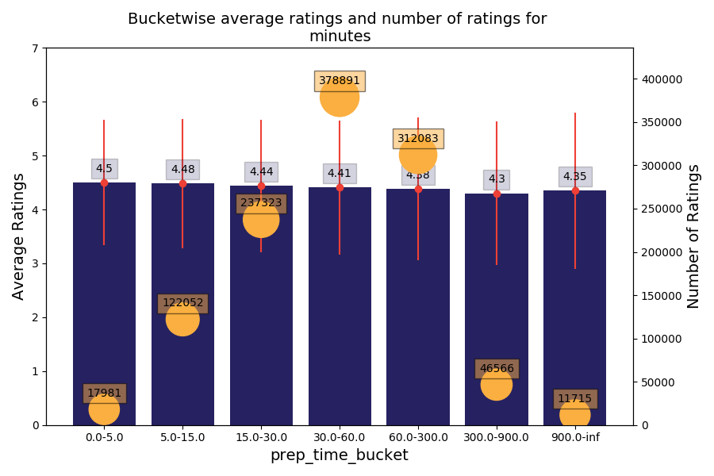

Slide 7
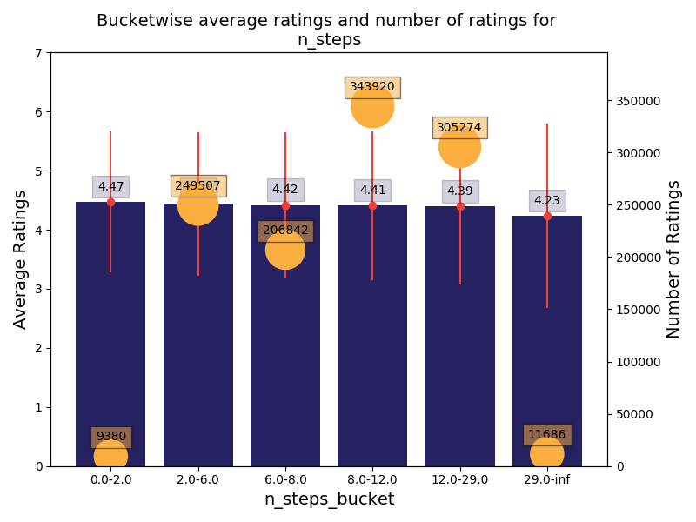

Slide 8
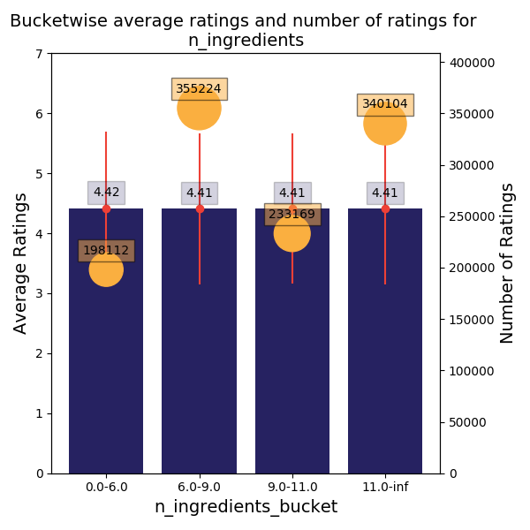

Slide 9
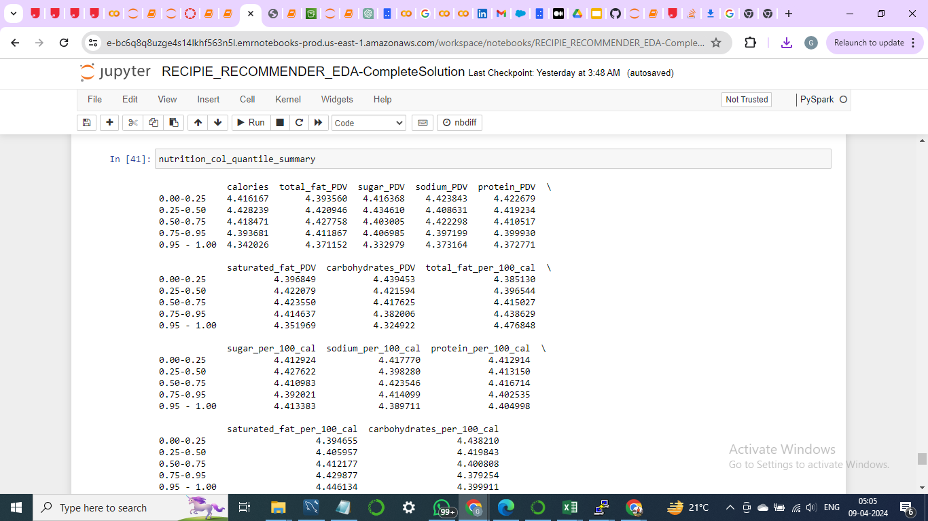
Columns to be bucketized.
years_since_submission_on_review_date
minutes
calories
total_fat_PDV
sugar_PDV
sodium_PDV
protein_PDV
saturated_fat_PDV
carbohydrates_PDV
After creating buckets, study the variation of the average rating for each bucket and decide
whether or not a particular bucketed column should be kept in the analysis.

Slide 10
Task 8: Create user-level features
create the following user-level features:
user_avg_rating
user_avg_n_ratings
user_avg_years_betwn_review_and_submission
user_avg_prep_time_recipes_reviewed
user_avg_n_steps_recipes_reviewed
user_avg_n_ingredients_recipes_reviewed
user_avg_years_betwn_review_and_submission_high_ratings
user_avg_calories_recipes_reviewed
user_avg_total_fat_per_100_cal_recipes_reviewed
user_avg_sugar_per_100_cal_recipes_reviewed
user_avg_sodium_per_100_cal_recipes_reviewed
user_avg_protein_per_100_cal_recipes_reviewed
user_avg_saturated_fat_per_100_cal_recipes_reviewed
user_avg_carbohydrates_per_100_cal_recipes_reviewed
user_avg_prep_time_recipes_reviewed_high_ratings
user_avg_n_steps_recipes_reviewed_high_ratings
user_avg_n_ingredients_recipes_reviewed_high_ratings
Here, high ratings refer to only those reviews where the user has given five ratings to a recipe.

Slide 11
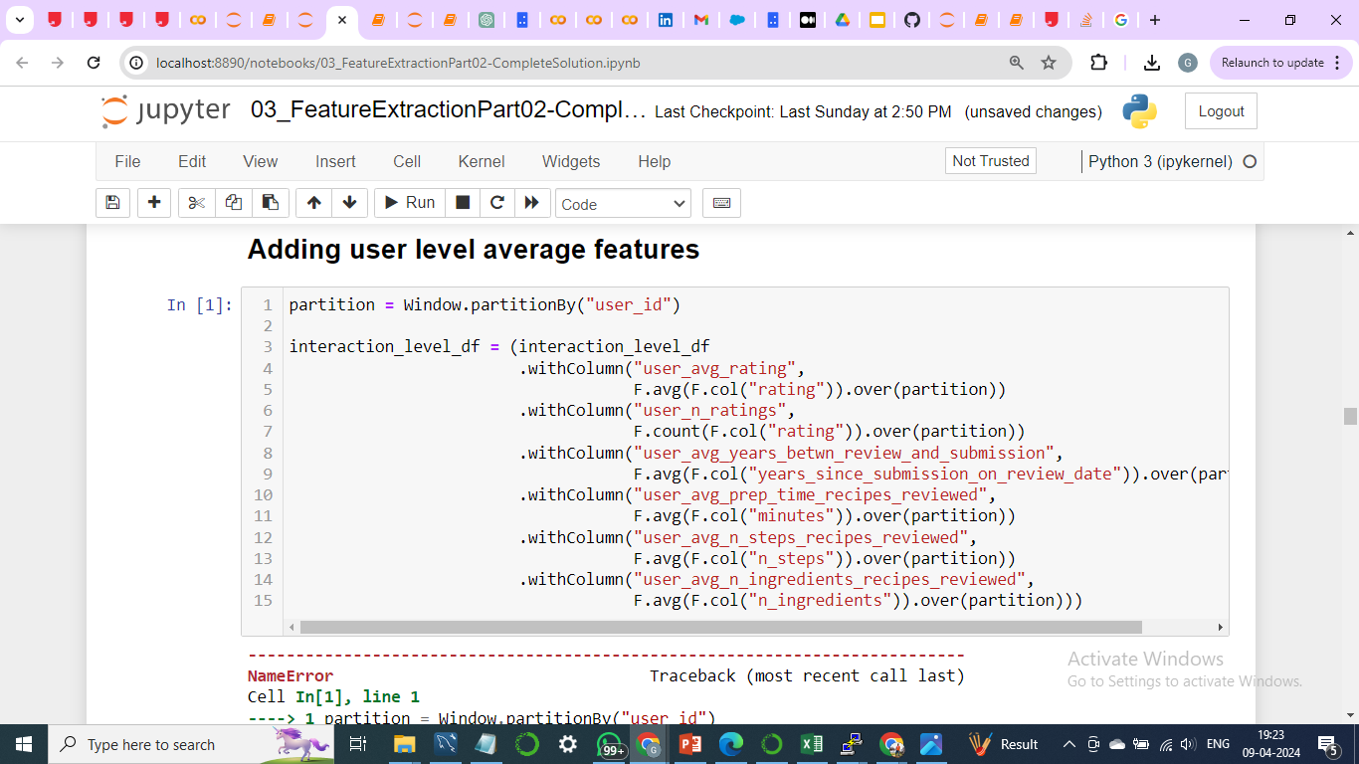
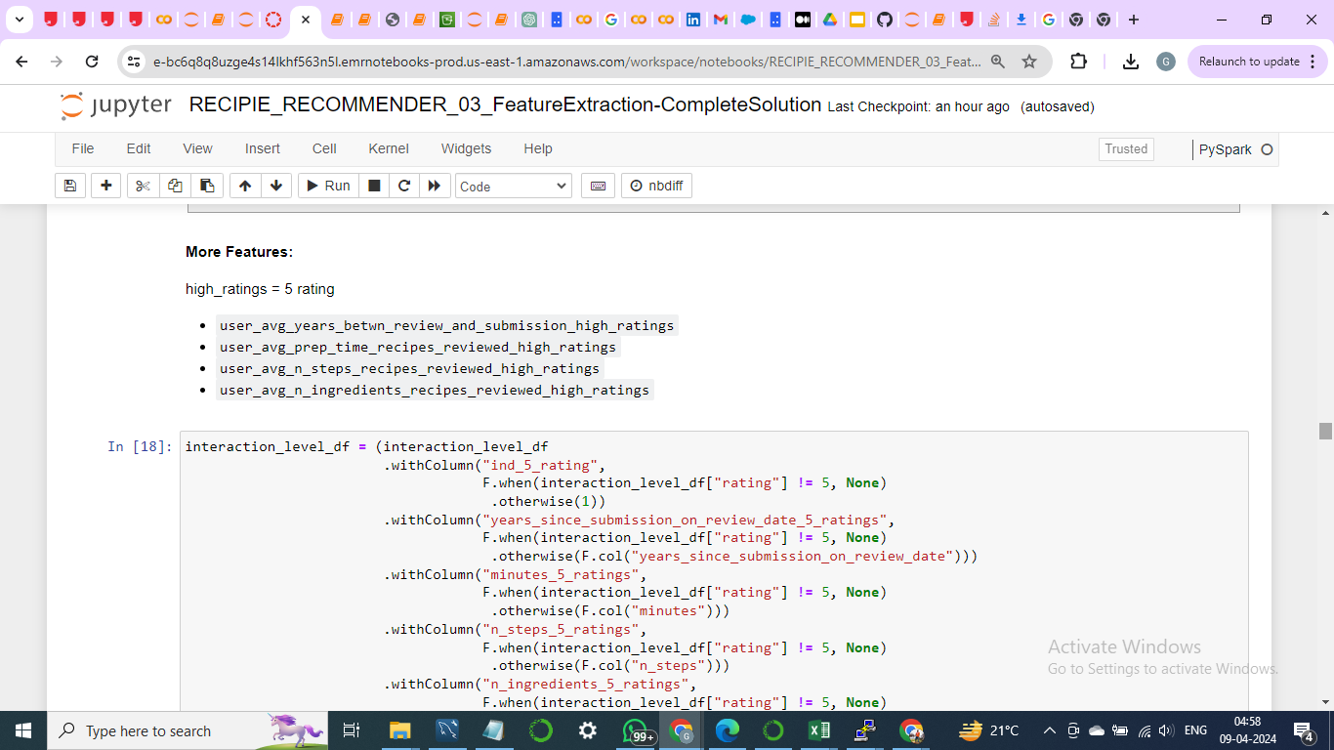

Slide 12
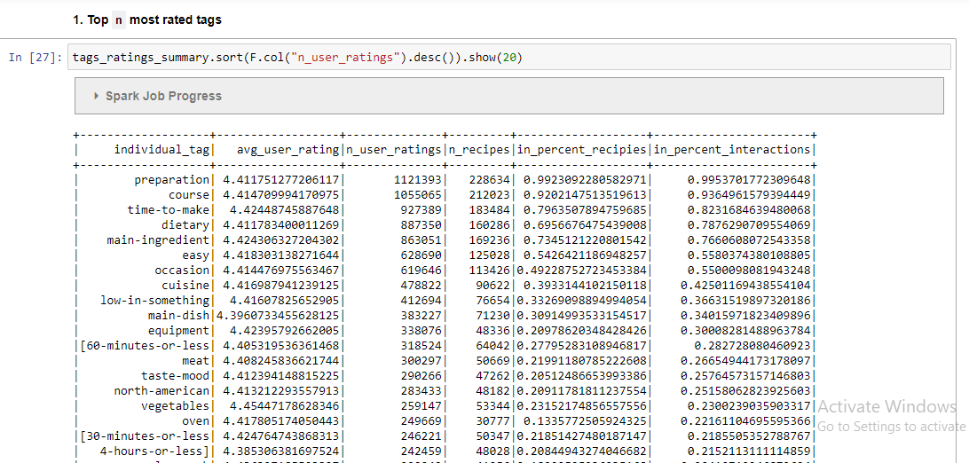
Task 9: Create tag-level features
Extract tags-level features. If you extract and list unique tags and explore all the available tags, you will realize that tags hold a lot of information about the recipe.
For example, the healthy tag signifies that the person who uploaded the recipe considers it healthy.
If a user specifically looks for the healthy tag, you would want to recommend more healthy recipes to them.
Find the most value-adding tags and create features to capture them.

Slide 13
