Slide 1


Slide 2

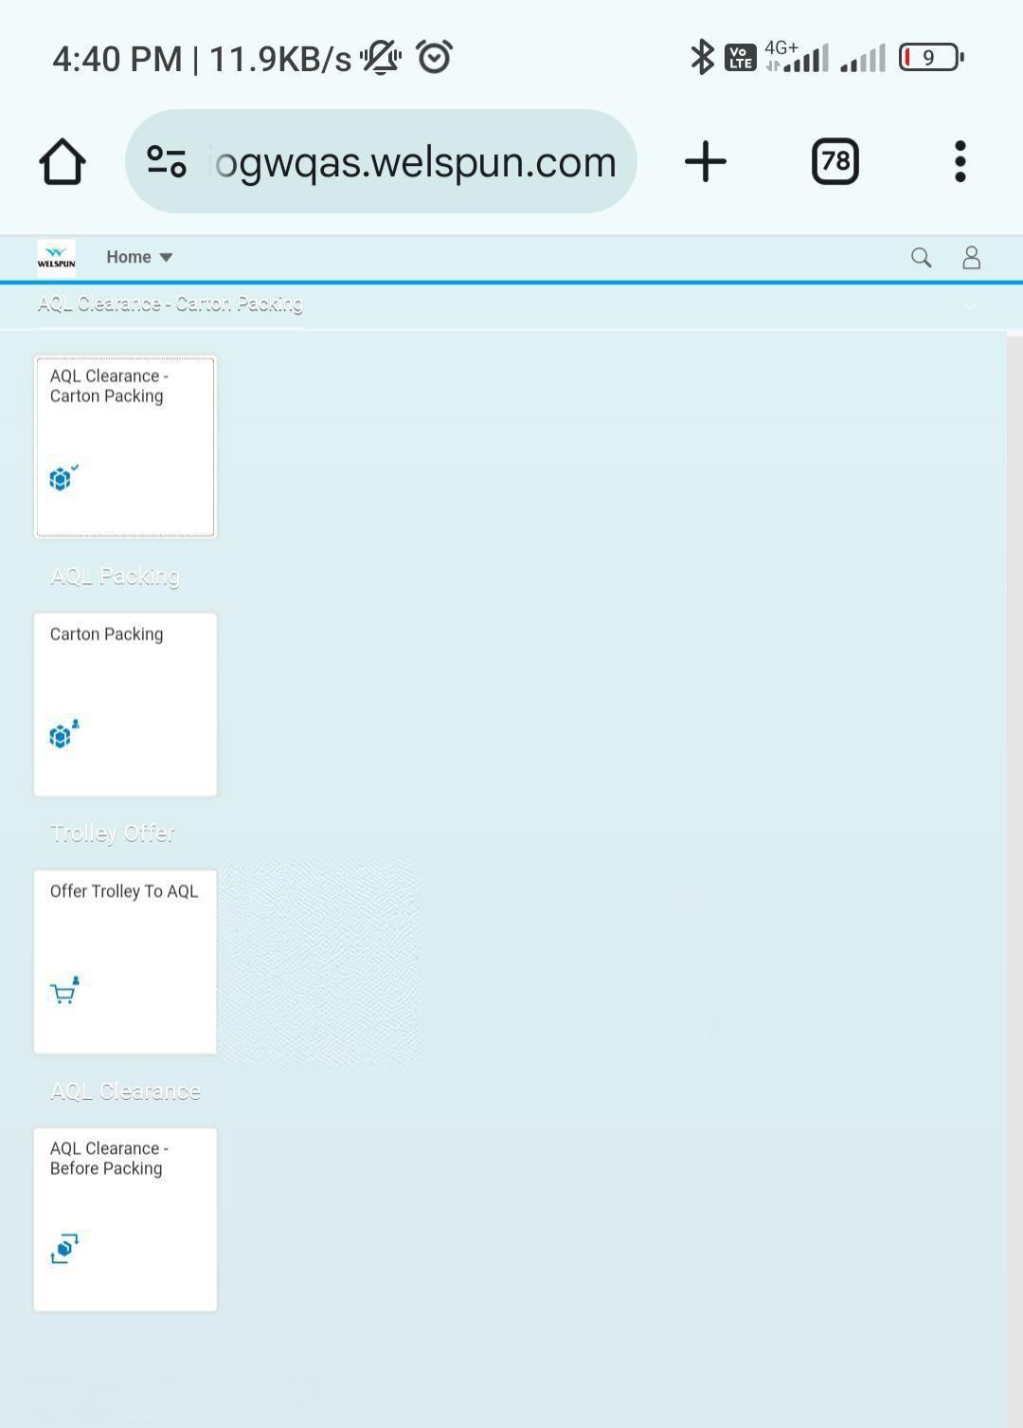
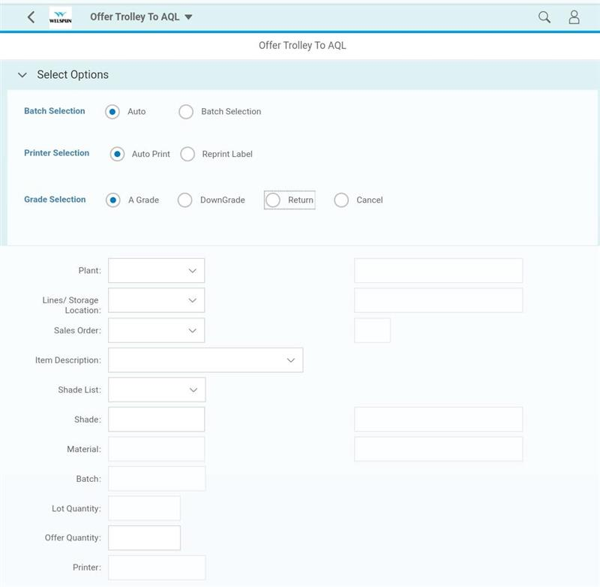

Designed and developed responsive web and mobile applications for seamless user experiences.
Built a workflow management application automating ticket assignment and tracking, integrated with SAP systems via OData services.
Automated processes to improve efficiency and reduce manual tasks.
Ensured adherence to design standards for consistency and usability.
Delivered scalable, high-performance solutions within deadlines.
Stock management
Tablet based application
01
02
03
04
05
05

Slide 3
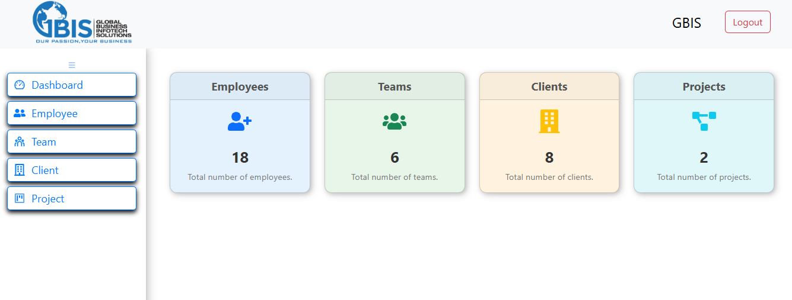
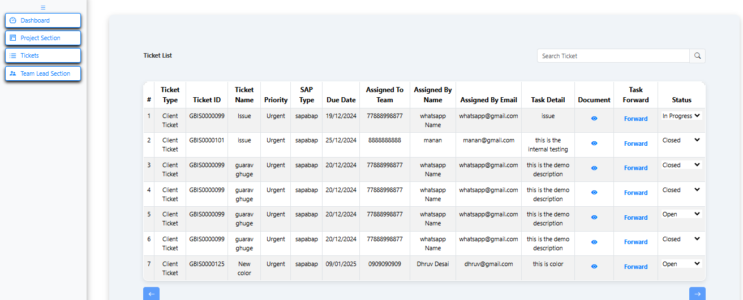
Ticketing tool for AMS
The Ticketing Tool is a MERN stack application designed to streamline ticket management.
Assignment of tickets from clients to Team Leads and from Team Leads to Employees, ensuring efficient task allocation and tracking.
01
02
03
04
05

Slide 4
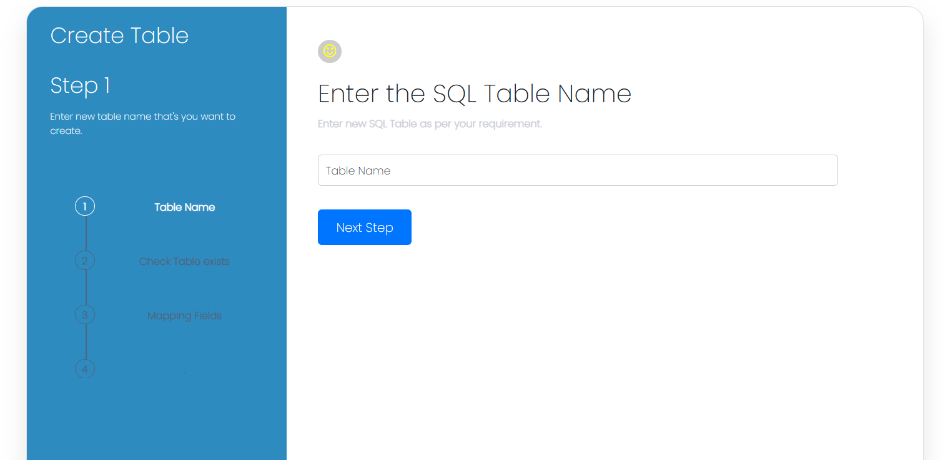
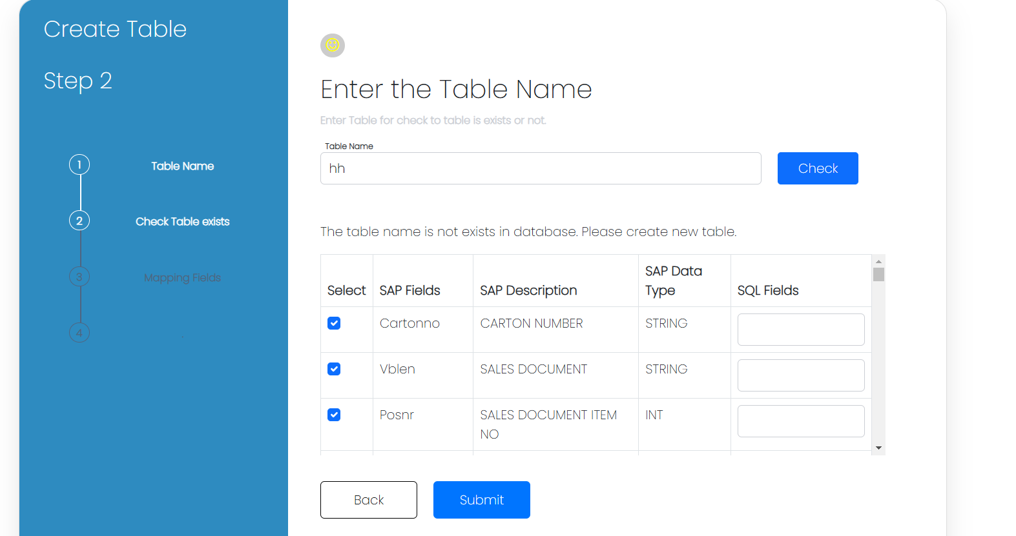
Automated tool for SAP integration
Dynamic API integration using .NET and SQL involves setting up APIs to handle requests (GET, POST, etc.), dynamically mapping API fields to SQL database fields using DTOs or tools like AutoMapper, and performing CRUD operations with EF, Dapper, or ADO.NET.
Dynamic configurations (e.g., JSON/XML) allow field mapping updates without code changes. Proper validation, error handling, testing, and monitoring ensure seamless integration, scalability, and maintainability
01
02
03
04
05

Slide 5
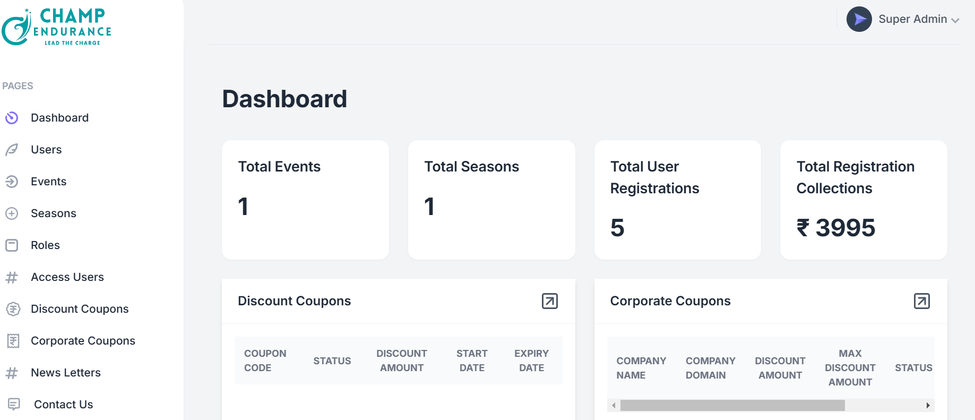
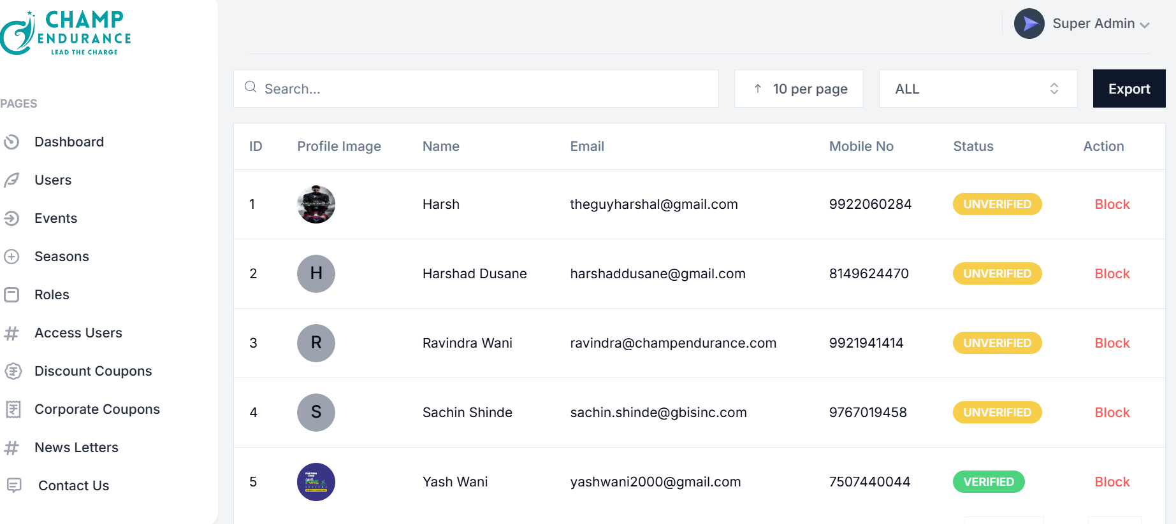
Event management application
The Marathon Website is a MERN stack application designed to facilitate online
marathon event registration and payment processing, providing users with a smooth and efficient way to sign up for marathons and manage event details.
The application integrates a secure payment gateway (e.g., Razorpay, Stripe, or PayPal) to process user payments
for marathon registrations, offering various payment methods like credit/debit cards, UPI, and wallets.
01
02
03
04
05

Slide 6
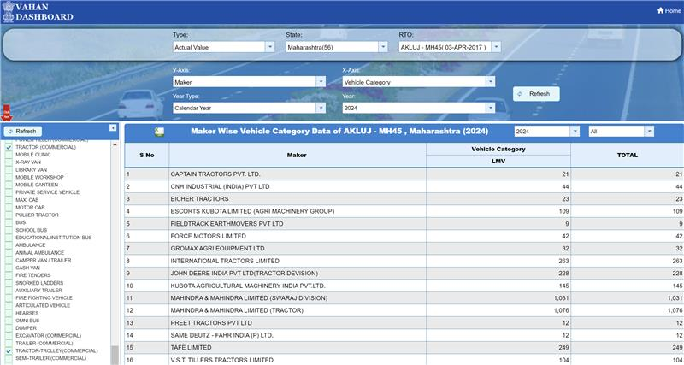
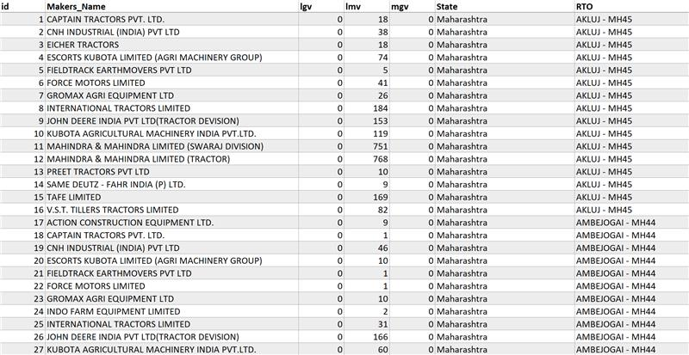
Data Scrapping
Automation tool
Data scraping, also known as data scraping, is an automated process of extracting information from websites and converting it into structured formats like CSV, Excel, or databases.
This method enables businesses to efficiently gather insights by tracking trends, monitoring competitors, or aggregating information
01
01
02
03
04
05

Slide 7
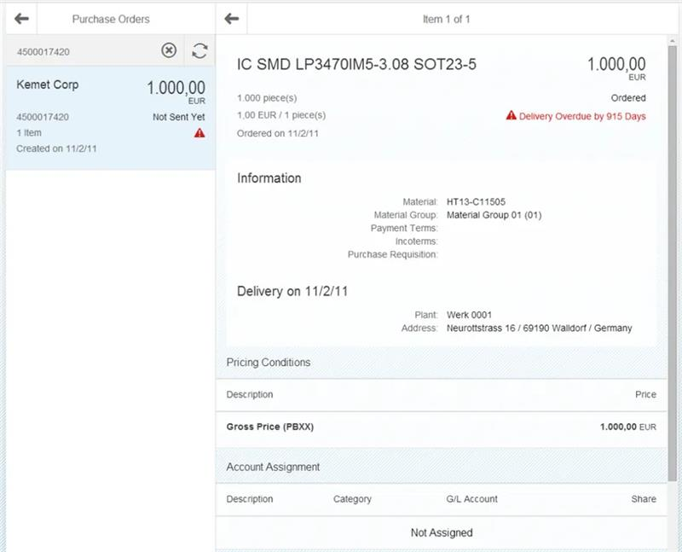
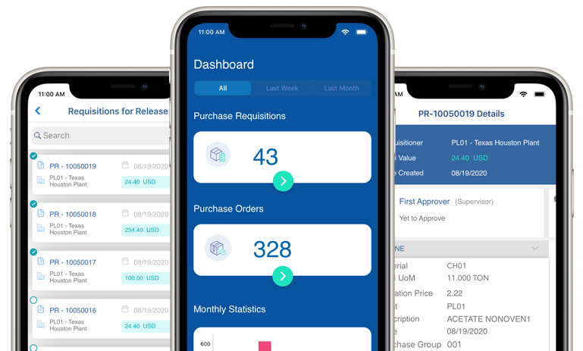
PO workflow application
The PO Release app simplifies purchase order approvals with real-time vendor, amount, and delivery details.
Integrated with SAP S/4HANA, it supports hierarchical approvals, enabling multi-level authorization.
Accessible on mobile and desktop, it ensures efficient workflows, notifications for pending tasks, and improved procurement management.
01
02
03
04
05
06

Slide 8
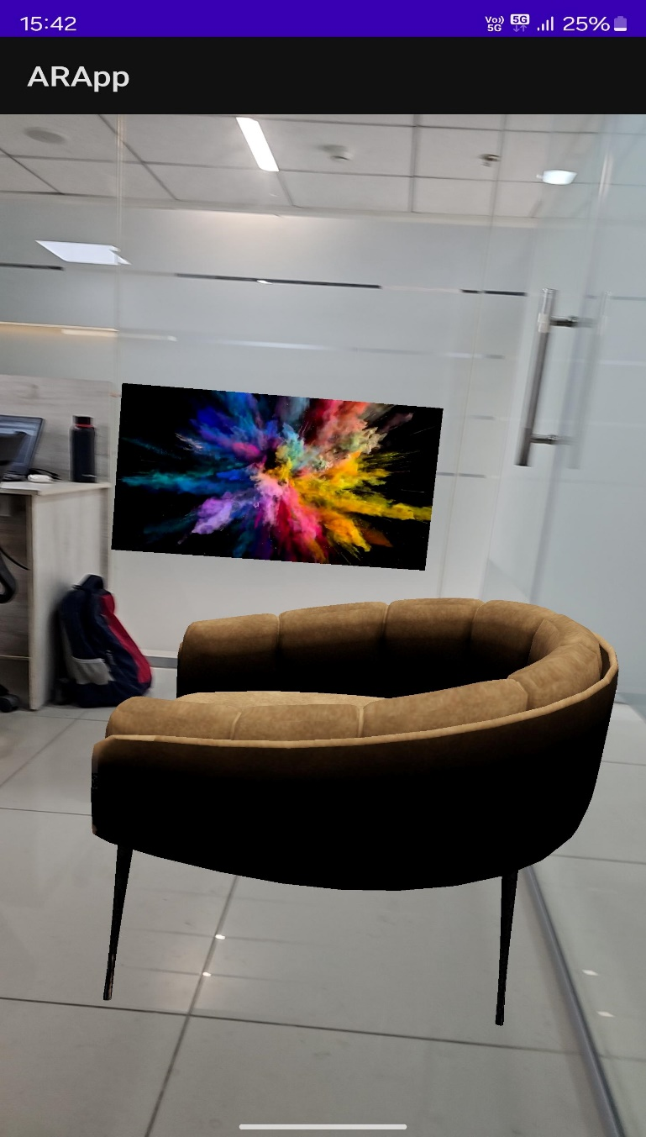
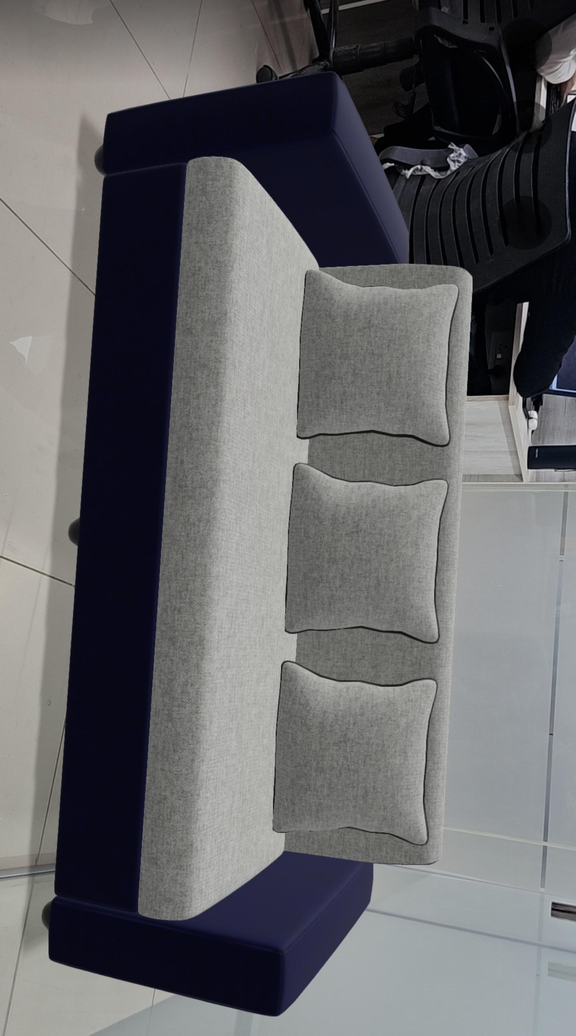
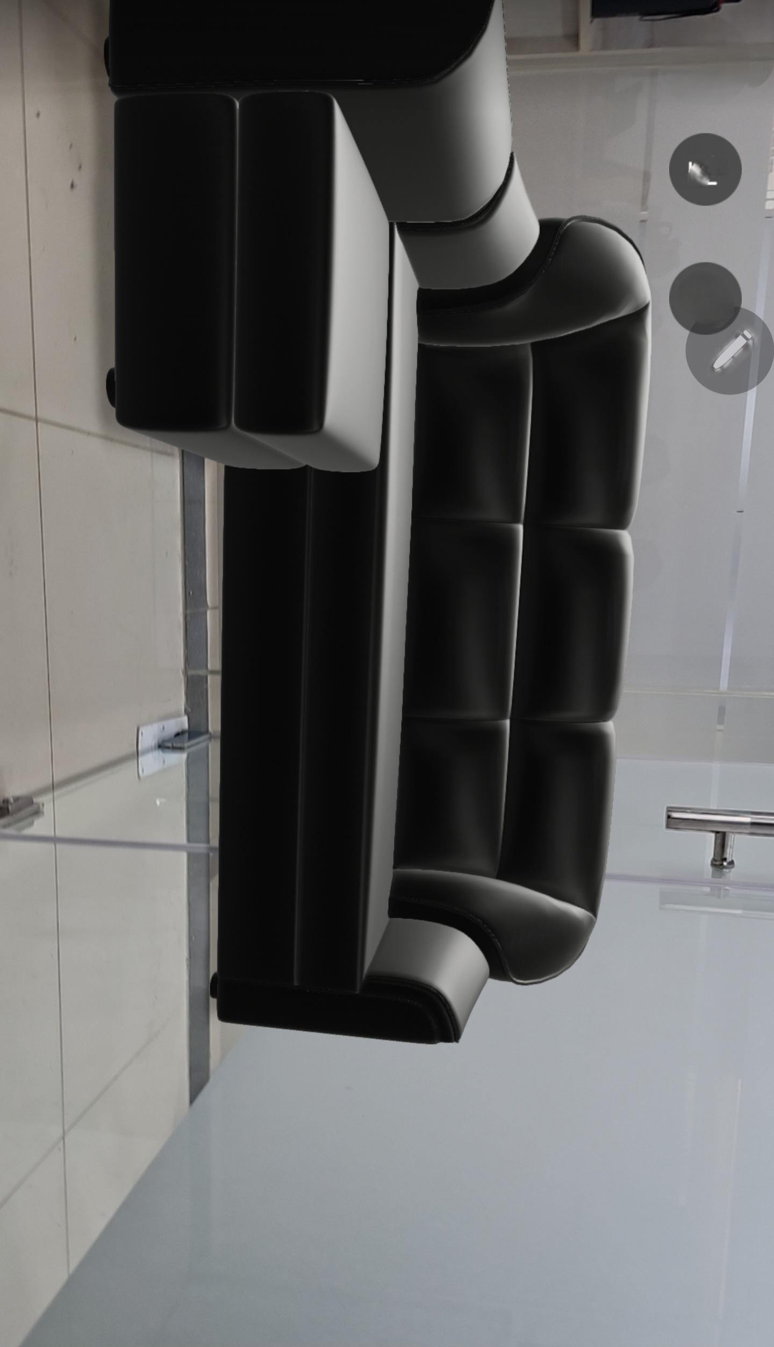
AR application for
Furnishing company
The AR mobile application allows users to visualize home furniture in their own space using augmented reality. By overlaying 3D models of furniture onto the real world through the smartphone’s camera, users can see how pieces will look and fit in their homes before making a purchase.
This interactive, real-time experience helps in making informed decisions about style, size, and placement, enhancing the shopping experience for home furniture.
03
01
04
05
06
07

Slide 9



THANK YOU..!!
Please let us know your test case,
we are ready to develop.
+91 993 052 2904
www.gbisinc.com
workwithus@gbisinc.com
Office No. 822, 8th Floor, Suratwwala Mark Plaza, Hinjewadi, Pune

