Slide 1
University of South Florida ISM 6136 – Data Mining
Exploratory Data Analysis and Data Mining of Boattrader Inc.
By:
Vinay Dabhade
Gandhar Pathak
Rajesh Patil
Gaurav Kulkarni

Slide 2
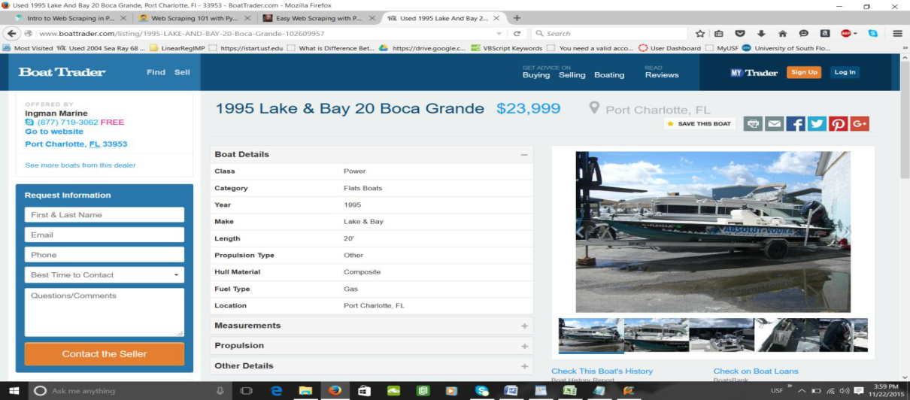
Data Preparation
This project aims to understand and implement data retrieval from a website through Python and then performing data mining on the processed data.
The process of automatically extracting meaningful data from a website, in real time, is called webscraping.
In this particular project, we have implemented a Webscraper engine in Python which can extract particular data from a Boat e-commerce website. This system extracts basic information of a boat listed on the website, like Price, Class, Location, Zipcode , Hull Material, fuel type, etc

Slide 3
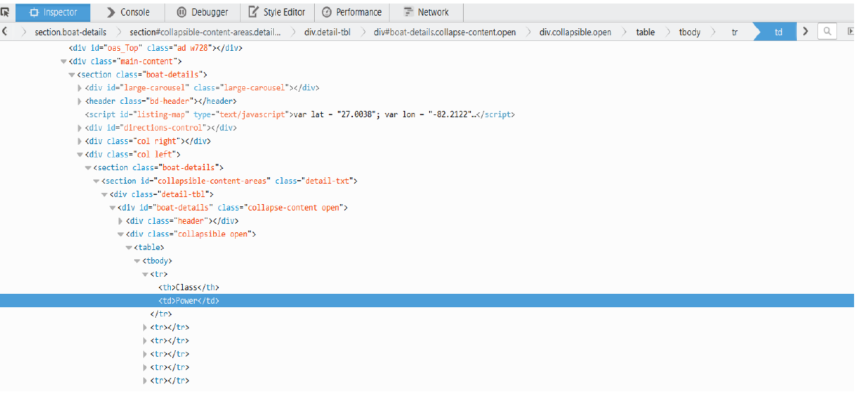
Python Webscrapping:
There are two basic tasks that are used to scrape web sites:
1. Load a web page to a string.
2. Parse HTML from a web page to locate the interesting bits.
The first thing to do when writing a scraping script is to manually inspect the page(s) to scrape to determine how the data can be located.
Inspecting the HTML, we can typically see below structure:
NOTE: Due to the massive amount of listings on the website, we have extracted listings within Florida only.

Slide 4
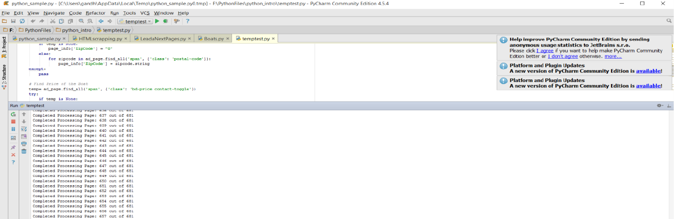
Data Preparation Algorithm
1) Connect to the search link to fetch all record details
2) Click on Page 1 link out of n pages.
3) Boat listings - find all links [href] of listings and store in array
4) Loop inside each listing
5) Find Boat Details like Class, Length, Price, etc
6) Go to next listing in the page and repeat step 5
7) At end of page listing, go to next page link
8) Do steps 3 to 7 for all pages
9) Export dataset to excel

Slide 5
Data Cleaning
Following stepwise data cleaning is implemented:
1) Remove all entries with ZipCode = 0 (indicating blank zipcode value)
2) Remove all entries with Price = Not mentioned (indicating invalid or empty price value)
3) Remove all entires with Seller_contact= Blank
4) Remove all entries with blank Fuel Types
5) Remove all duplicates
6) Trimmed Leading spaces to avoid error in loading data, removed single and double quotes from columns
7) Identified locations and classified them into cities and towns to simplify
8) Classified make year into range of decades and created price range based on distribution of prices
- After doing the data cleaning, We got 8201 records. This data was then used for exploratory data analysis and data modeling.

Slide 6
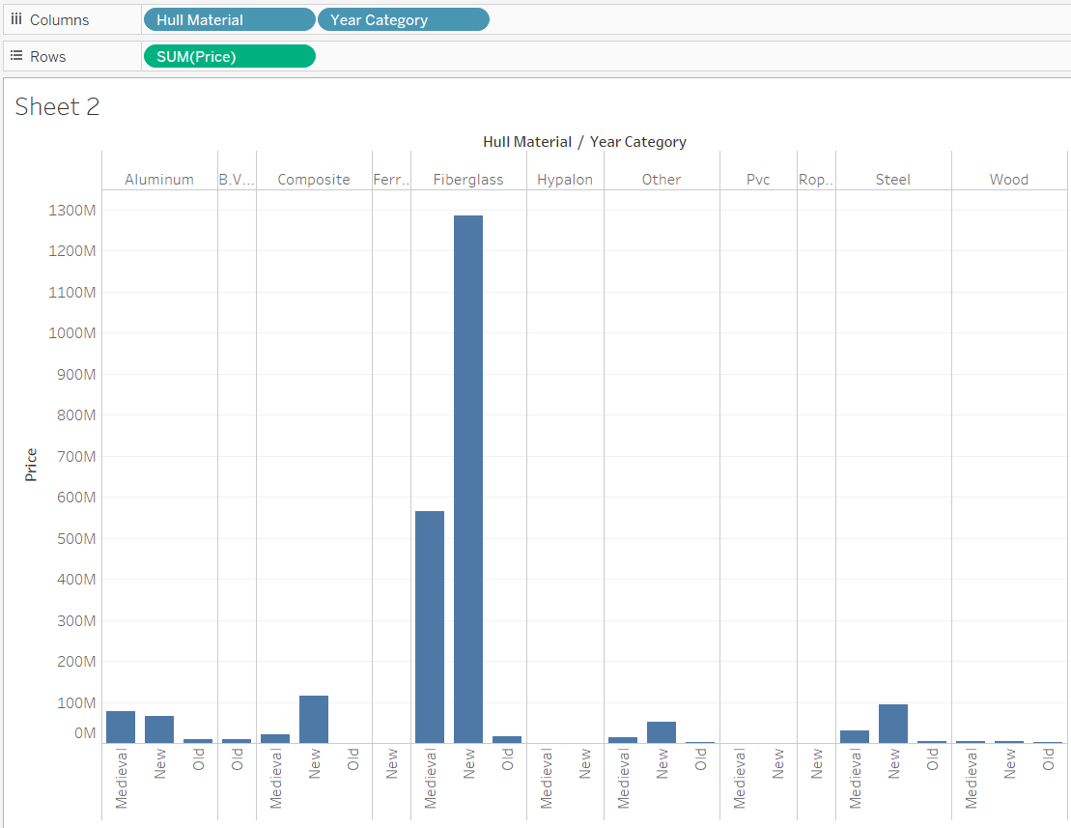
Data Visualization- Exploratory Data Analysis
We performed important data visualizations to understand how price varies by different characteristics of boats.
1) Price against Hull Material/Year Category

Slide 7
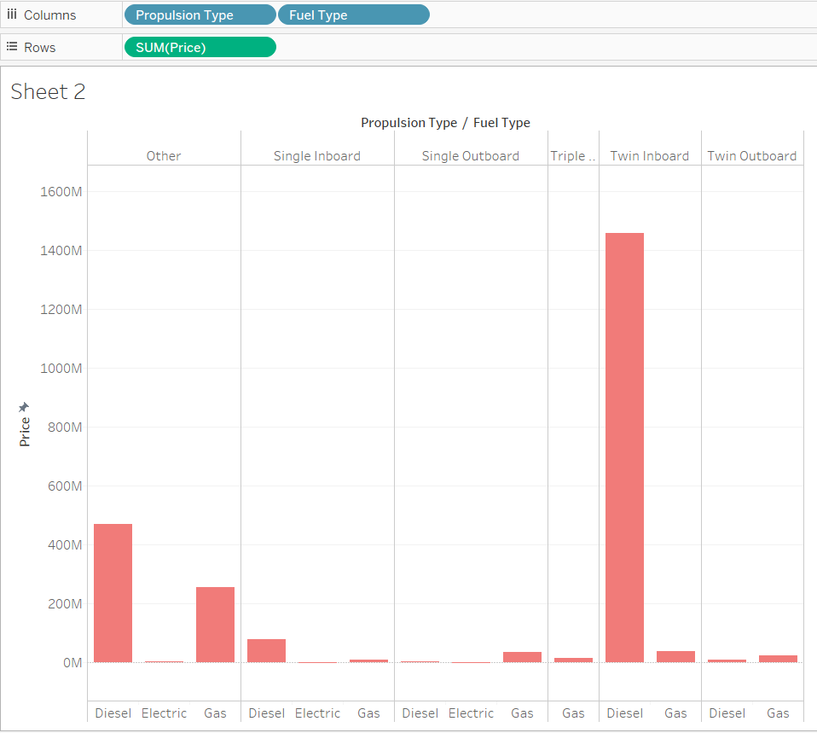
2) Price against Propulsion Type/Fuel Type

Slide 8
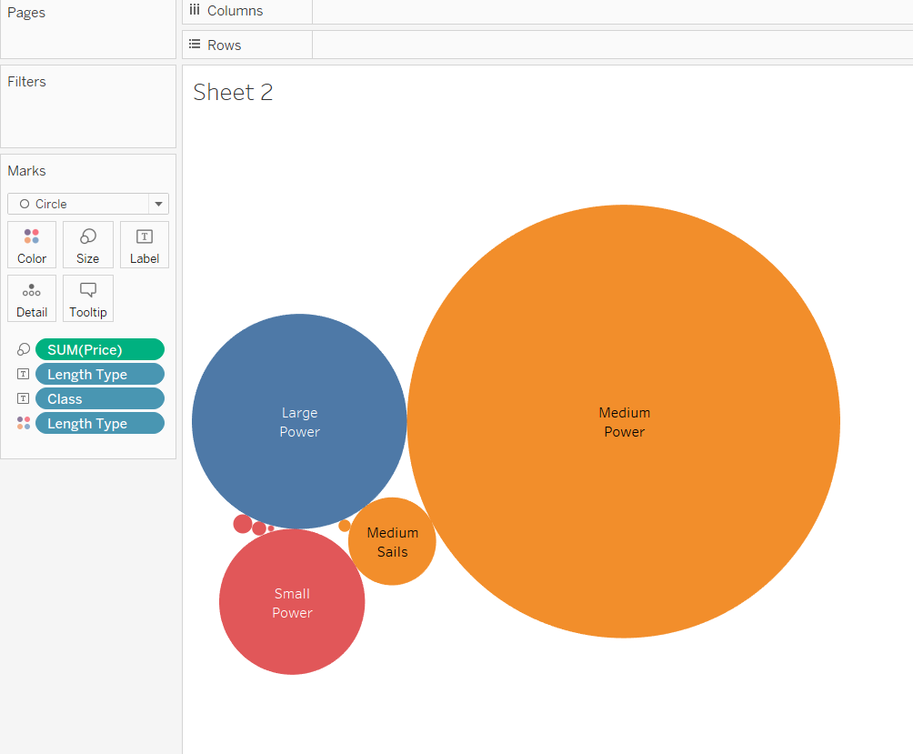
3) Price against Class/Length Type

Slide 9
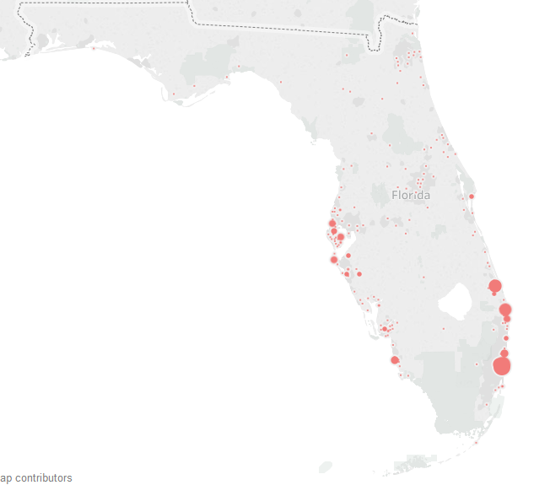
GEO-SPATIAL ANALYSIS:
Price Variation according to zip codes:

Slide 10
Observations
By looking at the above visualizations, we can conclude following about the data:
Price of boat increases as the Manufacture Year increases i.e Newer the boat , higher the price.
Hull Material=Fiber Glass are the most expensive boats
Boats with Class as “Power” are high in Price with class= “PWC” being the least paid
Boats with Size=Medium and Class=Power, are the highest priced, against
the expectation that longer boats should be high priced. Important observation!
Boats with Fuel Type= “Diesel” are highest price, with Electric Boats being least paid.
Price of the boats on east coast of Florida (Miami) are higher as compared to West Coast

Slide 11
Predictive modelling using Rapid Miner
linear regression modelling to predict prices. High P-value and low t-stat.
Neural networks gave a relatively high accuracy of prediction for Price range prediction.
75% accuracy achieved by increasing training cycles to 5000 cycles and keeping learning rate to 0.3

Slide 12
Price range=IF(J2>260000,"260K & Higher",IF(J24>100000,"100K - 260K",IF(J2>50000,"50K - 100K",IF(J2>25000,"25K - 50K","25K & lower"))))
Location Type=IF(OR(M3="St. Petersburg- FL",M3="Fort Lauderdale- FL",M3="Miami- FL",M3="Tampa- FL",M3="St Petersburg- FL",M3="Clearwater- FL",M3="St. Pete- FL",M3="Orlando- FL",M3="Jacksonville- FL",M3="Sarasota- FL",M3="Miami Beach- FL",M3="Clearwater Beach- FL",M3="Daytona Beach",M3="Fort Myers- FL"),"City","Town")
Year Range=IF(I3>=2010,"2010 & above",IF(I3>=2000,"2000-2009",IF(I3>=1990,"1990-1999",IF(I3>=1980,"1980-1989",IF(I3>=1970,"1970-1979","1960-1969")))))

Slide 13
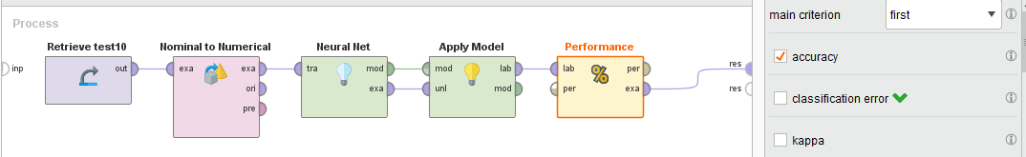
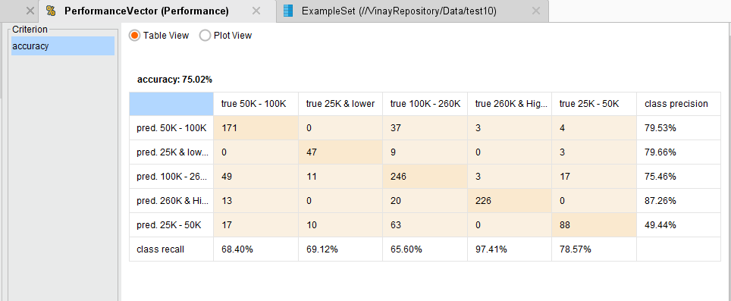

Slide 14
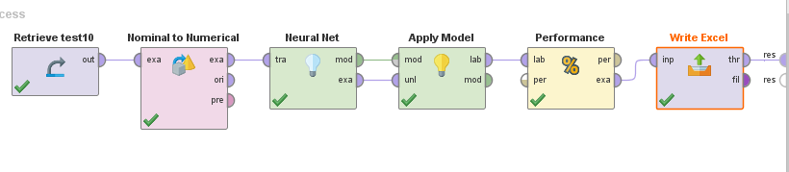

Slide 15
Building Decision Tree
Imported a cleaned dataset and set the variable ‘Price_Range’ as Target.
With the StatExplore node, obtained following details about dataset:
1. Nine I/p variables and one target variable
2. There are no missing values in the dataset.
Data is partitioned per below:
1. Training: 30%
2. Validation: 30%
3. Test: 40%

Slide 16
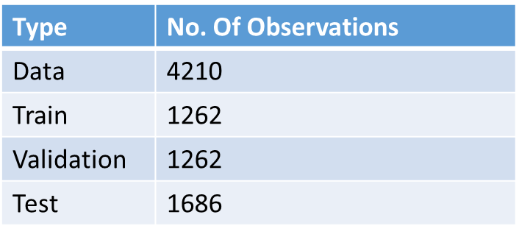
Partition Summary:
Important Parameters:
1. Maximum Depth: 10
2. Leaf Size: 4

Slide 17
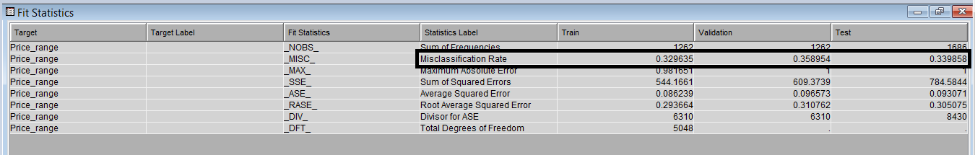
Decision Tree Diagram:
Fit Statistics: Accuracy achieved is 66.02%. This value is evaluated from the Misclassification rate of Test dataset.
Node Rules:

Slide 18
‘Length’ and ‘Year_range’ are the two influencing factors for splitting.
Example Node Rules:
1. if Year_range IS ONE OF: 1970-1979, 1980-1989 or MISSING
AND Length < 68.5 AND Length >= 46.5 or MISSING
then
77% of the boats’ prices range between 100K – 260K.
2. if Year_range IS ONE OF: 2010 & ABOVE
AND Length < 34.5 AND Length >= 29.5
then
83% of the boat’s prices range between 100K – 260K.

Slide 19
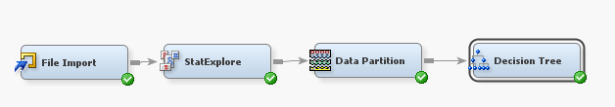
3. if Year_range IS ONE OF: 2010 & ABOVE
AND Length < 46.5 AND Length >= 34.5 or MISSING
then
73% of the boats have their prices 260K or Higher.
Data Mining Model:

Slide 20
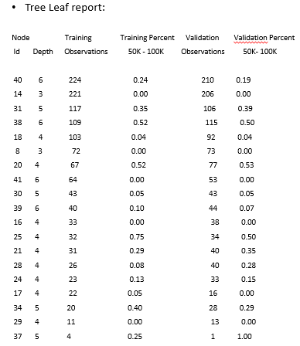

Slide 21
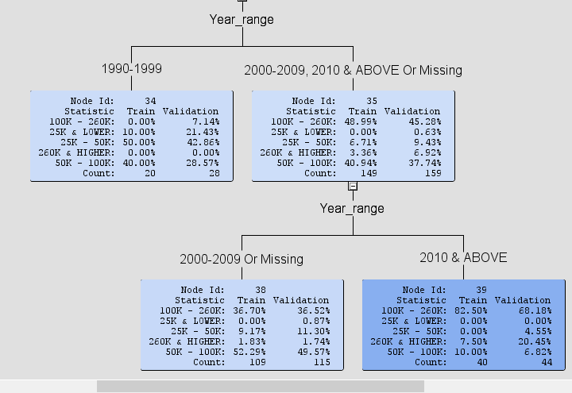
Example Node Splitting:
When Year range is 2000-2009, train and validation partitions consist of 109 and 115 records respectively.
Most of these records fall within range 50K-100K and 100k-260K
When the year is 2010 and above, train and validation partitions consist of 109 and 115 records respectively.

Slide 22
Learning Outcomes
Display a comprehensive understanding of different data mining tasks and the algorithms most appropriate for addressing them.
Evaluate models/algorithms with respect to their accuracy.
Demonstrate the visualization on a self directed piece of real dataset.
Conceptualise a data mining solution to a practical problem.

